Slide 1
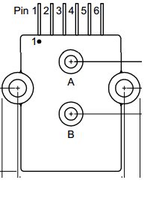
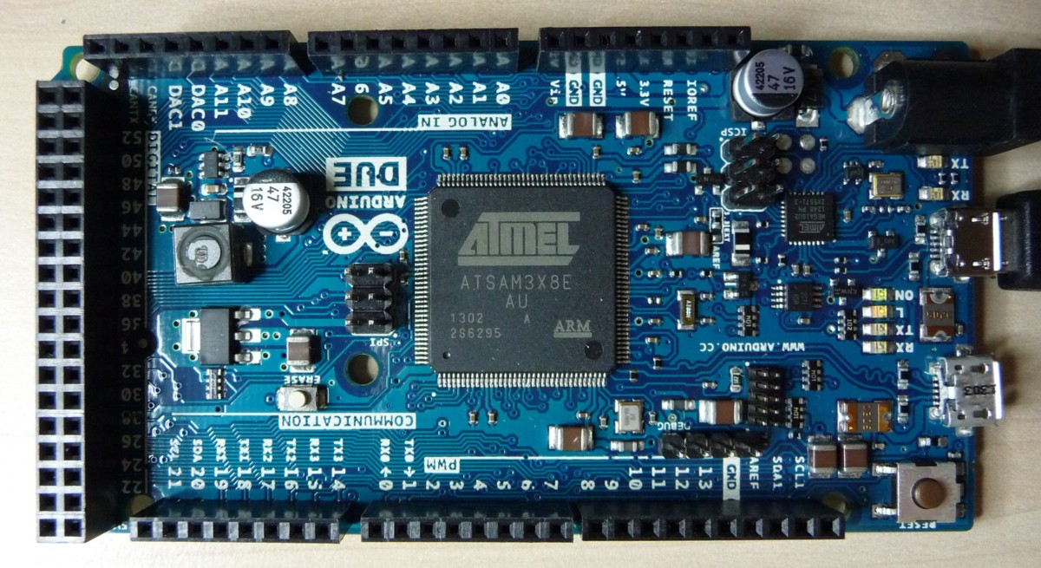
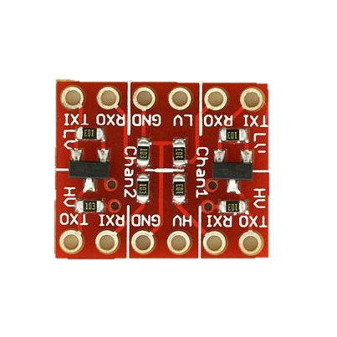
Sensor 2
TX
Sensor 3
3V3
RX
GND
Sensor 4
Slave Out
All Mode and BR Pins are pulled
to ground on power-up
GND
5V
Slave In

