Slide 1
The convective photosphere of the red supergiant CE Tau
M. Montargès, R. Norris, A Chiavassa, B. Tessore, A. Lèbre, and F. Baron

Slide 2
Background
Many chemical elements in the Universe are forged in evolved stars, but the mechanism that launches the material away from the star is unknown
Convection in red supergiant (RSG) stars may allow radiation pressure to begin outflow (probably not alone)
Large RSG convective granules may bias parallax measurements
Want to understand evolution of bright convective features
Notes:
Convection isn’t enough to outflow significant material by itself, but may be a component.
Convective granules are on the order of the stellar radius.

Slide 3
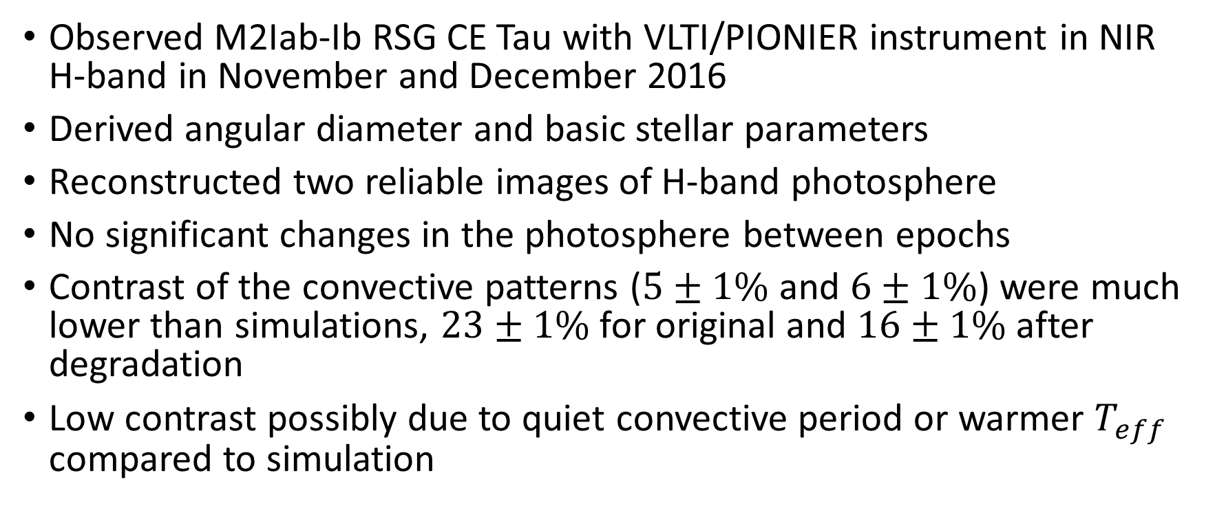
Conclusions
Observed M2Iab-Ib RSG CE Tau with VLTI/PIONIER instrument in NIR H-band in November and December 2016
Derived angular diameter and basic stellar parameters
Reconstructed two reliable images of H-band photosphere
No significant changes in the photosphere between epochs
Contrast of the convective patterns ($5±1\%$ and $6±1\%$) were much lower than simulations, $23±1\%$ for original and $16±1\%$ after degradation
Low contrast possibly due to quiet convective period or warmer $T_{eff}$ compared to simulation

Slide 4
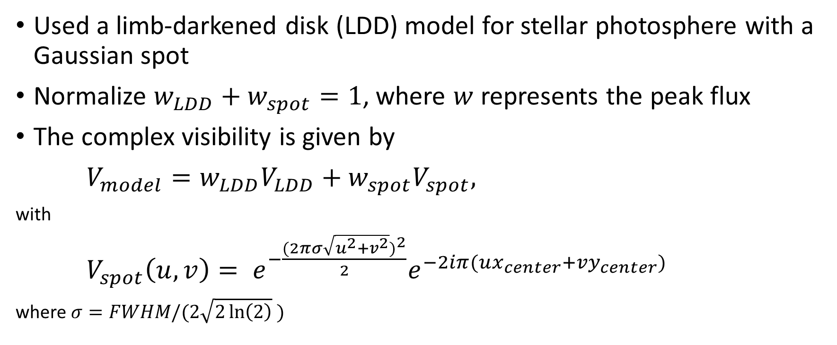
Model
Used a limb-darkened disk (LDD) model for stellar photosphere with a Gaussian spot
Normalize $w_{LDD}+w_{spot}=1$, where $w$ represents the peak flux
The complex visibility is given by
$V_{model}=w_{LDD}V_{LDD}+w_{spot}V_{spot},$
with
$V_{spot}\left(u,v\right)= e^{−\frac{(2πσ\sqrt{u^{2}+v^{2}})^{2}}{2}}e^{−2iπ(ux_{center}+vy_{center})}$
where$σ=FWHM/(2\sqrt{2\ln\left(2\right)} )$
Notes:
Considered uniform disk (UD) model – did not fit well.
Considered two spot model which did not converge on December dataset – chi2 probably too complicated.

Slide 5
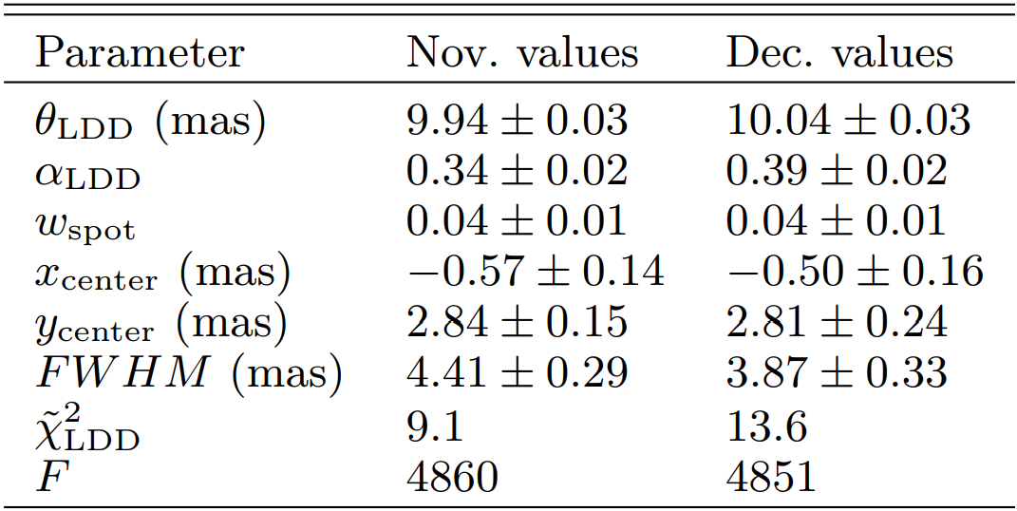
Model
Notes:
Theta – angular diameter
Alpha – exponent in intensity powerlaw
w – peak flux
x – relative R.A. of spot
y – relative dec of spot
FWHM – full width half max
Chi2 – chi2
F – goodness of fit (>~5 considered significant)

Slide 6
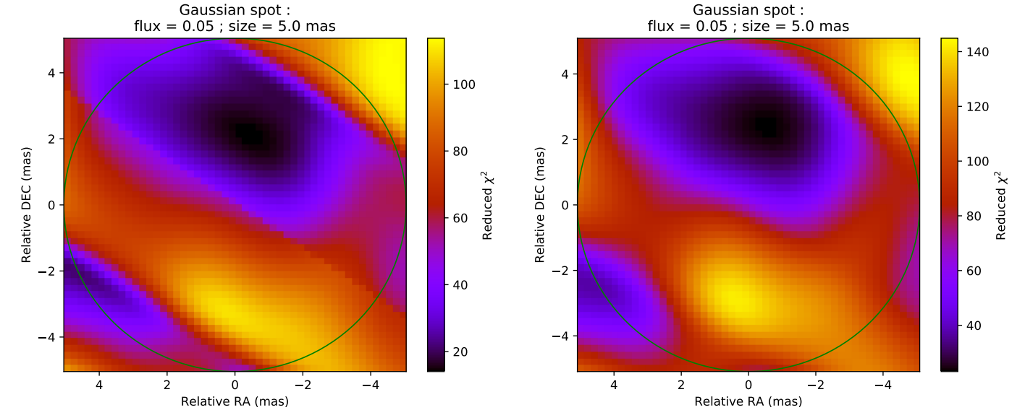
Model

Slide 7
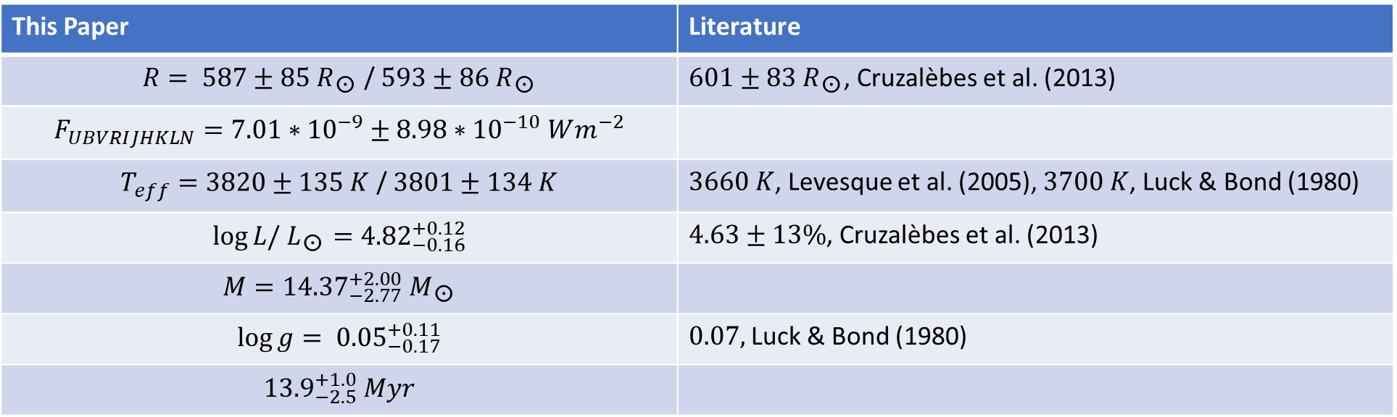
Stellar Parameters
This Paper | Literature
$R= 587±85 R_{\text{☉}}$ / $593±86{ R}_{\text{☉}}$ | $601±83{ R}_{\text{☉}}$, Cruzalèbes et al. (2013)
$$F_{UBVRIJHKLN}=7.01∗{10}^{−9}±8.98∗{10}^{−10} Wm^{−2}$$
$T_{eff}=3820±135 K$ / $3801±134 K$ | $3660 K$, Levesque et al. (2005), $3700 K$, Luck & Bond (1980)
$$\log{L/{ L}_{\text{☉}}}={4.82}_{−0.16}^{+0.12}$$ | $4.63±13\%$, Cruzalèbes et al. (2013)
$$M={14.37}_{−2.77}^{+2.00}{ M}_{\text{☉}}$$
$$\log{g}= {0.05}_{−0.17}^{+0.11}$$ | $0.07,$Luck & Bond (1980)
$${13.9}_{−2.5}^{+1.0} Myr$$
Notes:
Relied on parallax measurement of 1.82 +/- 0.26 mas – van Leeuwen (2007)
Mass estimate assumes initial mass of 15 solar masses.
Metallicity: [Fe/H] = 0.11
Age estimate based on H-R diagram and evolutionary models.

Slide 8
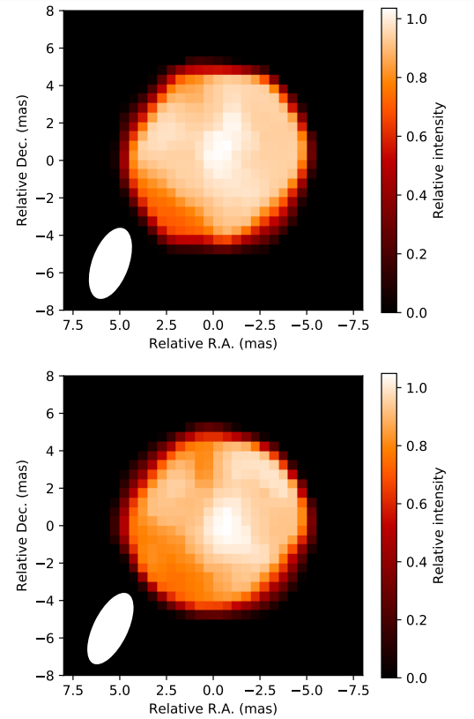
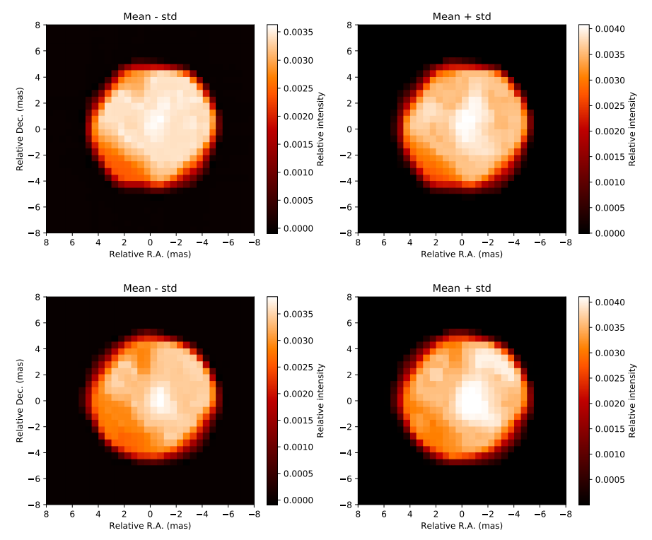
Image Reconstruction

Slide 9
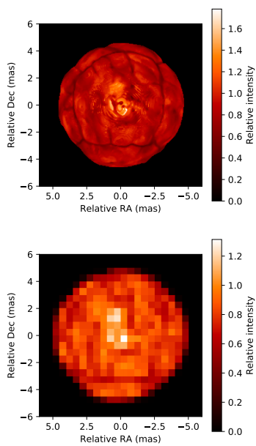
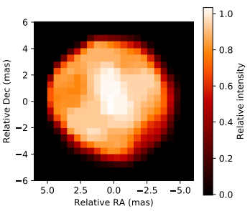
3D Radiative Hydrodynamics Simulation

Slide 10
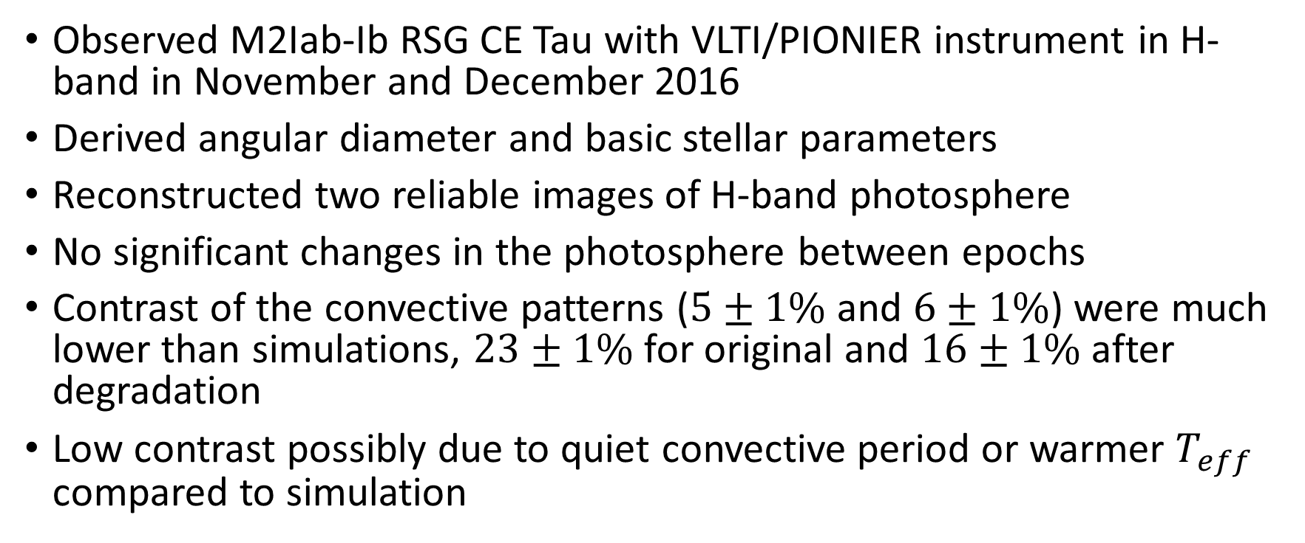
Conclusions
Observed M2Iab-Ib RSG CE Tau with VLTI/PIONIER instrument in H-band in November and December 2016
Derived angular diameter and basic stellar parameters
Reconstructed two reliable images of H-band photosphere
No significant changes in the photosphere between epochs
Contrast of the convective patterns ($5±1\%$ and $6±1\%$) were much lower than simulations, $23±1\%$ for original and $16±1\%$ after degradation
Low contrast possibly due to quiet convective period or warmer $T_{eff}$ compared to simulation

