Slide 1
The Impact of Nuclear Reaction Rate Uncertainties on the Evolution of Core-Collapse Supernova Progenitors
C. E. Fields, F. X. Timmes, R. Farmer, I. Petermann, William M. Wolf, and S. M. Couch

Slide 2
Conclusions
Explore properties of core-collapse supernova progenitors with respect to uncertainties in thermonuclear reaction rates
Notes:
Reaction rates and uncertainties taken from probability density functions from STARLIB
Variations at H-, He-depletion are of comparable magnitude to variations induced by choices of mass resolution and network resolution, can dominate at C-, Ne-, and O-depletion.

Slide 3

Conclusions
Explore properties of core-collapse supernova progenitors with respect to uncertainties in thermonuclear reaction rates
Most impactful uncertainties are in the $^{14}N(p,γ)^{15}O$, triple-α, $^{12}C(α,γ)^{16}O$, $^{12}C( ^{12}C,p)^{23}Na$, $^{12}C( ^{16}O,p)^{27}Al$, $^{16}O( ^{16}O,n)^{31}S$, $^{16}O( ^{16}O,p)^{31}P$, $^{16}O( ^{16}O,α)^{28}Si$
Notes:
Reaction rates and uncertainties taken from probability density functions from STARLIB
Variations at H-, He-depletion are of comparable magnitude to variations induced by choices of mass resolution and network resolution, can dominate at C-, Ne-, and O-depletion.

Slide 4
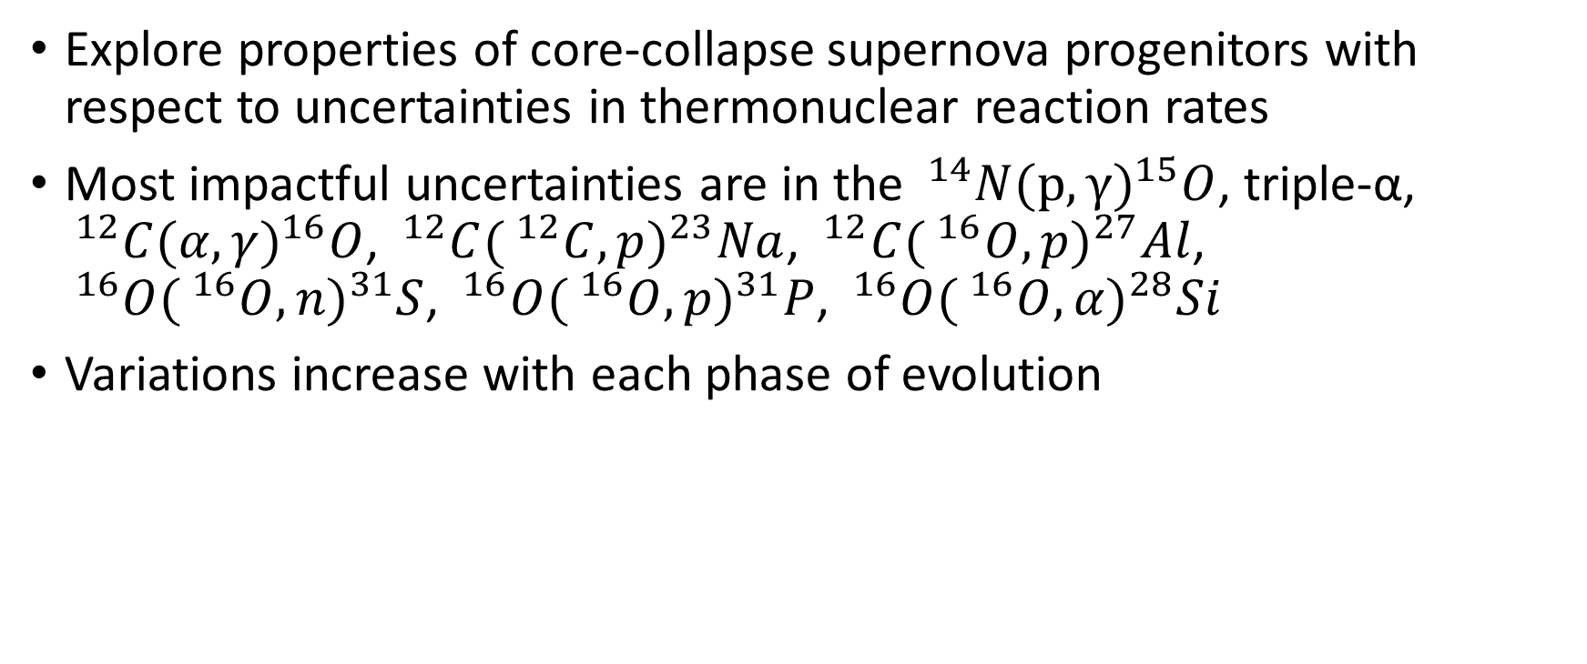
Conclusions
Explore properties of core-collapse supernova progenitors with respect to uncertainties in thermonuclear reaction rates
Most impactful uncertainties are in the $^{14}N(p,γ)^{15}O$, triple-α, $^{12}C(α,γ)^{16}O$, $^{12}C( ^{12}C,p)^{23}Na$, $^{12}C( ^{16}O,p)^{27}Al$, $^{16}O( ^{16}O,n)^{31}S$, $^{16}O( ^{16}O,p)^{31}P$, $^{16}O( ^{16}O,α)^{28}Si$
Variations increase with each phase of evolution
Notes:
Reaction rates and uncertainties taken from probability density functions from STARLIB
Variations at H-, He-depletion are of comparable magnitude to variations induced by choices of mass resolution and network resolution, can dominate at C-, Ne-, and O-depletion.

Slide 5
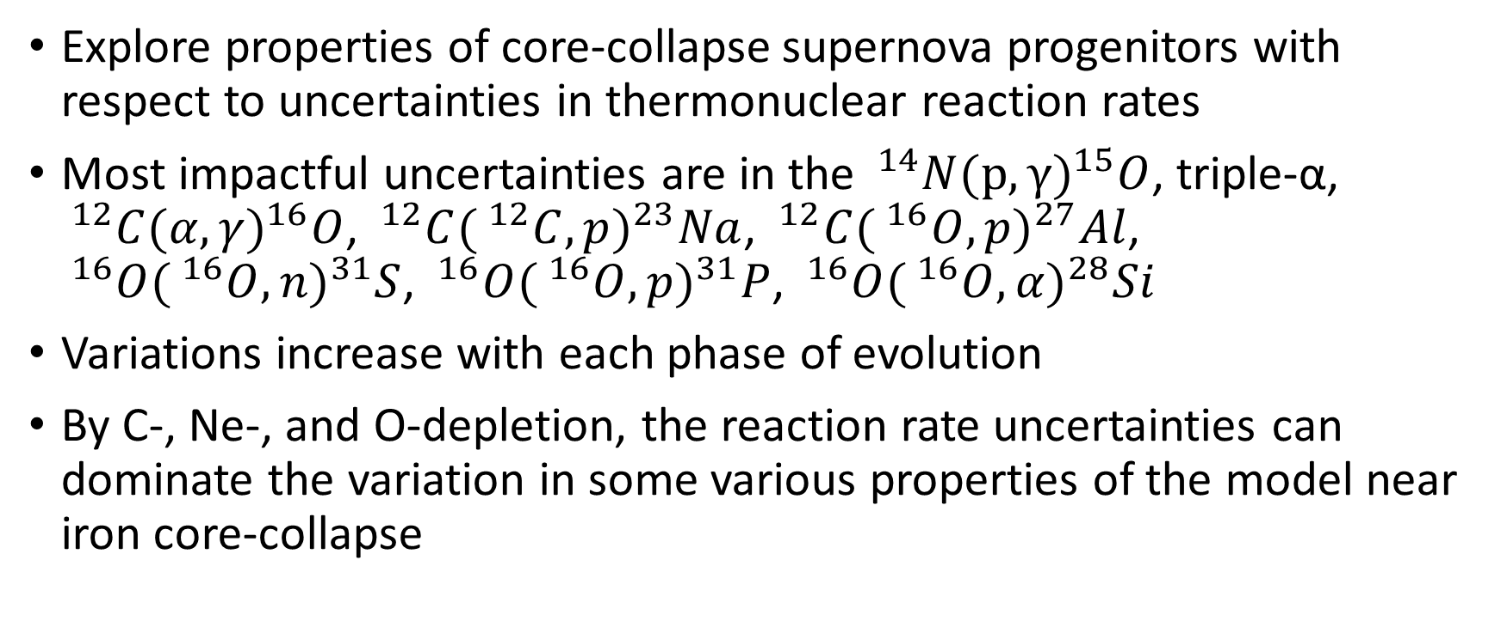
Conclusions
Explore properties of core-collapse supernova progenitors with respect to uncertainties in thermonuclear reaction rates
Most impactful uncertainties are in the $^{14}N(p,γ)^{15}O$, triple-α, $^{12}C(α,γ)^{16}O$, $^{12}C( ^{12}C,p)^{23}Na$, $^{12}C( ^{16}O,p)^{27}Al$, $^{16}O( ^{16}O,n)^{31}S$, $^{16}O( ^{16}O,p)^{31}P$, $^{16}O( ^{16}O,α)^{28}Si$
Variations increase with each phase of evolution
By C-, Ne-, and O-depletion, the reaction rate uncertainties can dominate the variation in some various properties of the model near iron core-collapse
Notes:
Reaction rates and uncertainties taken from probability density functions from STARLIB
Variations at H-, He-depletion are of comparable magnitude to variations induced by choices of mass resolution and network resolution, can dominate at C-, Ne-, and O-depletion.

Slide 6
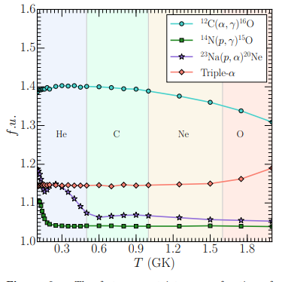
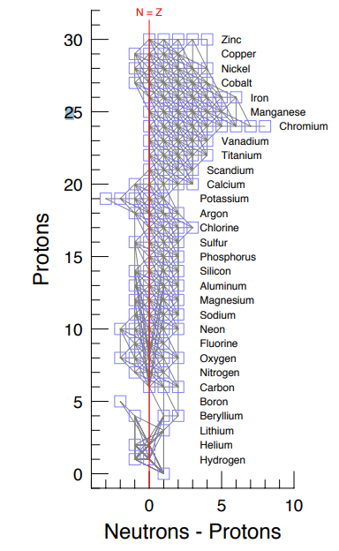
Notes:
Left: Factor uncertainty as a function of temperature provided by STARLIB over different approximate core burning temperatures
Right: 127 isotope reaction network. Thermonuclear and weak reaction rates coupling the isotopes are marked by gray lines.

Slide 7
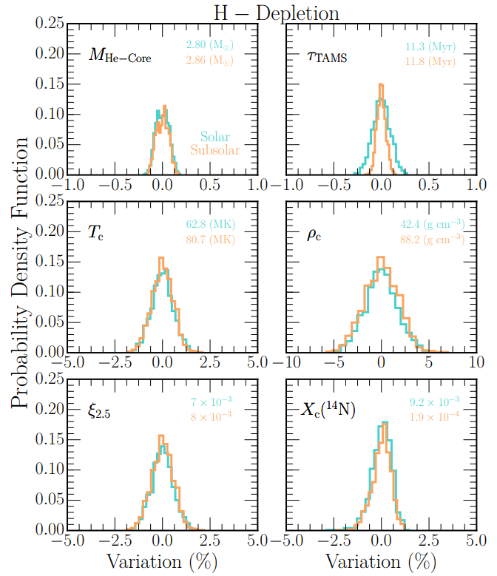
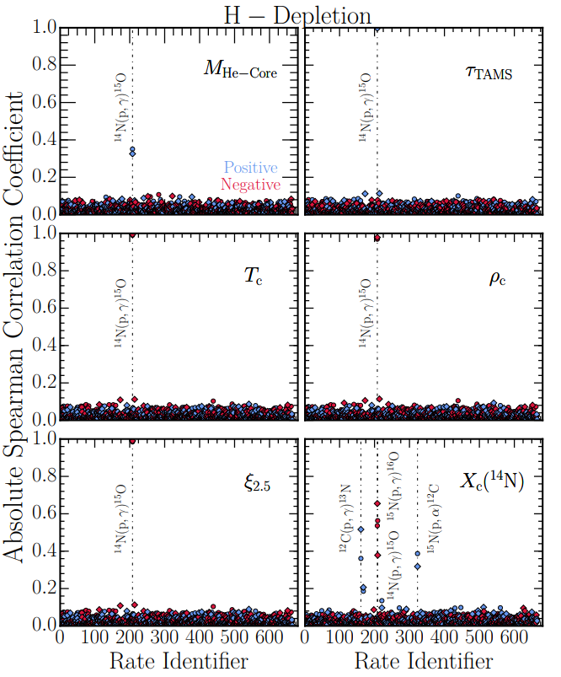
Notes:
Spearman Rank-Order Correlation (SROC) analysis used to determine relevant variables. A value of +1 represents perfectly increasing relationship, 0 represents perfectly uncorrelated, and -1 decreasing.

Slide 8
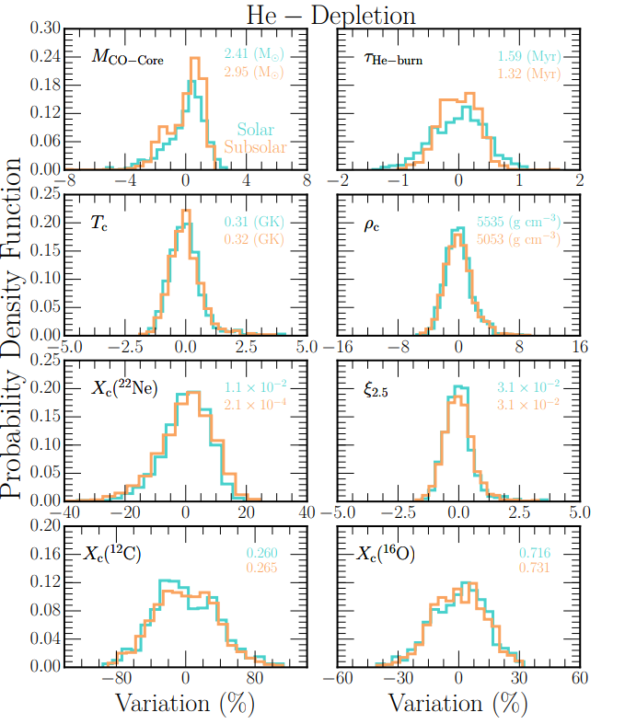
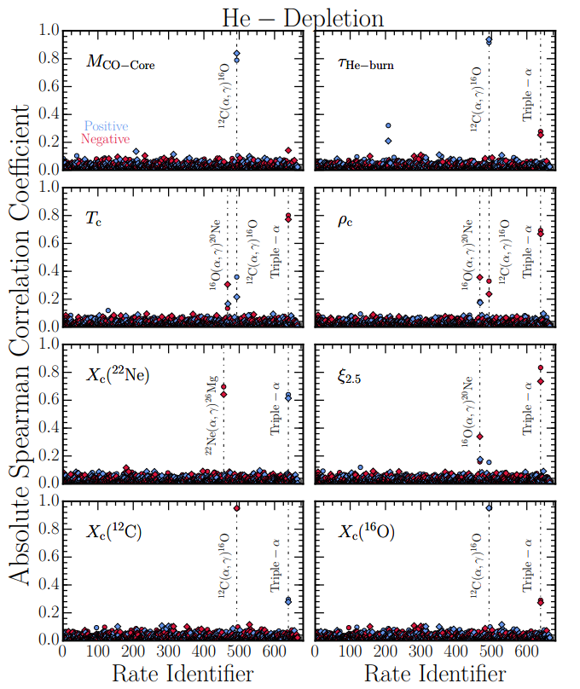

Slide 9
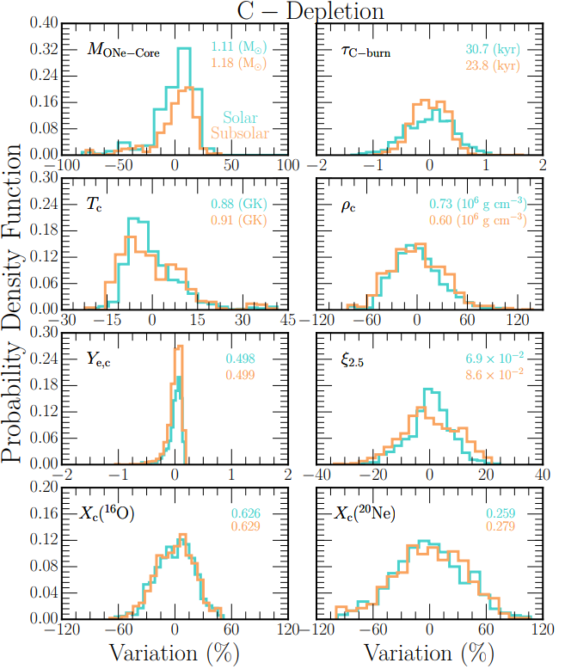
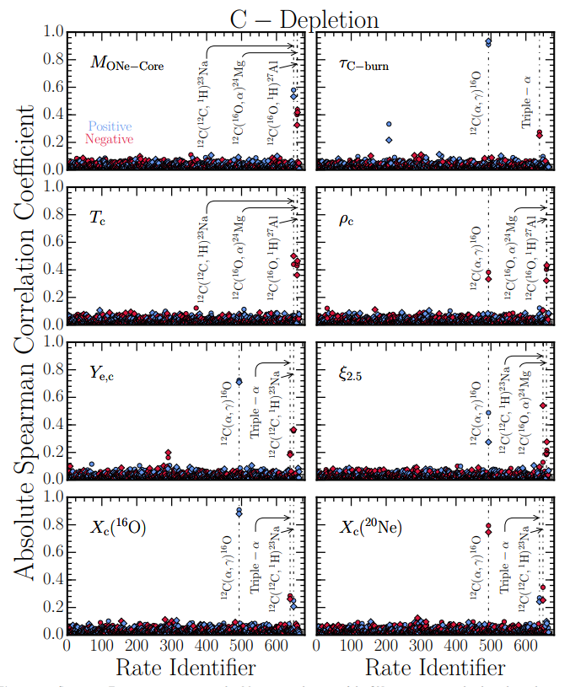

Slide 10
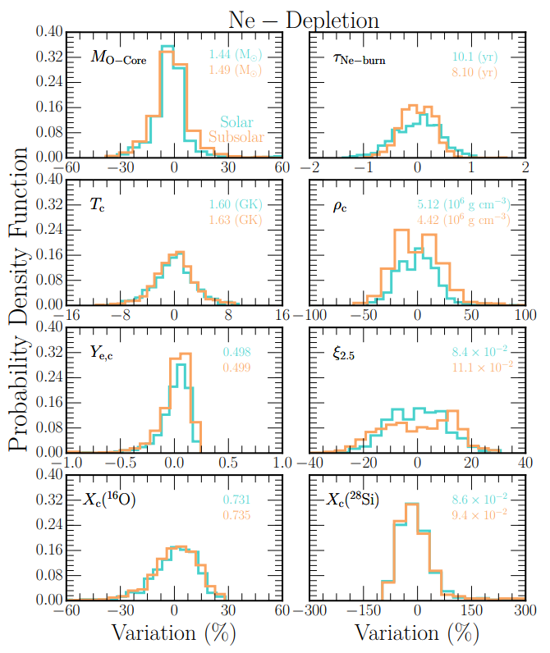
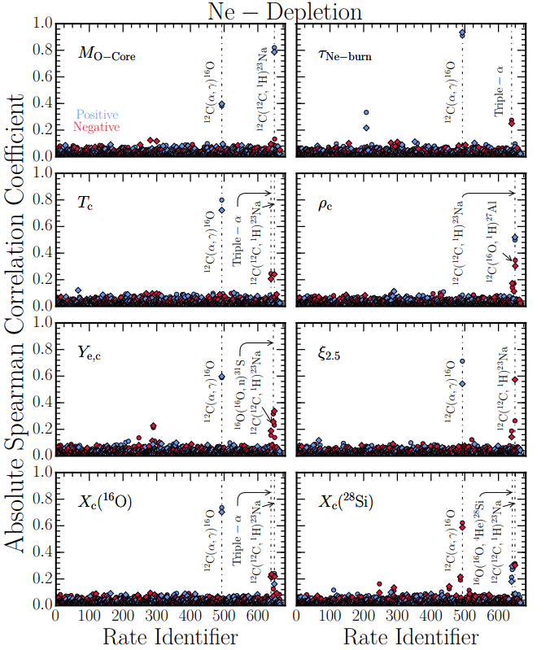

Slide 11
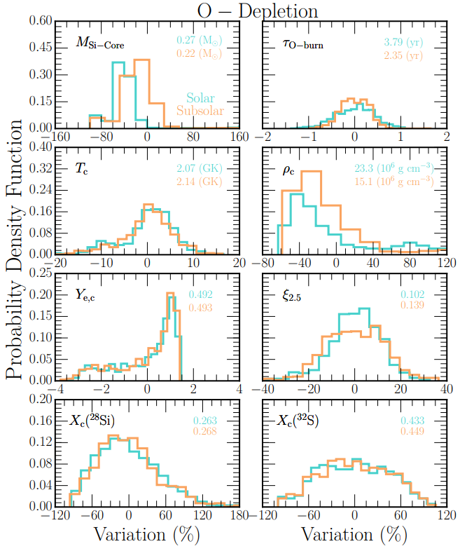
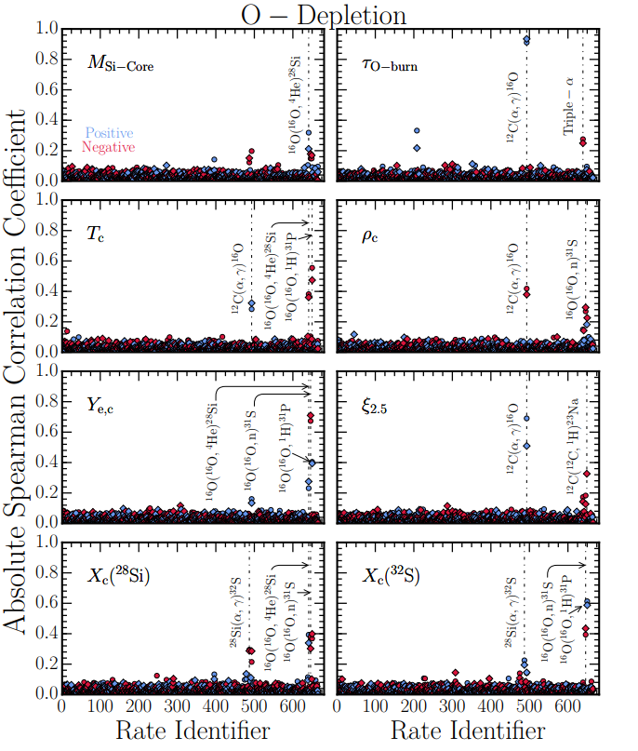

Slide 12
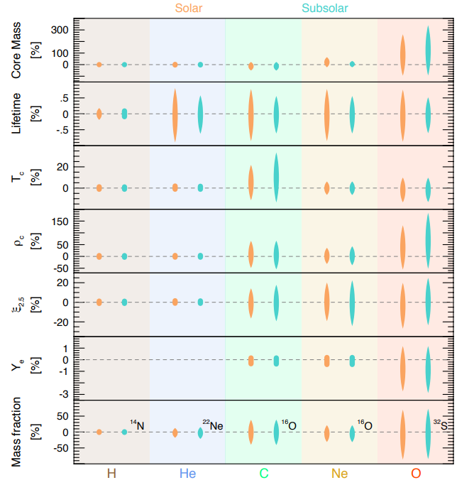
Vertical length of each tapered uncertainty band is the 95% CI for variations around the mean, the horizontal width represents the underlying PDF.

Slide 13
Conclusions
Sampled 665 forward reaction rates for an in-situ 127 isotope MESA reaction network

Slide 14
Conclusions
Sampled 665 forward reaction rates for an in-situ 127 isotope MESA reaction network
Surveyed core mass, burning lifetime, central temperature, central density, compactness parameter, and key abundances at five epochs

Slide 15
Conclusions
Sampled 665 forward reaction rates for an in-situ 127 isotope MESA reaction network
Surveyed core mass, burning lifetime, central temperature, central density, compactness parameter, and key abundances at five epochs
In general, variations induced by nuclear reaction rates grow with each passing phase of evolution

Slide 16
Conclusions
Sampled 665 forward reaction rates for an in-situ 127 isotope MESA reaction network
Surveyed core mass, burning lifetime, central temperature, central density, compactness parameter, and key abundances at five epochs
In general, variations induced by nuclear reaction rates grow with each passing phase of evolution
Variations from nuclear reaction rates are comparable in magnitude to variations from mass and network resolution choices

