Slide 1


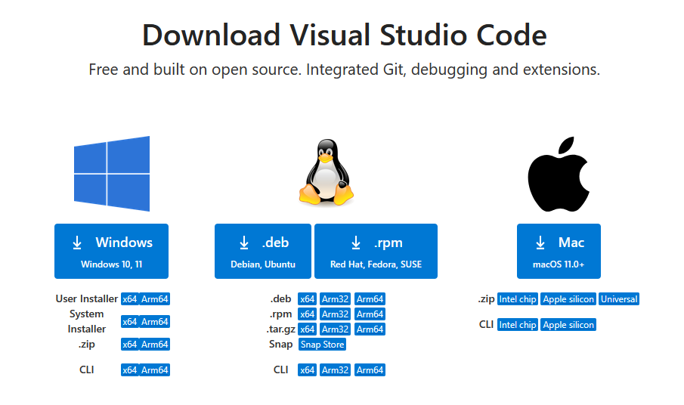
VSCode-QMIO access guide
0- Connect to guest wifi invitado with password: cafecafe0000#
1- Download the proper VSCode installer from: https://code.visualstudio.com/

Slide 2
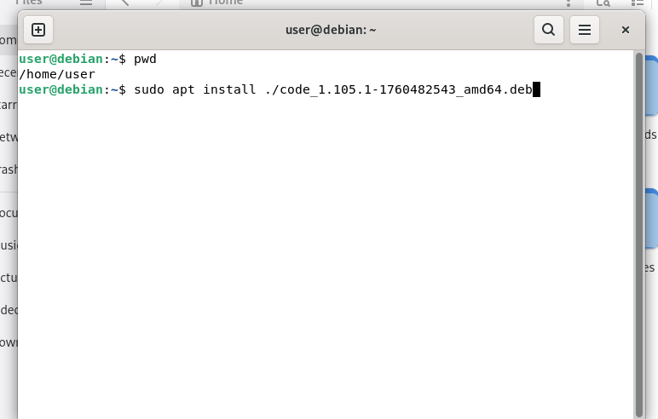
VSCode-QMIO access guide
Windows
2- Run the installer (.exe) and accept every default configuration.
Linux
2- To install, run in the terminal (make sure you are in the same directory as the .deb file, just move the file to your home):
sudo apt install ./code_1.105.1-1760482543_amd64.deb
(the exact version number may change, it should be the name of the .deb you downloaded).

Slide 3

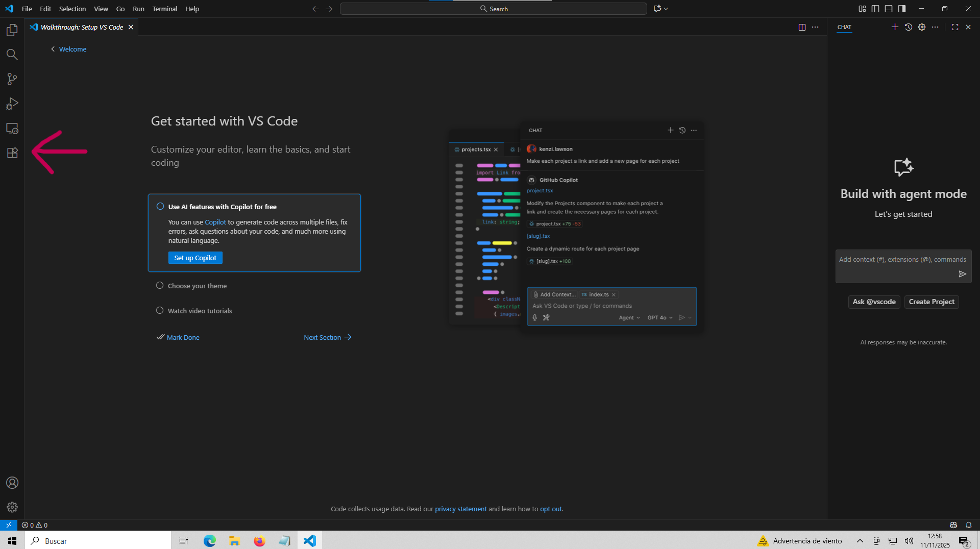
VS code-QMIO access guide
Windows
3- Open VSCode and go to extensions.
Linux
3- To open VSCode type code (if it asks for a password, ignore it). Go to extensions.

Slide 4
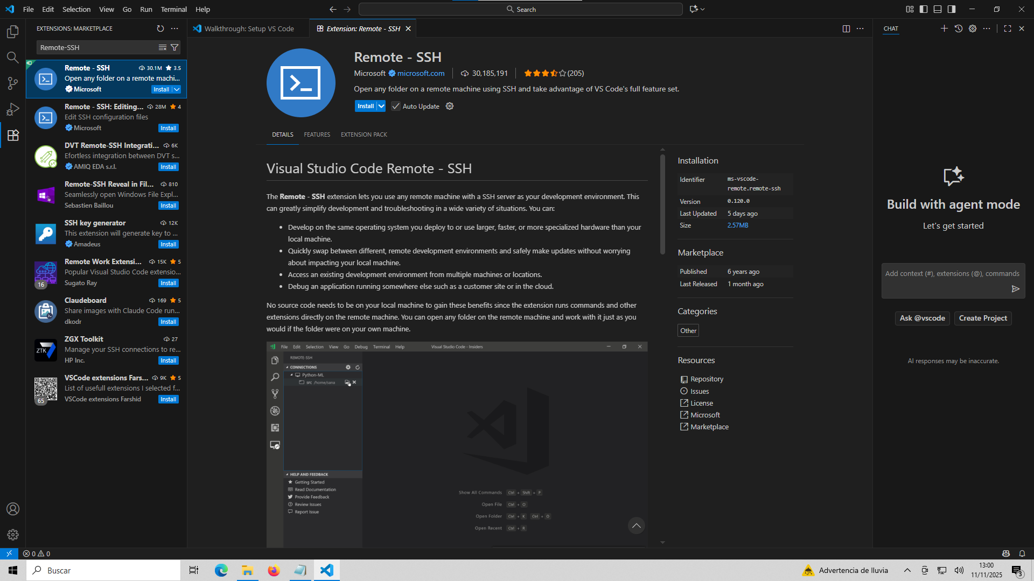
VS code-QMIO access guide
4- Install the official Microsoft extension: Remote-SSH

Slide 5
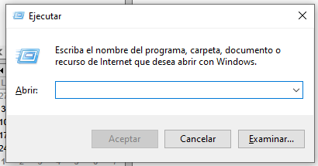
VS code-QMIO access guide
5- The next step is to create a ssh key pair to connect to Qmio. Let’s open the command terminal.
Windows
Press Windows + r, write cmd and press Enter to access the command terminal.
Linux
Open terminal.

Slide 6
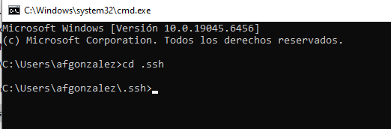
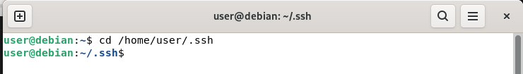
VS code-QMIO access guide
Windows
6- Type cd ssh to go to the .shh folder.
In case the .ssh folder does not exist, create it at:
C:\Users\<your_local_User>\
Then you will have to close the terminal and open it again to navigate to the folder.
Linux
6-Type cd /home/<your_user>/.ssh to navigate to the .shh directory.
In case the .ssh folder does not exist, create it at /home/<your_user>/ : mkdir .ssh

Slide 7
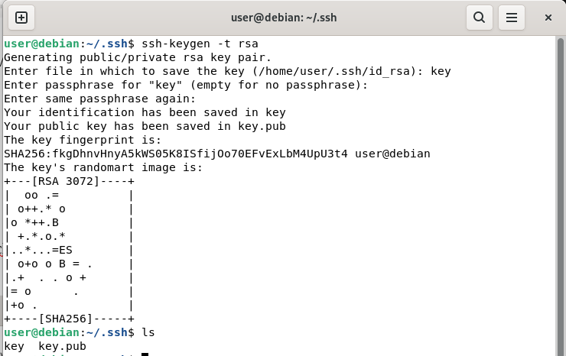
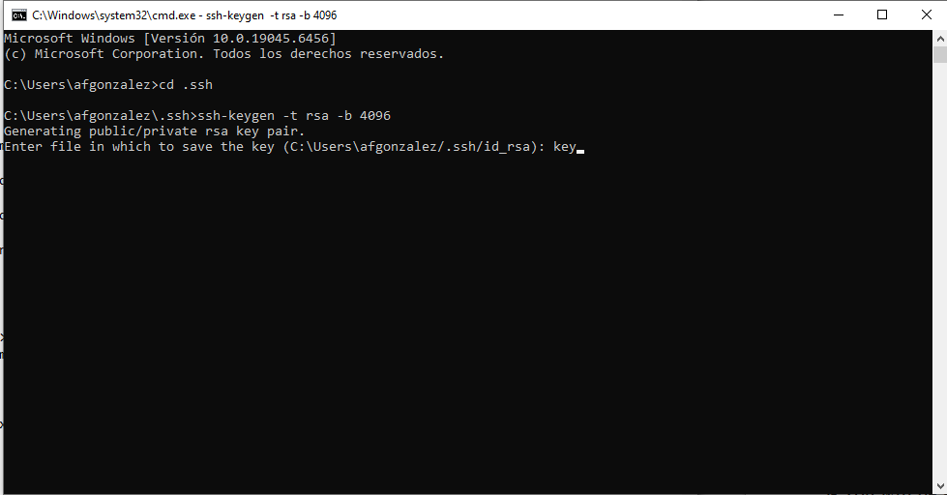
VS code-QMIO access guide
7- To create the keys, type:
ssh-keygen -t rsa -b 4096
You will be asked to write the name of a file in which they key will be written. Write: key
You will also be asked to write a password for the key file but it’s optional, just press Enter to skip it. The key files will be created inside .ssh.

Slide 8
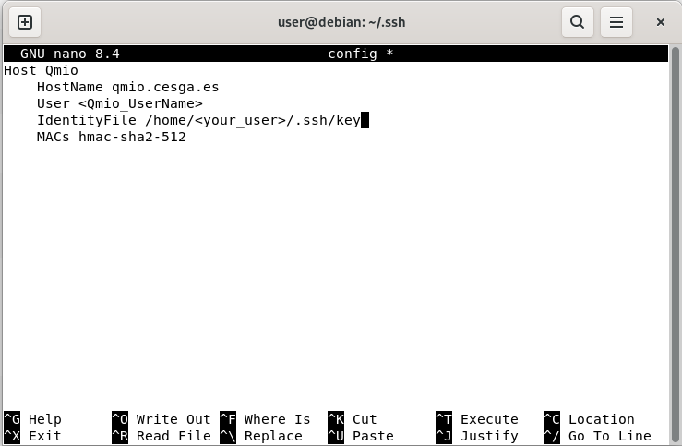
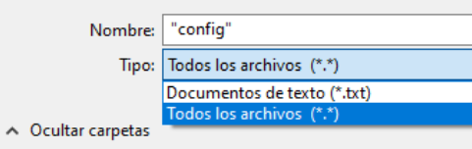
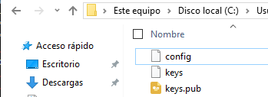
VS code-QMIO access guide
8- Now, inside the .ssh folder you will have to create an extensionless file called config with the following content:
Host Qmio
HostName qmio.cesga.es
User curso…
IdentityFile C:\Users\<Your_PC_UserName>\.ssh\key
MACs hmac-sha2-512
Windows
To create an extensionless file open notepad, write the text and then go to: save file as… Select “all files” and write the name of the file between double quotes : “config”
Linux
To create an extensionless file type nano config to open the text editor. Write the text above. Press ctrl+x to exit and then y and Enter to save.

Slide 9
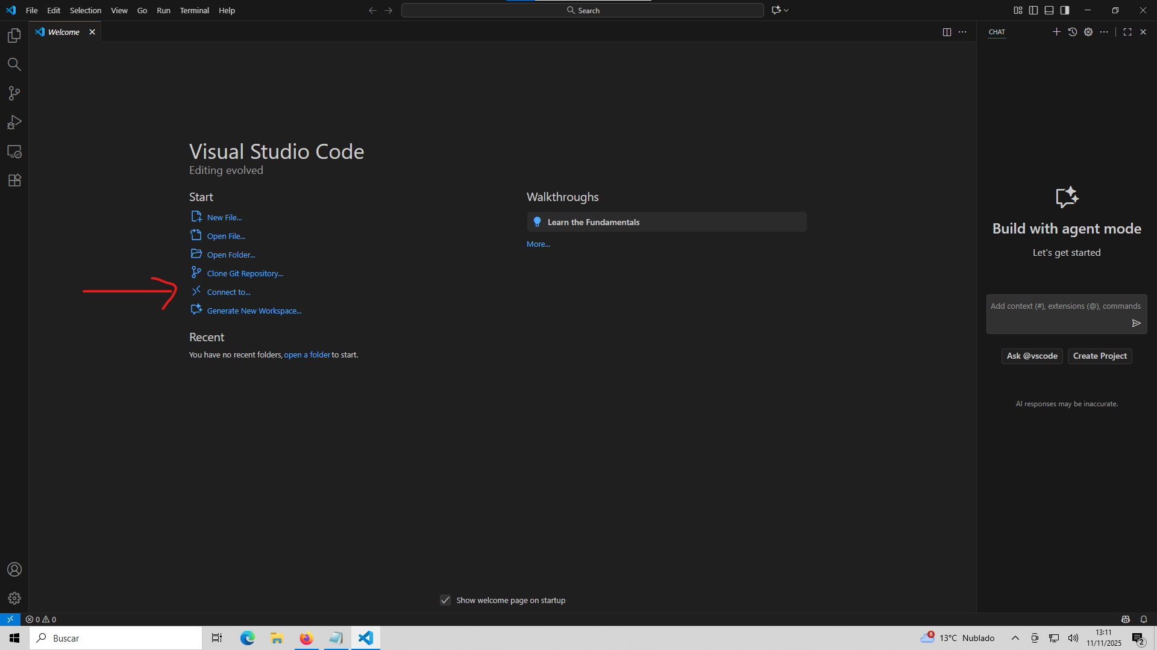
VS code-QMIO access guide
9- Now everything is ready for the connection, open VSCode and click Connect to

Slide 10
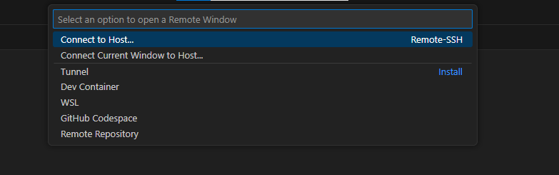
VS code-QMIO access guide
10- Click in Connect to Host.

Slide 11

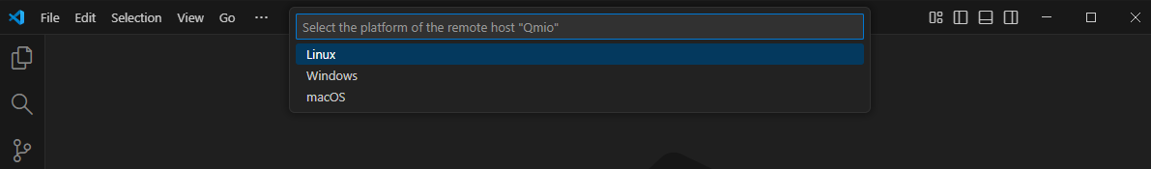
VS code-QMIO access guide
11- Select Qmio
12- Select Linux and then write your Qmio password in the box

Slide 12
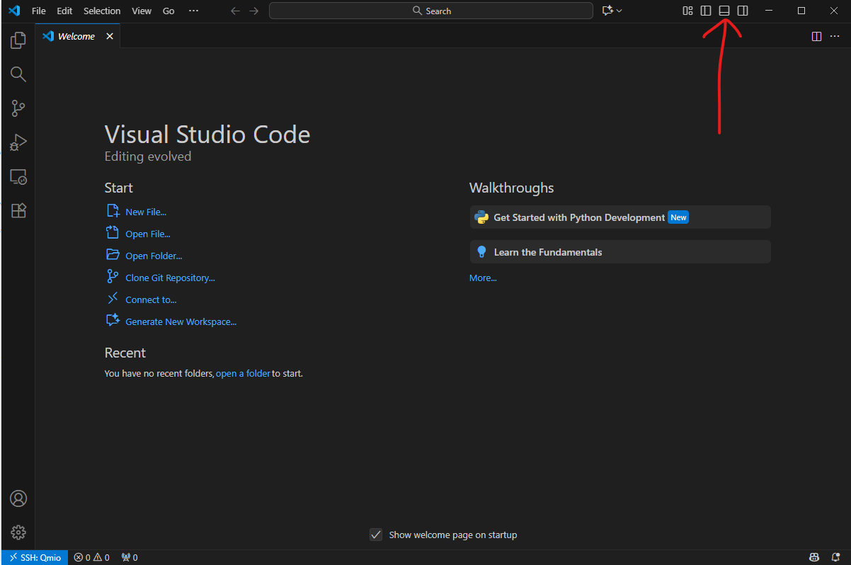
VS code-QMIO access guide
13- To open the Qmio terminal, click in this icon:

Slide 13
VS code-QMIO access guide
14- Once connected, type qia to activate the programming environment.
15- Move to the $Q_SWAP folder type cd $Q_SWAP (it must be the working directory).

Slide 14
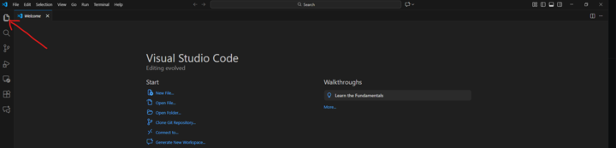
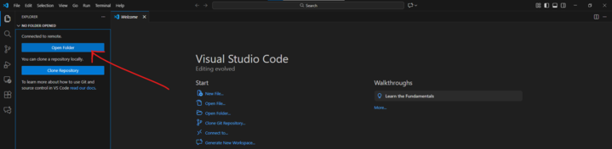
VS code-QMIO access guide
16-Now click on these icons

Slide 15
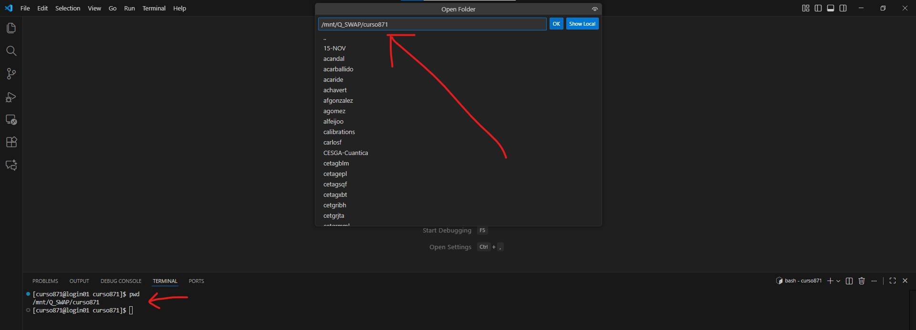
VS code-QMIO access guide
17_Type pwd in the terminal and copy the path on the search bar above

Slide 16
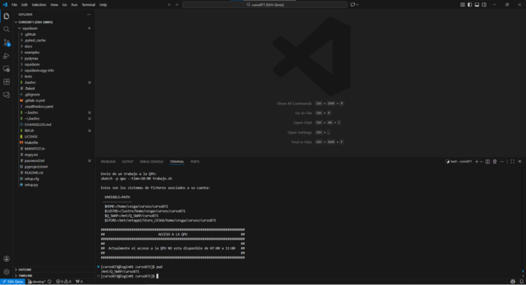
VS code-QMIO access guide
18_ Finally you will see the next screen and everything is ready!

Slide 17
VS code-QMIO access guide
In case your linux distribution is different from Debian, you can see the instructions on
the next link
https://code.visualstudio.com/docs/setup/linux

Slide 18
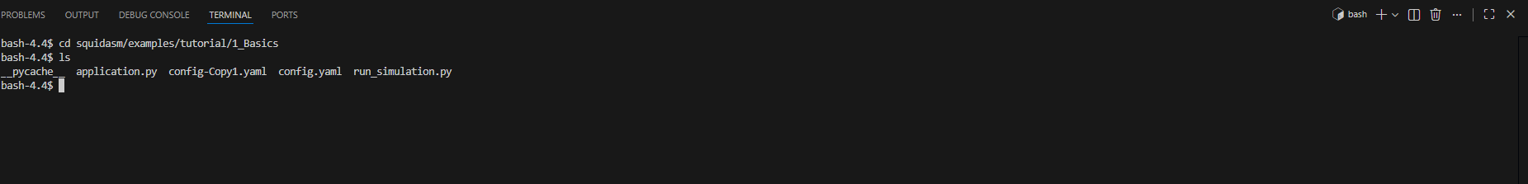
QMIO access guide
You can find some examples here:
Command for accessing QMIO from the terminal (not needed if using VSCode):
ssh -m hmac-sha2-512 cursoXXX@qmio.cesga.es

Slide 19
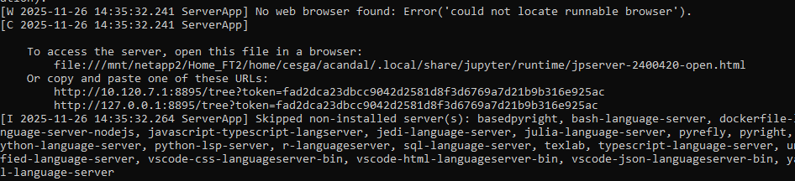
Jupyter-QMIO access guide
If you want to use Jupyter as an alternative way to write your code, type
jupyter notebook --ip=$(hostname -i) --port=8XXX &> opa.out &
cat opa.out
and copy the following url on your internet browser :

Slide 20

QIA Hackathon 2025 instructions
Pick a challenge, a team (or go solo), and get hacking!
All challenges and starting templates can be found at:
https://github.com/qia-hackathon-2025/qia-hackathon-2025
Get as much done as you can by 16:30 and present your results
with a demo, a slide deck.
Share your project in the qia-hackathon-2025 group. Ask one of
the organisers to create a repository for you.
Join Slack via

