Slide 1

STUDENT MANAGEMENT SYSTEM
A web-based system designed to make it easier to register, store, manage, and retrieve student information
GitHub Repo:
https://github.com/acheampongmaamary/student-management-system
code

Slide 2





The problem and the goal
01
AGENDA OVERVIEW
WHAT WE
WILL COVER
What the app does + live demo
02
A comprehensive presentation covering project goals, core functionality, architecture, and key learnings.
Tech stack and architecture
03
Project walkthrough
04
Lessons learnt
05

Slide 3
THE PROBLEM & THE GOAL
warning_amber
The Problem
check_circle_outline
The Goal
Complex Record Keeping: A registry keeps many details per student (names, ID, contacts, programme, level).
Inefficient Systems: Paper ledgers and loose spreadsheets are slow to search and easy to mistype.
Data Errors: Duplicate IDs and impossible values slip in unnoticed.
Single Web Page: Full CRUD functionality to Create, Read, Update, and Delete records.
Smart Validation: Catch data mistakes automatically before saving.
Cloud Storage: Centralized database accessible from any web browser.
Clean Codebase: Simple structure easily understood.

Slide 4
WHAT THE APP DOES: FULL CRUD
C
POST
R
GET
U
PATCH
D
DELETE
Create
Read
Update
Delete
Fill in the form and click “Add to register”. The new student appears in the table instantly.
When the page opens, every student is loaded from the database, sorted by Student ID.
Click “Edit” on a row. The form fills in, the button becomes “Update student”.
Click “Delete” and confirm. The record is removed from the database and the table.

Slide 5
TECHNOLOGY
THE TECH STACK I USED
The skeleton
The clothes
The brain
HTML5
CSS3
JavaScript
Defines the structure: inputs, labels, dropdowns, the table area.
The registry look: colours, fonts, CSS Grid layout, mobile-friendly rules.
Handles clicks, validation, age calculation and all database calls.
The engine
The delivery person
The cloud filing cabinet
Node.js
Express 5
Supabase
Lets us run JavaScript on a computer, outside of the browser.
A small web server that hands the page, CSS and JS to the browser.
A hosted PostgreSQL database with an instant REST API.
Notes:
[~1 minute]
Here is the technology, with an analogy for each piece.
HTML is the skeleton: it defines what is on the page. CSS is the clothes: it makes it look good. JavaScript is the brain: it reacts to clicks, checks your input and talks to the database.
Node.js lets us run JavaScript outside the browser, on a computer. Express is a tiny web server built on Node: think of it as a delivery person who hands the page to the browser.
Finally Supabase is our database in the cloud. It uses PostgreSQL underneath and gives us a ready-made REST API, so I did not need to write my own backend database code.
I deliberately used plain HTML, CSS and JavaScript with no front-end framework, so every concept is visible and easy to learn.

Slide 6
CODE TOUR
PROJECT STRUCTURE: WHERE EVERYTHING LIVES
project tree
server.js
Back end. Starts Express and serves the files.
student-management-system/
├── server.js
├── index.html
├── package.json
├── README.md
└── public/
├── css/
│ └── style.css
└── js/
└── script.js
index.html
The page structure: header, form, register table.
public/css/style.css
The look and feel: colours, fonts, layout.
public/js/script.js
The brain: validation, age maths, all database calls.
package.json
Lists dependencies and the “npm start” command.
README.md
Written guides for new developers.
Student Management System · KNUST Registry
8 / 16
Notes:
[~45 seconds]
Let me quickly orient you in the code. The project is small and easy to navigate.
At the top level we have server.js, which is the back end, index.html, which is the page, and package.json, which lists the dependencies. We only have one: Express.
Everything the browser downloads sits in the public folder: style.css for appearance and script.js for behaviour.
The README and the docs folder hold written guides, including an onboarding guide for new team members.
The next three slides go through server.js, then the HTML and CSS, then script.js.

Slide 7
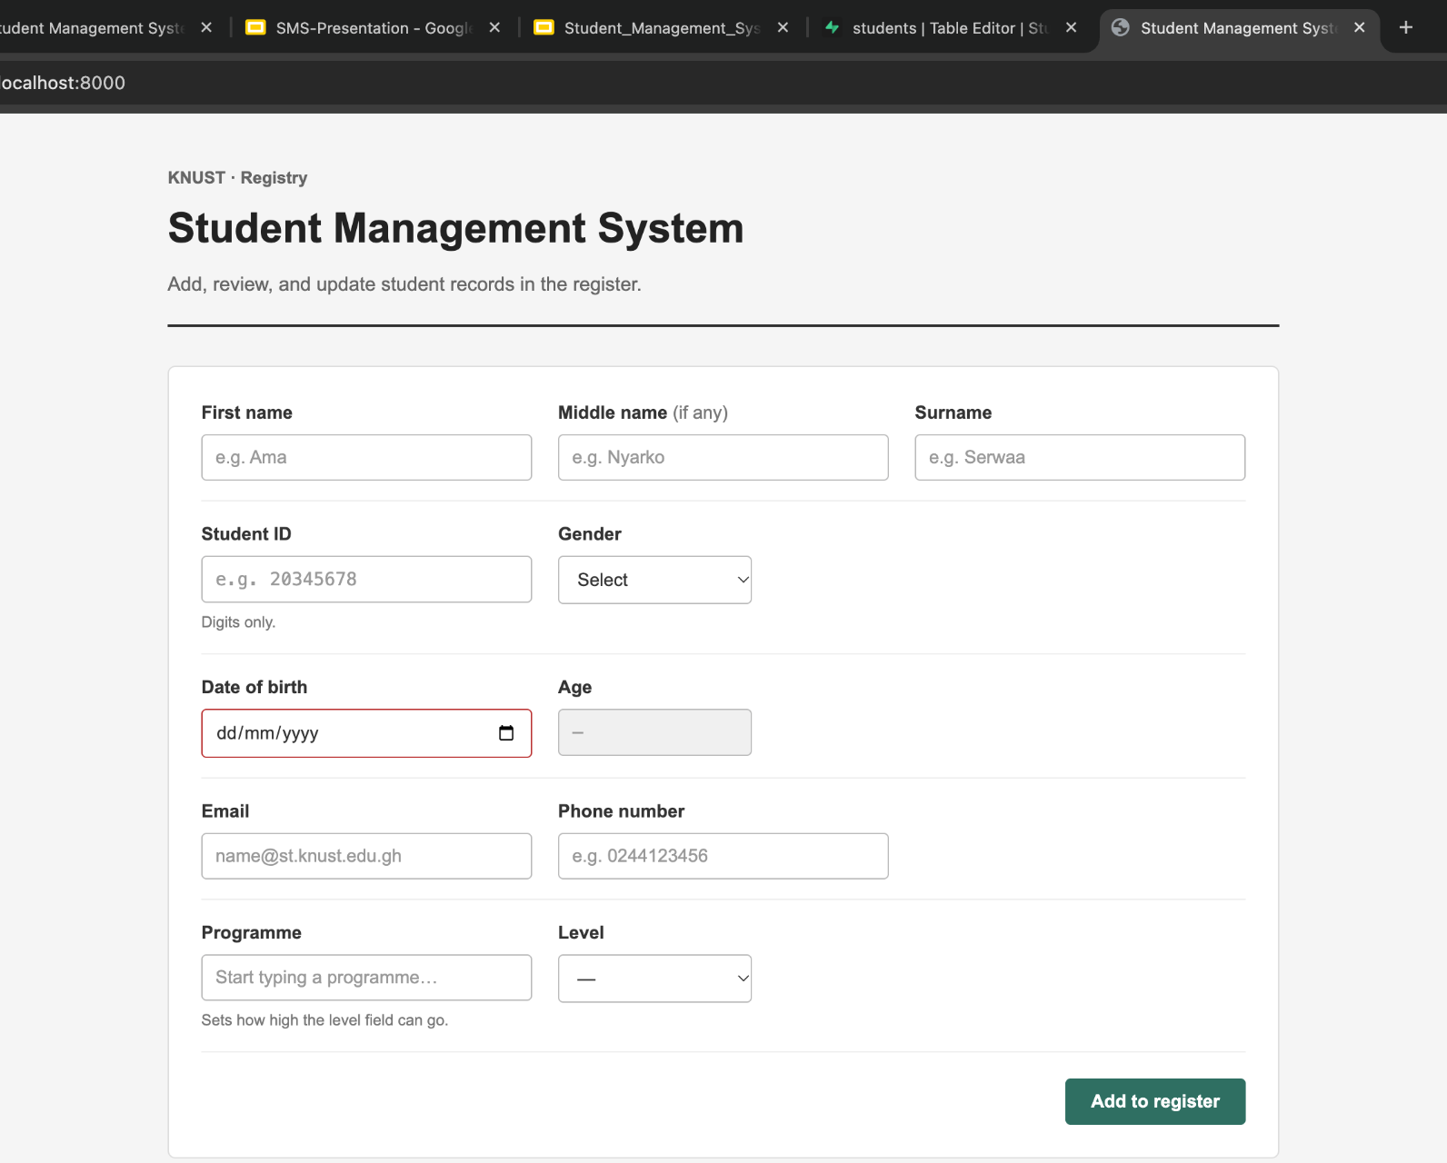
LIVE DEMO
THE INTERFACE: DIGITAL REGISTRY LEDGER
WHAT TO POINT OUT
01
Names first, optional middle, surname
02
Student ID digits only, exactly 8
03
Date of birth Age fills automatically
04
Programme type to search; limits Level
05
Add to register validates, then saves to cloud
Notes:
[~1 minute 30 seconds, ideally a LIVE DEMO]
This is the real application running on my machine at localhost:3000. The design is inspired by a traditional registry ledger: parchment colours, ruled lines and serif headings.
LIVE DEMO SUGGESTION (about 60 seconds):
1) Type a name. 2) In Student ID, try typing letters: they are rejected automatically. 3) Pick a date of birth and show the Age filling in by itself. 4) Choose 'Doctor Of Pharmacy' and show levels up to 600, then choose 'Bsc Computer Science' and show 500 and 600 become disabled. 5) Click 'Add to register' and show the new row appear, then click Edit and Delete on it.
If the internet or demo fails, use the screenshots in this deck: the next slides show the table with its Edit and Delete buttons.

Slide 8
REFLECTION
LESSONS LEARNT
01
File paths must match
The HTML links /public/css/style.css, so the server must serve the folder under /public. A mismatch gives a silent 404 and an unstyled page.
02
Asynchronous code is tricky
Network calls take time. async/await with try/catch/finally keeps the page responsive and shows clear error messages.
03
Keep screen and database in sync
After every save or delete I update a local ID list and a row Map, so the table always matches the database without reloading.
04
Browser validation is not security
A user can bypass JavaScript checks. Real protection needs database rules (unique constraints, Row Level Security).
05
Public keys need care
The Supabase “anon” key is designed to be public, but only safe when Row Level Security policies are enabled. Never expose a service_role key.
Student Management System · KNUST Registry
14 / 16
Notes:
[~1 minute 15 seconds]
Here are the main things I learned.
One: file paths must match. My page asked for /public/css/style.css but the server only exposed the public folder at the root, so the CSS returned a 404 error. A good reminder to check the Network tab in the browser's developer tools.
Two: asynchronous code takes practice. Using async and await with try, catch and finally keeps the app responsive and lets me show helpful error messages.
Three: keeping the screen and the database in sync. After every save or delete I update a list of IDs and the row Map.
Four and five are about security, and they are the most important. Browser validation helps users but does not protect data, because anyone can bypass it. Real protection must also exist in the database. And the anon key in the code is designed to be public, but it is only safe if Row Level Security is turned on in Supabase.

Slide 9
CONCLUSION
THANK YOU & QUESTIONS
?
repository
GitHub Repository
Questions & Discussion
Thank you for your time and attention.
We welcome any questions regarding the architecture, database integration, or interface design.
Feel free to share feedback or suggestions for future enhancements.
// Source Code & Documentation
github.com/
acheampongmaamary/
student-management-system
Access full setup instructions, server logic, database scripts, and complete project code on GitHub.
Student Management System · KNUST Registry
16 / 16
Notes:
[~15 seconds, then Q&A]
That is the Student Management System. To try it yourself, clone the repository, run npm install, then npm start, and open localhost:3000. Thank you for listening. I'm happy to take questions.
LIKELY QUESTIONS AND SHORT ANSWERS
- Why not use a framework like React? To keep the code simple and learn the fundamentals of HTML, CSS and JavaScript first.
- Is the API key a security risk? The anon key is meant to be public; the real protection is Row Level Security policies in Supabase, which I would tighten, together with staff login.
- Why does the server not talk to the database? Supabase offers a REST API the browser can call directly, so the Express server only needs to deliver the files.
- What happens if two people use the app at once? Each action goes to the database, so data is shared. A unique constraint on student_id in the database would stop duplicate IDs even if two people add the same one at the same time.
- Why is the Supabase script included in index.html if you use fetch? It is loaded from a CDN but the project calls the REST API with fetch directly, so it could be removed or used later.
- How is age calculated? Current year minus birth year, minus one if the birthday has not happened yet this year.

