Slide 1
KNUST · REGISTRY
Student Management System
A beginner-friendly full-stack web app to add, view, edit and delete student records
Intern Project Presentation
https://github.com/acheampongmaamary/student-management-system
HTML · CSS · JavaScript · Node.js · Express · Supabase
Notes:
[~30 seconds]
Good morning/afternoon everyone. My name is ___ and today I'll walk you through my project: the Student Management System.
It is a small web application for a university registry, in the style of KNUST, that lets staff add, view, edit and delete student records.
In the next 12 to 13 minutes I'll show you what it does, how it is built, walk through the important parts of the code, and finish with what I learned and what I would improve next.
The full source code is on GitHub at the link on this slide.

Slide 2
ROADMAP
What we will cover (about 13 minutes)
1
The problem and the goal
1 min
2
What the app does + live demo
2 min
3
Tech stack and architecture
2 min
4
Code walkthrough: server, HTML/CSS, JavaScript
4 min
5
Validation rules and lessons learned
2 min
6
Future improvements and questions
2 min
Student Management System · KNUST Registry
2 / 16
Notes:
[~30 seconds]
Here is the plan. First the problem the app solves, then a quick live demo.
Then I'll explain the technology and how the pieces talk to each other.
The biggest part is the code walkthrough, where I'll cover the server, the page itself, and the JavaScript that does the real work.
After that: the validation rules I built, the challenges I met, and ideas for the future. There will be time for questions at the end.

Slide 3
CONTEXT
The problem and the goal
The problem
The goal
A registry keeps many details per student: names, ID, contacts, programme, level
Paper ledgers and loose spreadsheets are slow to search and easy to mistype
Duplicate IDs and impossible values (e.g. level 600 on a 4-year degree) slip in unnoticed
One simple web page to Create, Read, Update and Delete records (CRUD)
Catch mistakes before saving, using smart validation
Store data in the cloud so it is available from any browser
Keep the code simple enough for a beginner to understand
4
11
13
0
CRUD operations
data fields per student
programmes supported
page reloads needed
Student Management System · KNUST Registry
3 / 16
Notes:
[~1 minute]
Think about a university registry office. Every student has a lot of information attached: their names, ID number, date of birth, contacts, the programme they study and their level.
On paper or in scattered spreadsheets this is slow to search, and mistakes creep in: two students with the same ID, a typo in a phone number, or a level that doesn't exist for that programme.
My goal was to build one simple web page that lets staff create, read, update and delete records, which developers call CRUD, and that checks the data before it is saved.
The data is kept in a cloud database so it works from any browser. And I wanted the code to stay simple and readable.
Quick numbers: four CRUD operations, eleven fields per student, thirteen supported programmes, and no page reloads at any point.

Slide 4
FEATURES
What the app does: full CRUD
C
R
U
D
POST
GET
PATCH
DELETE
Create
Read
Update
Delete
Fill in the form and click “Add to register”. The new student appears in the table instantly.
When the page opens, every student is loaded from the database, sorted by Student ID.
Click “Edit” on a row. The form fills in, the button becomes “Update student”.
Click “Delete” and confirm. The record is removed from the database and the table.
No page reloads. JavaScript talks to the database in the background and only updates the part of the page that changed.
Student Management System · KNUST Registry
4 / 16
Notes:
[~1 minute]
The app does the four classic database operations. Create: you fill the form and press 'Add to register', and a new row appears. Read: when the page opens, all students are fetched from the database and shown in a table, sorted by Student ID.
Update: you click 'Edit' on a row, the form is filled in with that student's details, and the button changes to 'Update student'. Delete: you click 'Delete', confirm, and the record disappears.
The small labels on each card, POST, GET, PATCH and DELETE, are the HTTP methods behind each action. I'll come back to those in the code section.
The important point: none of this reloads the page. JavaScript talks to the database in the background and only updates what changed.

Slide 5
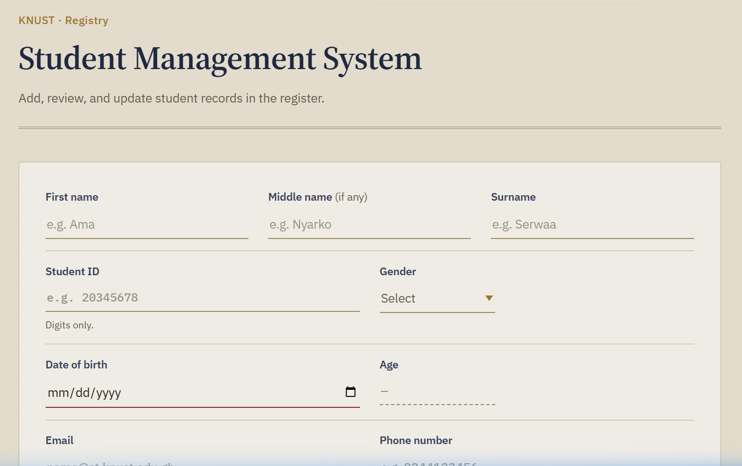
LIVE DEMO
The interface: a digital registry ledger
What to point out
1
Names first, optional middle, surname
2
Student ID digits only, exactly 8
3
Date of birth Age fills in automatically
4
Programme type to search; limits the Level
5
Add to register validates, then saves to the cloud
Student Management System · KNUST Registry
5 / 16
Notes:
[~1 minute 30 seconds, ideally a LIVE DEMO]
This is the real application running on my machine at localhost:3000. The design is inspired by a traditional registry ledger: parchment colours, ruled lines and serif headings.
LIVE DEMO SUGGESTION (about 60 seconds):
1) Type a name. 2) In Student ID, try typing letters: they are rejected automatically. 3) Pick a date of birth and show the Age filling in by itself. 4) Choose 'Doctor Of Pharmacy' and show levels up to 600, then choose 'Bsc Computer Science' and show 500 and 600 become disabled. 5) Click 'Add to register' and show the new row appear, then click Edit and Delete on it.
If the internet or demo fails, use the screenshots in this deck: the next slides show the table with its Edit and Delete buttons.

Slide 6
TECHNOLOGY
The tech stack in plain English
HTML5
CSS3
JavaScript
The skeleton
The clothes
The brain
Defines the structure: inputs, labels, dropdowns, the table area.
The registry look: colours, fonts, CSS Grid layout, mobile-friendly rules.
Handles clicks, validation, age calculation and all database calls.
Node.js
Express 5
Supabase
The engine
The delivery person
The cloud filing cabinet
Lets us run JavaScript on a computer, outside of the browser.
A small web server that hands the page, CSS and JS to the browser.
A hosted PostgreSQL database with an instant REST API.
Student Management System · KNUST Registry
6 / 16
Notes:
[~1 minute]
Here is the technology, with an analogy for each piece.
HTML is the skeleton: it defines what is on the page. CSS is the clothes: it makes it look good. JavaScript is the brain: it reacts to clicks, checks your input and talks to the database.
Node.js lets us run JavaScript outside the browser, on a computer. Express is a tiny web server built on Node: think of it as a delivery person who hands the page to the browser.
Finally Supabase is our database in the cloud. It uses PostgreSQL underneath and gives us a ready-made REST API, so I did not need to write my own backend database code.
I deliberately used plain HTML, CSS and JavaScript with no front-end framework, so every concept is visible and easy to learn.

Slide 7
ARCHITECTURE
How the three parts work together
Express server
Web browser
Supabase (cloud)
server.js · port 3000
index.html · style.css · script.js
PostgREST API + PostgreSQL
Serves index.html
Serves CSS and JavaScript
Never touches the database
1
Shows the form and table
Validates user input
Calls the database directly
2
“students” table
Saves, reads, updates, deletes
Replies in JSON format
1 Getting the page
2 Working with the data
You open http://localhost:3000. The browser asks Express for the page.
Express replies with index.html, then the CSS and JS files it links to.
script.js uses fetch() to send GET, POST, PATCH and DELETE requests to Supabase.
Supabase answers with JSON; the page updates without reloading.
Student Management System · KNUST Registry
7 / 16
Notes:
[~1 minute 30 seconds]
This diagram is the heart of the project. There are three parts.
On the left, the Express server. Its only job is to hand the website files to the browser. Step one: you type localhost:3000, the browser asks Express for the page, and Express sends back index.html, the CSS and the JavaScript.
In the middle, the browser. This is where the application really lives: it shows the form, checks the input, and builds the table.
On the right, Supabase, the cloud database. Step two: once the page has loaded, script.js uses the fetch function to send requests straight to Supabase to read, save, update or delete students, and Supabase replies with JSON.
So the server delivers the app, but the data never passes through it. That keeps the server very small, around twenty lines.

Slide 8
CODE TOUR
Project structure: where everything lives
project tree
server.js
Back end. Starts Express and serves the files.
student-management-system/
├── server.js
├── index.html
├── package.json
├── README.md
├── docs/
│ └── INTERN_ONBOARDING_GUIDE.md
└── public/
├── css/
│ └── style.css
└── js/
└── script.js
index.html
The page structure: header, form, register table.
public/css/style.css
The look and feel: colours, fonts, layout.
public/js/script.js
The brain: validation, age maths, all database calls.
package.json
Lists dependencies and the “npm start” command.
docs/ and README.md
Written guides for new developers.
Student Management System · KNUST Registry
8 / 16
Notes:
[~45 seconds]
Let me quickly orient you in the code. The project is small and easy to navigate.
At the top level we have server.js, which is the back end, index.html, which is the page, and package.json, which lists the dependencies. We only have one: Express.
Everything the browser downloads sits in the public folder: style.css for appearance and script.js for behaviour.
The README and the docs folder hold written guides, including an onboarding guide for new team members.
The next three slides go through server.js, then the HTML and CSS, then script.js.

Slide 9
CODE WALKTHROUGH 1 / 3
server.js: a tiny web server
server.js (simplified)
1
Import and create
require() loads Express. express() creates the app object that handles every request.
const express = require("express");
const path = require("path");
const app = express();
const PORT = process.env.PORT || 3000;
// 1. Let the browser download CSS and JS
app.use("/public",
express.static(path.join(__dirname, "public")));
// 2. Visiting "/" returns the page
app.get("/", (req, res) => {
res.sendFile(path.resolve(__dirname, "index.html"));
});
// 3. Start listening for visitors
app.listen(PORT);
2
Static files
express.static is middleware: if the browser asks for /public/css/style.css, Express finds that file and sends it.
3
A route
app.get("/") says: when someone visits the home page, reply with index.html.
4
Listen
app.listen opens the port. PORT can be changed with an environment variable.
Student Management System · KNUST Registry
9 / 16
Notes:
[~1 minute 15 seconds]
This is the whole server, simplified. It is only about twenty lines of real code.
First we import Express and create an app. The PORT line says: use the PORT environment variable if there is one, otherwise 3000.
Step one is static files. This is something called middleware: a helper that runs when a request comes in. It tells Express that if the browser asks for something inside the public folder, like our CSS or JavaScript, just send that file.
Step two is a route. When someone visits the home page, a slash, we reply with index.html.
Step three, app.listen, starts the server so it can accept visitors.
A lesson I learned here: the HTML asks for /public/css/style.css, so the server has to expose the folder under the /public path, otherwise the browser gets a 404 and the page shows without styling.

Slide 10
CODE WALKTHROUGH 2 / 3
index.html and style.css: structure and style
index.html: the structure
style.css: the “Registry” theme
Semantic tags: <header>, <form>, <section> instead of anonymous <div>s
Right input types: email, date, tel, plus required for must-fill fields
inputmode="numeric" shows a number keypad on phones
<datalist> gives a searchable Programme dropdown
Age is readonly: JavaScript calculates it, the user cannot type it
Table rows are empty in the HTML; script.js fills them in
--ink
--paper
--brass
--teal
--danger
CSS variables in :root: change one colour, update the whole app
CSS Grid lays out each table row in 10 neat columns
Fonts: Source Serif 4 for headings, IBM Plex for text and IDs
A @media (max-width: 640px) rule makes it phone-friendly
Respects “reduced motion” for accessibility
Student Management System · KNUST Registry
10 / 16
Notes:
[~1 minute]
Now the page itself. In index.html I used semantic tags like header, form and section, which makes the page easier to understand, and better for accessibility and screen readers.
I also picked the right input types: email, date and tel. The browser then helps for free: a date picker, a number keypad on phones, and basic checks. The Age field is read-only because JavaScript fills it in; the user cannot type into it. The Programme field uses a datalist, which gives a searchable dropdown without any library.
The table rows are not in the HTML at all. script.js creates them from the database data.
For the styling, I defined the colour palette once as CSS variables in the root, so a theme change is a one-line edit. The table uses CSS Grid to align ten columns, and a media query makes the form stack nicely on small screens.

Slide 11
CODE WALKTHROUGH 3 / 3
script.js: talking to the database
HTTP method | Function | What it does | URL ending
GET | fetchSupabaseData() | Read all students | ?select=*&order=student_id.asc
POST | insertStudentData() | Create a student | (none)
PATCH | updateStudentData() | Update one student | ?student_id=eq.<id>
DELETE | deleteStudentData() | Delete one student | ?student_id=eq.<id>
async function fetchSupabaseData() {
const response = await fetch(
`${BASE_URL}?select=*&order=student_id.asc`,
{ method: "GET", headers }
);
if (!response.ok) throw new Error(...);
return await response.json();
}
async / await: wait for the network without freezing the page.
headers: API key + JSON content type sent with every request.
Prefer: return=representation makes Supabase send back the saved row.
try / catch: any error becomes a friendly status message.
Student Management System · KNUST Registry
11 / 16
Notes:
[~1 minute 30 seconds]
Now the most important file, script.js. At the top are four small functions, one for each database operation. This table is the cheat sheet.
GET reads all students. POST creates one. PATCH updates one. DELETE removes one. For PATCH and DELETE we tell Supabase which student with a filter at the end of the URL: student_id equals the ID. That is what eq dot means.
Look at the code example on the left. The function is marked async and uses the await keyword in front of fetch. That means 'send the request and wait for the answer, but do not freeze the page while waiting'. If the server replies with an error, we throw an error, and further up the code catches it and shows a message to the user.
On the right: every request carries headers containing the API key. And I ask Supabase to return the saved row, so the table can be updated immediately with exactly what is stored.

Slide 12
SMART BEHAVIOUR
Validation rules: catching mistakes early
✓
Student ID Digits only, exactly 8. Letters are stripped as you type.
Programme length sets max level
4 years
max 400 Computer Science, IT, Engineering, Maths, Stats, Physics, Biochemistry, Nursing, LLB
✓
Duplicate check An ID that is already registered is rejected.
5 years
max 500 Architecture
✓
Phone number Digits only, maximum 10.
6 years
max 600 Pharm D, MB ChB
✓
Date of birth Cannot be in the future. Age is calculated automatically.
✓
Level vs programme Levels above the degree length are disabled.
// Age: subtract a year if the
// birthday has not happened yet
let years = now.year - dob.year;
if (monthDiff < 0 || (monthDiff === 0
&& today.date < dob.date)) years--;
✓
Required + email Browser checks empty fields and email format.
Student Management System · KNUST Registry
12 / 16
Notes:
[~1 minute]
One of my main goals was to stop mistakes before they reach the database, so I built several rules.
The Student ID accepts digits only and must be exactly eight. If you type a letter, it is removed immediately. The app also keeps a list of IDs that are already registered, and rejects duplicates. The phone number is digits only, maximum ten. The date of birth cannot be in the future, and the age is calculated automatically.
My favourite rule links the programme and the level. Each programme has a duration in years: most are four, Architecture is five, and Pharmacy and Medicine are six. The maximum level is the number of years times one hundred. So if you choose Computer Science, the 500 and 600 options are disabled.
The age calculation is shown bottom right: take this year minus the birth year, then subtract one if the birthday has not happened yet this year.
Honest note: these checks run in the browser, and I come back to that in the lessons.

Slide 13
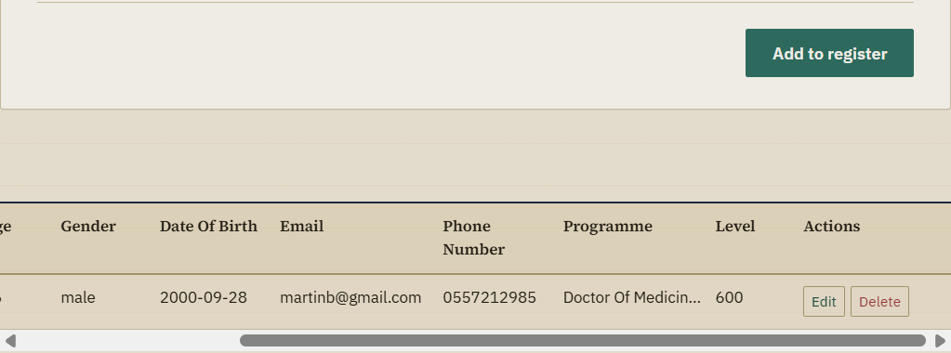
UNDER THE HOOD
How “Edit” works: one variable decides everything
1
Click Edit
2
Edit mode on
3
Submit
4
Save change
5
Update table
The student's data is copied into the form.
editingStudentId is set. Button says “Update student”.
Validation runs, with a duplicate-ID exception for this student.
A PATCH request updates the row where student_id = the original ID.
Old row removed, updated row added, form reset.
let editingStudentId = null;
// null -> we are ADDING
// "21850024" -> we are EDITING
if (editingStudentId !== null) {
await updateStudentData(...); // PATCH
} else {
await insertStudentData(...); // POST
}
Student Management System · KNUST Registry
13 / 16
Notes:
[~1 minute]
This slide shows a design idea I am proud of. The same form is used both for adding and for editing, and one variable decides which one is happening: editingStudentId.
When you click Edit, the student's details are copied into the form, editingStudentId is set to that student's ID, and the button text changes to 'Update student'. When you submit, the code checks that variable: if it is not null, we send a PATCH request to update; if it is null, we send a POST request to create.
The duplicate-ID check has one exception: the student you are editing is allowed to keep their own ID.
After saving, the old row is removed from the table and the updated one is added. To find rows quickly, I store every table row in a JavaScript Map keyed by student ID, so updating or deleting does not need to search the whole table.
The screenshot shows the Edit and Delete buttons at the end of each row.

Slide 14
REFLECTION
Challenges and lessons learned
File paths must match
The HTML links /public/css/style.css, so the server must serve the folder under /public. A mismatch gives a silent 404 and an unstyled page.
1
Asynchronous code is tricky
Network calls take time. async/await with try/catch/finally keeps the page responsive and shows clear error messages.
2
Keep screen and database in sync
After every save or delete I update a local ID list and a row Map, so the table always matches the database without reloading.
3
Browser validation is not security
A user can bypass JavaScript checks. Real protection needs database rules (unique constraints, Row Level Security).
4
Public keys need care
The Supabase “anon” key is designed to be public, but only safe when Row Level Security policies are enabled. Never expose a service_role key.
5
Student Management System · KNUST Registry
14 / 16
Notes:
[~1 minute 15 seconds]
Here are the main things I learned.
One: file paths must match. My page asked for /public/css/style.css but the server only exposed the public folder at the root, so the CSS returned a 404 error. A good reminder to check the Network tab in the browser's developer tools.
Two: asynchronous code takes practice. Using async and await with try, catch and finally keeps the app responsive and lets me show helpful error messages.
Three: keeping the screen and the database in sync. After every save or delete I update a list of IDs and the row Map.
Four and five are about security, and they are the most important. Browser validation helps users but does not protect data, because anyone can bypass it. Real protection must also exist in the database. And the anon key in the code is designed to be public, but it is only safe if Row Level Security is turned on in Supabase.

Slide 15
NEXT STEPS
Future improvements
Quick wins
Medium term
Long term
Search and filter bar above the table
“Clear form” button
Export the register to CSV
Friendly toast messages instead of pop-ups
Pagination and column sorting
Automated tests for validation logic
Move settings into an environment file
Database constraints: unique student_id
Staff login with Supabase Auth
Row Level Security policies per role
Programmes loaded from the database
Deploy online (Render, Netlify or Vercel)
Starter challenges with step-by-step hints are in docs/INTERN_ONBOARDING_GUIDE.md
Student Management System · KNUST Registry
15 / 16
Notes:
[~1 minute]
If I continued the project, I would work in three steps.
Quick wins: a search bar to filter the table, a clear-form button, export to CSV, and nicer notifications instead of browser pop-ups.
Medium term: pagination and sorting for large registers, automated tests for the validation logic, moving settings into an environment file, and adding a unique constraint on student ID in the database.
Long term: a staff login with Supabase Auth, with Row Level Security policies, loading the programmes from the database instead of hard-coding them, and deploying the app online.
The onboarding guide in the docs folder has step-by-step hints for the first three quick wins, so future interns can practise on this project.

Slide 16
Thank you
run it locally
# 1. Get the code
git clone https://github.com/acheampongmaamary/
student-management-system.git
cd student-management-system
# 2. Install dependencies (Express)
npm install
# 3. Start the server
npm start
# 4. Open in your browser
http://localhost:3000
Questions?
Try it yourself in four commands. Every file is commented for beginners.
GitHub repository
github.com/acheampongmaamary/
student-management-system
Requires Node.js (nodejs.org). Press Ctrl + C in the terminal to stop the server.
Notes:
[~15 seconds, then Q&A]
That is the Student Management System. To try it yourself, clone the repository, run npm install, then npm start, and open localhost:3000. Thank you for listening. I'm happy to take questions.
LIKELY QUESTIONS AND SHORT ANSWERS
- Why not use a framework like React? To keep the code simple and learn the fundamentals of HTML, CSS and JavaScript first.
- Is the API key a security risk? The anon key is meant to be public; the real protection is Row Level Security policies in Supabase, which I would tighten, together with staff login.
- Why does the server not talk to the database? Supabase offers a REST API the browser can call directly, so the Express server only needs to deliver the files.
- What happens if two people use the app at once? Each action goes to the database, so data is shared. A unique constraint on student_id in the database would stop duplicate IDs even if two people add the same one at the same time.
- Why is the Supabase script included in index.html if you use fetch? It is loaded from a CDN but the project calls the REST API with fetch directly, so it could be removed or used later.
- How is age calculated? Current year minus birth year, minus one if the birthday has not happened yet this year.

