Slide 1
Advanced Topic
Feature Modules
Dynamic Component
Standalone Component
App Deployment
App Performance Improvement(AOT,JIT)
NgRX
Accessibility
Unit Test
Internationalization

Slide 2
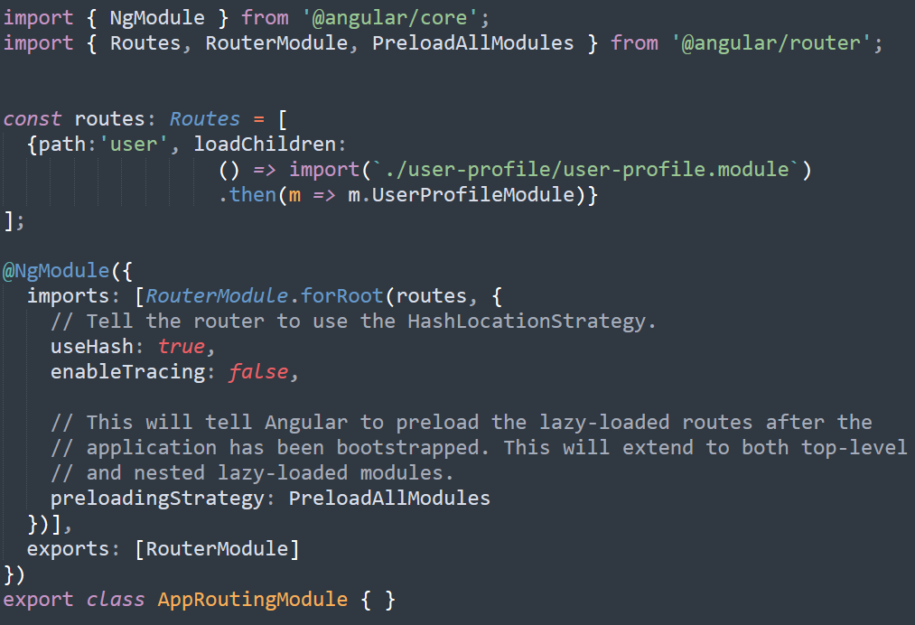
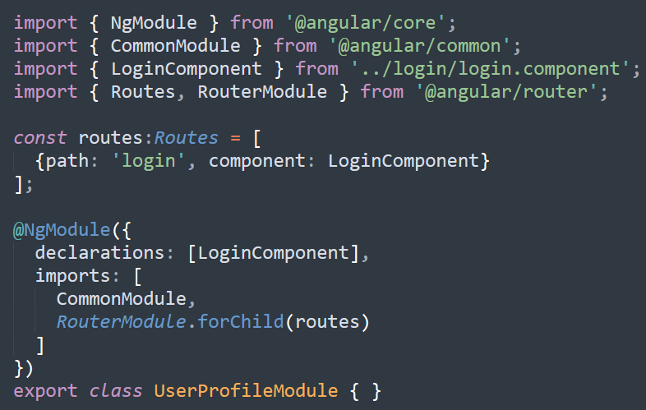
Feature Module
Code Organization: Put a specific feature code into one module – just like package in java.
Performance: Can lazy load feature module or load in background
ng generate module user-profile
ng generate component user-profile/Login

Slide 3
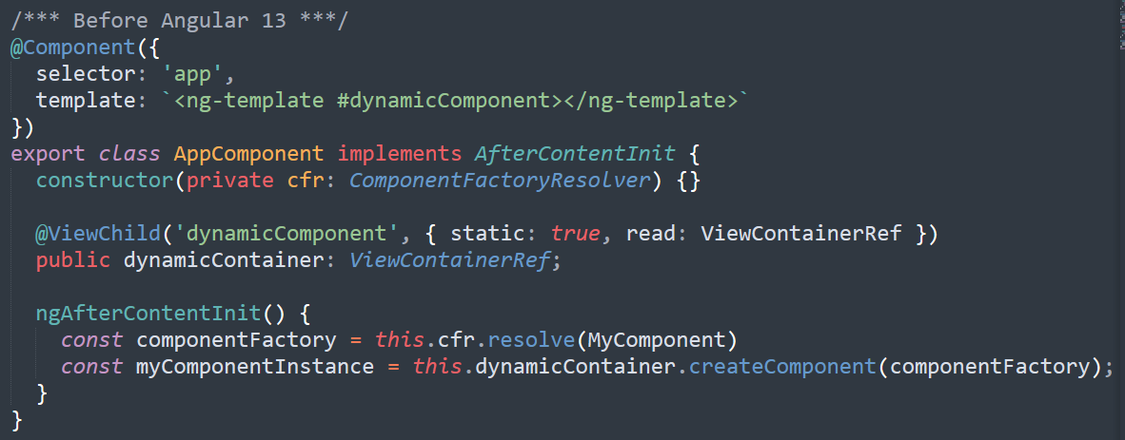
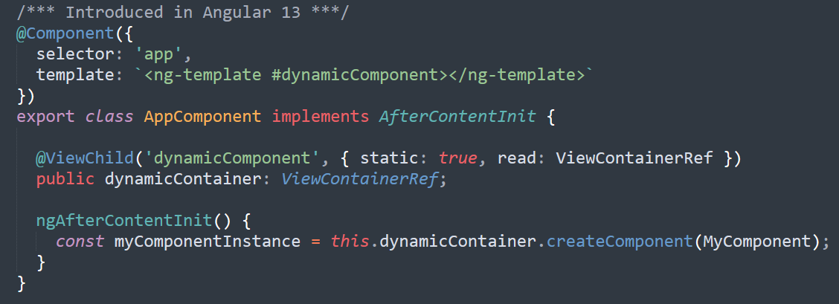
Dynamic Component
To dynamically load a component at runtime.
Notes:
Subject makes sure the observers will receive identical data
Pull vs Push system

Slide 4
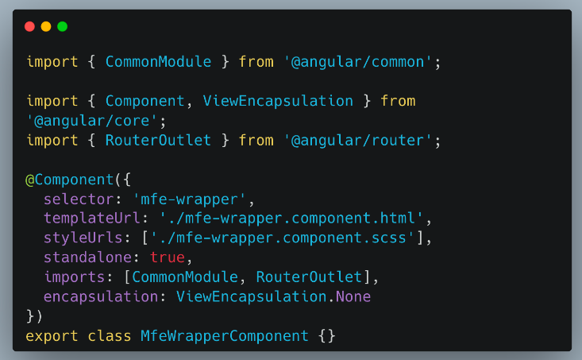
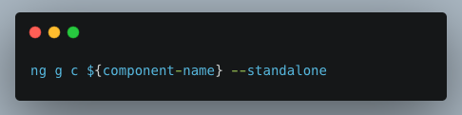
Standalone Component
A independent component that does not need to be in a module.
Prevent loading un-related components within same module.
Notes:
Subject makes sure the observers will receive identical data
Pull vs Push system

Slide 5
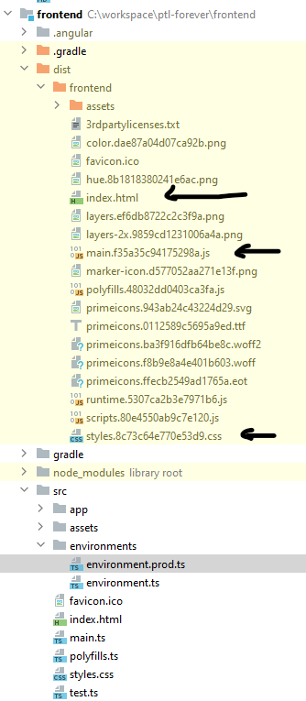
Angular Deployment
ng build (--prod)
/dist folder

Slide 6
Performance
Use trackBy in ngFor loop
Use lazy loading for modules
For multiple options, use ngSwitch instead of ngIf
Use onPush change detection strategy to only check for changes when input changes
Use immutable data structures if possible
Use AOT compilation instead of JIT compilation
RxJS can cache some data in memory
Use NgRx to manage the state.

Slide 7
NgRx

