Slide 1
RxJS & HTTP

Slide 2
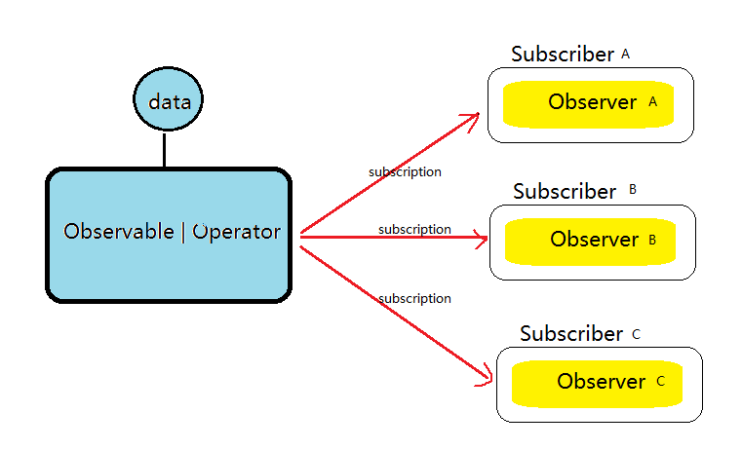
RxJs: Observable system
Main Components
Observable
Subscription
Observer
Operator
Subject
Notes:
Subject makes sure the observers will receive identical data
Pull vs Push system

Slide 3
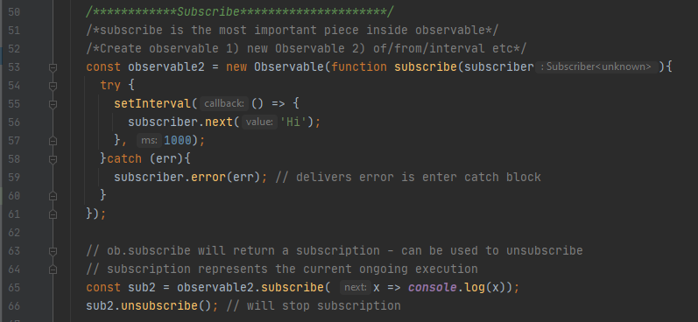
RxJs: Observable
Create -> subscribe -> executing -> cancel
Create
Subscribe and executing
cancel

Slide 4
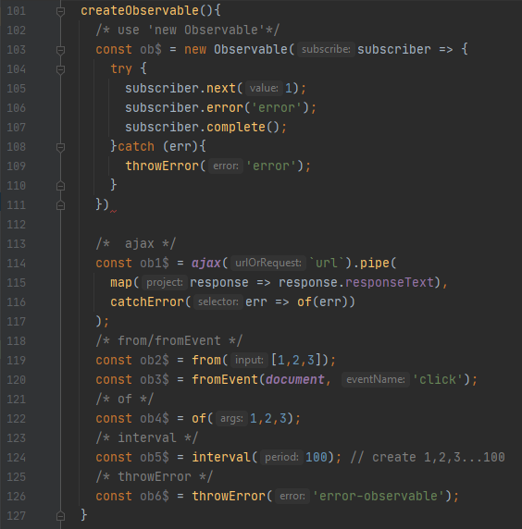
RxJs: Operator (create or transform observable)
Creation Operator
Ajax/(*HttpClient)
From/fromEvent
Of
Interval
throwError

Slide 5
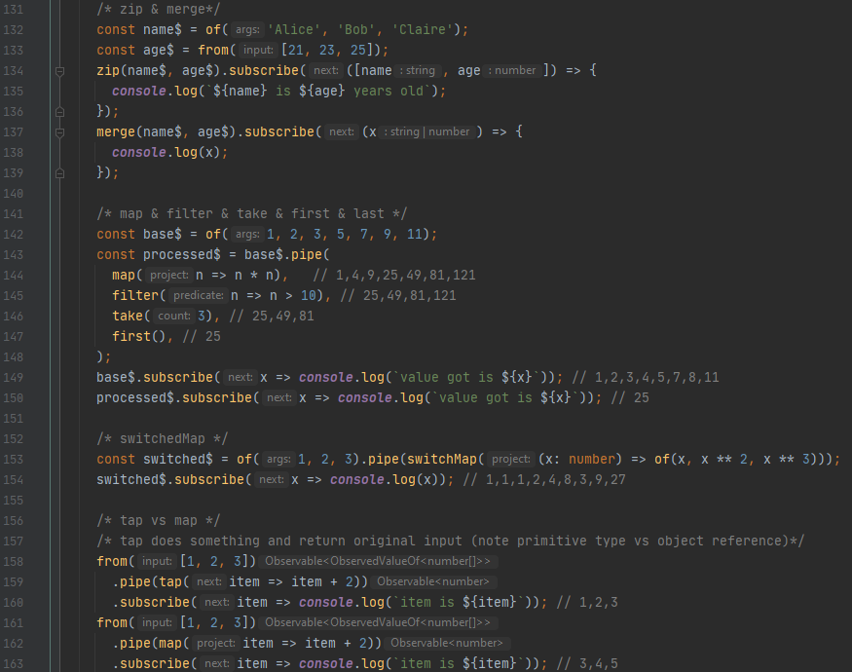
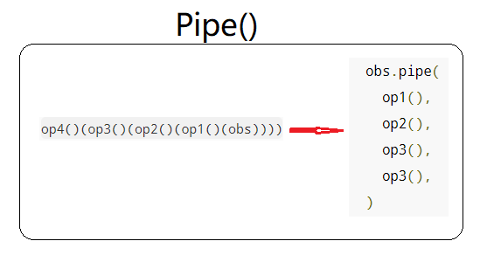
RxJs: Operator (create or transform observable)
Pipeable Operator(transform to another observable)
Zip / merge
Map/switchMap
Debounce/filter/take/first/last
catchError/retry
Tap/delay/reduce
Pipe Chain
Operator Chain (Pipe)

Slide 6
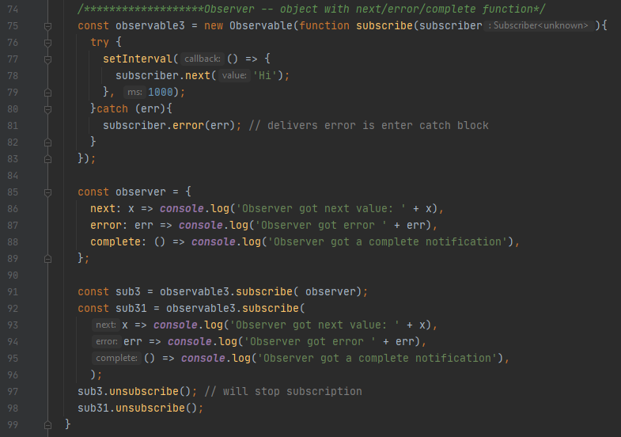
RxJs: Observer & Subscription
Observer
Object with 3 callbacks
to consume data from observable
next*(error|complete)
Subscription
Object represents the execution of observable
Call ‘unsubscribe’ to cancel execution

Slide 7
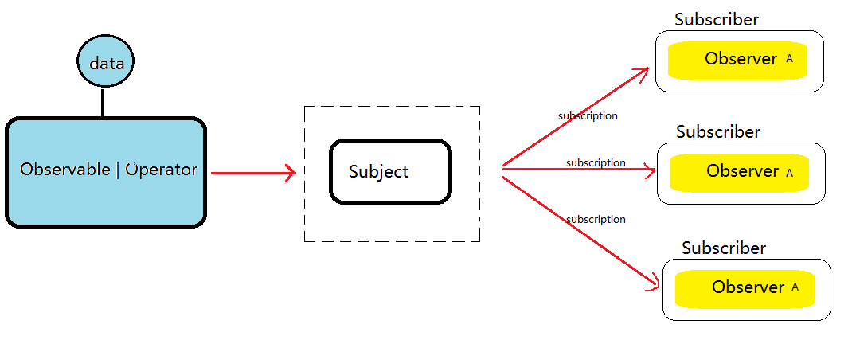
RxJs: Subject
Unicast vs Multicast
Subject can work as observable and observer

Slide 8
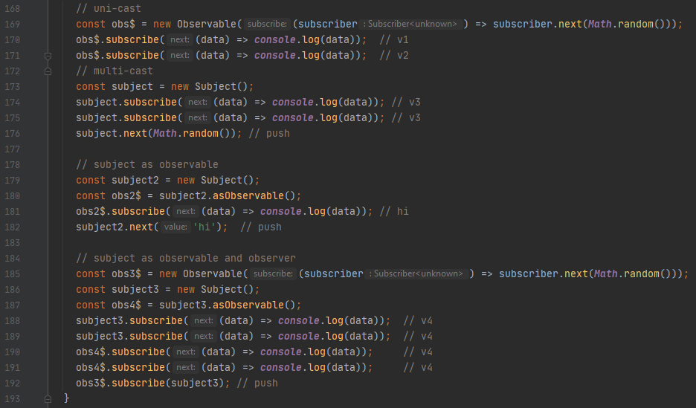
RxJs: Subject
Example

Slide 9
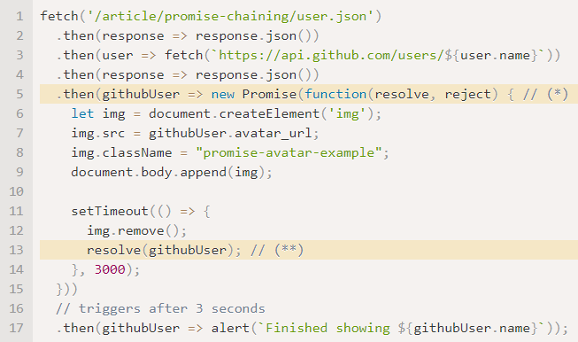
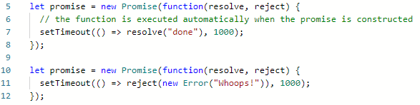
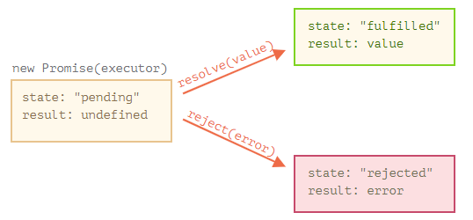
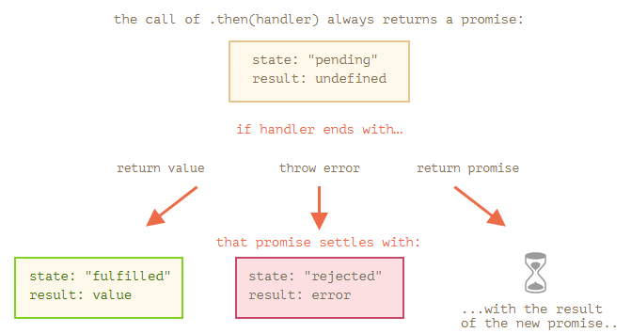
Promise
Promise Chain
Asynchronous Push
Notes:
Promise: A special javascript object links ‘producing code’ with ‘consuming code’

Slide 10
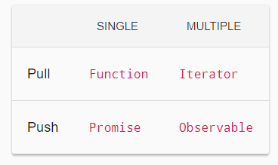
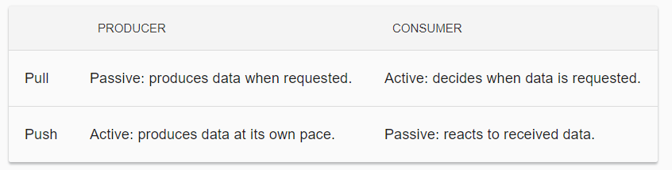
Observable vs Promise
Observable is lazy push system, Promise is eager push
(observable need subscribe, promise trigger on definition)
Observable provide many values, Promises provide one value
(observable keep emit new values until complete/error, promise return just one result)
Observable chaining use pipe (transform observable to new one) and it is separate from subscribe. Promise only has .then() function to handle chain. It is also the subscribe system.
Observable can cancel by unsubscribe, Promise is not cancellabe

Slide 11
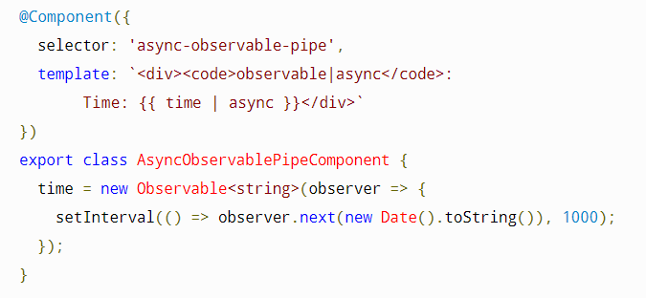
Observable in Angular
@Output() value = new EventEmitter<any>() --- EventEmitter extends RxJs subject
HttpClient.get/put/post/delete
Async Pipe
Router and ActivatedRoute
(discussed in routing)
FormControl property in Reactive Forms
Notes:
HttpClient and Router/ActiviatedRoute are explicit using
@Output(), Async and FormControl are mostly just implicit using.

Slide 12
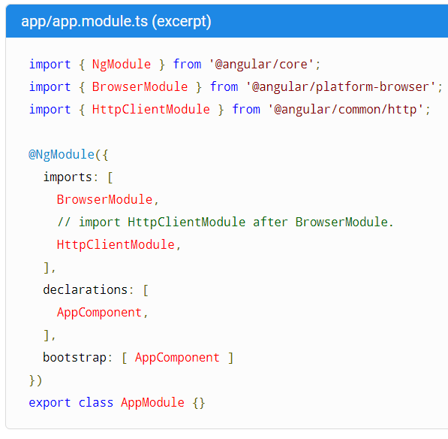
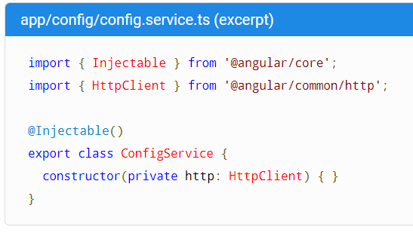
HttpClient
Import HttpClientModule
Inject into constructor of any class

Slide 13
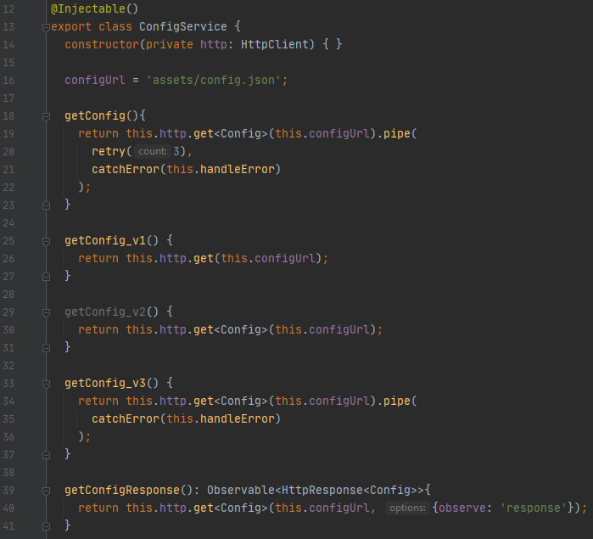
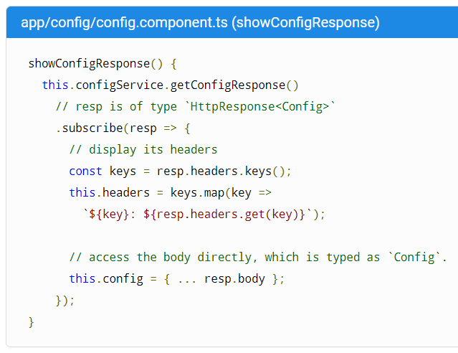

HttpClient: GET
GET
Remember: Always Subscribe
Notes:
Always subscribe, otherwise, the HttpClient will not be triggered

Slide 14
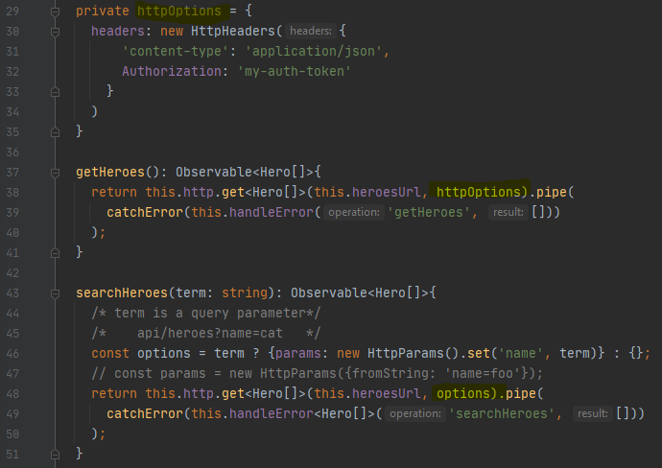
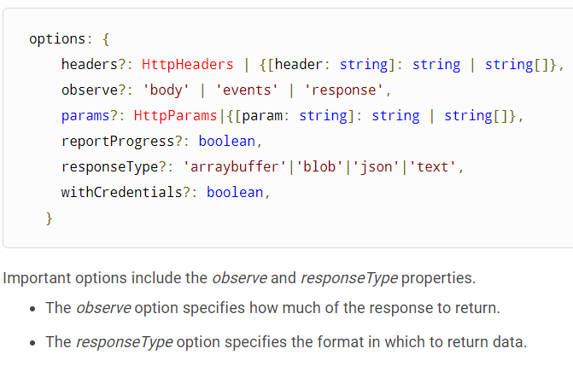
HttpClient: Request Options
Set Header parameters (HttpHeaders)
Set Query parameters (HttpParams)

Slide 15
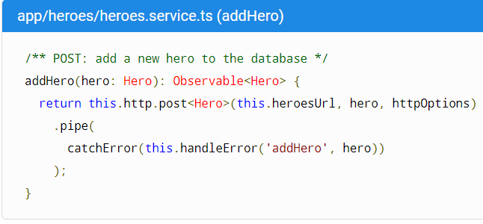
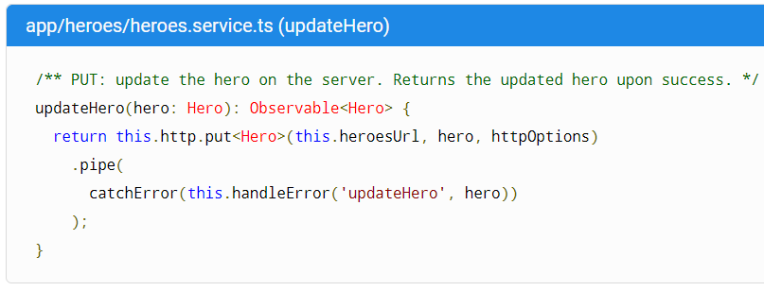
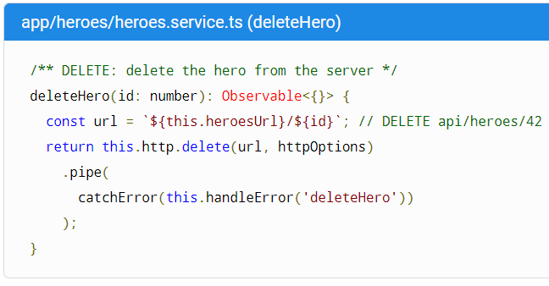
HttpClient: POST/PUT/DELETE
Add the request body as second parameter
Notes:
Always subscribe, otherwise, the HttpClient will not be triggered

Slide 16
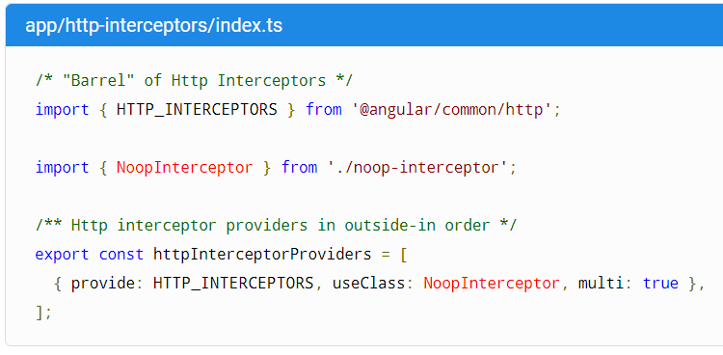
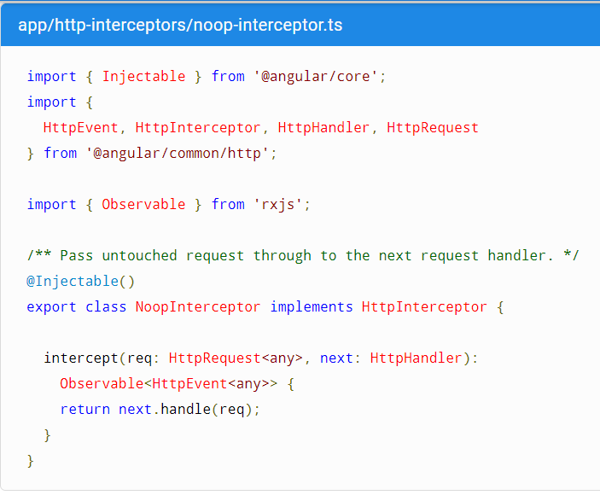
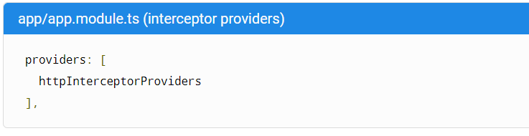
HttpClient: Interceptor
Interceptor inspect and transform HTTP requests and responses
1) Design interceptor by implementing “HttpInterceptor”
2) Inject interceptor to module.ts “Providers” array
The “next” object refers to the next interceptor in the chain
Notes:
Always subscribe, otherwise, the HttpClient will not be triggered

Slide 17
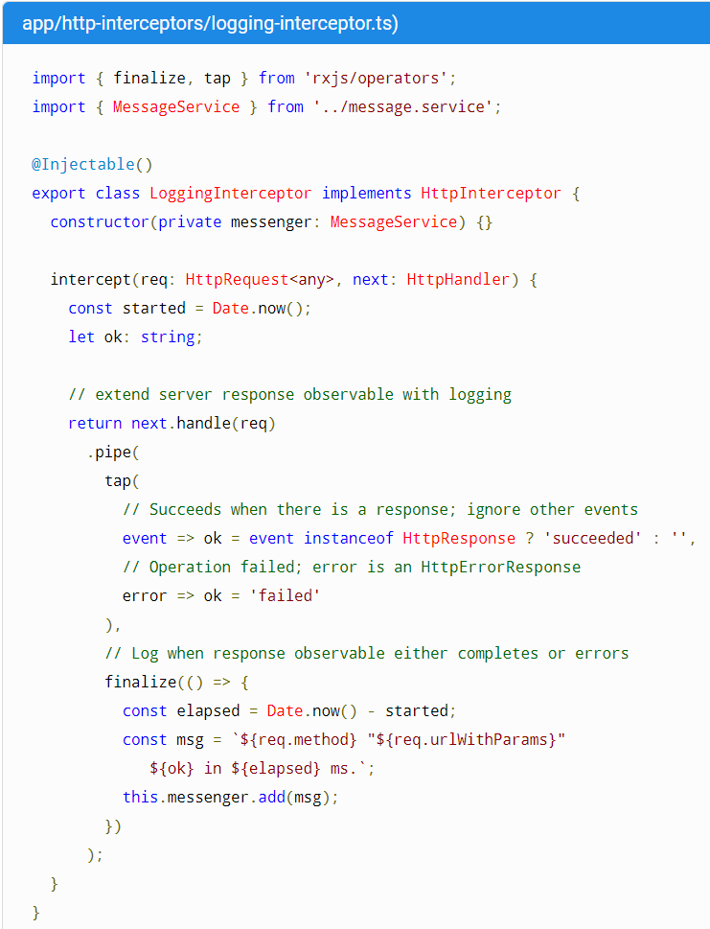
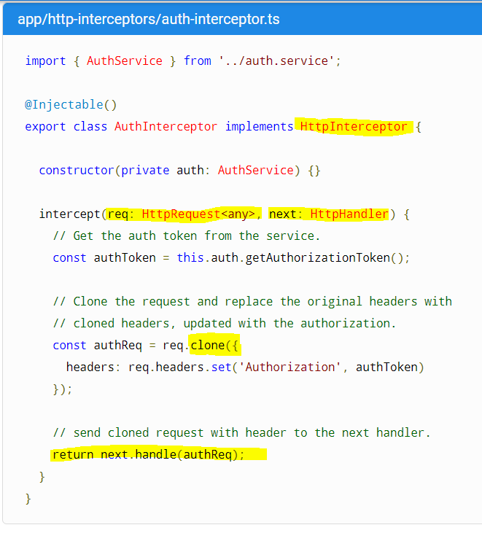
HttpClient: Interceptor
Notes:
Implement the HttpInterceptor interface and intercept(req, next) method
Next object -- refer to next interceptor in the interceptor chain
DO NOT modify req directly. Instead clone a new copy – req is supposed to be readonly

