Slide 1
Angular Basics

Slide 2
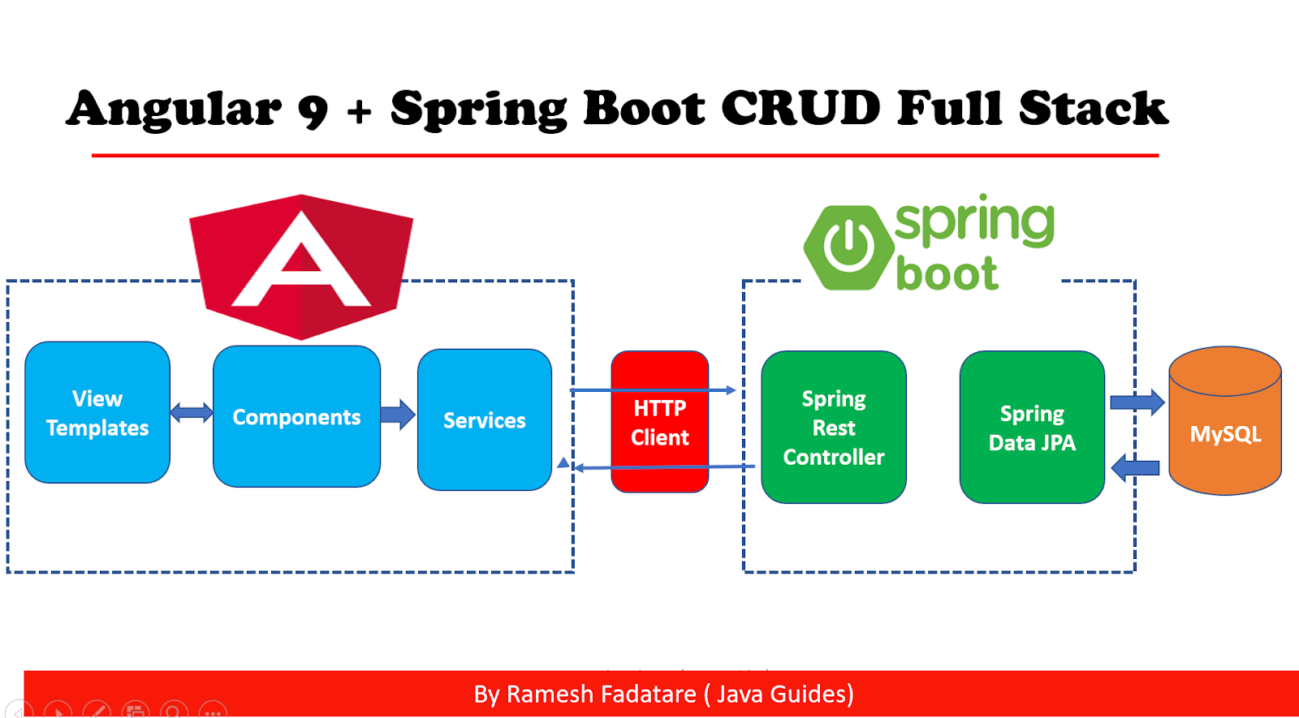
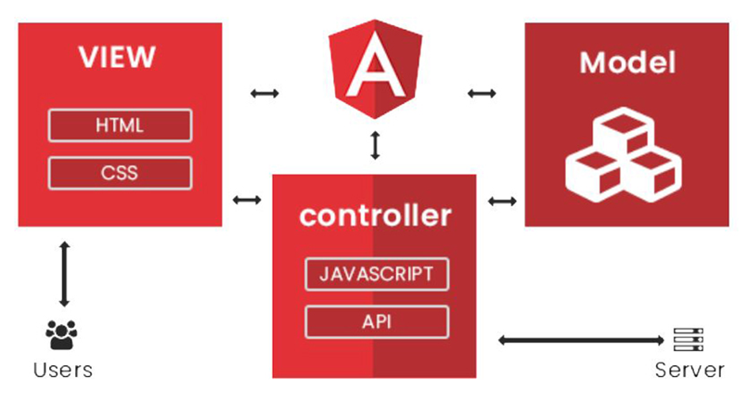
Where is Angular?

Slide 3
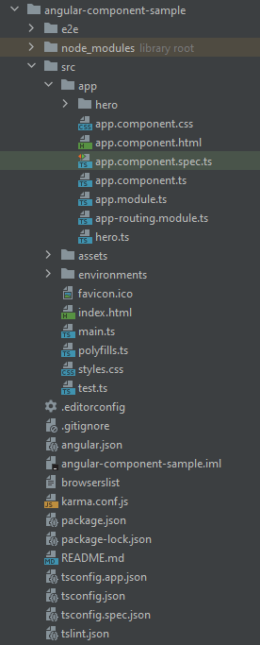
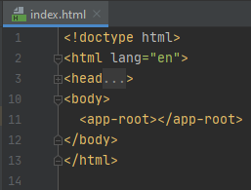
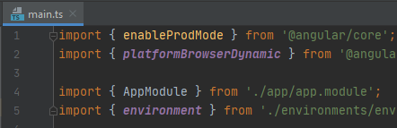
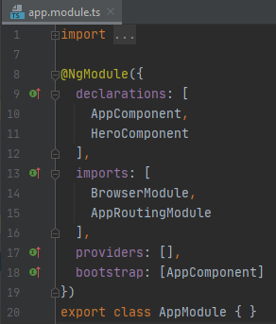
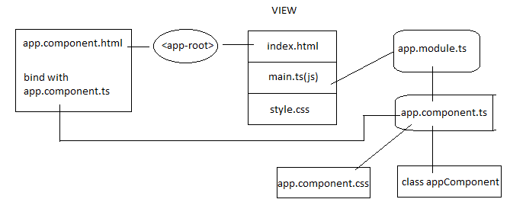
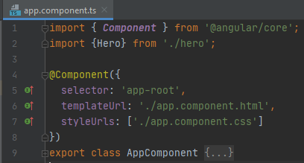
Code Structure
Main.ts – app.module.ts – app.component.ts – class AppComponent
Index.html – app.component.html – other sub htmls
AppComponent (app.component.ts, app.component.html, app.component.css)
App-routing.module.ts
Angular.json, package.json, tsconfig.json

Slide 4
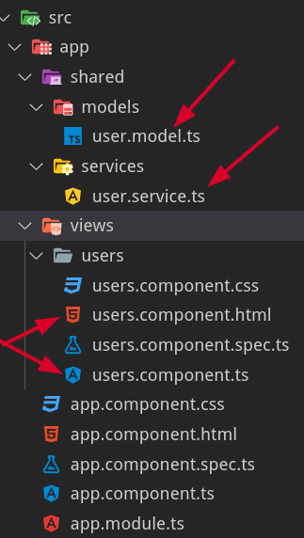
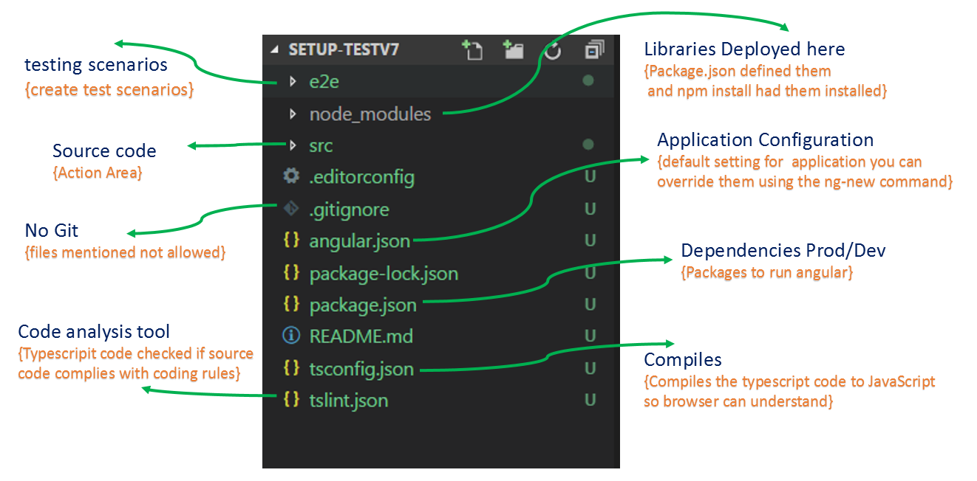
Code Structure - MVC
Notes:
Ng g class test –type=model

Slide 5
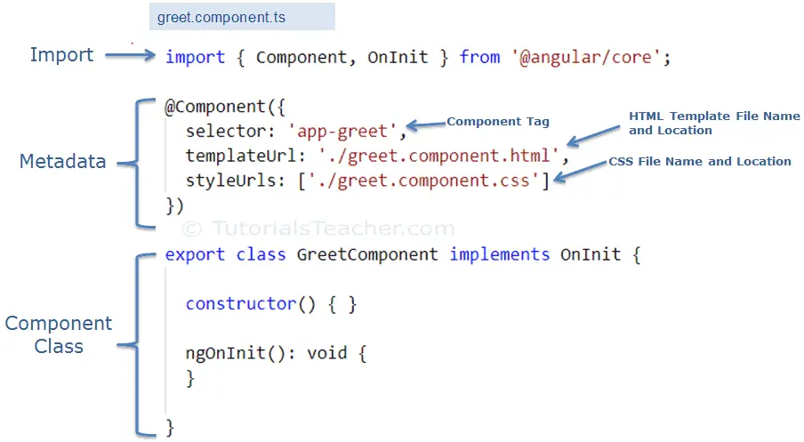
Components
Create a new Component
@Component
Selector/Template/Style
String interpolation
Data binding – (property vs events vs 2 way)
ngModel

Slide 6
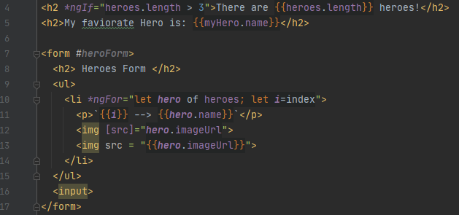
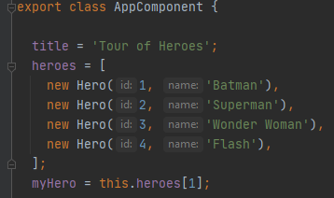
*ngFor, *ngIf
{{}} interprets data from component class to template
*ngFor – directive for iteration (let item of items)
*ngIf – directive for condition
Notes:
ngIf vs [class.hidden]/ngHide

Slide 7
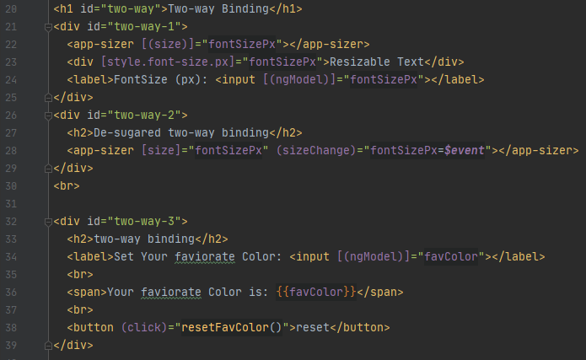
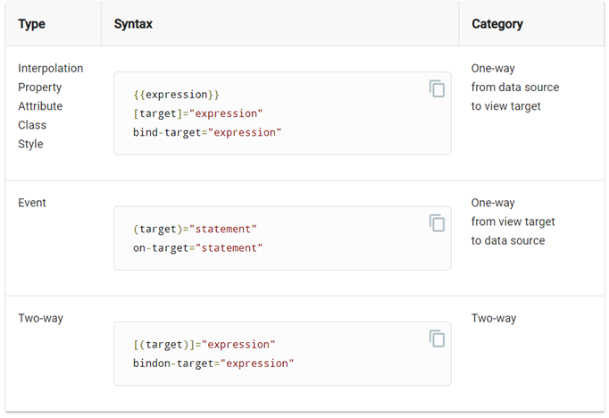
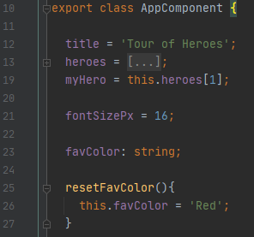
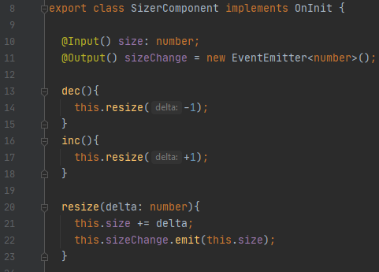
Two-Way binding
App.component.html
App.component.ts
Sizer.component.ts
Notes:
[()] – must have both @Input() and @Output() in the directive
You must import “FormsModule” in your AppModule in order to use [(ngModel)]

Slide 8
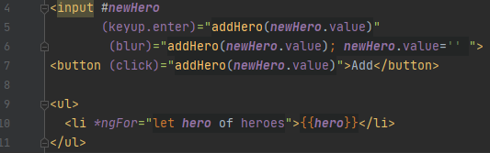
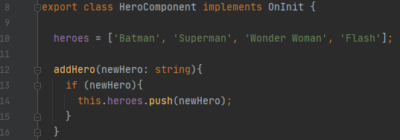
User input event

Slide 9
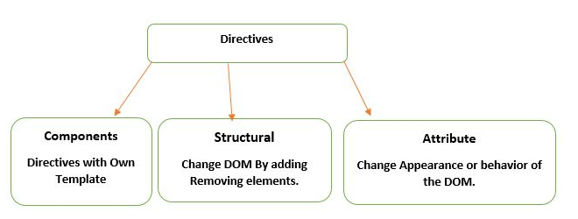
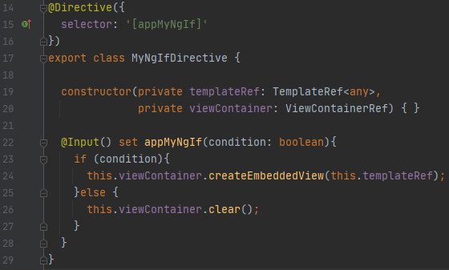
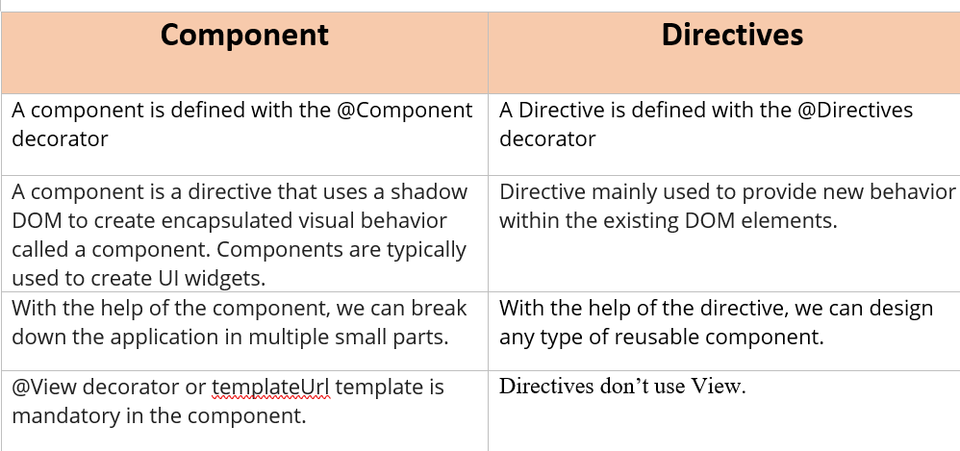
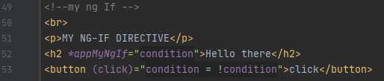
Directives
Structure Directive change the structure of view (like NgFor and NgIf)
Notes:
When structure directive is not hooked to html semantics, we can use <ng-container>
TemplateRef<any>
ViewContainerRef
@Input() set ‘selector-name’

Slide 10
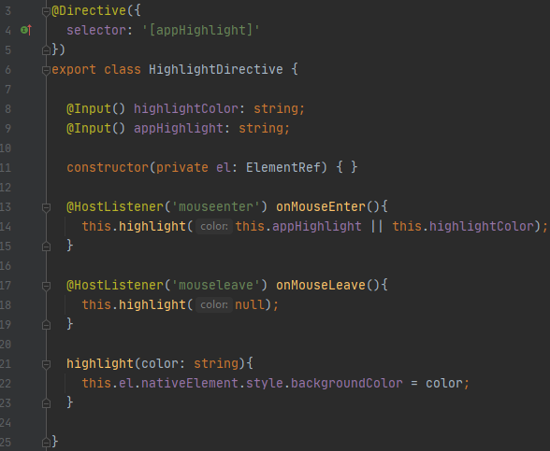
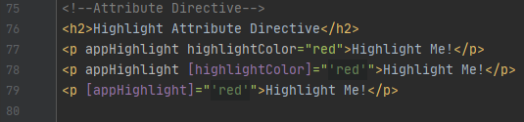
Directives
Attribute Directive use as attributes of elements (like NgStyle)
Notes:
No asterisk (*)
ElementRef – this DOM element this directive is added to
@HostListener – listen to user event performed on this DOM element
@Input() takes the input ‘expression’ --- line 78 – has to be expression
@HostBinding(‘class.open’) isClassOpen = true; --------- @hostbinding bind to a property, @HostListener listens to an event
Renderer
constructor(private render: Renderer2)
this.renderer.removeClass(button, ‘open’) ---- not angular relied, it worked on its own.

Slide 11
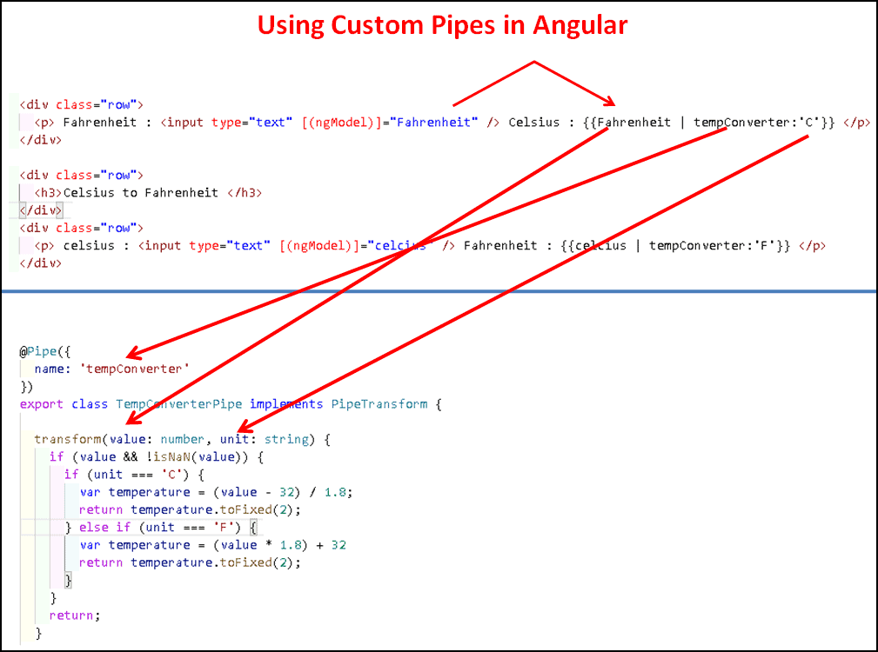
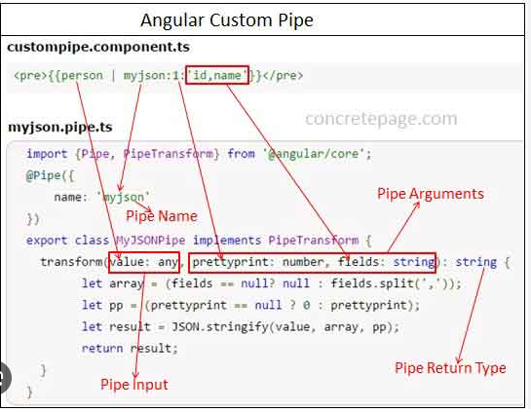
Pipe

Slide 12
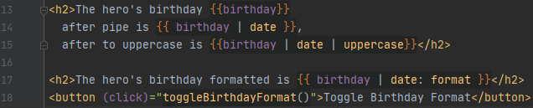
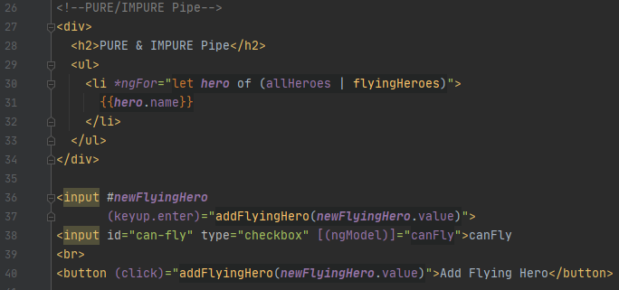
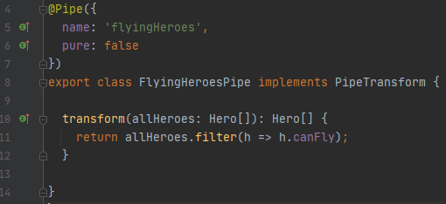
Pipes
Common Pipes
DatePipe,
UpperCasePipe, LowerCasePiple,
CurrencyPipe,
DecimalPipe,
PercentPipe,
Async
Pipe Chain
Create your own Pipe
Pure | Impure Pipe
Notes:
Line 15- pipe chain
Line 4 – self defined pipe -- @Pipe, implements PipeTransform, override transform function
Line 6 – Pure and Impure pipe
Pure pipe is executed when input value changes, Impure pipe is executed on every change detection cycle.

Slide 13
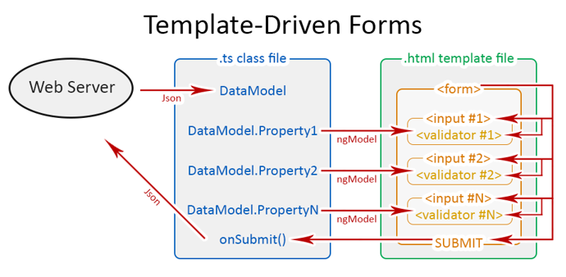
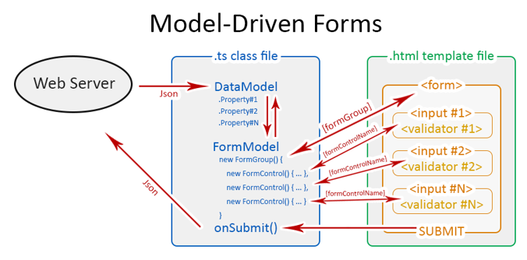
Forms
1 Template-Driven form
2. Reactive Form
3. Form Validations
4. Double submission
5. Reset
6. Error handling
7. Async Validator
8. Custom Validator

Slide 14
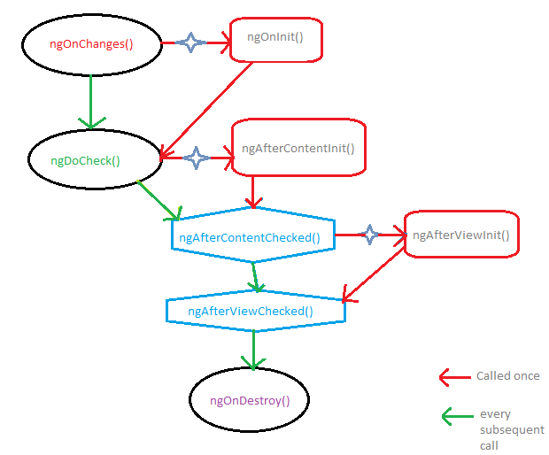
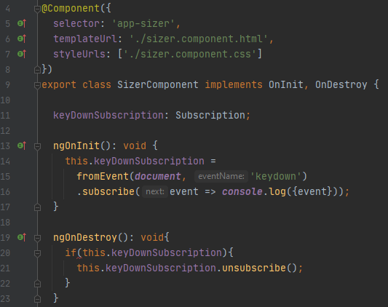
Component LifeCycle
ngOnInit
ngOnDestroy

Slide 15
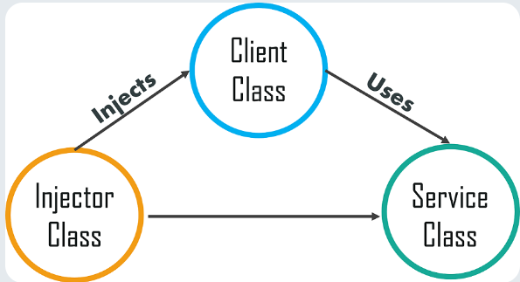
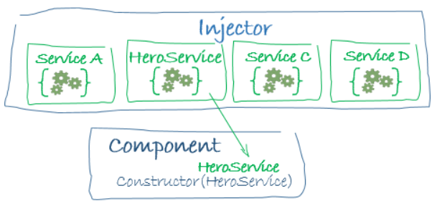
Dependency Injection
Why: to take the common service logics out as independent. If other components or directives need, just inject – loose coupling the logic.
(DI service does not carry data in general)

Slide 16

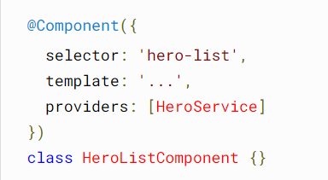
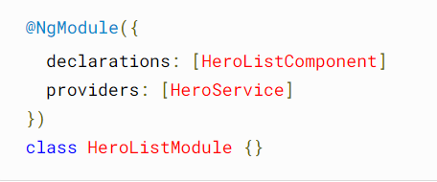
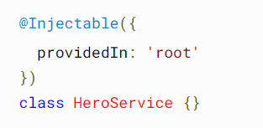
Dependency Injection - Injectable
Component level, Module Level, Application Level

Slide 17
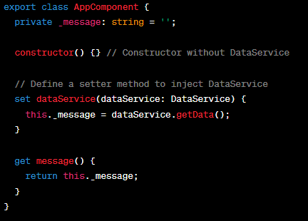
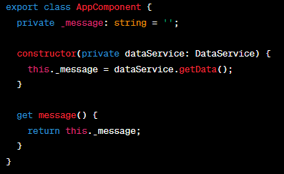
Dependency Injection – Constructor, Setter based

Slide 18
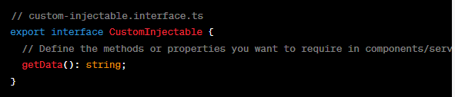
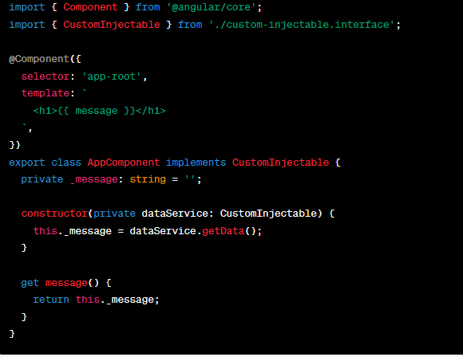
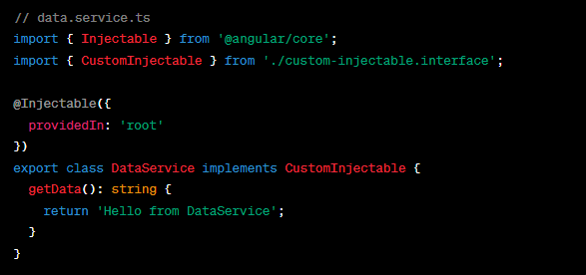
Dependency Injection – Interface Injection

Slide 19
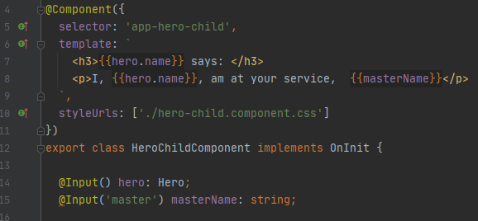
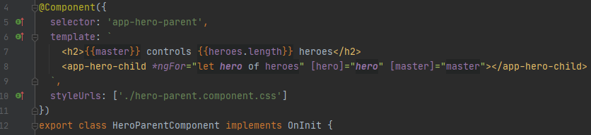
Component Communication
child
Parent send data to child
Use @Input() inside child
parent

Slide 20
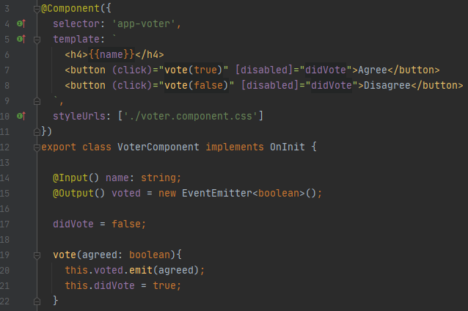
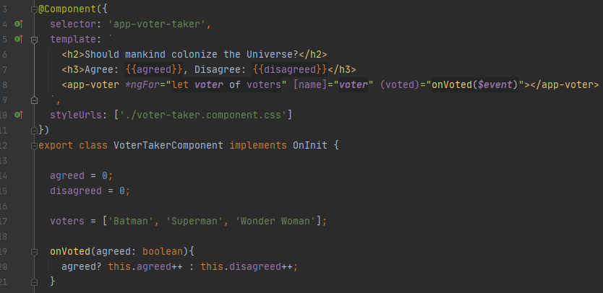
Component Communication
child
Child send data to parent
Use @Output() = EventEmitter
inside child

Slide 21
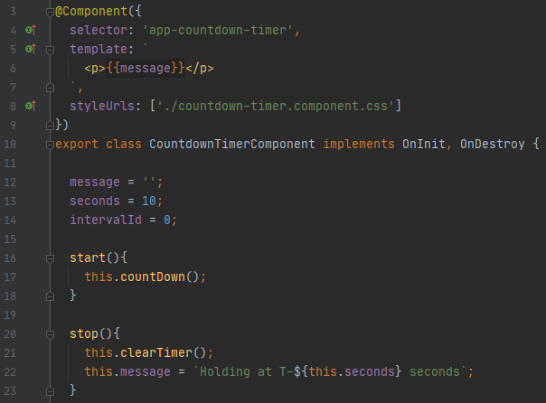
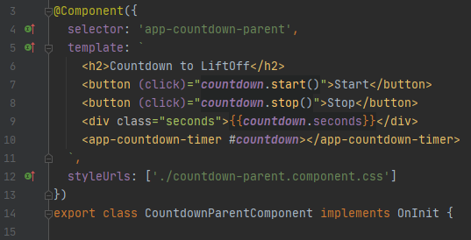
Component Communication
Parent’s template access child’s properties/methods
Assign local variable to child anchor
child

Slide 22

Component Communication
Parent’s component access child’s properties/methods
Via @ViewChild() inside parent component
child
Notes:
@ViewChild(“element”)
@ViewChildren(“elementGroup”)
@ContentChild(“content”)
@ContentChildren(“contentChildren”)

Slide 23

Component Communication
Parent and Child components call talk to each other (bi-directional)
Via Service (Subscription and Observable) inside parent component
Notes:
https://angular.io/guide/component-interaction#parent-and-children-communicate-via-a-service

