Slide 1
Angular Routing

Slide 2
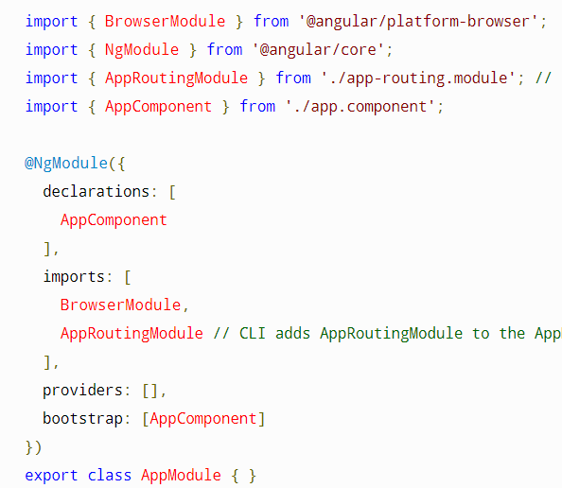
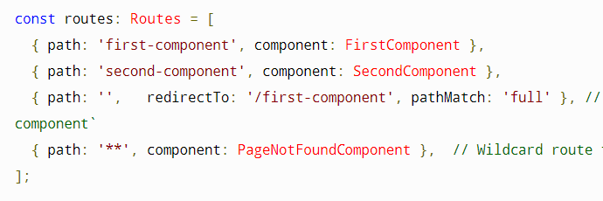
Basic Routing: routes
Import Routing module into main module
Define constant route array
Routing order: find first match
RedirectTo
In HTML: <a routerLink="/first-component“>

Slide 3
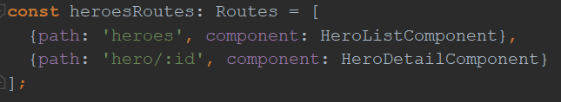
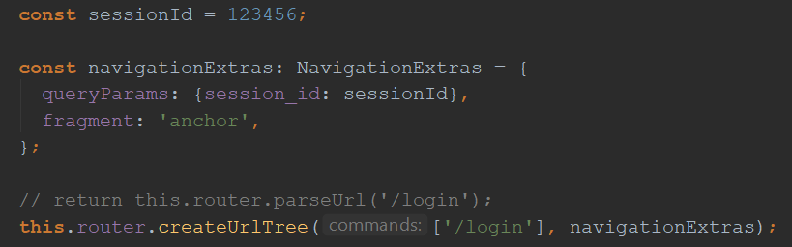

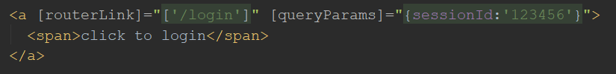
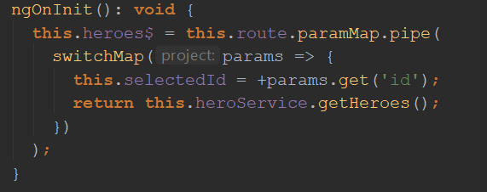
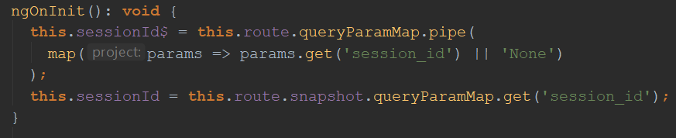
Basic Routing: Variables
Path Variable -- :id
Query Parameter - NavigationExtras

Slide 4
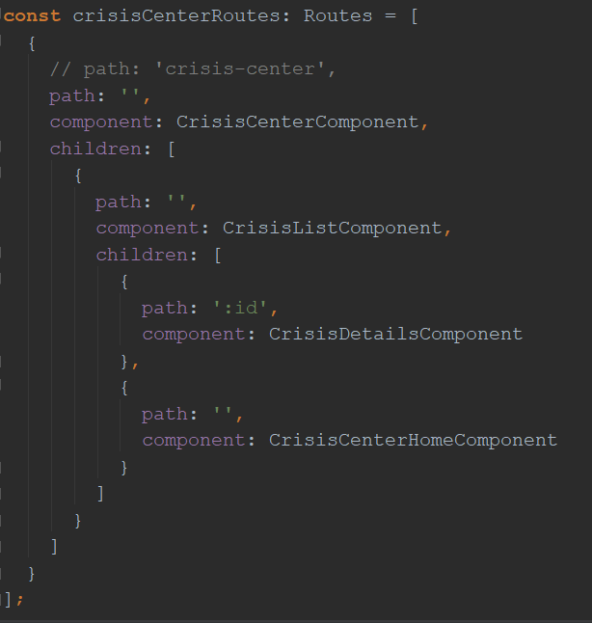
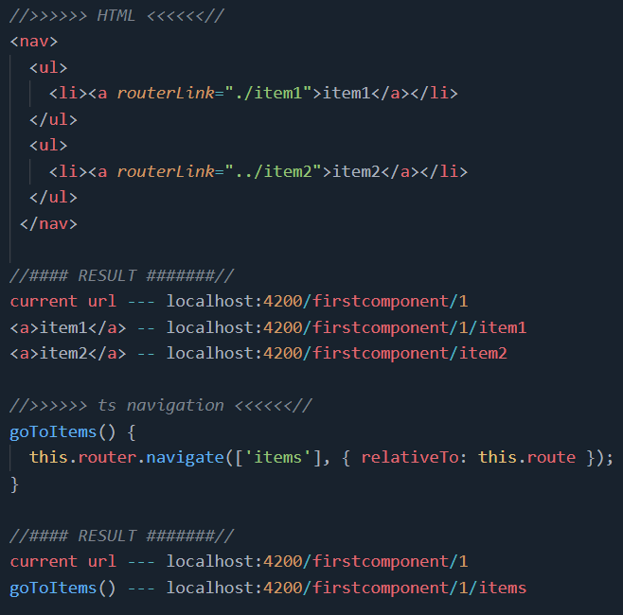
Basic Routing: Nested & relative routing

Slide 5
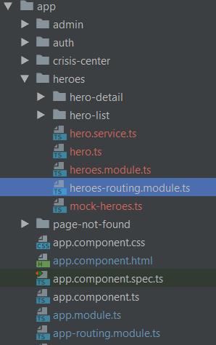
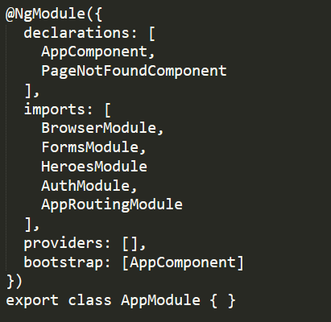
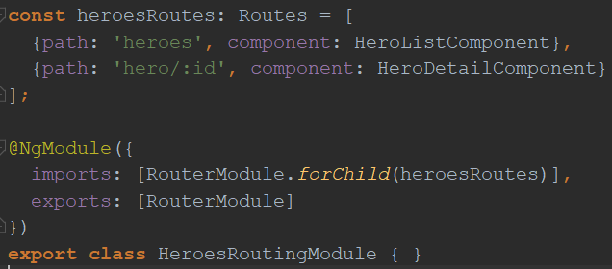
Routing: Feature module
1. define feature module
2. import to main module
3. define feature routing
* order of feature modules matter

Slide 6
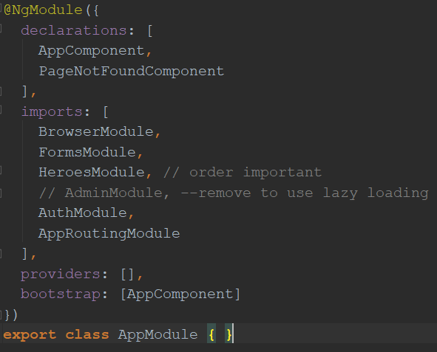
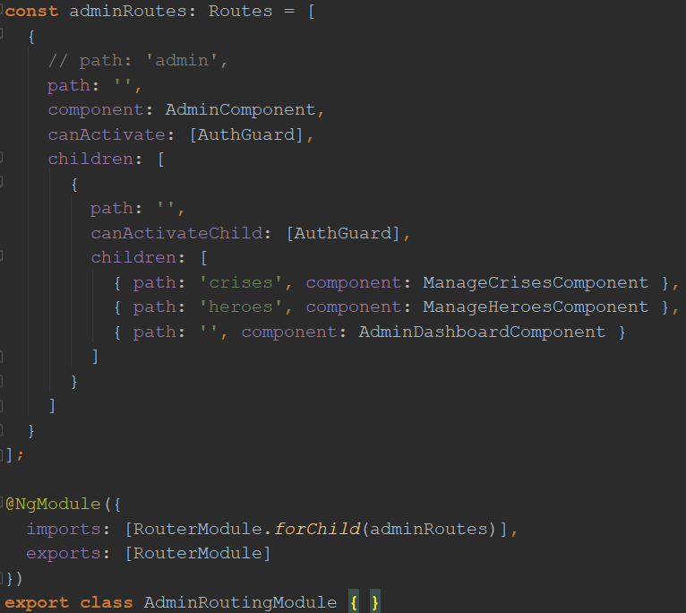
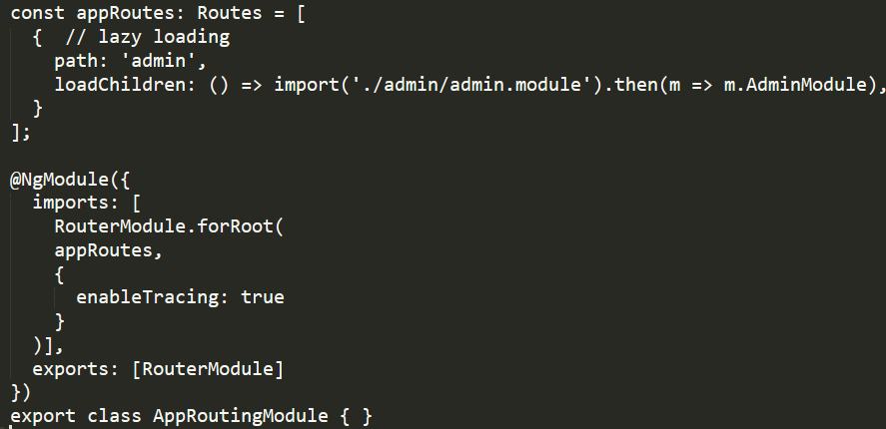
Routing: Lazy Loading Feature Module
1. define feature module
2. import to main module
2. Use “loadChildren” in main routing
3. define feature routing
* order of feature modules matter
* forRoot() vs forChild()

Slide 7
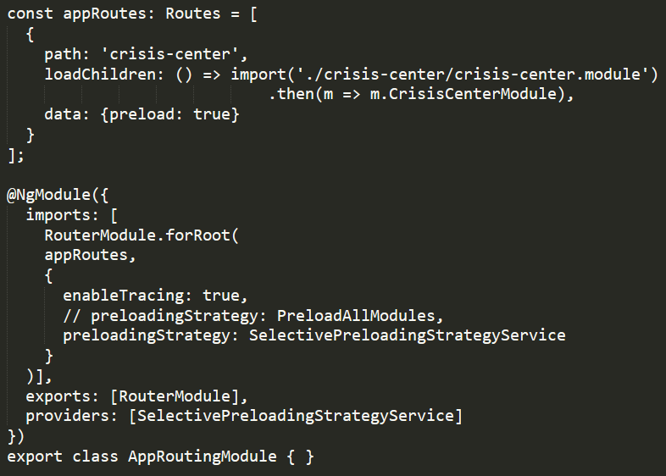
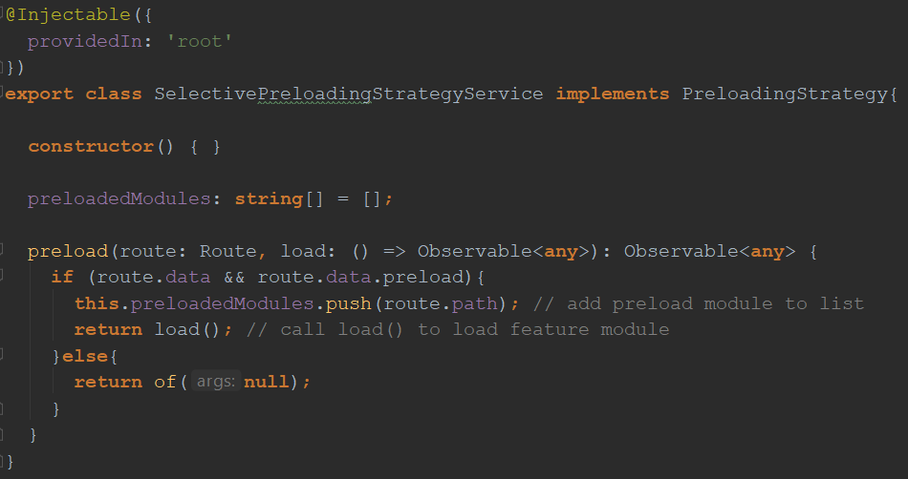
Routing: Pre-Loading Feature Module
1. define feature module
2. data: {preload: true}
3. customize preloading strategy

Slide 8
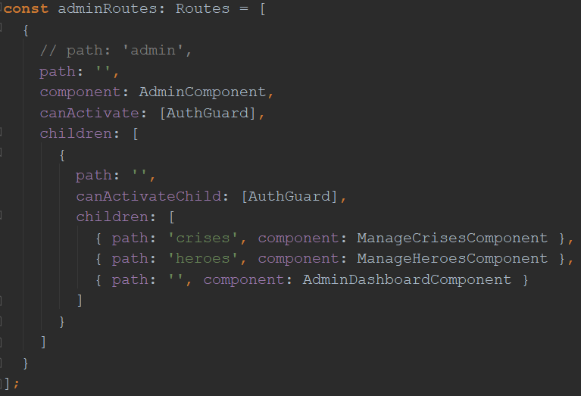
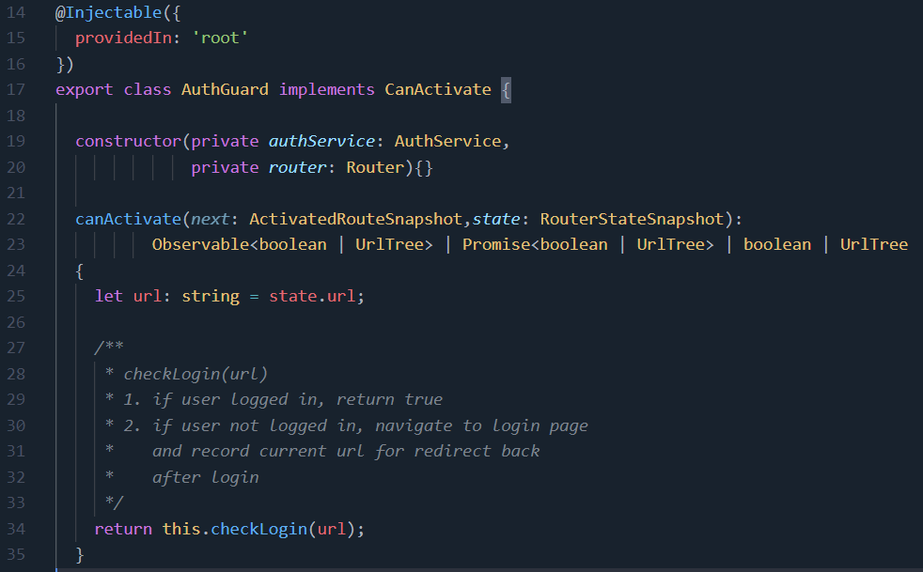
Routing: Security
Some modules can only be visited/loaded if user is logged in
canActivate(for routes); canActivateChild(for child routes); canLoad(for module)

