Slide 1
Data Analysis and Investment Strategy
H
Big Mountain Resort
How can Big Mountain Resort change their ticket pricings to minimize operational costs and develop resort areas to support a higher ticket price while increasing revenue for the upcoming season?
H
D
E
I
P
Notes:
Hypothesis: Create a Hypothesis with an emphasis on SMART principles. (S – Specific, M – Measurable, A – Achievable, R – Realistic, T – Timebound). If you cannot do this, you do not have a good grasp on the business problem.
Context: With context, we have clearly identified the problem at hand and have elucidated on how our initiative may solve this problem, alongside the commercial implications this will have on the business.
Criteria for Success: Clearly defining the criteria for success ensures that the scope of your work is clearly defined and understood. Otherwise, if this isn’t defined – your work will never end which will result in mismatched expectations.
Scope of Solution Space: Scoping out the solution space ensures that the business initiative is SPECIFIC for a certain segment or area. This prevents solutions that have been developed being scaled and applied for all other business units that the solution may not be responsible or scalable for.
Constraints within Solution Space: Looking forward, what are the foreseeable problems we are likely to encounter? Could this be stakeholder resistance? Could this be we don’t have access to the right data?
Stakeholders to provide key insight: Who are the people I need to speak to, to get the answers I need for my data analysis?
What key data sources are required?
Based off my discussions with the key stakeholders – can we clearly list out all the data sources we need so we can make a highly targeted request as opposed to a scatter-gun approach where we ask for a bit of everything?

Slide 2
Problem Identification
How can Big Mountain Resort change their ticket pricings to minimize operational costs and develop resort areas to support a higher ticket price while increasing revenue for the upcoming season?
H
Context
Big Mountain Resort is a 105-trail ski resort with an annual average attendance rate of 350,000 people. Assume each visitor buys 5 tickets.
On-site operational equipment consists of:
11 lifts
2 T-bars
1 magic carpet
Installed an additional chair lift with seasonal cost of $1,540,000.
Current pricing strategy is sub-optimal
Need to select an ideal value for the ticket price by minimizing costs and/or developing the resort to support a higher ticket price.
Possible Constraints = high operational/maintenance costs, competitive marketing prices, limited data (only ski_data given)
H
D
E
I
P
Notes:
Hypothesis: Create a Hypothesis with an emphasis on SMART principles. (S – Specific, M – Measurable, A – Achievable, R – Realistic, T – Timebound). If you cannot do this, you do not have a good grasp on the business problem.
Context: With context, we have clearly identified the problem at hand and have elucidated on how our initiative may solve this problem, alongside the commercial implications this will have on the business.
Criteria for Success: Clearly defining the criteria for success ensures that the scope of your work is clearly defined and understood. Otherwise, if this isn’t defined – your work will never end which will result in mismatched expectations.
Scope of Solution Space: Scoping out the solution space ensures that the business initiative is SPECIFIC for a certain segment or area. This prevents solutions that have been developed being scaled and applied for all other business units that the solution may not be responsible or scalable for.
Constraints within Solution Space: Looking forward, what are the foreseeable problems we are likely to encounter? Could this be stakeholder resistance? Could this be we don’t have access to the right data?
Stakeholders to provide key insight: Who are the people I need to speak to, to get the answers I need for my data analysis?
What key data sources are required?
Based off my discussions with the key stakeholders – can we clearly list out all the data sources we need so we can make a highly targeted request as opposed to a scatter-gun approach where we ask for a bit of everything?

Slide 3
Recommendation and Key-Findings
How can Big Mountain Resort change their ticket pricings to minimize operational costs and develop resort areas to support a higher ticket price while increasing revenue for the upcoming season?
H
Rec
Ticket price increase of $14.87 (18% increase)
Price increase: $81.00 → $95.87
Revenue increase: +$26,022,500
Scenario (2): add a run, increase the vertical drop by 150 feet, and install an additional chair lift
Key-Findings
increasing the seasonal ticket price by $0.88 to $83.87 can cover the lift's cost of installation.
Depending on the cost of operation closing the 5 least used runs can be considered.
H
D
E
I
P
Notes:
Hypothesis: Create a Hypothesis with an emphasis on SMART principles. (S – Specific, M – Measurable, A – Achievable, R – Realistic, T – Timebound). If you cannot do this, you do not have a good grasp on the business problem.
Context: With context, we have clearly identified the problem at hand and have elucidated on how our initiative may solve this problem, alongside the commercial implications this will have on the business.
Criteria for Success: Clearly defining the criteria for success ensures that the scope of your work is clearly defined and understood. Otherwise, if this isn’t defined – your work will never end which will result in mismatched expectations.
Scope of Solution Space: Scoping out the solution space ensures that the business initiative is SPECIFIC for a certain segment or area. This prevents solutions that have been developed being scaled and applied for all other business units that the solution may not be responsible or scalable for.
Constraints within Solution Space: Looking forward, what are the foreseeable problems we are likely to encounter? Could this be stakeholder resistance? Could this be we don’t have access to the right data?
Stakeholders to provide key insight: Who are the people I need to speak to, to get the answers I need for my data analysis?
What key data sources are required?
Based off my discussions with the key stakeholders – can we clearly list out all the data sources we need so we can make a highly targeted request as opposed to a scatter-gun approach where we ask for a bit of everything?

Slide 4
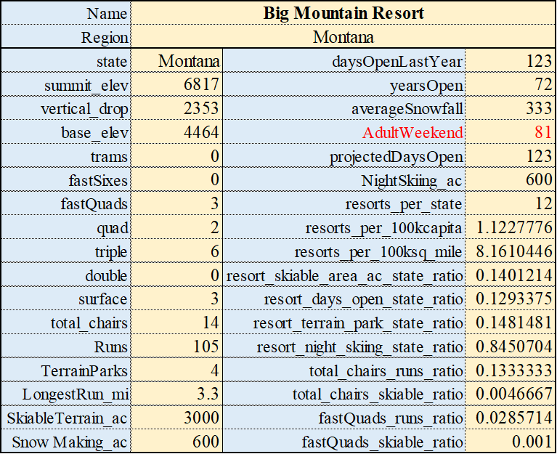
Modeling Results and Analysis
How can Big Mountain Resort change their ticket pricings to minimize operational costs and develop resort areas to support a higher ticket price while increasing revenue for the upcoming season?
H
Data
-The final cleaned ski data consists of:
- 277 facility entries
- 36 features
- GOAL: search for patterns and relationships that have a strong correlation to the target ticket price feature, AdultWeekend.
H
D
E
I
P
Notes:
Hypothesis: Create a Hypothesis with an emphasis on SMART principles. (S – Specific, M – Measurable, A – Achievable, R – Realistic, T – Timebound). If you cannot do this, you do not have a good grasp on the business problem.
Context: With context, we have clearly identified the problem at hand and have elucidated on how our initiative may solve this problem, alongside the commercial implications this will have on the business.
Criteria for Success: Clearly defining the criteria for success ensures that the scope of your work is clearly defined and understood. Otherwise, if this isn’t defined – your work will never end which will result in mismatched expectations.
Scope of Solution Space: Scoping out the solution space ensures that the business initiative is SPECIFIC for a certain segment or area. This prevents solutions that have been developed being scaled and applied for all other business units that the solution may not be responsible or scalable for.
Constraints within Solution Space: Looking forward, what are the foreseeable problems we are likely to encounter? Could this be stakeholder resistance? Could this be we don’t have access to the right data?
Stakeholders to provide key insight: Who are the people I need to speak to, to get the answers I need for my data analysis?
What key data sources are required?
Based off my discussions with the key stakeholders – can we clearly list out all the data sources we need so we can make a highly targeted request as opposed to a scatter-gun approach where we ask for a bit of everything?

Slide 5
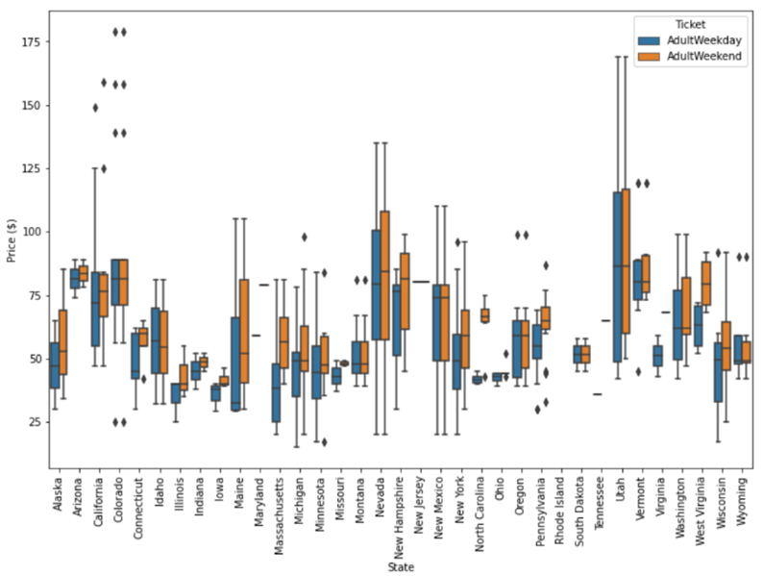
Modeling Results and Analysis
How can Big Mountain Resort change their ticket pricings to minimize operational costs and develop resort areas to support a higher ticket price while increasing revenue for the upcoming season?
H
Ticket Price Distribution by State
-variability and distribution of the average ticket price for each resort based on its corresponding state
-most state weekend prices that are higher than its corresponding state weekday prices seem relatively constrained to resorts that have ticket prices less than $95
H
D
E
I
P
Notes:
Hypothesis: Create a Hypothesis with an emphasis on SMART principles. (S – Specific, M – Measurable, A – Achievable, R – Realistic, T – Timebound). If you cannot do this, you do not have a good grasp on the business problem.
Context: With context, we have clearly identified the problem at hand and have elucidated on how our initiative may solve this problem, alongside the commercial implications this will have on the business.
Criteria for Success: Clearly defining the criteria for success ensures that the scope of your work is clearly defined and understood. Otherwise, if this isn’t defined – your work will never end which will result in mismatched expectations.
Scope of Solution Space: Scoping out the solution space ensures that the business initiative is SPECIFIC for a certain segment or area. This prevents solutions that have been developed being scaled and applied for all other business units that the solution may not be responsible or scalable for.
Constraints within Solution Space: Looking forward, what are the foreseeable problems we are likely to encounter? Could this be stakeholder resistance? Could this be we don’t have access to the right data?
Stakeholders to provide key insight: Who are the people I need to speak to, to get the answers I need for my data analysis?
What key data sources are required?
Based off my discussions with the key stakeholders – can we clearly list out all the data sources we need so we can make a highly targeted request as opposed to a scatter-gun approach where we ask for a bit of everything?

Slide 6
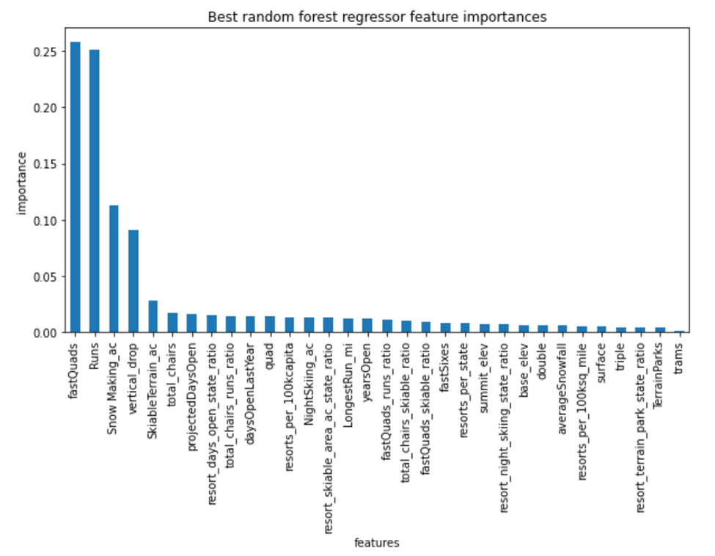
Modeling Results and Analysis
How can Big Mountain Resort change their ticket pricings to minimize operational costs and develop resort areas to support a higher ticket price while increasing revenue for the upcoming season?
H
Chosen Model
-relationship of importance vs each numeric feature created with a random forest regression pipeline, cross-validation, and a hyperparameter search using GridSearchCV
-model chosen is the random forest regression model because it has a lower cross-validation mean absolute error by 0.85 and has less variability
H
D
E
I
P
Notes:
Hypothesis: Create a Hypothesis with an emphasis on SMART principles. (S – Specific, M – Measurable, A – Achievable, R – Realistic, T – Timebound). If you cannot do this, you do not have a good grasp on the business problem.
Context: With context, we have clearly identified the problem at hand and have elucidated on how our initiative may solve this problem, alongside the commercial implications this will have on the business.
Criteria for Success: Clearly defining the criteria for success ensures that the scope of your work is clearly defined and understood. Otherwise, if this isn’t defined – your work will never end which will result in mismatched expectations.
Scope of Solution Space: Scoping out the solution space ensures that the business initiative is SPECIFIC for a certain segment or area. This prevents solutions that have been developed being scaled and applied for all other business units that the solution may not be responsible or scalable for.
Constraints within Solution Space: Looking forward, what are the foreseeable problems we are likely to encounter? Could this be stakeholder resistance? Could this be we don’t have access to the right data?
Stakeholders to provide key insight: Who are the people I need to speak to, to get the answers I need for my data analysis?
What key data sources are required?
Based off my discussions with the key stakeholders – can we clearly list out all the data sources we need so we can make a highly targeted request as opposed to a scatter-gun approach where we ask for a bit of everything?

Slide 7
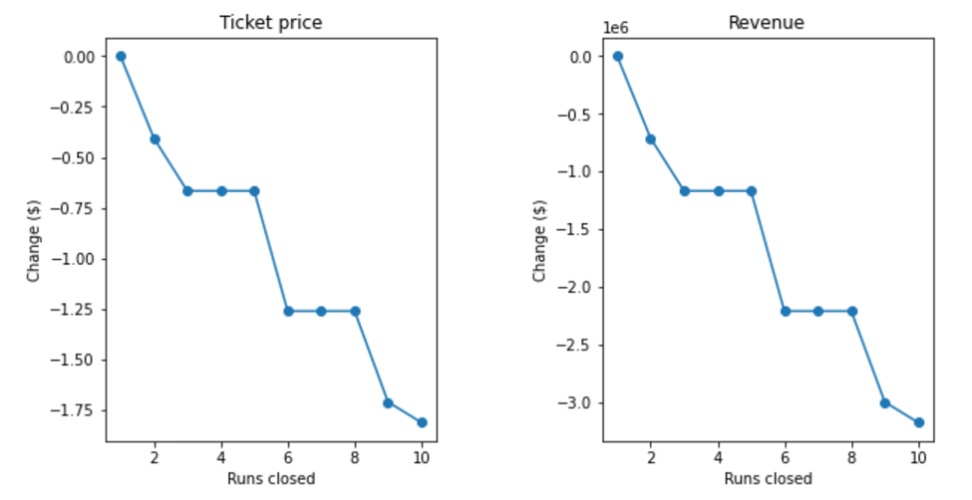
Modeling Results and Analysis
How can Big Mountain Resort change their ticket pricings to minimize operational costs and develop resort areas to support a higher ticket price while increasing revenue for the upcoming season?
H
Given Scenarios
-Closing 1 → no change
-Closing 2-3 → (0.4 - 0.65) price loss
-Closing 3-5 → no change
-Closing 6+ → 1.33+ price loss
-Closing 5? → 0.65 price loss and decrease in operational costs for 5 runs
H
D
E
I
P
Notes:
Hypothesis: Create a Hypothesis with an emphasis on SMART principles. (S – Specific, M – Measurable, A – Achievable, R – Realistic, T – Timebound). If you cannot do this, you do not have a good grasp on the business problem.
Context: With context, we have clearly identified the problem at hand and have elucidated on how our initiative may solve this problem, alongside the commercial implications this will have on the business.
Criteria for Success: Clearly defining the criteria for success ensures that the scope of your work is clearly defined and understood. Otherwise, if this isn’t defined – your work will never end which will result in mismatched expectations.
Scope of Solution Space: Scoping out the solution space ensures that the business initiative is SPECIFIC for a certain segment or area. This prevents solutions that have been developed being scaled and applied for all other business units that the solution may not be responsible or scalable for.
Constraints within Solution Space: Looking forward, what are the foreseeable problems we are likely to encounter? Could this be stakeholder resistance? Could this be we don’t have access to the right data?
Stakeholders to provide key insight: Who are the people I need to speak to, to get the answers I need for my data analysis?
What key data sources are required?
Based off my discussions with the key stakeholders – can we clearly list out all the data sources we need so we can make a highly targeted request as opposed to a scatter-gun approach where we ask for a bit of everything?

Slide 8
Conclusion
How can Big Mountain Resort change their ticket pricings to minimize operational costs and develop resort areas to support a higher ticket price while increasing revenue for the upcoming season?
H
Summary
-18% increased ticket price strikes the healthy balance between consumer affordability and supplier profit
-able to securely cover the short and long-term installation plus maintenance cost for the new operating equipment
-new ski features enticing and marketable
-BMR operates within a market where people pay varying ticket prices based on its respective facility
-optimization of ticket price is crucial to stay competitive
H
D
E
I
P
Notes:
Hypothesis: Create a Hypothesis with an emphasis on SMART principles. (S – Specific, M – Measurable, A – Achievable, R – Realistic, T – Timebound). If you cannot do this, you do not have a good grasp on the business problem.
Context: With context, we have clearly identified the problem at hand and have elucidated on how our initiative may solve this problem, alongside the commercial implications this will have on the business.
Criteria for Success: Clearly defining the criteria for success ensures that the scope of your work is clearly defined and understood. Otherwise, if this isn’t defined – your work will never end which will result in mismatched expectations.
Scope of Solution Space: Scoping out the solution space ensures that the business initiative is SPECIFIC for a certain segment or area. This prevents solutions that have been developed being scaled and applied for all other business units that the solution may not be responsible or scalable for.
Constraints within Solution Space: Looking forward, what are the foreseeable problems we are likely to encounter? Could this be stakeholder resistance? Could this be we don’t have access to the right data?
Stakeholders to provide key insight: Who are the people I need to speak to, to get the answers I need for my data analysis?
What key data sources are required?
Based off my discussions with the key stakeholders – can we clearly list out all the data sources we need so we can make a highly targeted request as opposed to a scatter-gun approach where we ask for a bit of everything?

Slide 9
Thank You
H
Questions?
H
D
E
I
P
Notes:
Hypothesis: Create a Hypothesis with an emphasis on SMART principles. (S – Specific, M – Measurable, A – Achievable, R – Realistic, T – Timebound). If you cannot do this, you do not have a good grasp on the business problem.
Context: With context, we have clearly identified the problem at hand and have elucidated on how our initiative may solve this problem, alongside the commercial implications this will have on the business.
Criteria for Success: Clearly defining the criteria for success ensures that the scope of your work is clearly defined and understood. Otherwise, if this isn’t defined – your work will never end which will result in mismatched expectations.
Scope of Solution Space: Scoping out the solution space ensures that the business initiative is SPECIFIC for a certain segment or area. This prevents solutions that have been developed being scaled and applied for all other business units that the solution may not be responsible or scalable for.
Constraints within Solution Space: Looking forward, what are the foreseeable problems we are likely to encounter? Could this be stakeholder resistance? Could this be we don’t have access to the right data?
Stakeholders to provide key insight: Who are the people I need to speak to, to get the answers I need for my data analysis?
What key data sources are required?
Based off my discussions with the key stakeholders – can we clearly list out all the data sources we need so we can make a highly targeted request as opposed to a scatter-gun approach where we ask for a bit of everything?

