Slide 1
Software Testing Lab
Ashraf Gaffar

Slide 2

The Book
Pragmatic Unit Testing in Java 8 with JUnit
1st Edition
Publisher: Pragmatic Bookshelf; 1st edition (March 31, 2015)
Language: English
Paperback: 236 pages
ISBN-10: 1941222595
ISBN-13: 978-1941222591

Slide 3
Environment
Java [Java 8]
https://java.com/download
Eclipse IDE
http://eclipse.org/downloads/
IntelliJ IDEA (on your own)
http://www.jetbrains.com/idea/download/
NetBeans (On your own)
https://netbeans.org/downloads/
Junit
https://github.com/junit-team/junit/wiki/Download-and-Install

Slide 4
Setup (see the book)
We’re going to put our tests in the same package (iloveyouboss) as ScoreCollection.
In Eclipse, we separate the tests and production code by putting the tests in one source folder (test) and the production code in another (src).
Create a source folder named test before continuing.
In Eclipse, the easiest way to do this is in the Package Explorer. Select the project, right-click to bring up the context menu, and select New ▶ Source Folder. Type the name test as the Folder Name and click Finish.

Slide 5
Setup (cont.)
Next, we’ll create a JUnit test class for ScoreCollection.
In Eclipse, here’s one way to do this:
Select the ScoreCollection.java entry from the Package Explorer.
Right-click to bring up the context menu.
Select New ▶ JUnit Test Case.

Slide 6
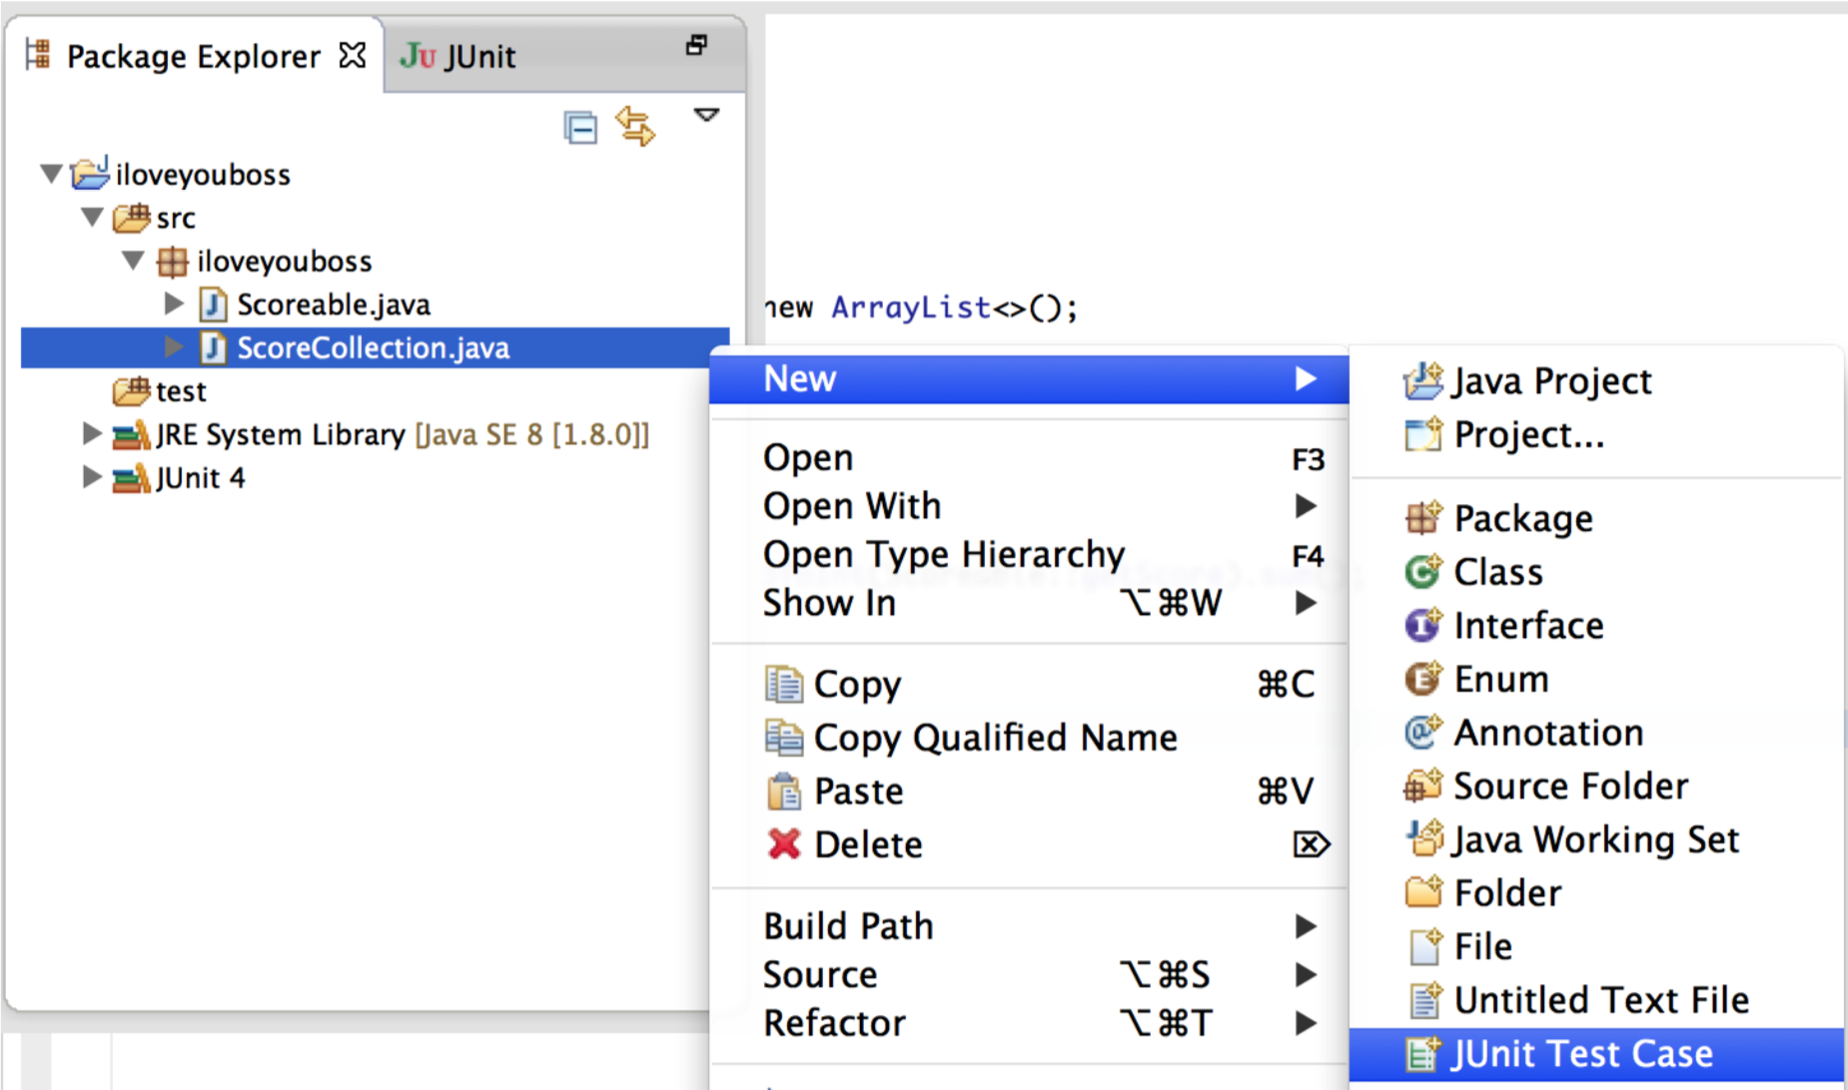
Setup 3

Slide 7
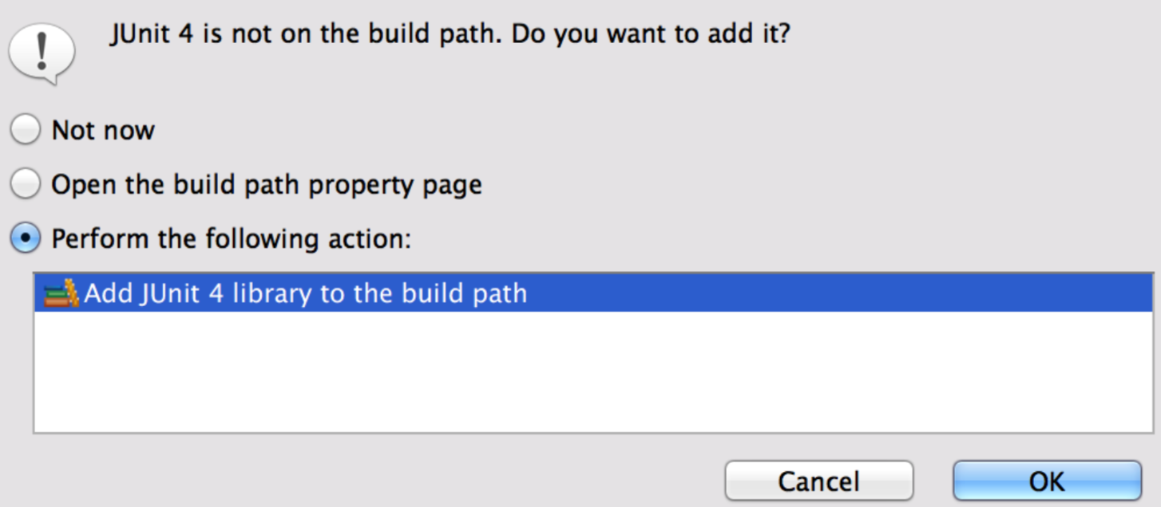
Adding JUnit to the Path

Slide 8
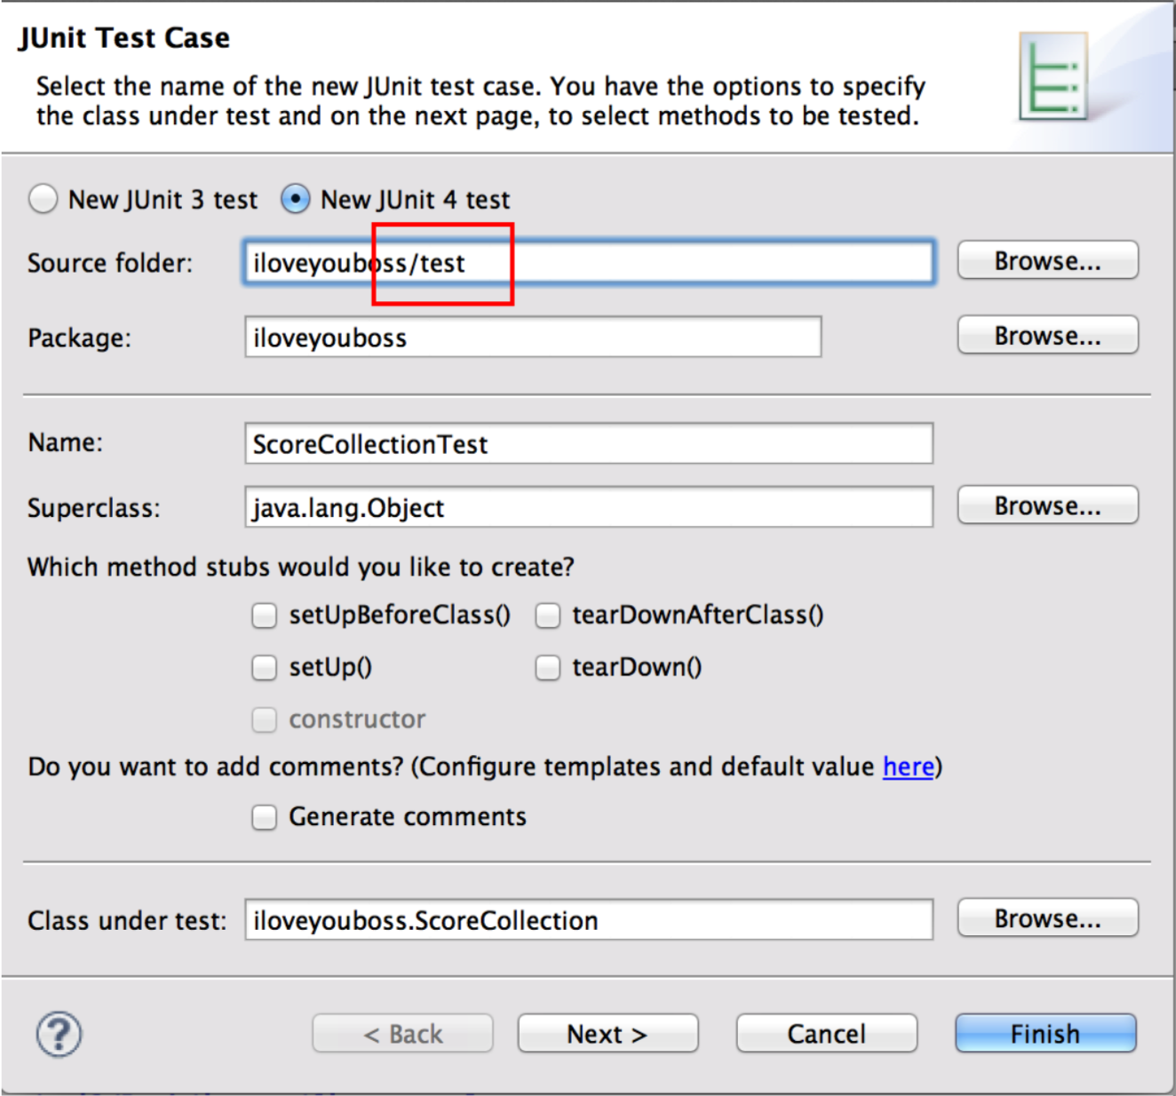
The Wizard

Slide 9

And
We’re good to run some tests

