Slide 1

INSURANCE FRAUD DETECTION
Group 6 Repository:
Auto_Insurance_Claims
Xinyi Hu
Nehal Jain
Gayatri Krishnamoorthy
Juliana Liu
Christina Ming
Aishwarya Rao
Nancy Samuel
Proaggressive
Insurance

Slide 2

OUR TEAM
Nehal
Christina
Nancy
Gayatri
Product Manager
/Analyst
nehalj12
Business Analyst
cm0301
Data Analyst
nancieeyy
Data Analyst
Gayatrik9
Aishwarya
Juliana
Xinyi
Data Scientist
aishwaryarao595
Data Scientist
julianaliu1997
Data Scientist
Syrenia
Proaggressive
Notes:
Christina

Slide 3
CONTEXT
Competitive Landscape
Price hardening cycle
Industry revenue declined 5.0% in 2020
37.0% of consumers are likely to purchase auto insurance online in the future
Fraud detection becomes increasingly crucial for an online-focused strategy shift
Business Problem
Auto insurers lose at least $29 billion a year due to premium leakage, according to Verisk
Objectives and Benefits
Predict the likelihood of auto insurance fraud through a classification model
Identify factors that can be used to detect fraud from causal analysis
Performance Metrics
Recall
Precision
ROC-AUC
Source: IBISWorld, Insurance Information Institute
Notes:
Christina
Price hardening cycle - Competition is fierce with online-focused discount insurer entering the market
Industry revenue declined 5.0% in 2020 as a result of lower investment income and consumer confidence as pandemic hits
According to the latest available information from comScore, 37.0% of consumers are likely to purchase auto insurance online in the future
Fraud detection becomes increasingly crucial for an online-focused strategy shift
People just file claims online by taking pictures of defective parts
Payments can then be made based on the pictures
Vulnerable to staged accidents
Auto insurers lose at least $29 billion a year
2 use cases
Predict how likely is a claim fraudulent through a classification model
Identify factors that can be used to determine fraudulent records from causal analysis
Recall is our primary metric because we are interested in detecting as many abnormal records as possible considering the downside of not detecting one is a lot higher than otherwise

Slide 4
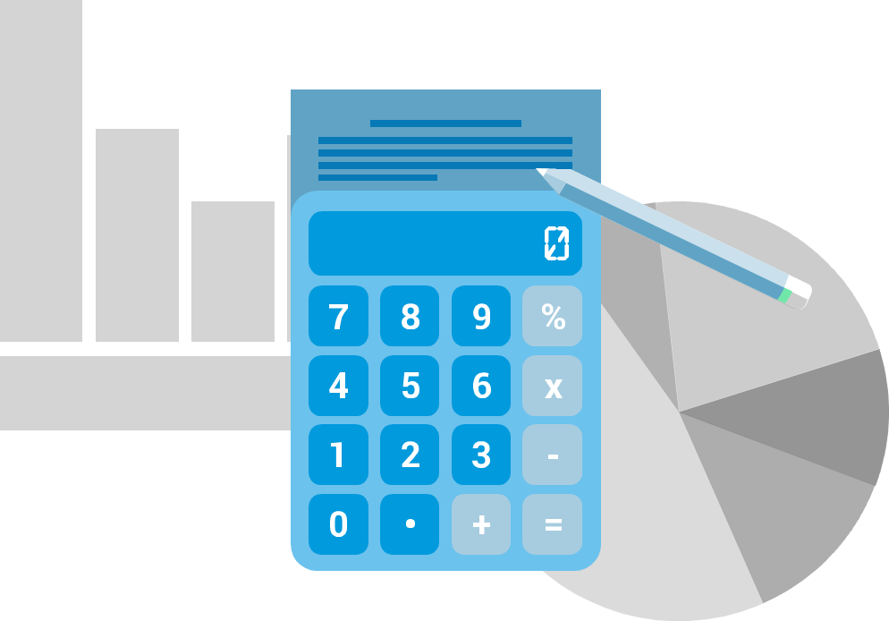




HYPOTHESES / PROBLEM STATEMENT
Logical: A classification tool will help the company’s decision making process
H0: The claim application is not fraudulent Witness present, Base policy, Deductible
H1: The claim application is fraudulent Accident Area, Age, Fault, Past Number of claims
 | Claim is not fraudulent | Claim is fraudulent
Predict as fraudulent | Type I Error (False Positives) | Correct Outcome
Predict as not Fraudulent | Correct Outcome | Type II Error (False Negatives)
Notes:
Nancy
Traditionally businesses relied on rules alone to block fraudulent claims. This causes problems: - lots of rules tends to result in a high number of false positives - meaning you’re likely to block a lot of genuine customers.
- Fixed outcomes are risky since the thresholds can change over time.so they aren’t robust.
And hence our logical assumption is that a classification tool will help in the company’s decision making process. since this is where Machine learning models shine when you don’t know the exact signals that indicate fraudulent activity, but model identify the signals itself.
So we assume our null hypothesis to be the status quo: under ideal circumstances.

Slide 5
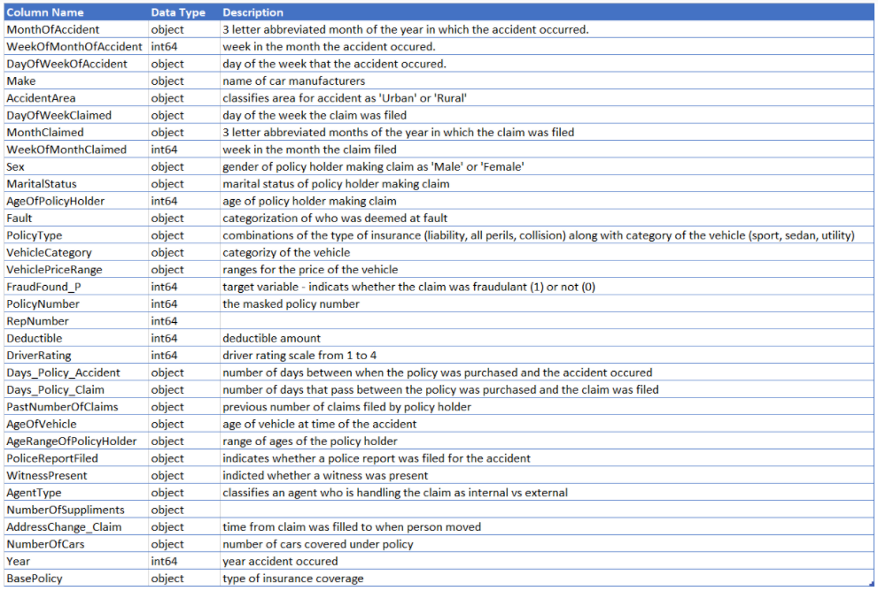
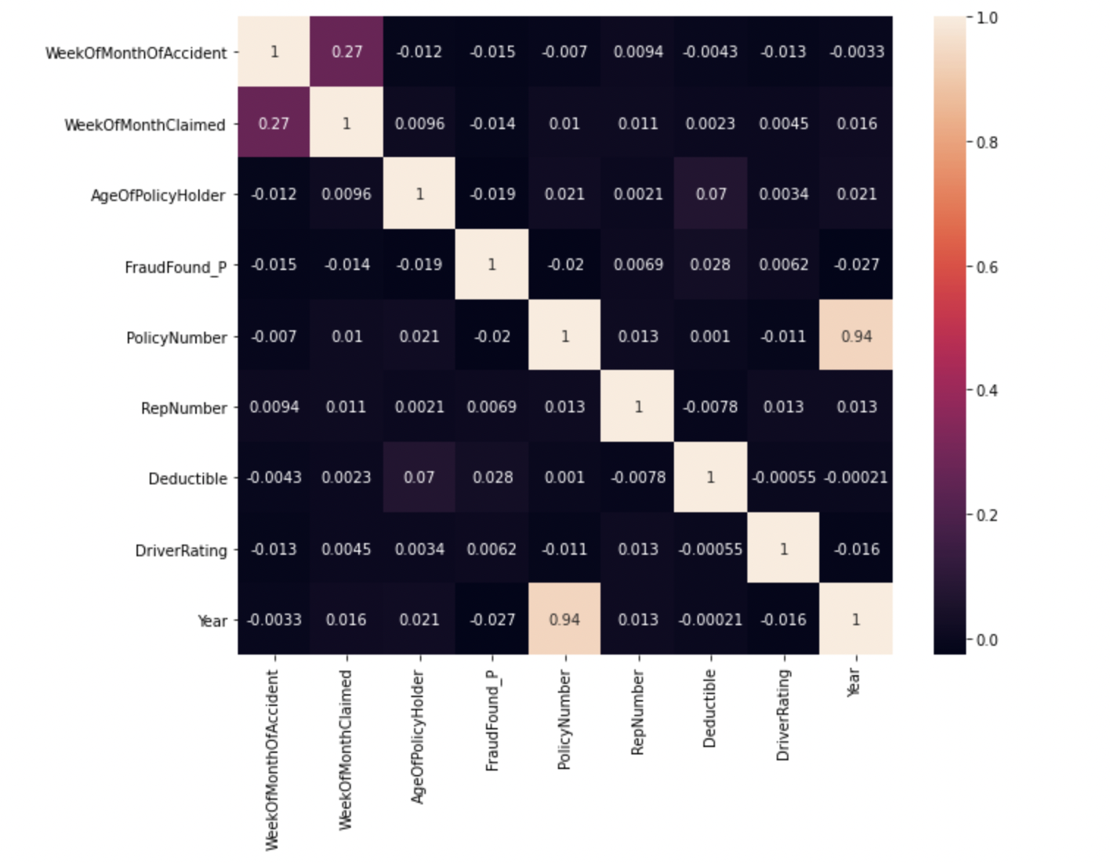
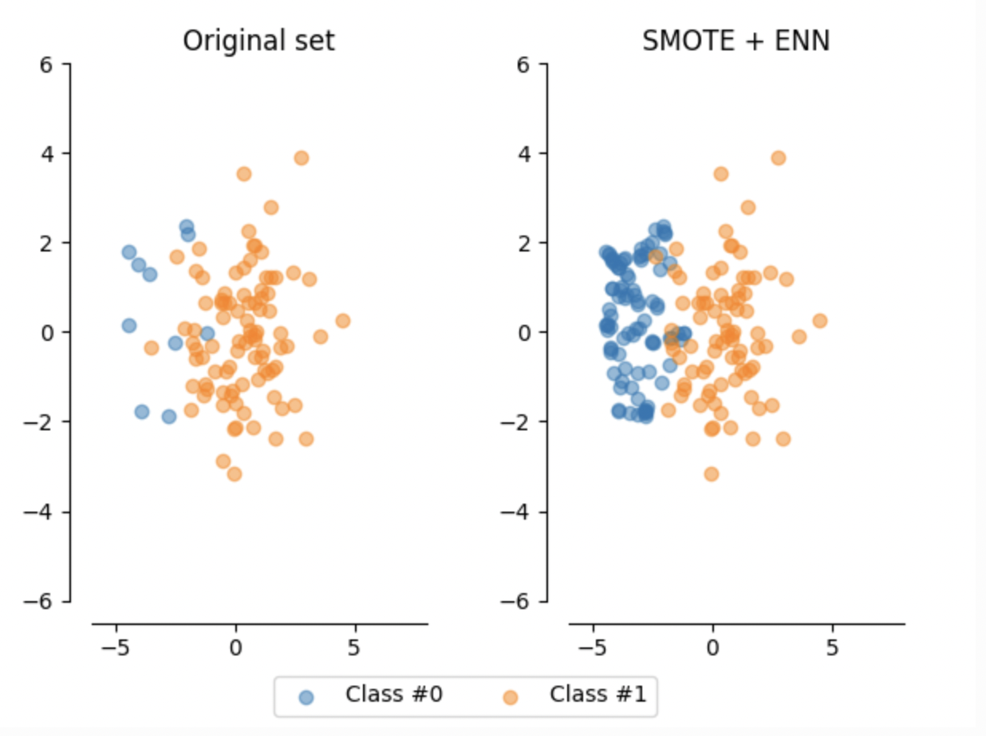
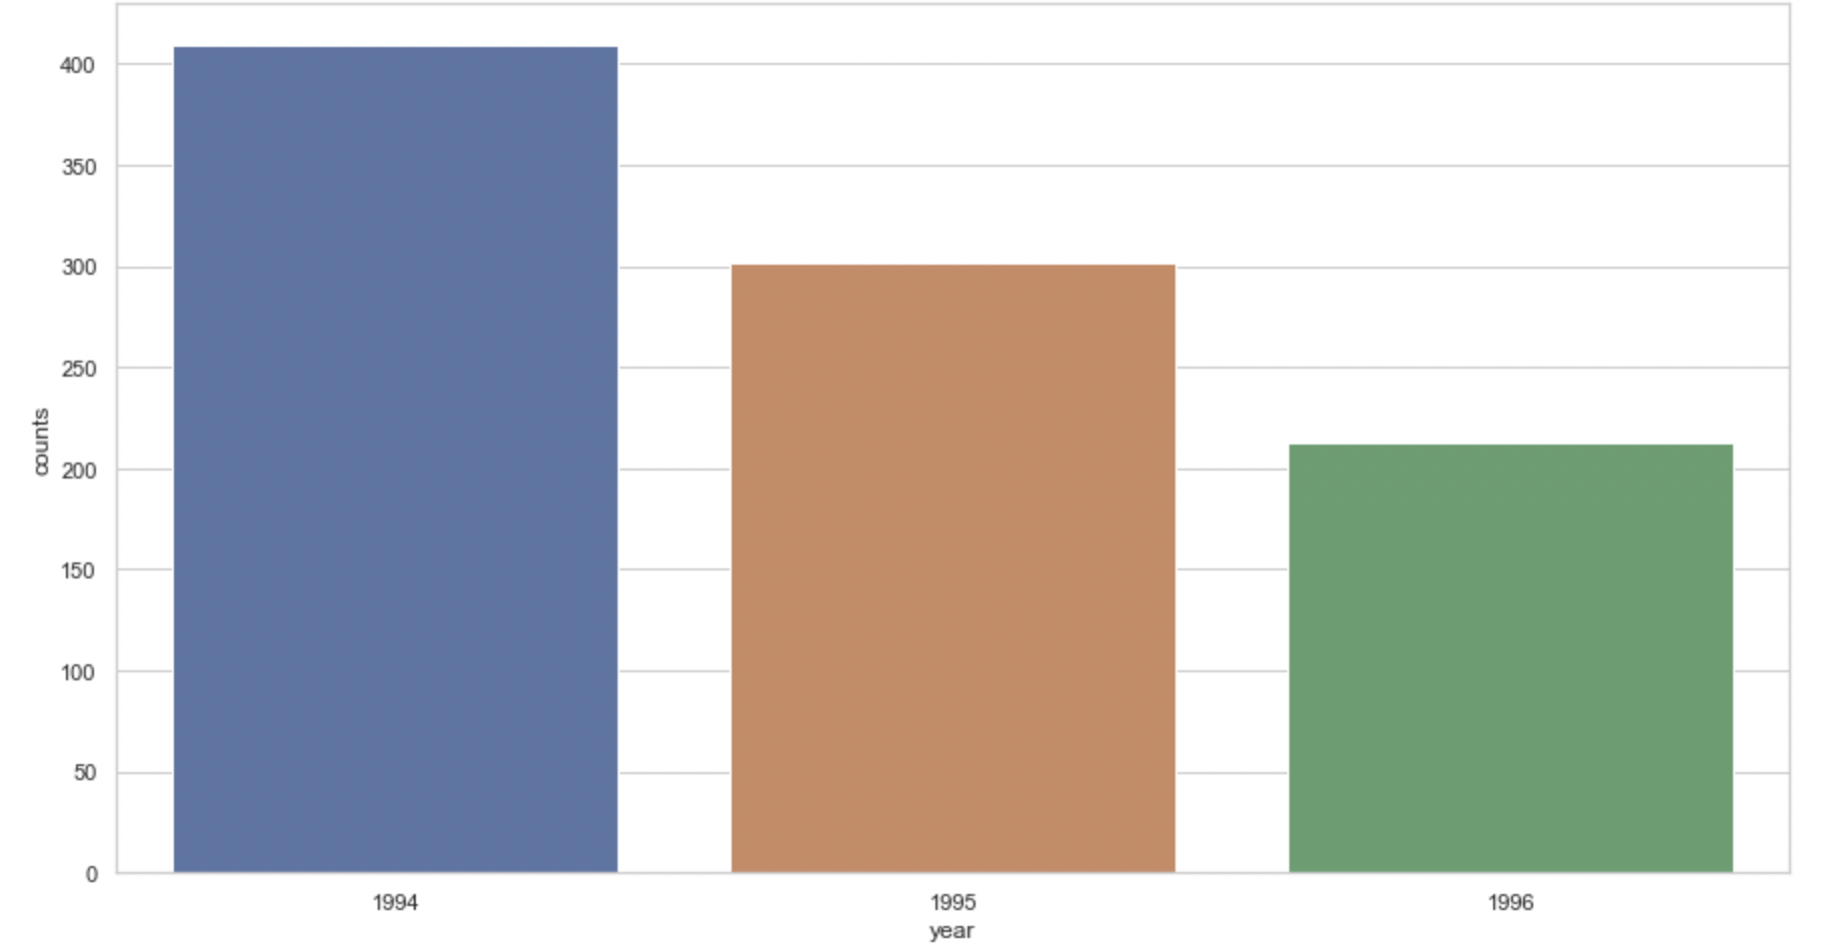
Data Acquisition and Statistics
Data Preprocessing
Combination of oversampling + undersampling
Source:Kaggle-vehicle-claim-fraud-detection
Number of variables : 33
Number of observations : 15420
Handling missing values - using imputer
Feature selection
Detection of outliers and removal
Feature engineering
Feature encoding
Data scaling - using Standard Scalar
Variable types | Number of variables
Categorical | 22
Numeric | 9
Boolean | 2
Data Exploration
Data Transformation
Distribution
Trends
Patterns
Outliers
Correlation
Number of fraudulent claims across years
Notes:
Gayatri
Data acquisition - This vehicle dataset has been taken from Kaggle. This dataset contains vehicle attributes - , model, accident details, policy details - policy type, tenure etc. The target is to detect if a claim application is fraudulent or not - FraudFound_P
Data exploration - We see how various features are related to each other, their effect on target variables. Distribution, Patterns,trends,outliers, effect of missing values, proportion, correlation
Resampling -
Data imbalanced ( around 6% where are target variable =1)- resampling
Results are effective when we combine over sampling + under sampling
smote(oversampling the minority class) SMOTE works by selecting examples that are close in the feature space, drawing a line between the examples in the feature space and drawing a new sample as a point along that line.+enn (Edited Nearest Neighbours, or ENN, rule. This rule involves using k=3 nearest neighbours to locate those examples in a dataset that are misclassified and that are then removed. It can be applied to all classes or just those examples in the majority class). Next ,we apply standard machine learning classification algorithms that can be fit successfully on the transformed datasets.

Slide 6
MODEL
 | Performance Metrics
Models | Precision | Recall | F1 Score | AUC-ROC | Accuracy
Random Forest | 18.9% | 35.1% | 0.25 | 0.81 | 87.4%
XGBoost | 13.1% | 93.1% | 0.23 | 0.8 | 62.4%
Adaboost | 10.3% | 84.7% | 18.3% | 0.75 | 13.4%
GaussianNB | 11.8% | 85.5% | 0.207 | 0.77 | 61.8%
KNN | 7.9% | 58% | 0.14 | 0.61 | 58.2%
We choose XGBoost because of Recall
Notes:
Aishwarya
Models
Models chosen mainly are tree based model as they inherently prevent overfitting and dont require feature selection explicitly.
A] Random Forest
Random Forests implicitly perform feature selection and generate uncorrelated decision trees.
Not influenced by outliers
balance the bias-variance trade-off well.
B] XGBoost
Misclassified observations from each model are up-weighed
lightning speed
high accuracies
C] Adaboost
robust to overfitting in low noise datasets
D] GaussianNB
a conditional probabilistic classification model that considers each of the features in the dataset to contribute independently to the probability of the class of the tumor regardless of any possible correlation between the above-mentioned associations.
E] KNN
determines neighborhoods based on distance metric.
Quick calculation time
Allows it to immediately adapt to new training data
Performance metrics
Chosen recall as our performance metric
Preference given to Recall over Precision as focus is on false negatives over false positives
False negative: Claim is fraudulent but the model didnt predict it to be
False Positive: Claim is not fraudulent but model predicted it to be
Company is likely to incur more loses because of false negatives than false positives

Slide 7
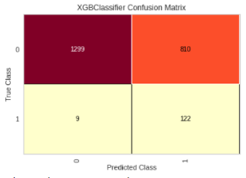
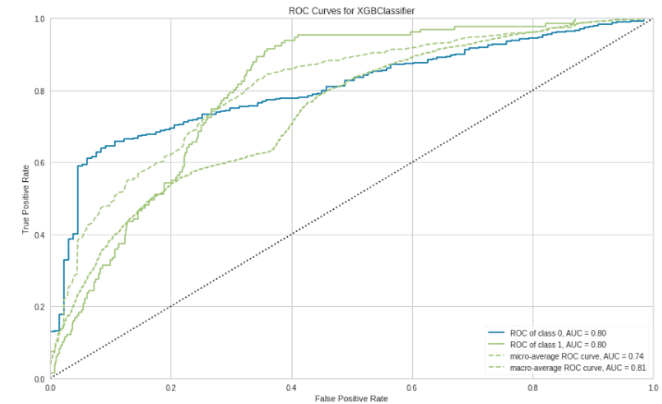
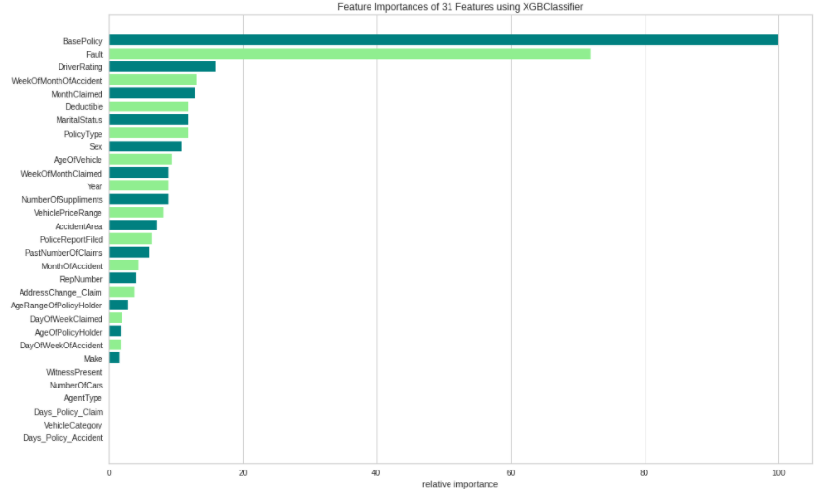
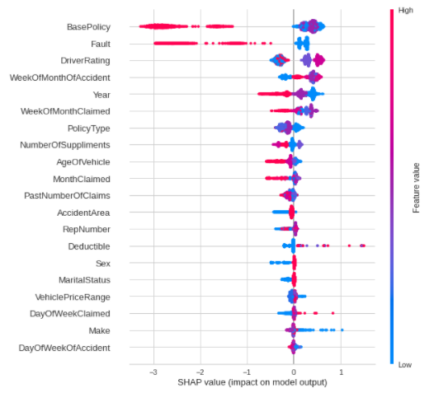
Model RESULTS
Notes:
Juliana
To measure the performance of our best model, we are looking at several evaluation metrics here.
We prioritized recall matrix over precision and f1score. And as we can see from the confusion matrix, our data contains 2240 observations, among the 131 number of fraud cases we have, the model successfully identify 122, which is a 93% of accuracy here.
By looking at the ROC curve, we see a AUC of 0.8, which means that there is a 80% chance that our model will be able to distinguish between non-fraud class and fraudulent class.
Xinyi
From the combination of feature importance and shap value plots, we can see how some features affect the target variable
BasePolicy and Fault are the two most important features contributing to the output most. As for BasePolicy, certain coverage type, like Liability has negative influence on the output, it’s less likely to find fraud in this category. As for Fault, if Third Party is deemed at fault, it will have negative influence on the output. It makes sense because PolicyHolders are less motivated by the fact that they are not at fault to claim fraud insurance.
Next, we will see the analysis results of causal inference

Slide 8
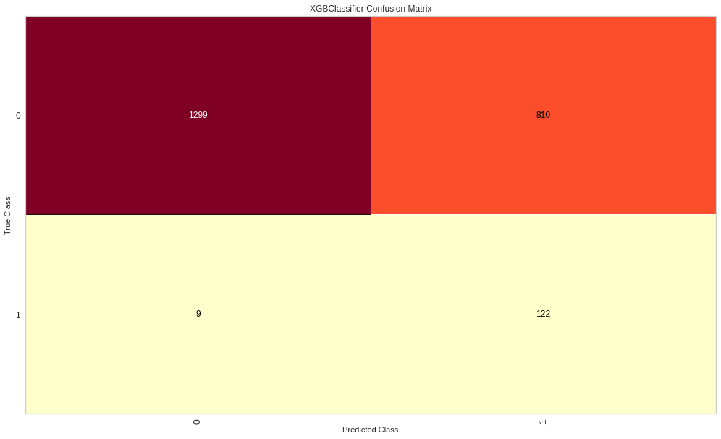
Model RESULTS
Evaluation Metrics
Notes:
Juliana
To measure the performance of our best model, we are looking at several evaluation metrics here.
And as we can see from the confusion matrix, our test dataset contains 2240 observations, among the 131 number of fraud cases presented here, the model successfully identify 122, which is a 93% of accuracy here.
By looking at the ROC curve, we see a AUC of 0.8, which means that there is a 80% chance that our model will be able to distinguish between non-fraud class and fraudulent class.
Xinyi
From the combination of feature importance and shap value plots, we can see how some features affect the target variable
BasePolicy and Fault are the two most important features contributing to the output most. As for BasePolicy, certain coverage type, like Liability has negative influence on the output, it’s less likely to find fraud in this category. As for Fault, if Third Party is deemed at fault, it will have negative influence on the output. It makes sense because PolicyHolders are less motivated by the fact that they are not at fault to claim fraud insurance.
Next, we will see the analysis results of causal inference

Slide 9
Model RESULTS
Feature Importance & Shap Value
Notes:
Xinyi
From the combination of feature importance and shap value plots, we can see how some features affect the target variable based on our best model
BasePolicy and Fault are the two most important features contributing to the output most. As for BasePolicy, certain coverage type, like Liability has negative influence on the output, it’s less likely to find fraud in this category. As for Fault, if Third Party is deemed at fault, it will have negative influence on the output. It makes sense because PolicyHolders are less motivated by the fact that they are not at fault to claim fraud insurance.
Next, we will see the analysis results of causal inference

Slide 10
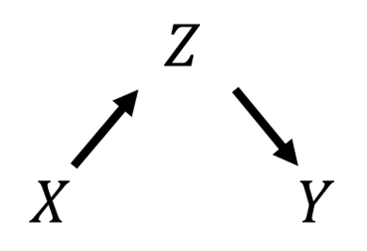
CAUSAL ANALYSIS
Feature | P-Values | Estimate
Fault | 0.000 | -0.07
PolicyType | 0.000 | -0.037
Past Number Of Claims | 0.000 | -0.003
Make | 0.000 | -0.001
Vehicle Price Range | 0.000 | 0.002
AccidentArea | 0.005 | -0.027
Base Policy | 0.030 | -0.042
Age Of Vehicle | 0.043 | -0.004
Police Report Filed | 0.085 | -0.005
Age Of Policy Holder | 0.429 | -0.004
Number Of Cars | 0.434 | 0.001
DriverRating | 0.642 | 0.001
Agent Type | 0.666 | -0.02
Vehicle Category | 0.856 | -0.037
Target/ Outcome variable : Fraud Found
P-Value < 0.001 ➟ Causal Relationship between treatment and outcome variable.
Notes:
Nehal

Slide 11
CONCLUSION
Business Insights
Claims with Policy Holder’s Fault, Collision Base Policy, Higher Vehicle Price Range, more past claims are more likely to be fraudulent.
Threats to Validity / Limitations
Limited Data from past years
Inspectability Issues - Rejection needs to be explained to customers.
Next Steps
Ensemble Anomaly detection- Semi-Supervised Learning
Incorporate more demographics data, prior customer profile like Risk profile.
Notes:
Nehal/ Juliana
Business Insights: Important factors affecting Claims, How likely is the claim Fraudulent?
Threats to Validity: Limited Data
Next Steps:
SVM based Anomaly detection - Semi-Supervised Learning
Incorporate more demographics data, prior customer profile like Risk profile.

Slide 12

THANK YOU!

Slide 13
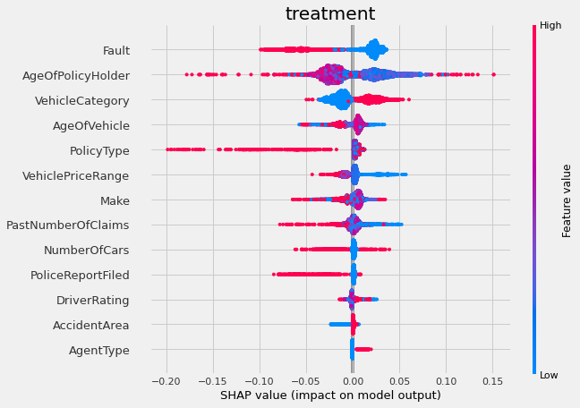
APPENDIX: Causal Analysis
Effect of treatment “Base Policy” = Collision
➟ Back to Causal Analysis

Slide 14
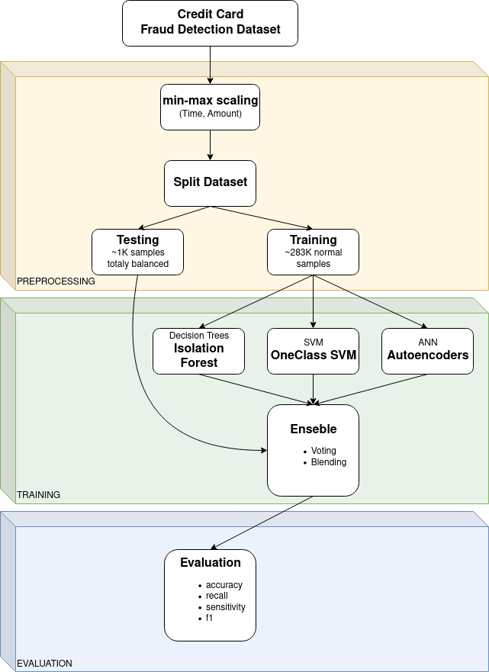
APPENDIX: Future Steps
Back

