Slide 1
Challenge 2 — Home Handyman Portfolio
COMP5450 Mobile Programming · Group 5
May 27, 2026

Slide 2
Problem & Goal
Homeowners need a single, trustworthy view of a handyman's work.
Our app combines services, portfolio, reviews, and contact in one place.
The handout says: "showcase skills that attract potential customers."
Cross-platform Flutter lets us ship to Android, iOS, and web from one codebase.

Slide 3
Tech Stack
Flutter 3.32 + Dart — cross-platform framework from the course
Material 3 design with a warm amber/orange theme
Repository pattern for data access (program to an interface)
Firebase-ready: abstract PortfolioRepository → swap mock for Firestore
Tested with flutter analyze (0 issues) and 7 widget tests

Slide 4
Architecture
models/ — Service, Project, Review (plain Dart classes)
data/ — PortfolioRepository (abstract) + MockPortfolioRepository
screens/ — one file per screen (Home, Services, Portfolio, About, Reviews, Contact)
widgets/ — reusable cards (HeroBanner, ServiceCard, ProjectCard, ReviewCard, StatChip)
Swapping to Firestore requires changing only one class — no screen edits.

Slide 5
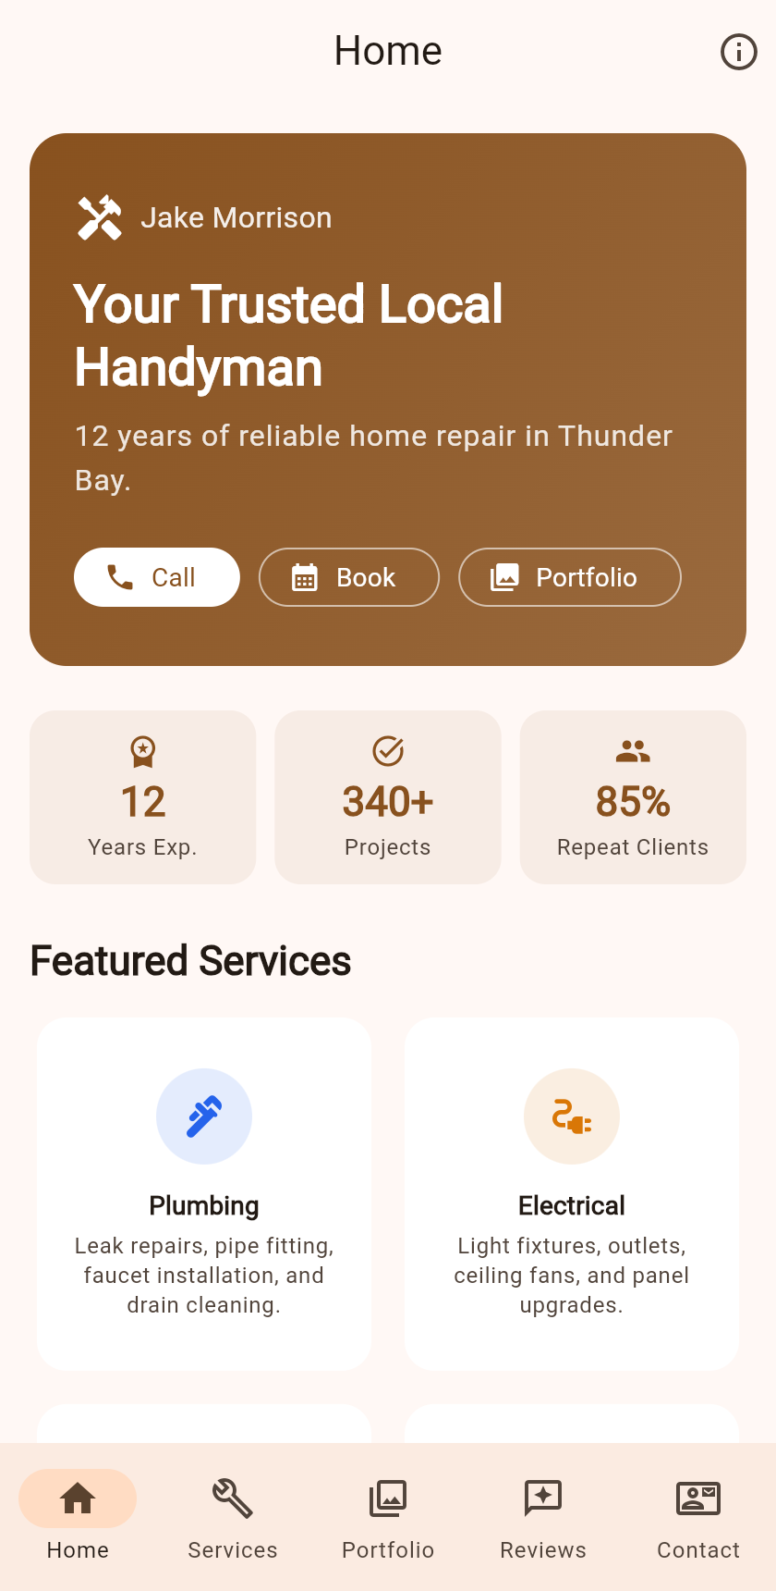
Home Screen
Hero banner with Call / Book / Portfolio buttons
Stat chips: 12 years, 340+ projects, 85% repeat clients
Featured services grid (top 4 of 6)
ConstrainedBox(maxWidth: 600) for responsive centering

Slide 6
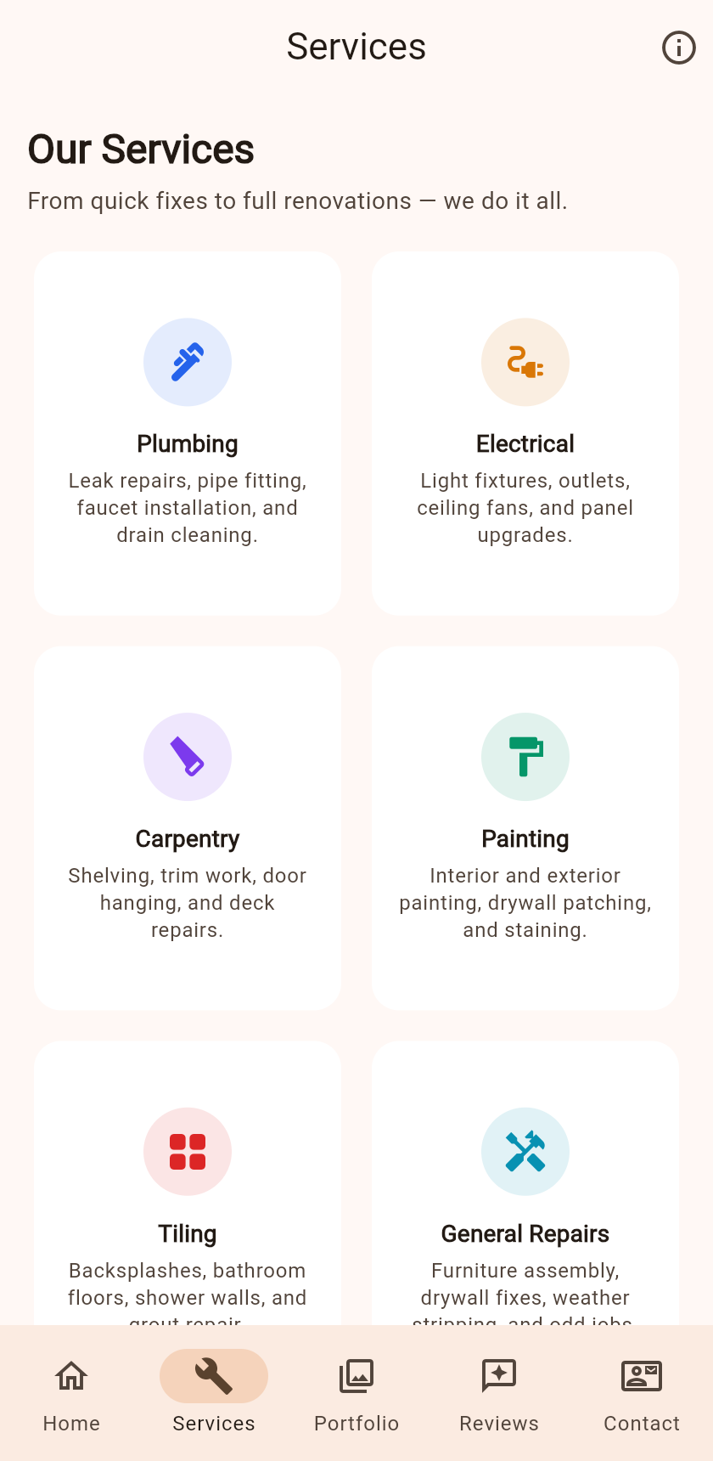
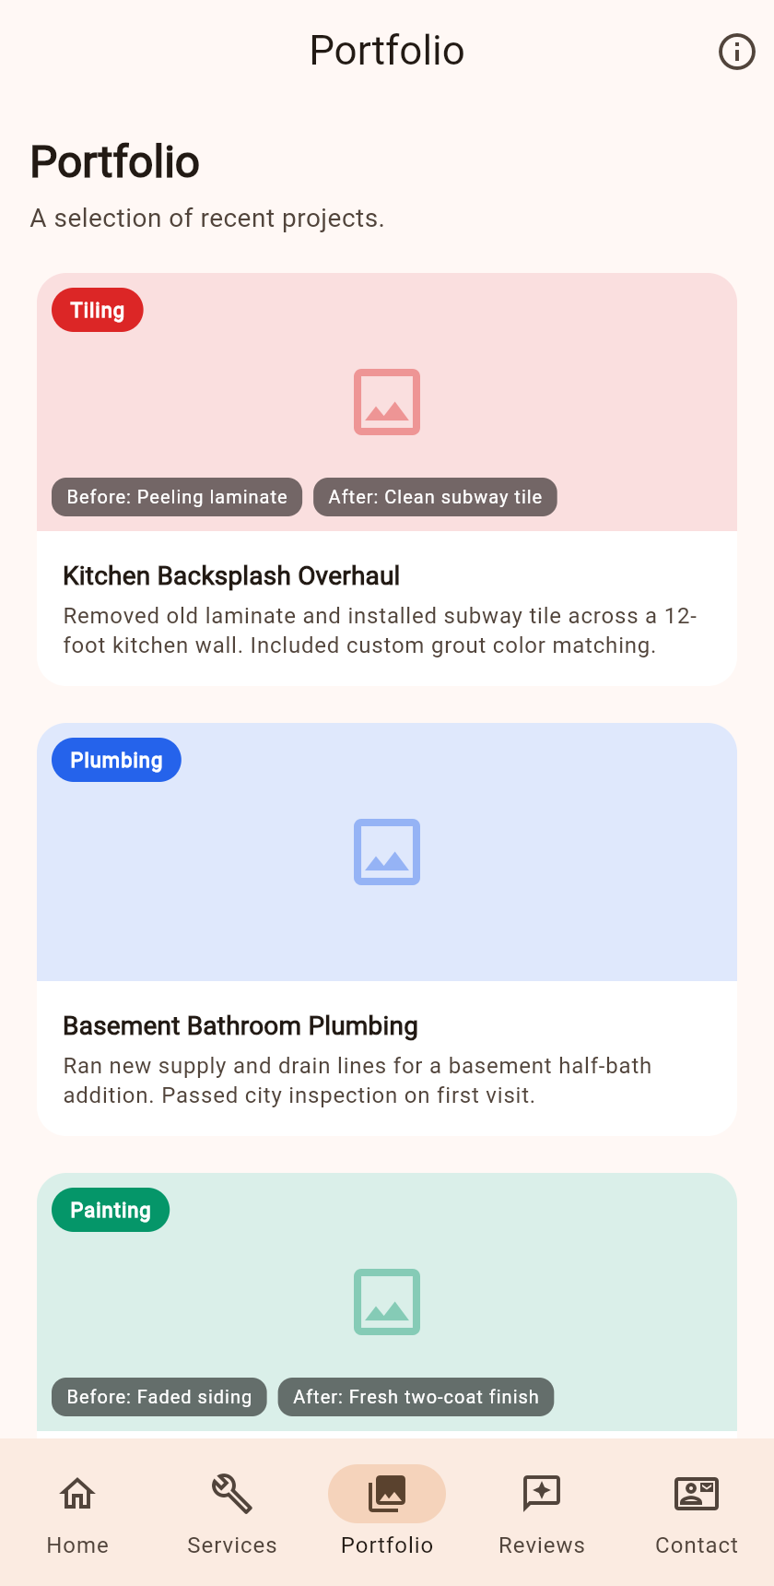
Services & Portfolio
Services: 6 categories in a 2-column grid with icons
Portfolio: project cards with category tags and before/after labels
Placeholder images with color overlays (no network images)
All data from MockPortfolioRepository → easy to swap

Slide 7
Reviews & Contact
Reviews: average rating header + testimonial cards (name, stars, quote)
Contact: business info tiles + message form with validation
Form calls submitContact() — simulates 400ms delay, shows snackbar
When Firebase is connected, the same method writes to Firestore

Slide 8
About Screen
Accessible from the info icon in the app bar
Profile avatar, name, tagline
Stat chips: years, projects, repeat rate
Bio paragraph, certifications, and service area

Slide 9
Testing & Quality
flutter analyze — 0 warnings or errors
flutter test — 7 widget tests, all pass
Tests cover: all 5 tabs, About page nav, form validation
flutter build web — successful, used for screenshots

Slide 10
Firebase Integration Plan
1. Add firebase_core, cloud_firestore, firebase_storage to pubspec.yaml
2. Create FirestorePortfolioRepository implementing the same interface
3. Replace mock in main.dart — zero screen changes
"Program to an interface, not an implementation"

Slide 11
Conclusion
Six-screen Flutter portfolio app for a home handyman service
Material 3 with warm amber theme, responsive layout
Repository pattern keeps data access swappable
All tests pass, analysis clean, web build verified
Firebase integration is a one-class swap
Thank you — questions?

