Slide 1
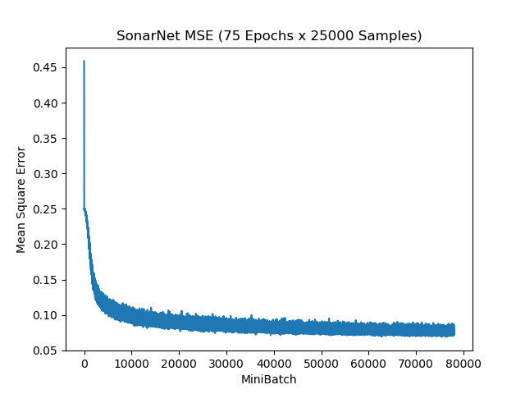
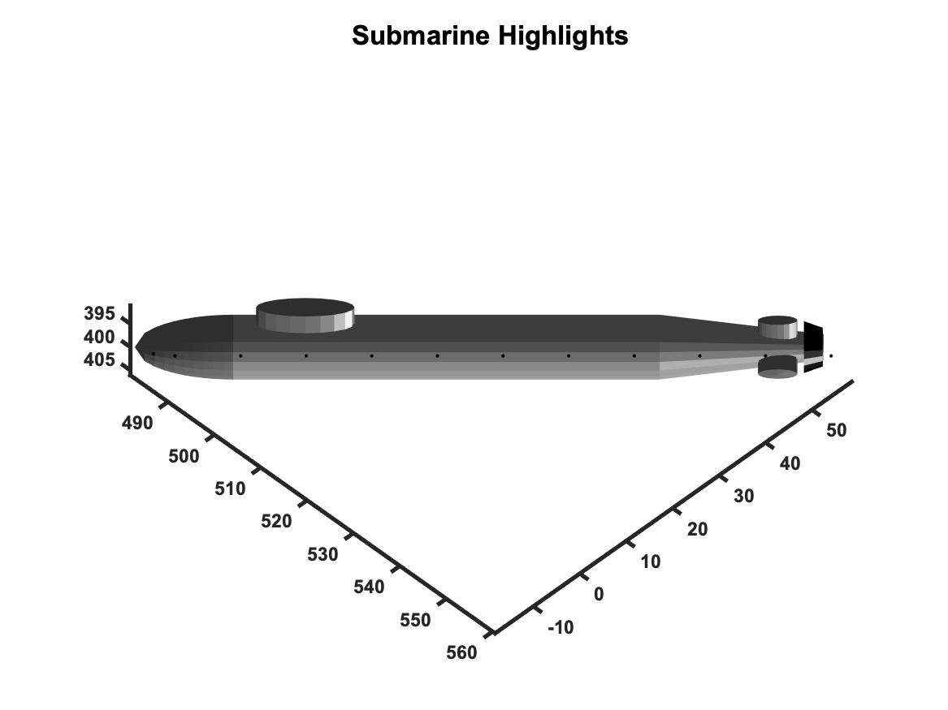
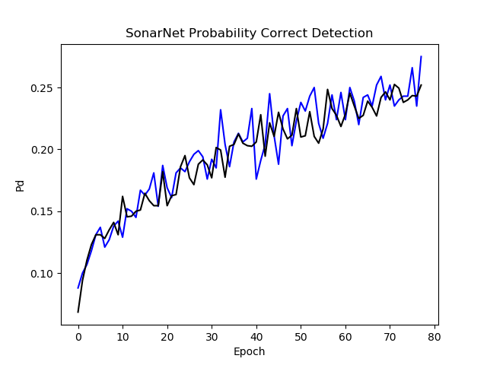
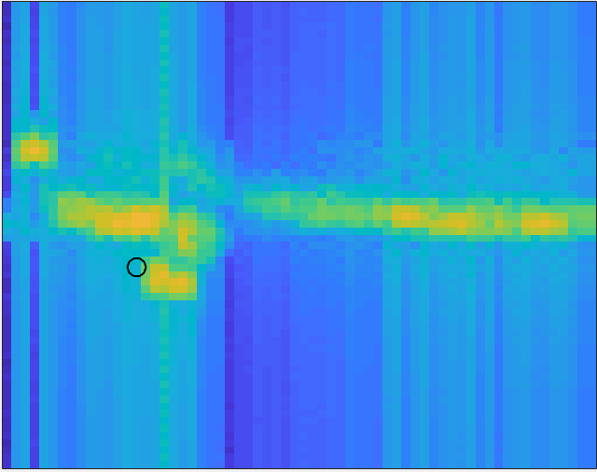
Deep Learning for Sonar Signal Processing
Matt Daily, CSC 492
Overview
Current sonar systems rely upon complicated signal processing algorithms to detect targets, what is in essence an image recognition task.
Using a simulation to generate representative data, I am testing the application of CNNs to this problem
Network Design
The network consists of:
Two convolutional ”pre-processing” layers
A branch of two convolutional layers that represent projections along the frequency and range axes
Two fully connected layers as a classifier
A Sigmoid activation after the 2nd FC
I used an MSE error model rather than SoftMAX because there can be targets in multiple bins.
SONARNET
Training
40,000 total samples
20,000 training
10,000 validation
10,000 test
Each training sample differs in:
Target presence, location, speed
Water depth, wind speed, bottom type, volume scattering
SGD Optimilzer with variable learning rate (1e-2, 1e-4, 1e-6) and mini-batch size 20
CONV: 25x7x7->25
ReLU
MaxPool: 5x5
CONV: 25x11x11->25
ReLU
MaxPool: 3x3
Problem Statement
In this case, we are hypothesizing a torpedo sonar. It’s job is to identify the range and Doppler (frame and bin) of a target if there is one. Relevant details are:
The target has structure modelled as highlights) and is moving
The sonar is on the front of the torpedo which is moving, and it has an array that makes many beams (25 in this case).
The primary source of interference is reverberation, the scattering of sonar from inhomgenieties in the water and boundaries.
A MATLAB simulation was used to generate training, validation, and test data with random
Target presence, location, speed
Water depth, wind speed, bottom type, volume scattering
X: 25 beams x 64 frames x 64 bins
Y: 64+64 frame/bin detection state
CONV: 11x11x25->64
CONV: 11x11x25->64
ReLU
ReLU
MaxPool: 64
MaxPool: 64
FC: 128
ReLU
FC: 128
Sigmoid
Detector Performance
Detection defined as having an activation of > 0.5 in correct frame/bin only
Due to time limitations, Pfa was not calculated
Final Detector Performance
Pd = 0.25
Would Expect > 0.75 from SOA SP
Surface
Bottom
Target
References
Burdic, “Underwater Acoustic System Analysis 2nd Ed”, Peninsula Publishing, 1990 Li, Johnson, Leung, “csn231 Lecture Notes”, 2018 PyTorch Discussion Board, “VGG-16 Architecture”, https://discuss.pytorch.org/t/vgg-16-architecture/27024
Noh, Hong, Han, “Learning Deconvolution Network For Semantic Segmentation”, Computer Vision Foundation

