Slide 1
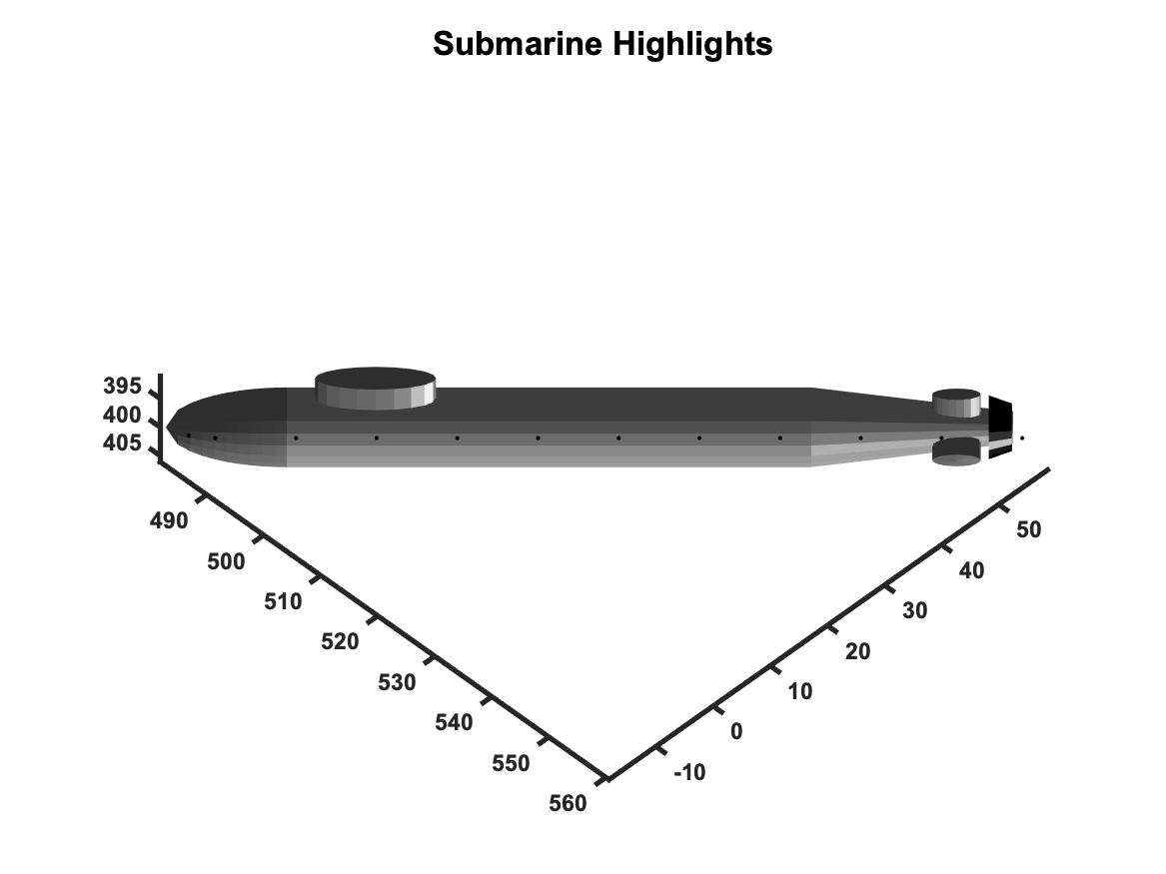
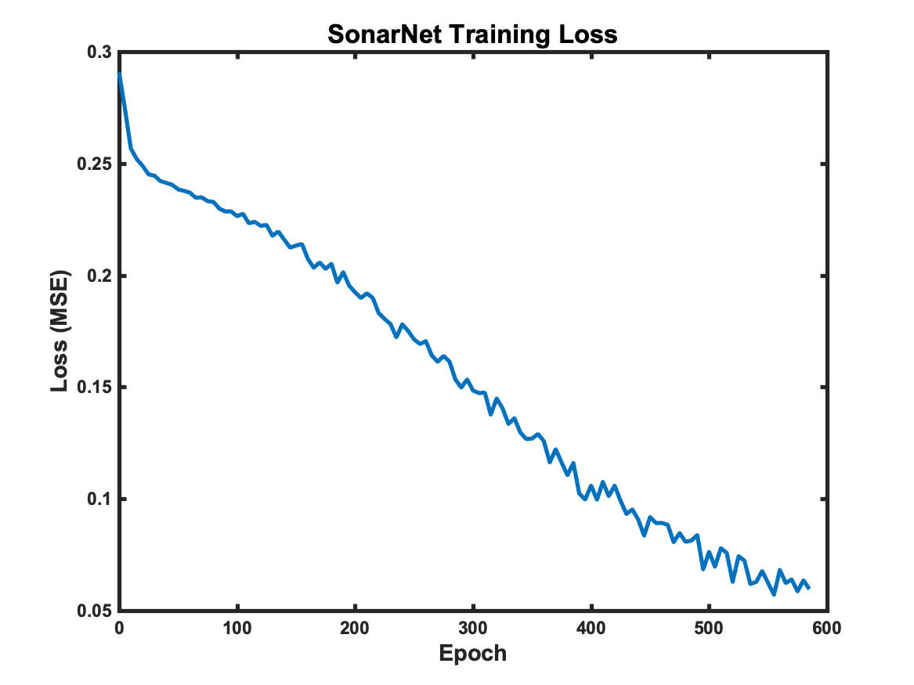
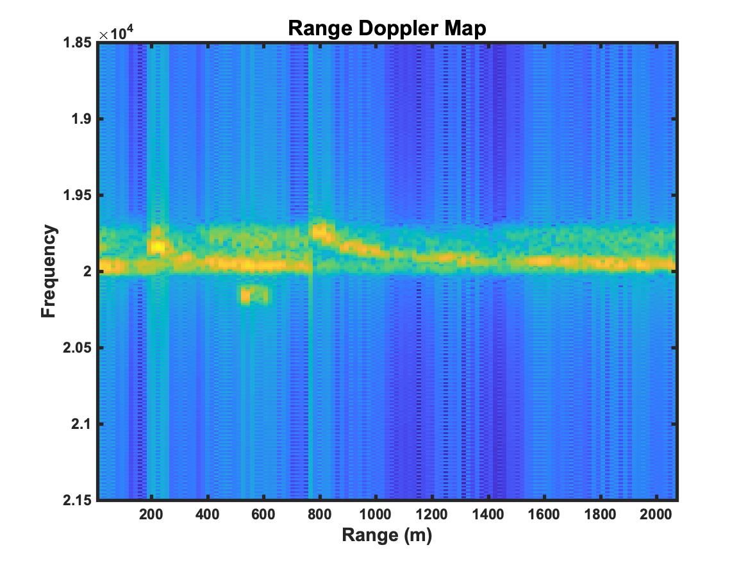
Deep Learning for Sonar Signal Processing
Matt Daily, CSC 492
Overview
Current sonar systems rely upon complicated signal processing algorithms to detect targets, what is in essence an image recognition task.
Using a simulation to generate representative data, I am testing the application of CNNs to this problem
Network Design
The network consists of:
Two “VGG style” convolutional ”pre-processing” layers
A branch of two convolutional layers that represent projections along the frequency and range axes
Two fully connected layers as a classifier
I used an MSE error model rather than SoftMAX because there can be targets in multiple bins. Training was with SGD
SONARNET
Training
25,000 total samples
15,000 training
5,000 validation
5,000 test
Each training sample differs in:
Target presence, location, speed
Decoy presence, location, doppler
Water depth, wind speed, bottom type, volume scattering
CONV: 25x11x11->25
ReLU
MaxPool: 5x5
CONV: 25x19x19->25
ReLU
MaxPool: 3x3
Problem Statement
In this case, we are hypothesizing a torpedo sonar. Relevant details are:
The target has structure and is moving
There can be decoys (echo repeaters)
The sonar is on the front of the torpedo which is moving, and it has an array that makes many beams (25 in this case).
The primary source of interference is reverberation, the scattering of sonar from inhomgenieties in the water and boundaries.
A simulation was used to generate training, validation, and test data with random
Target presence, location, speed
Decoy presence, location, doppler
Water depth, wind speed, bottom type, volume scattering
CONV: 11x11x25->128
CONV: 11x11x25->256
ReLU
ReLU
MaxPool: 128
MaxPool: 256
FC: 384
FC: 384
Detector Performance
Detector performance of both decoy and real were compared to SOA split window normalizer
Surface
Bottom
 | True | Decoy | Total
Split Window | Work | In | Progress
VGG-16
Target

