Slide 1







Ultraflexible Smart FLoating Offshore Wind Turbine (USFLOWT)
Model Linearization
David Stockhouse
Aoife Henry
Manuel Pusch
Dec. 3, 2021
https://arpa-e.energy.gov/?q=arpa-e-programs/atlantis

Slide 2
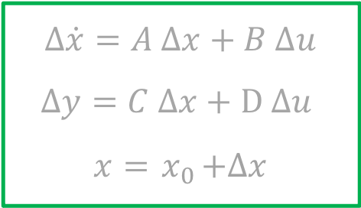
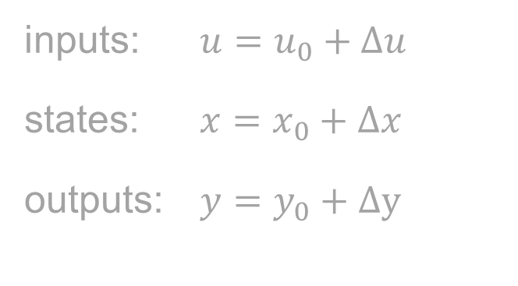
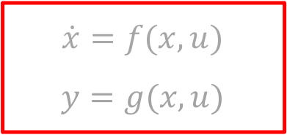
Model Linearization
applied deviation
$$\dot{x}=f(x, u)$$
$$y=g(x,u)$$
nonlinear model
inputs: $u=u_{0}+Δu$
states: $x=x_{0}+Δx$
outputs: $y=y_{0}+Δy$
steady state operation point
$$Δ\dot{x}=A Δx+B Δu$$
$$Δy=C Δx+D Δu$$
$$x={ x}_{0}+Δx$$
linear model

Slide 3


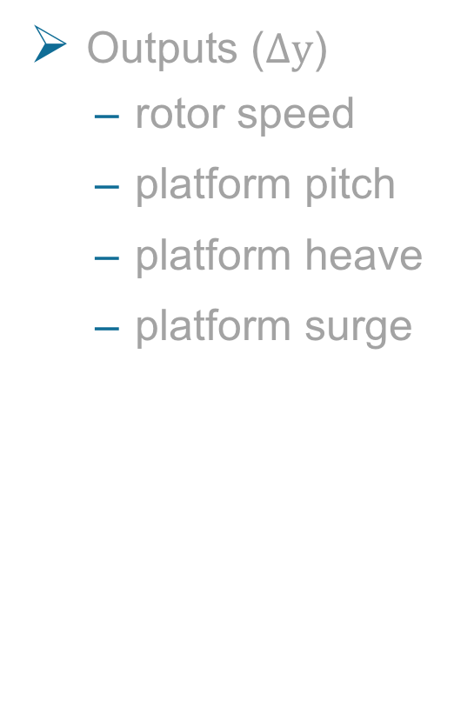
Inputs and Outputs
Wind Speeds (steady)
$12$ m/s
$14$ m/s
$20$ m/s
Inputs ($Δu$)
collective blade pitch
generator torque
Outputs ($Δy$)
rotor speed
platform pitch
platform heave
platform surge
Notes:
Other inputs: yaw angle, wave, wind shear, etc.

Slide 4
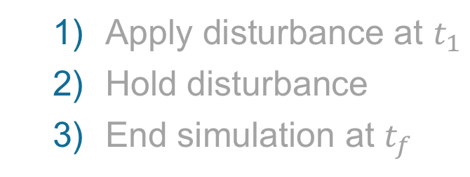
Inputs: Disturbance Signals
Types
positive step
negative step
sine
Parametrization
amplitude
frequency
Apply disturbance at $t_{1}$
Hold disturbance
End simulation at $t_{f}$
Notes:
Will never reach steady-state for sine disturbance
Steady-state not that relevant, even then only for step
Metric = |y_nonlin – y_lin|, integral error
Goal: 2 responses should be as similar as possible after TDist

Slide 5
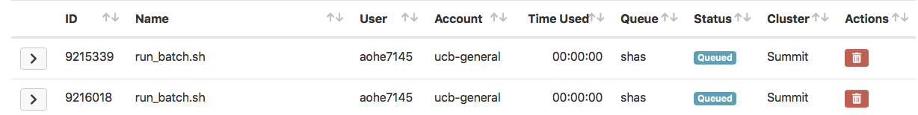

Time Domain Outputs: Steady-State Error

Slide 6
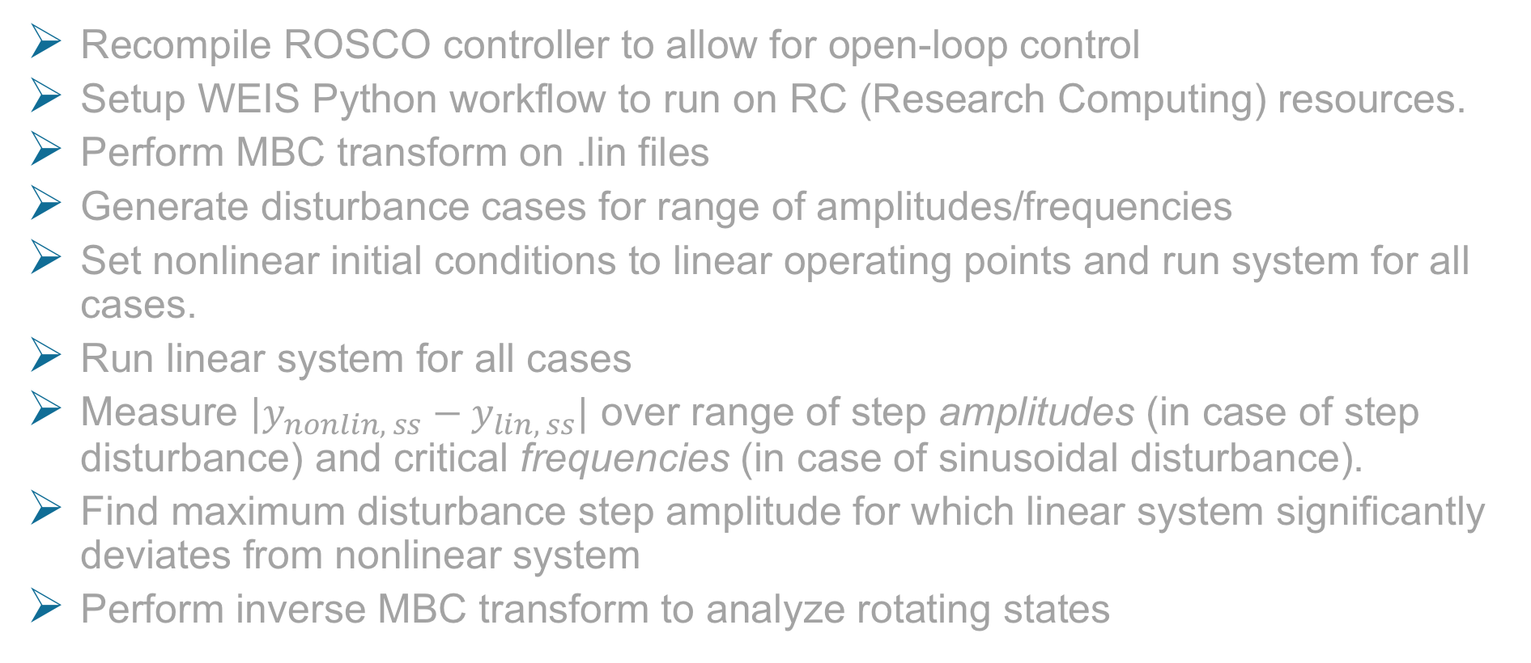
Simulation Setup
Recompile ROSCO controller to allow for open-loop control
Setup WEIS Python workflow to run on RC (Research Computing) resources.
Perform MBC transform on .lin files
Generate disturbance cases for range of amplitudes/frequencies
Set nonlinear initial conditions to linear operating points and run system for all cases.
Run linear system for all cases
Measure ${|y}_{nonlin, ss}−y_{lin, ss}|$ over range of step amplitudes (in case of step disturbance) and critical frequencies (in case of sinusoidal disturbance).
Find maximum disturbance step amplitude for which linear system significantly deviates from nonlinear system
Perform inverse MBC transform to analyze rotating states

Slide 7
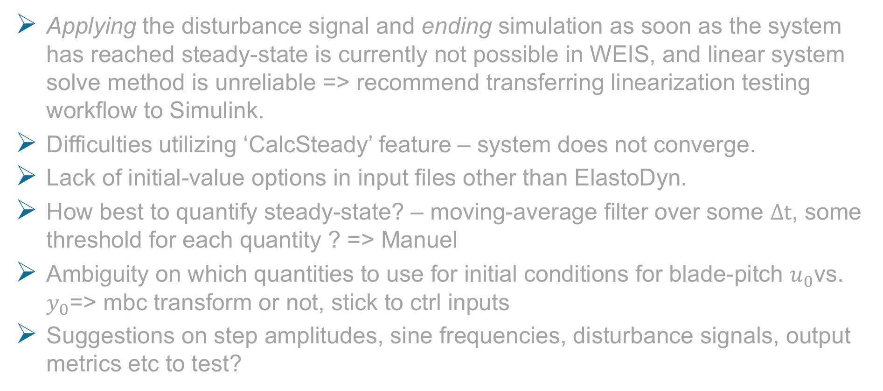
Highlighted Issues & Open Questions
Applying the disturbance signal and ending simulation as soon as the system has reached steady-state is currently not possible in WEIS, and linear system solve method is unreliable => recommend transferring linearization testing workflow to Simulink.
Difficulties utilizing ‘CalcSteady’ feature – system does not converge.
Lack of initial-value options in input files other than ElastoDyn.
How best to quantify steady-state? – moving-average filter over some $Δt$, some threshold for each quantity ? => Manuel
Ambiguity on which quantities to use for initial conditions for blade-pitch $u_{0}$vs. $y_{0}$=> mbc transform or not, stick to ctrl inputs
Suggestions on step amplitudes, sine frequencies, disturbance signals, output metrics etc to test?

Slide 8
BACKUP

