Slide 1

AngularJS Introduction

Slide 2

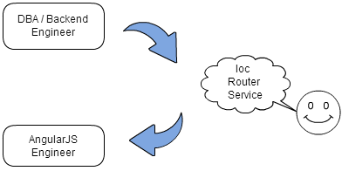
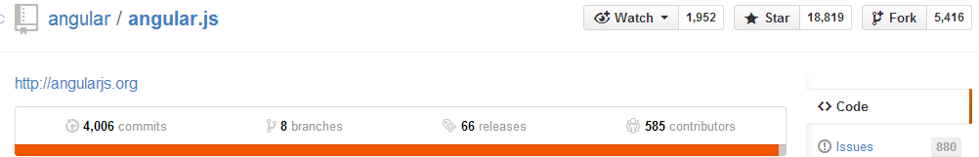
Author-Miško Hevery

Slide 3
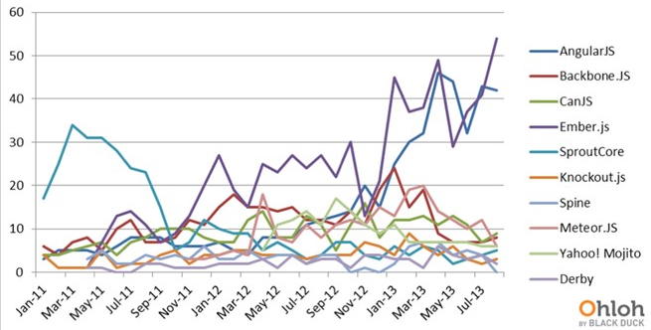
Github Contributors

Slide 4
What is Angular
AngularJS is a structural framework for dynamic web apps. It lets you use HTML as your template language and lets you extend HTML's syntax to express your application's components clearly and succinctly. Out of the box, it eliminates much of the code you currently write through data binding and dependency injection.

Slide 5
Concept
Controller
Filter
Service
ViewRoute
Expression
Form

Slide 6
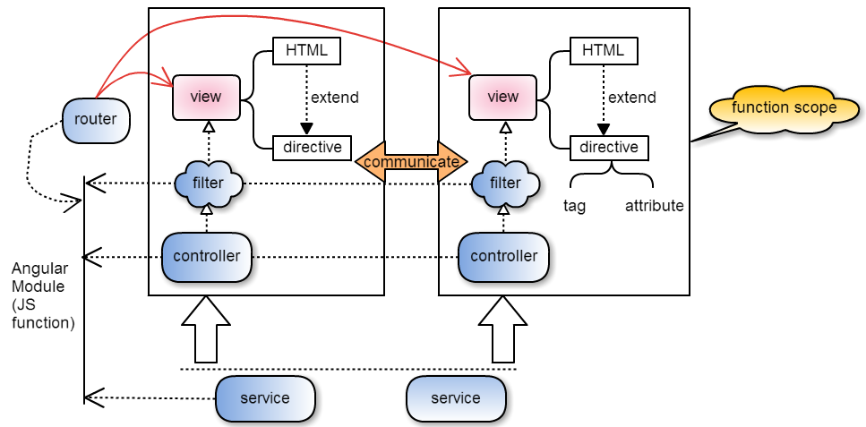
Angluar Structure

Slide 7
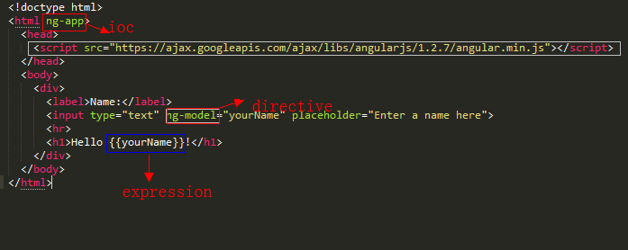
Simple Demo
Demo

Slide 8
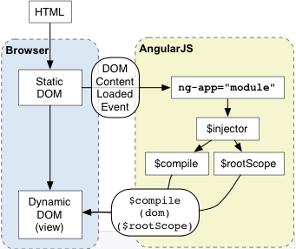
Bootstrap

Slide 9
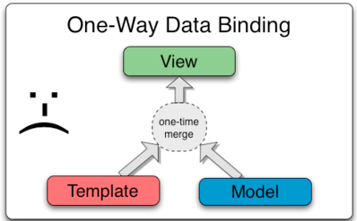
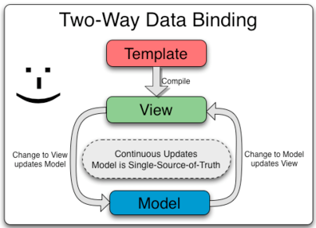
Data Binding
Classical Angluar

Slide 10
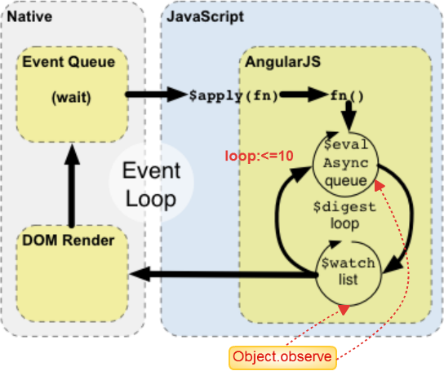
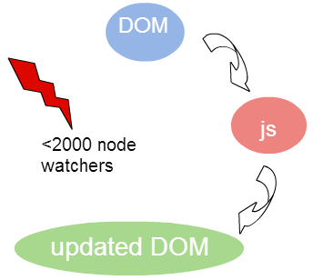
Data Binding-dirty checking
1. Async list
2. watch list

Slide 11
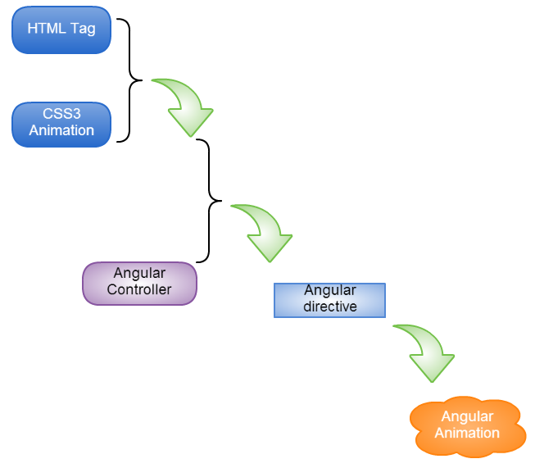
Animation

Slide 12
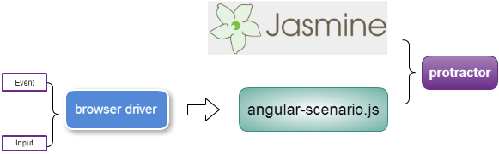
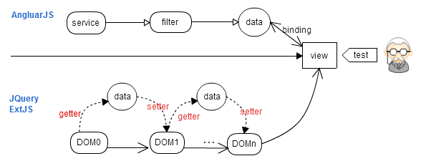
E2E Testing

Slide 13
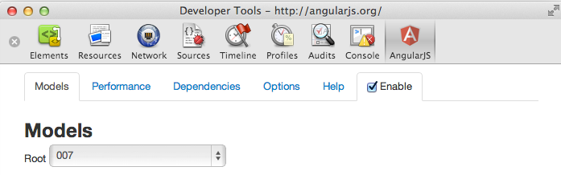
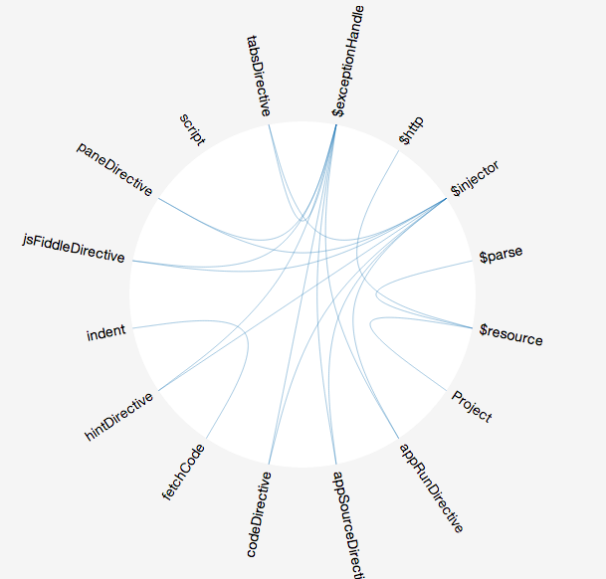
Debug for Angular-Batarang

Slide 14
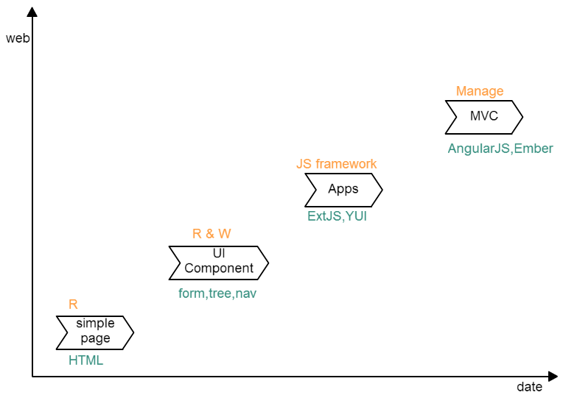
Position In Web

Slide 15
Pros
MVC (Complete separation M & V & C)
A declarative user interface
Behavior with directives
Flexibility with filters
Expression in HTML
Module & Service
Scope(controller) Separation
Context aware communication
Unit testing & E2E testing

Slide 16
Cons
Data Binding: dirty-checking (<2000 nodes)
No Browser optimization (DOM not String in template)
Less UI Component (Angular-UI)
Difficult for debuging (Batarang)

Slide 17
AngularJS Resource
http://pivotal.github.io/jasmine/
https://github.com/angular/angular.js/blob/master/src/ng/browser.js
https://raw2.github.com/achenzhaoa/angularjs-richui/gh-pages/angular-1.2.3/angular-scenario.js
http://angular-ui.github.io/

Slide 18
Thank you!

