Slide 1
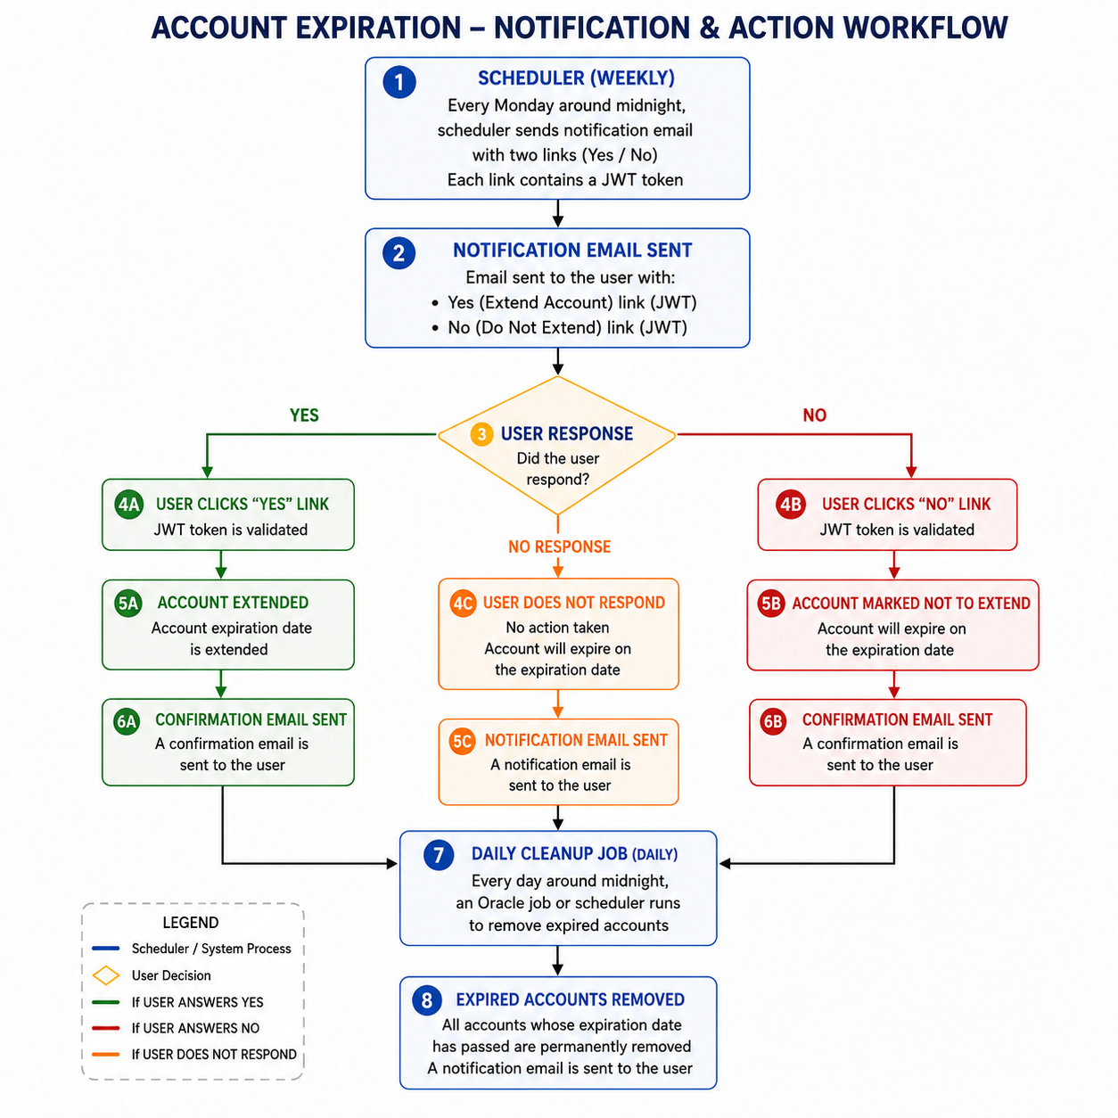
Account Expiration – Notification & Action Workflow

