Slide 1

UFo
Unique Folder app
TEAM - 18
Sreekanth Bhamidipati – 5
Akhil Beerelli – 4
Avinash Sankarasetty – 81
Abhilash Parimi - 65

Slide 2
Introduction
Android File Manager delivers a great experience with all of the features you didn't realize that you wanted. From managing files, to storage, their features all work well together delivering a simple and easy to use app.
The application will connect with online database to store the user uploaded files.

Slide 3
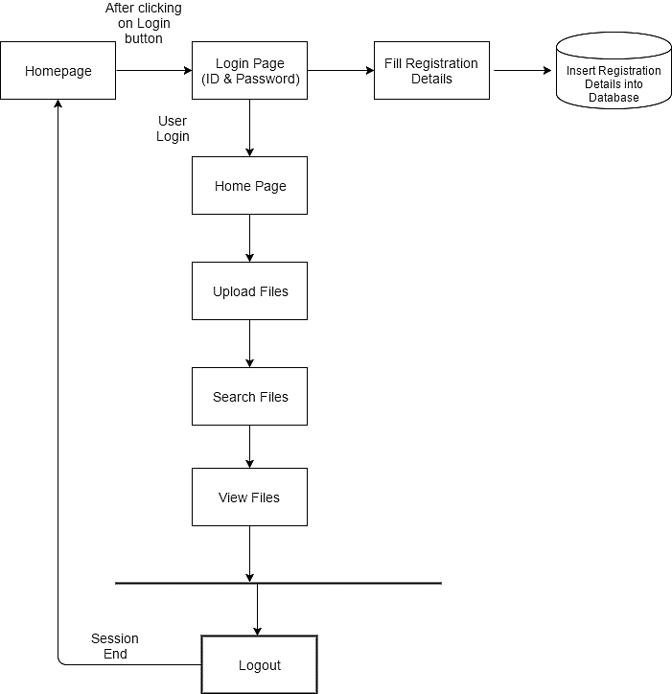
Software Architecture

Slide 4
Problems with existing system
In traditional file explorer system, there is no security for the uploaded data.
The files are not categorized, which leads to unstructured data.
Data duplication may exist which increases the disk size
Files cannot be searched using voice command.
Performance of device may become slow due to consuming huge storage area.

Slide 5
App Features
The user data is stored in the database
The application keeps the user files safe and secured.
Application allows user to search a file over voice command.
Maintains the files in a categorized and in a structured manner.
It avoids the data duplication which prevents re-writing the similar file.

Slide 6
Video
https://youtu.be/vqLV-dYMPfM

