Slide 1
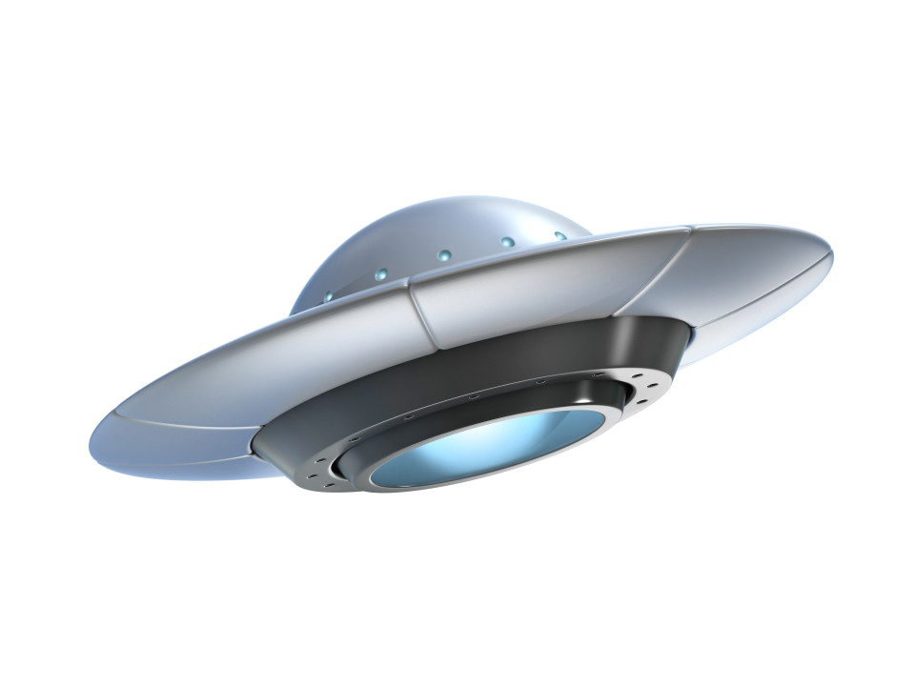
UFo
Unique Folder app
TEAM - 18
Sreekanth Bhamidipati – 5
Akhil Beerelli – 4
Avinash Sankarasetty – 81
Abhilash Parimi - 65

Slide 2
Introduction
Android File Manager delivers a great experience with all of the features you didn't realize that you wanted. From managing files, to storage, their features all work well together delivering a simple and easy to use app.
The application will connect with online database to store the user uploaded files.

Slide 3
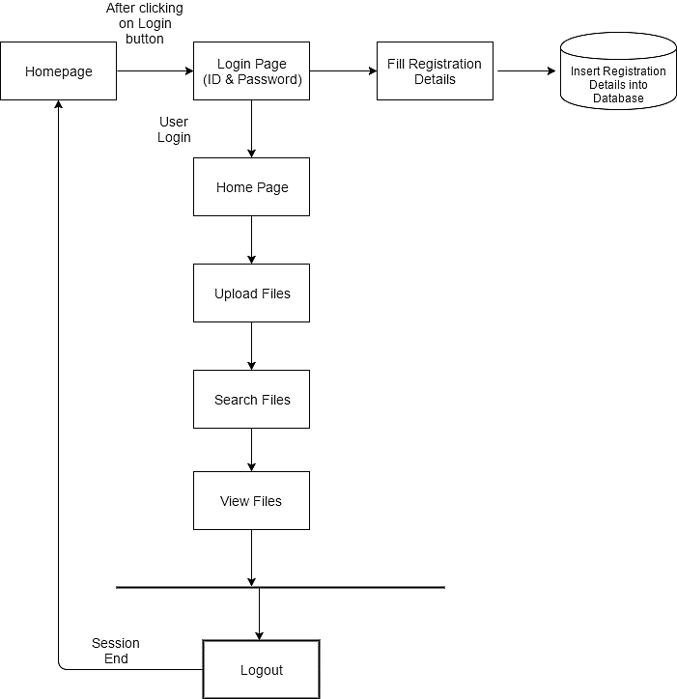
Software Architecture

Slide 4
Problems with existing system
In traditional file explorer system, there was no such security for the uploaded data.
The files were not categorized, which may lead to unstructured data.
Data duplication may also exist which increases the disk size which may lead to slow the outcome process.
No file search over voice command.
Performance of device may become slow due to consuming huge storage area.

Slide 5
App Features

Slide 6
Video

