Slide 1
Data collection
Web scraping & Crawling
Sigal Shaked
Slides were taken by permission from Dr. Ofrit Lesser

Slide 2
Agenda
Getting data
XML
Download file with R
RSS
JSON
Web scraping (example Twitter)
Web crawling

Slide 3
Teaching APIs and web scraping
Although the simplest approach to acquiring data (and the most expeditious for teaching purposes) is to download it from the web.
We spent an entire class demonstrating how (and why) to gather data from the Internet using APIs and web scraping.

Slide 4
How to get data from websites?
RSS Feeds
Really Simple Syndication
News Feeds (RSS) News feeds are an easy way to keep up with websites without having to constantly visit them.
APIs
Application Program Interface
A set of routines, protocols, and tools for building software applications.
Web Scraping
Extracting information from websites using dedicated code.
Notes:
http://stackoverflow.com/questions/4607141/how-does-a-site-like-kayak-com-aggregate-content
https://en.wikipedia.org/wiki/RSS
Several major sites such as Facebook and Twitter previously offered RSS feeds but have reduced or removed support. Additionally, widely used readers such as Shiira, FeedDemon, and Google Reader have been discontinued having cited declining popularity in RSS.^{[29]} However, RSS still remains a widely used standard. RSS support was removed in OS X Mountain Lion's versions of Mail and Safari, although the features were partially restored in Safari 8.^{[30][31]} As of August 2015, Mozilla Firefox and Internet Explorer include RSS support by default, while Google Chrome and Microsoft Edge do not. Additionally, reader services such as Feedly provide synchronization between desktop RSS readers and mobile devices.

Slide 5

Using RSS feeds
RSS (Really Simple Syndication)
פורמט להעברת מידע בין שרתים. לרוב המידע המועבר נקבע ומוגדר מראש.
נפוץ בקרב אתרי חדשות המאפשרים גישה למידע דרך פורטלים שונים (או אפליקציות)
דוגמא: ynet
כדורגל ישראלי http://www.ynet.co.il/Integration/StoryRss57.xml
אפשר להירשם (subscribe) לשירותי RSS ולקבל אותם על בסיס קבוע לפורטל/ מייל/ טלפון וכו
Notes:
http://stackoverflow.com/questions/4607141/how-does-a-site-like-kayak-com-aggregate-content
https://en.wikipedia.org/wiki/RSS
Several major sites such as Facebook and Twitter previously offered RSS feeds but have reduced or removed support. Additionally, widely used readers such as Shiira, FeedDemon, and Google Reader have been discontinued having cited declining popularity in RSS.^{[29]} However, RSS still remains a widely used standard. RSS support was removed in OS X Mountain Lion's versions of Mail and Safari, although the features were partially restored in Safari 8.^{[30][31]} As of August 2015, Mozilla Firefox and Internet Explorer include RSS support by default, while Google Chrome and Microsoft Edge do not. Additionally, reader services such as Feedly provide synchronization between desktop RSS readers and mobile devices.

Slide 6

Using APIs
Web service/ API
מערכת שמטרתה לתמוך בתקשורת בין שרתים (שרת משתמש ושרת אתר/ אוסף אתרים). נותן השירות מטעם שרת האתר יוצר אוסף של פונקציות המאפשרות גישה למסד הנתונים של האתר.
המערכת/ השירות נקרא Web service
אוסף הפונקציות נקרא API (Application Programming Interface)
Notes:
http://stackoverflow.com/questions/4607141/how-does-a-site-like-kayak-com-aggregate-content
https://en.wikipedia.org/wiki/RSS
Several major sites such as Facebook and Twitter previously offered RSS feeds but have reduced or removed support. Additionally, widely used readers such as Shiira, FeedDemon, and Google Reader have been discontinued having cited declining popularity in RSS.^{[29]} However, RSS still remains a widely used standard. RSS support was removed in OS X Mountain Lion's versions of Mail and Safari, although the features were partially restored in Safari 8.^{[30][31]} As of August 2015, Mozilla Firefox and Internet Explorer include RSS support by default, while Google Chrome and Microsoft Edge do not. Additionally, reader services such as Feedly provide synchronization between desktop RSS readers and mobile devices.

Slide 7
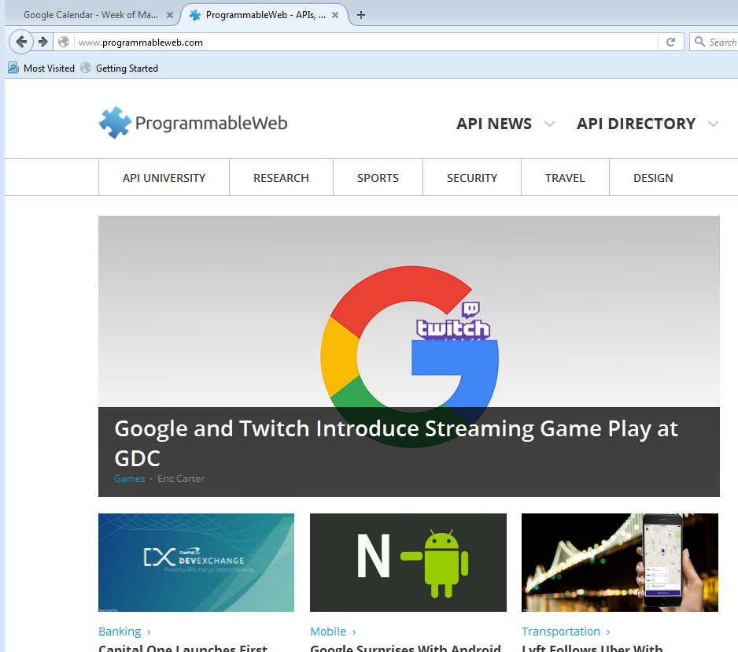
Available APIs info
http://www.programmableweb.com/

Slide 8
Web Scraping
Web crawling
תוכנת מחשב שאוספת באופן אוטומטי מידע מאתרים מקוונים. תוכנת המחשב תתחיל ממקור מסוים (או מקורות) ותיגש למקורות נוספים דרך קישורים באתר.
דוגמאות: Google (או כל מנוע חיפוש אחר)
Web scrapping
קילוף או העתקה של תכנים מאתרים ברשת האינטרנט אל מאגר מקומי כמו בסיס נתונים, בד"כ נעשה באמצעות תוכנת משתמש או זחלן (web crawler)
Most unreliable & most expensive to maintain.
However sometime this is the only way.
Notes:
http://stackoverflow.com/questions/4607141/how-does-a-site-like-kayak-com-aggregate-content
https://en.wikipedia.org/wiki/RSS
Several major sites such as Facebook and Twitter previously offered RSS feeds but have reduced or removed support. Additionally, widely used readers such as Shiira, FeedDemon, and Google Reader have been discontinued having cited declining popularity in RSS.^{[29]} However, RSS still remains a widely used standard. RSS support was removed in OS X Mountain Lion's versions of Mail and Safari, although the features were partially restored in Safari 8.^{[30][31]} As of August 2015, Mozilla Firefox and Internet Explorer include RSS support by default, while Google Chrome and Microsoft Edge do not. Additionally, reader services such as Feedly provide synchronization between desktop RSS readers and mobile devices.

Slide 9
Web crawling guidelines
Issues with automated access (from point of view of crawled business)
Load on site resources
Non-business purpose
Solutions
Technological (passwd-protected, encryption, traffic monitoring and refusal of access) – not very effective/practical
Legal (copyright infringement, trespass to chattel, breach of contract)
“Terms of service/use” document (intended to support litigation)
robots.txt – directly for automated data retrieval tools

Slide 10
Robots.txt
Before crawling, check if there is a robots.txt file by going to URL/robots.txt – if not, check “terms of use”
Check the following websites and determine their restrictions
Amazon.com
eBay.com
Yahoo.com
www.cs.umd.edu
www.smith.umd.edu
www.barnesandnoble.com
www.booksamillion.com
www.wikipedia.org
www.nytimes.com
travelocity.com

Slide 11
RSS
Rich Site Summary
Really Simple Syndication

Slide 12
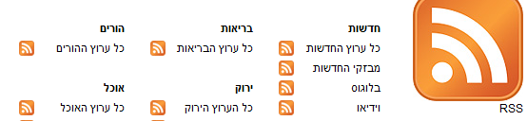
RSS
פורמט להעברת מידע בין שרתים.
אחד השימושים הנפוצים של RSS היום הינו לאפשר למפיצים או צרכנים לקבל מידע שוטף מהאתר (בצורת RSS feed) ולהציגו במקומות שונים ע"י RSS Readers, דוח טבלאי, או פורמט אחר.
הפורמט של RSS feed הוא XML.
דוגמא: ynetמספקת שירותי RSS לאתרי החדשות שלה.

Slide 13
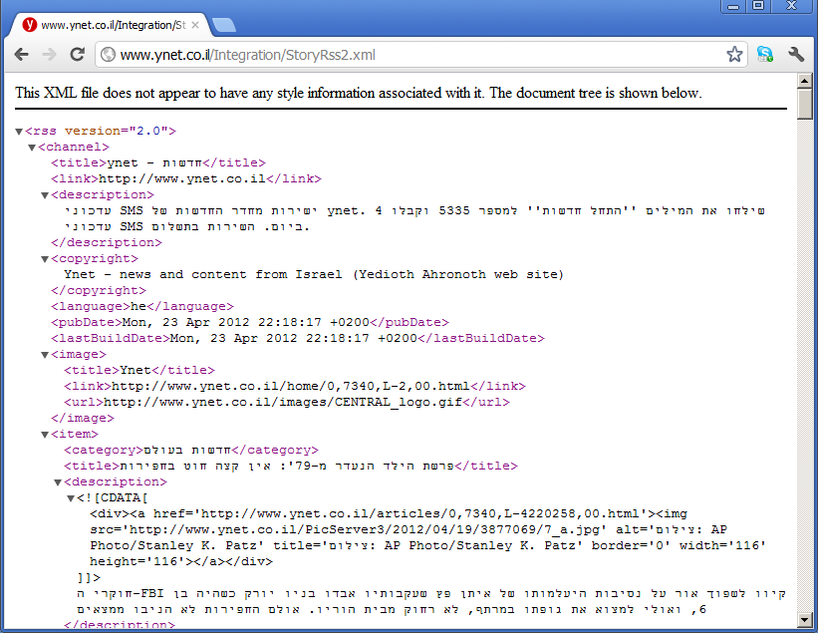
YNET RSS example
http://www.ynet.co.il/Integration/StoryRss2.xml

Slide 14
RSS structure
Fixed structure
ערוץ (channel)
מידע על הערוץ
כתבה (item)
כתבה (item)
כתבה (item)
מידע על הכתבה
מידע על הכתבה
מידע על הכתבה

Slide 15
XML
Extensible markup language
Frequently used to store structured data
Particularly widely used in internet applications
Extracting XML is the basis for most web scraping components
Markup - labels that give the text structure
Content - the actual text of the document

Slide 16
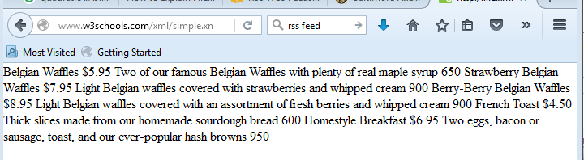
XML
XML Tutorial
http://www.w3schools.com/xml/
Example - www.w3schools.com/xml/simple.xml
View source
Save the XML file & open with excel

Slide 17
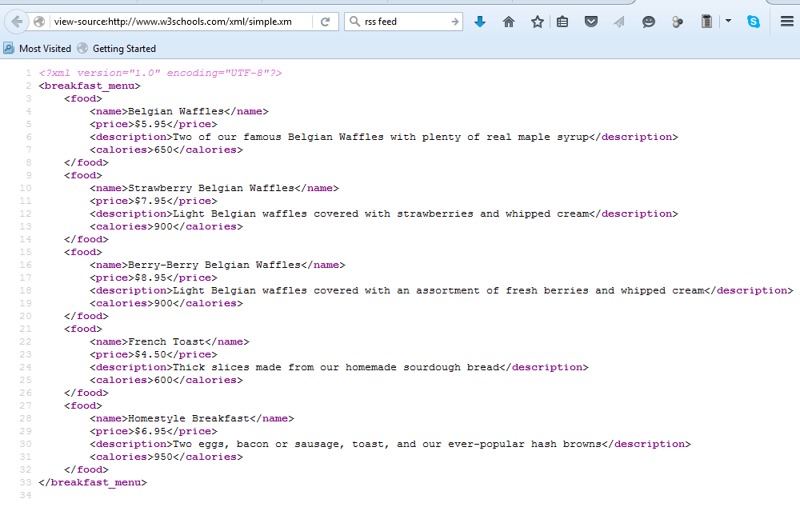
simple.xml – view source

Slide 18
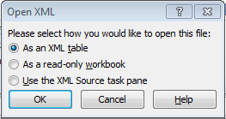
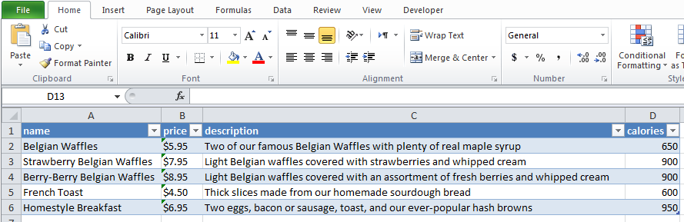
simple.xml – open file with Excel
Save the RSS as a local XML file
Open the XML file with excel
Open in XML format (in the popping menu)

Slide 19
Web scraping

Slide 20
Reading data from the web
Webscraping: Programmatically extracting data from the HTML code of websites.
It can be a great way to get data
Many websites have information you may want to programmatically read
In some cases this is against the terms of service for the website
Attempting to read too many pages too quickly can get your IP address blocked
http://en.wikipedia.org/wiki/Web_scraping

Slide 21
XML-Tags, elements and attributes
Tags correspond to general labels
Start tags <section>
End tags </section>
Empty tags <line-break />
Elements are specific examples of tags
<Greeting> Hello, world </Greeting>
Attributes are components of the label
<img src=“kim.jpg" alt="instructor"/>
<step number="3"> Connect A to B. </step>
Good source for more info: https://en.wikipedia.org/wiki/XML

Slide 22
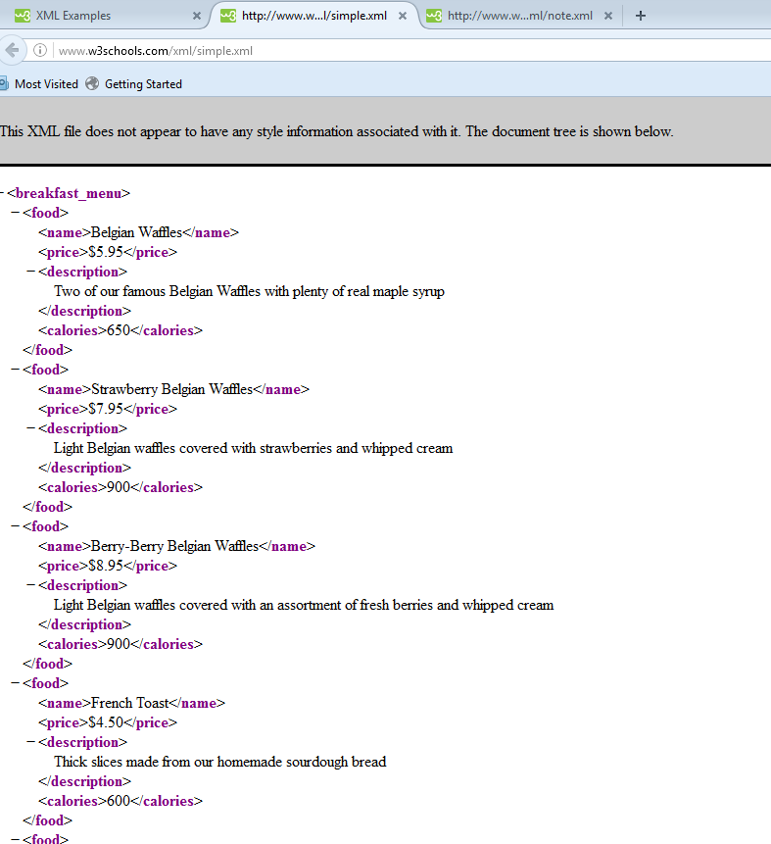
Example XML file
http://www.w3schools.com/xml/simple.xml

Slide 23
XML tutorials
Official XML tutorials short, long
An outstanding guide to the XML package

Slide 24
JSON
Javascript Object Notation
Lightweight data storage
Common format for data from application programming interfaces (APIs)
Similar structure to XML but different syntax/format
Data stored as
Numbers (double)
Strings (double quoted)
Boolean (true or false)
Array (ordered, comma separated enclosed in square brackets [])
Object (unorderd, comma separated collection of key:value pairs in curley brackets {})
http://en.wikipedia.org/wiki/JSON

Slide 25
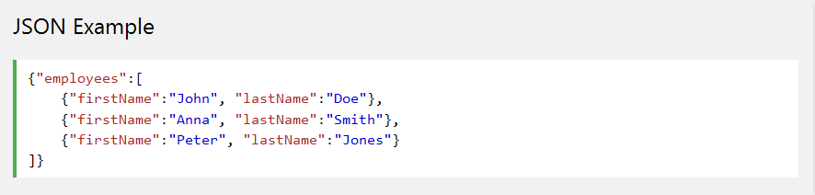
Example JSON file
JSON is an easier-to-use alternative to XML.
See http://www.w3schools.com/json/
JSON example defines an employees object, with an array of 3 employee records:

Slide 26
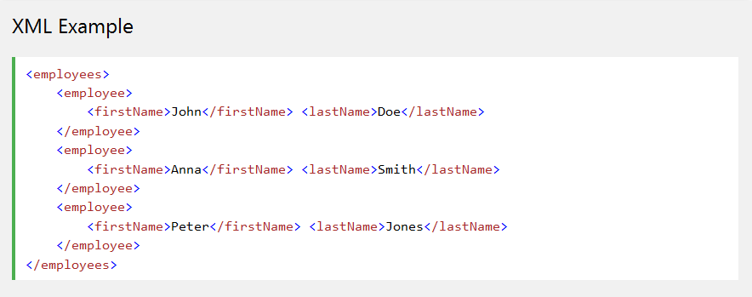
Example XML vs JSON
Same example with XML.

Slide 27
Further resources
http://www.json.org/
A good tutorial on jsonlite
http://www.r-bloggers.com/new-package-jsonlite-a-smarter-json-encoderdecoder/
jsonlite vignette

Slide 28
REST API
Example

Slide 29
REST APIs
REST stands for Representational State Transfer
A style of software architecture for distributed hypermedia systems such as the World Wide Web.
A collection of network architecture principles which outline how resources are defined and addressed
REST architecture involves reading a designated Web page that contains an XML file. The XML file describes and includes the desired content.
Notes:
this is the presentation

Slide 30
REST and HTTP
The motivation for REST was to capture the characteristics of the Web which made the Web successful.
URI (Uniform Resource Identifier) Addressable resources
HTTP Protocol
Make a Request – Receive Response – Display Response
Exploits the use of the HTTP protocol methods such as:
POST, GET, PUT, DELETE
Notes:
https://www.youtube.com/watch?v=7YcW25PHnAA

Slide 31
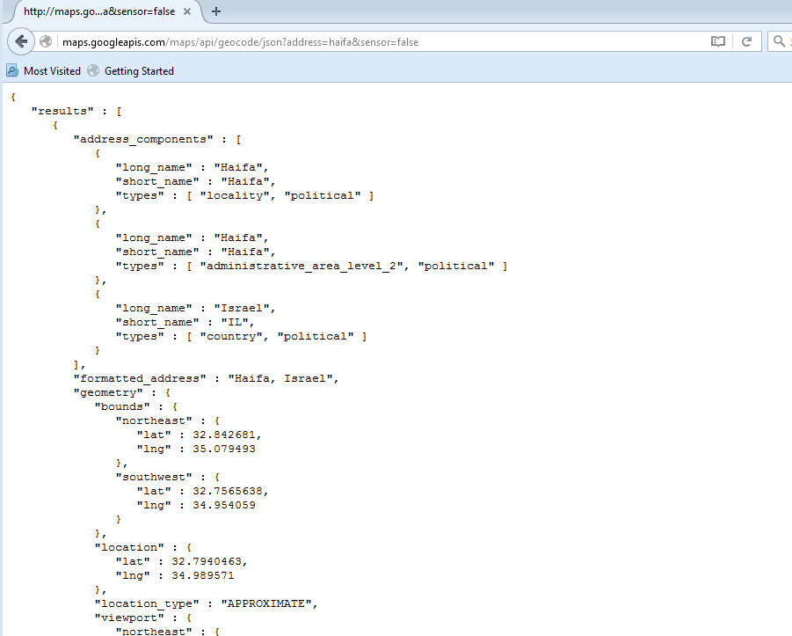
Example – google maps api
Look at the JSON array of:
http://maps.googleapis.com/maps/api/geocode/json?address=haifa&sensor=false

Slide 32
Ebay Rest API - דוגמא
eBay מאפשרת גישה למסד הנתונים שלה דרך אוסף APIs נוחים פשוטים לשימוש. לדוגמא, Shopping API:
http://developer.ebay.com/DevZone/shopping/docs/Concepts/ShoppingAPIGuide.html
ע"מ להשתמש בפונקציונאליות שהאתר מאפשר, יש להירשם תחילה לאתר הפיתוח ולקבל AppID.

Slide 33
Ebay Rest API
חפש מוצר דרך ה-API:
http://open.api.ebay.com/shopping?
callname=FindProducts&
responseencoding=XML&
appid=<YOUR APP ID>&
siteid=0&
QueryKeywords=iPhone&
AvailableItemsOnly=false&
MaxEntries=20&
version=813

Slide 34
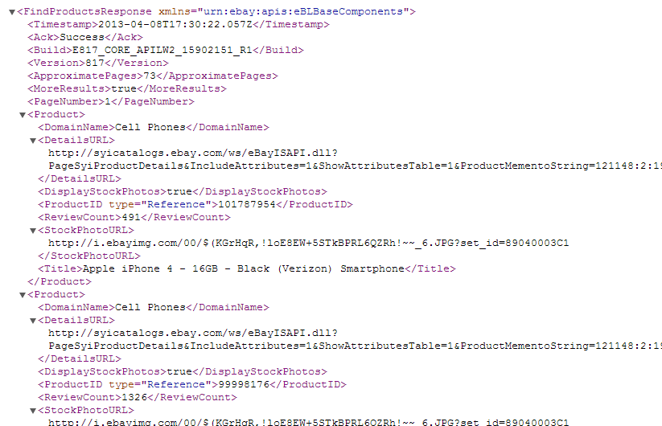
Ebay Rest API
XML format – possible to open with excel, but not scalable
We have seen how to parse and handle it with R

Slide 35
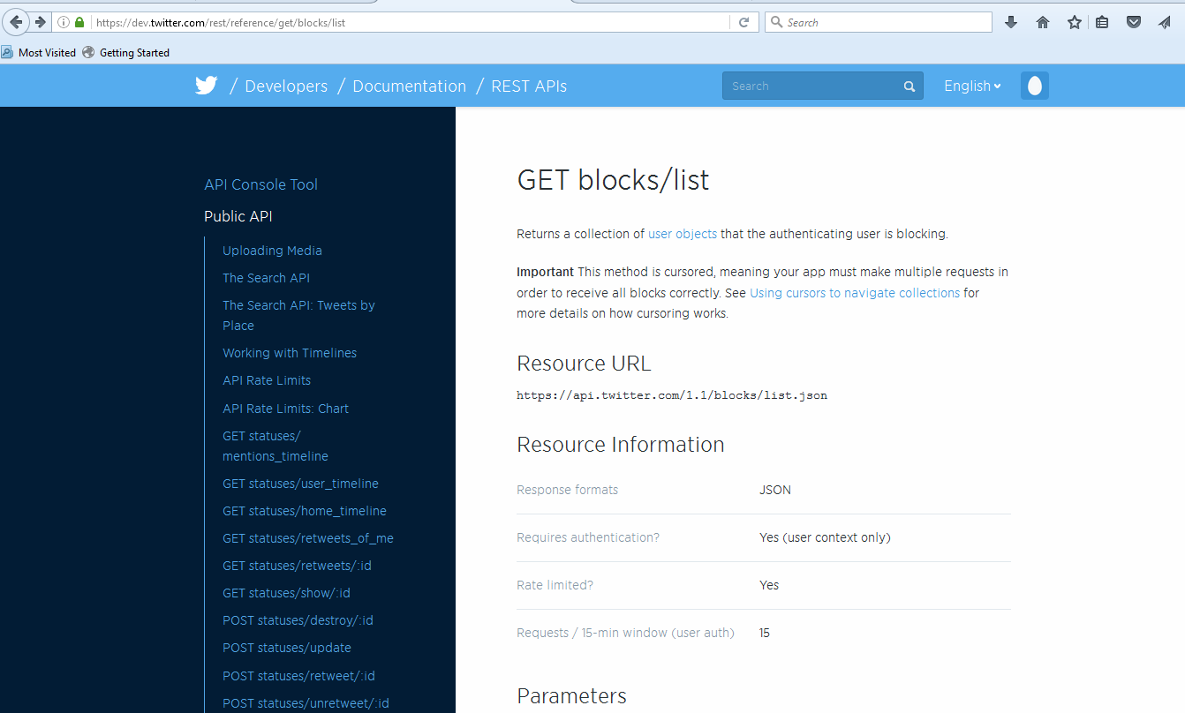
Application programming interfaces
https://dev.twitter.com/rest/reference/get/blocks/list

Slide 36
Twitter with R example
Install & load twitteR
Setup a twitter account (if you don’t already have one)
http://twitter.com/signup
Go to https://apps.twitter.com & sign on with your twitter account
Click on the button that says “Create New App”

Slide 37
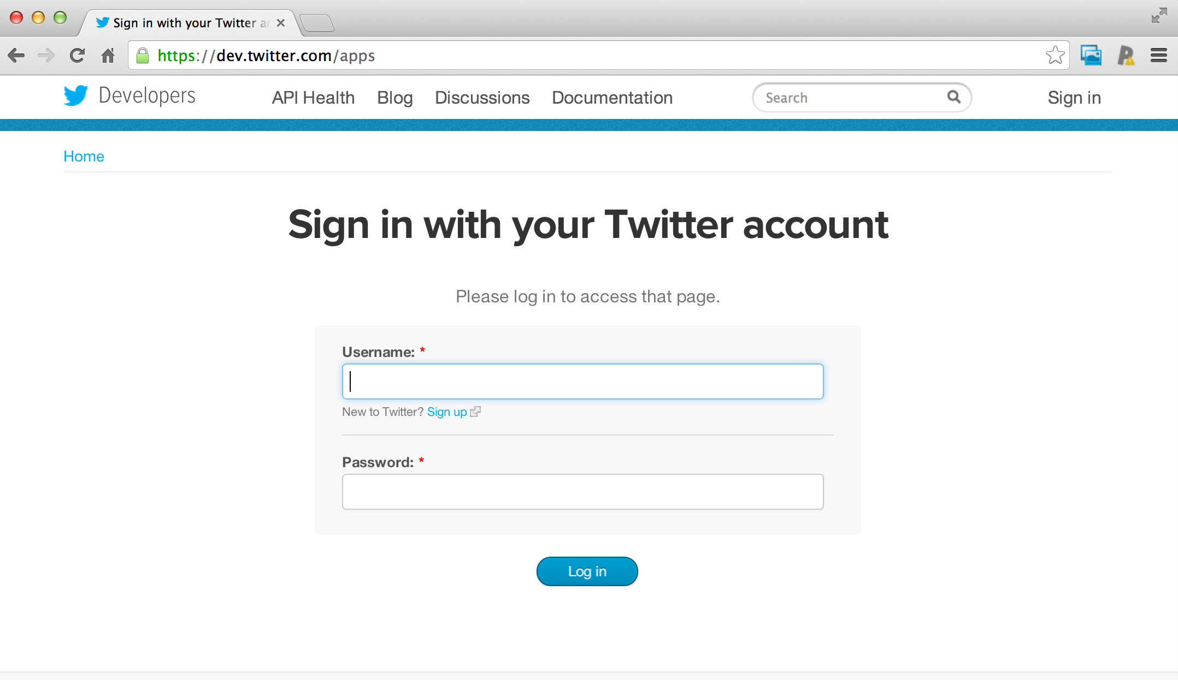
Creating an application
Sign in with you twitter account

Slide 38
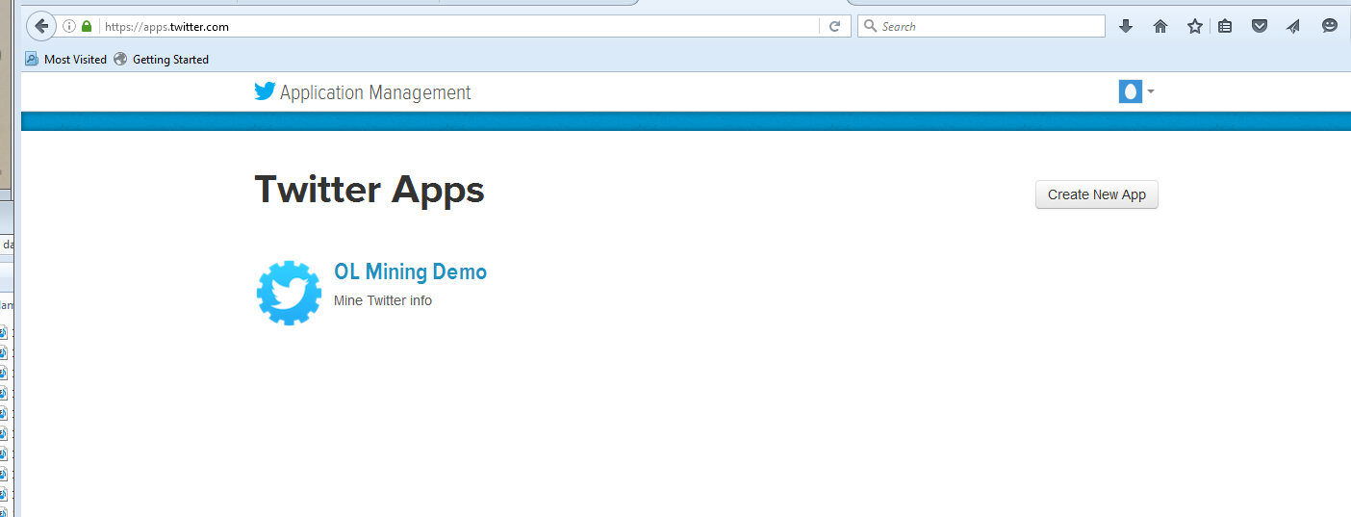
Create a new twitter application
https://apps.twitter.com/

Slide 39
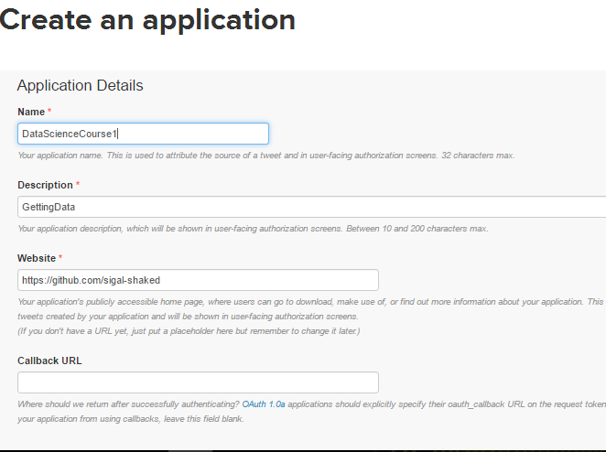

Slide 40
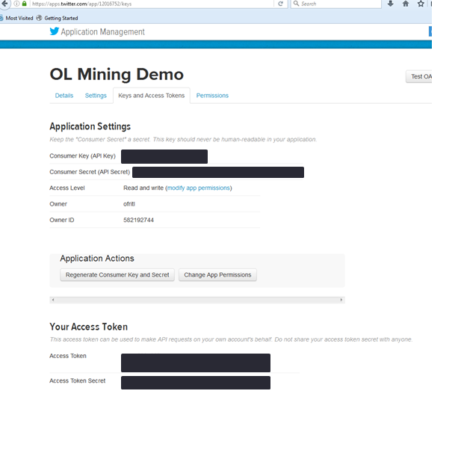
Creating an application
Generate your access token
Save these four keys to R file: (instead of writing it explicitly in the code)
consumer_key <- "your_consumer_key"
consumer_secret <- "your_consumer_secret"
access_token <- "your_access_token"
access_secret <- "your_access_secret"

Slide 41
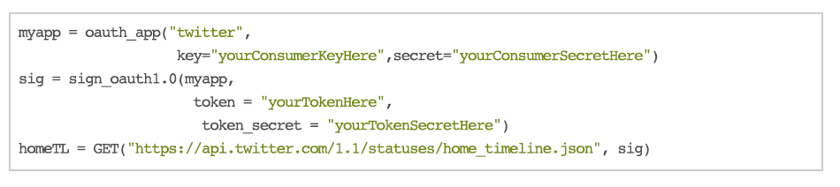
Accessing Twitter from R with the httr package

Slide 42
Example & General guidelines
See code example on course site
httr allows GET, POST, PUT, DELETE requests if you are authorized
You can authenticate with a user name or a password
Most modern APIs use something like oauth
httr works well with Facebook, Google, Twitter, Github, etc.

Slide 43
Data resources - governments
United Nations http://data.un.org/
U.S. http://www.data.gov/
List of cities/states with open data
United Kingdom http://data.gov.uk/
France http://www.data.gouv.fr/
Israel https://data.gov.il/
Ghana http://data.gov.gh/
Australia http://data.gov.au/
Germany https://www.govdata.de/
Hong Kong http://www.gov.hk/en/theme/psi/datasets/
Japan http://www.data.go.jp/
Many more http://www.data.gov/opendatasites

Slide 44
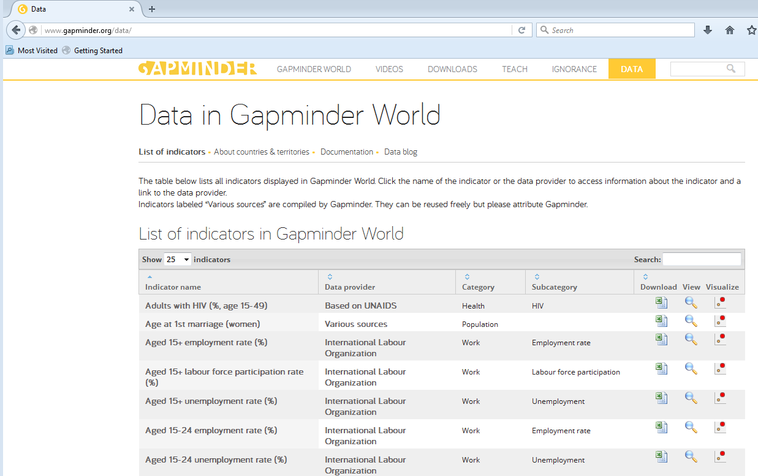
Gapminder
http://www.gapminder.org/data/

Slide 45
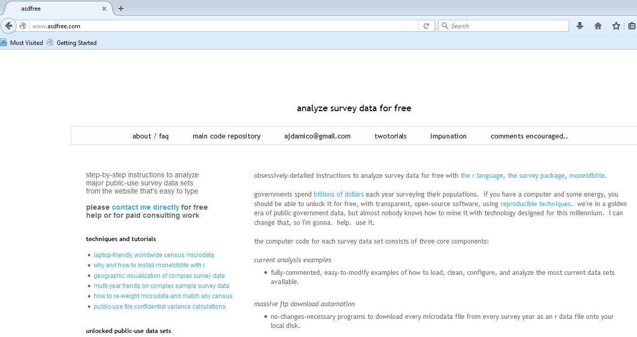
survey data for free from us
http://www.asdfree.com/

Slide 46
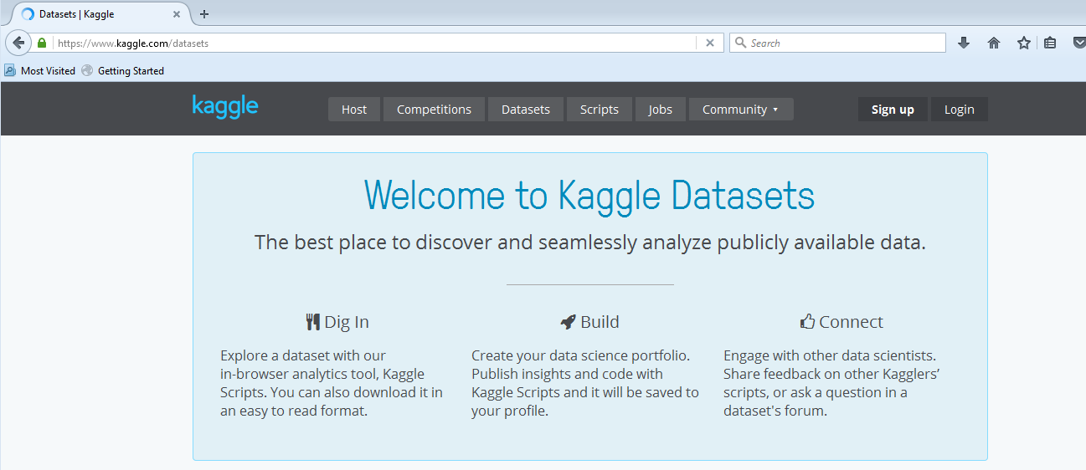
Kaggle
http://kaggle.com

Slide 47
Collections by data scientists
Hilary Mason http://bitly.com/bundles/hmason/1
Peter Skomoroch https://delicious.com/pskomoroch/dataset
Jeff Hammerbacher http://www.quora.com/Jeff-Hammerbacher/Introduction-to-Data-Science-Data-Sets
Gregory Piatetsky-Shapiro http://www.kdnuggets.com/gps.html
http://blog.mortardata.com/post/67652898761/6-dataset-lists-curated-by-data-scientists

Slide 48
More specialized collections
Stanford Large Newtork Data
UCI Machine Learning
KDD Nugets Datasets
CMU Statlib
Gene expression omnibus
ArXiv Data
Public Data Sets on Amazon Web Services

Slide 49
Free available datasets
Machine Learning Repository: http://archive.ics.uci.edu/ml/
Google public data: http://www.google.com/publicdata/directory
Rdatasets http://vincentarelbundock.github.io/Rdatasets/
Many more…

Slide 50
Some APIs with R interface
twitter and twitteR package
figshare and rfigshare
PLoS and rplos
rOpenSci
Facebook and RFacebook
Google maps and RGoogleMaps

