Slide 1
Community detection
Sigal Shaked
Slides were taken with permission from Prof. Lior Rokach and Dr. Ofrit Lesser

Slide 2
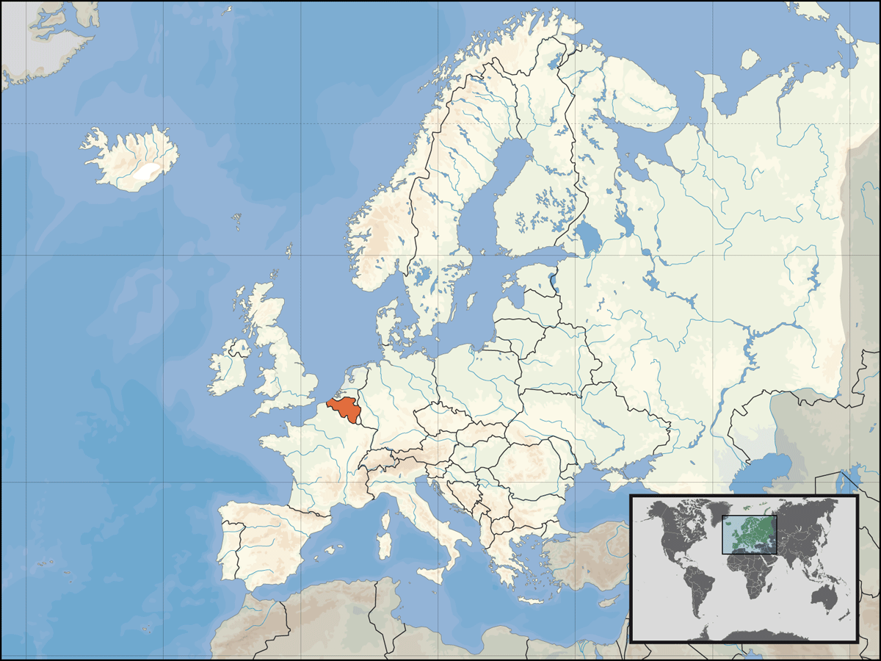
Community Detection Example - Belgium
Notes:
Graphical representation of the network of communities extracted from
a Belgian mobile phone network. About 2 million customers are represented on
this network. The size of a node is proportional to the number of individuals in the
corresponding community and its color on a red–green scale represents the main
language spoken in the community (red for French and green for Dutch). Only the
communities composed of more than 100 customers have been plotted. Notice
the intermediate community of mixed colors between the two main language
clusters. A zoom at higher resolution reveals that it is made of several sub-
communities with less apparent language separation.

Slide 3
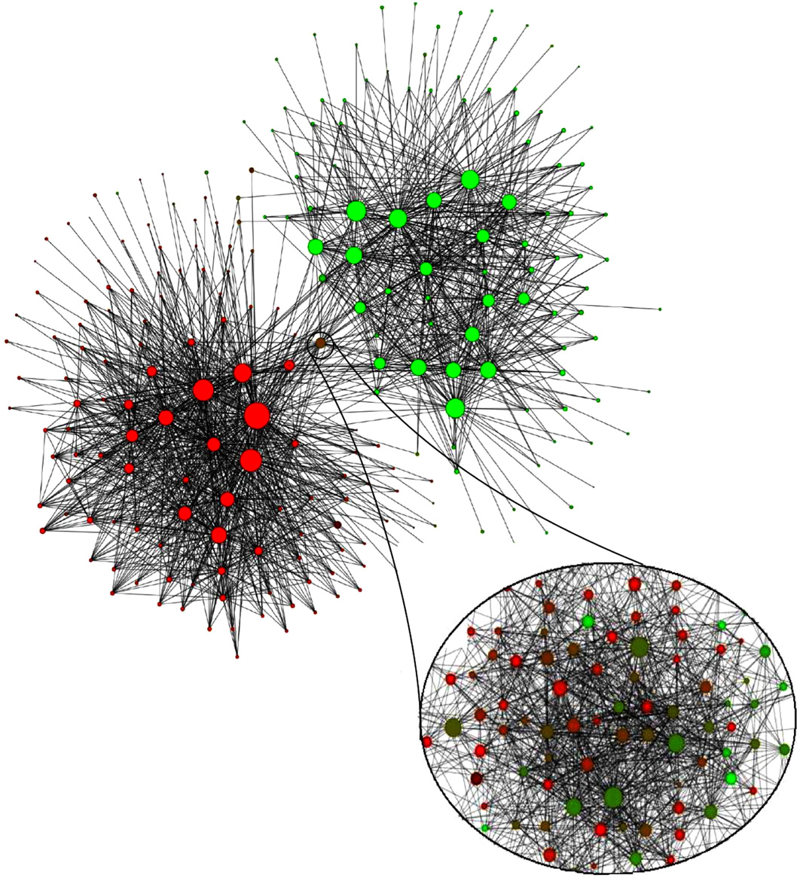
Belgian mobile phone network
Red - French
Green - Dutch
V.D. Blondel et al, J. Stat. Mech. P10008 (2008)
Notes:
Graphical representation of the network of communities extracted from
a Belgian mobile phone network. About 2 million customers are represented on
this network. The size of a node is proportional to the number of individuals in the
corresponding community and its colour on a red–green scale represents the main
language spoken in the community (red for French and green for Dutch). Only the
communities composed of more than 100 customers have been plotted. Notice
the intermediate community of mixed colours between the two main language
clusters. A zoom at higher resolution reveals that it is made of several sub-
communities with less apparent language separation.

Slide 4
Why do it?
Discover communities of practice
Possible use example : marketing strategy
Measure isolation of groups
Understand opinion dynamics / adoption

Slide 5
What makes a community?
frequency of ties among members
everybody in the group has links to at least k others in the group
closeness or reachability of subgroup members
individuals are separated by at most n hops
relative frequency of ties among subgroup members compared to nonmembers

Slide 6
Approaches to Graph Partitioning
Divisive methods of graph partitioning - Top-down
remove the “spanning links” between densely-connected regions
Once network is divided into large pieces, further iterative spanning links can be identified within these pieces
Aggregate nodes together into regions – Bottom-up
Find nodes that are likely to belong to the same region and merge them together.

Slide 7


Divisive Algorithms - Girvan & Newman
Algorithm
Undirected unweighted networks
compute the betweenness of all edges
while (betweenness of any edge > threshold):
remove edge with highest betweenness
recalculate betweenness
Connected components are communities
Gives a hierarchical decomposition of the network
Edge betweenness – number of shortest path going through this edge

Slide 8
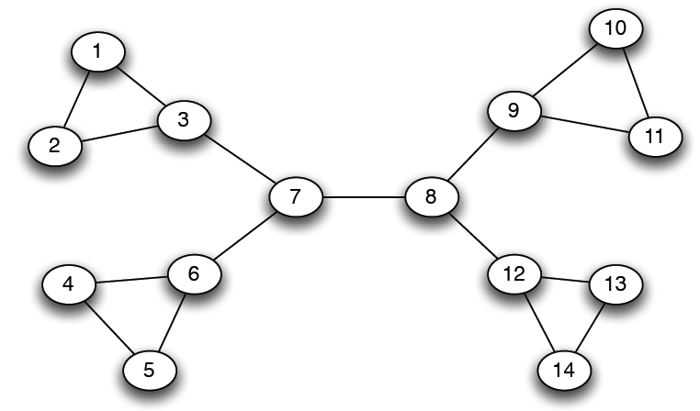
Girvan-Newman: Example
12
1
33
49
Need to re-compute betweenness at every step

Slide 9
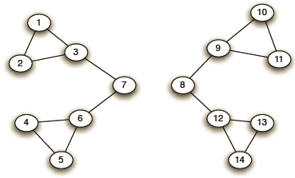
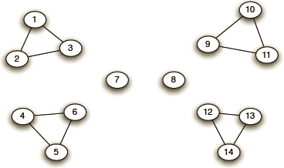
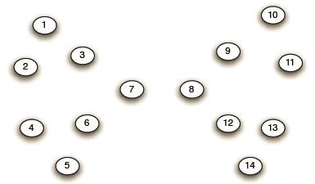
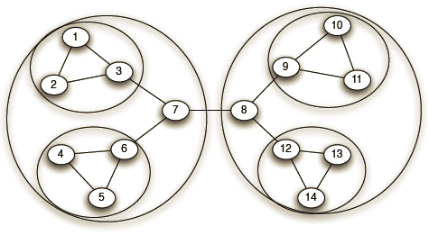
Girvan-Newman: Example
Step 1:
Step 2:
Step 3:
Hierarchical network decomposition:
J. Leskovec, A. Rajaraman, J. Ullman: Mining of Massive Datasets, http://www.mmds.org

Slide 10
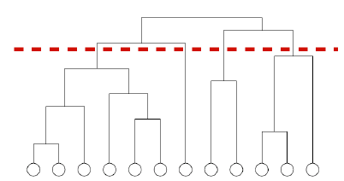
How to select the number of clusters?

Slide 11
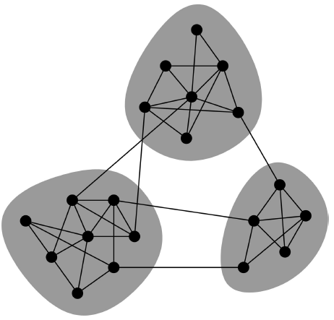
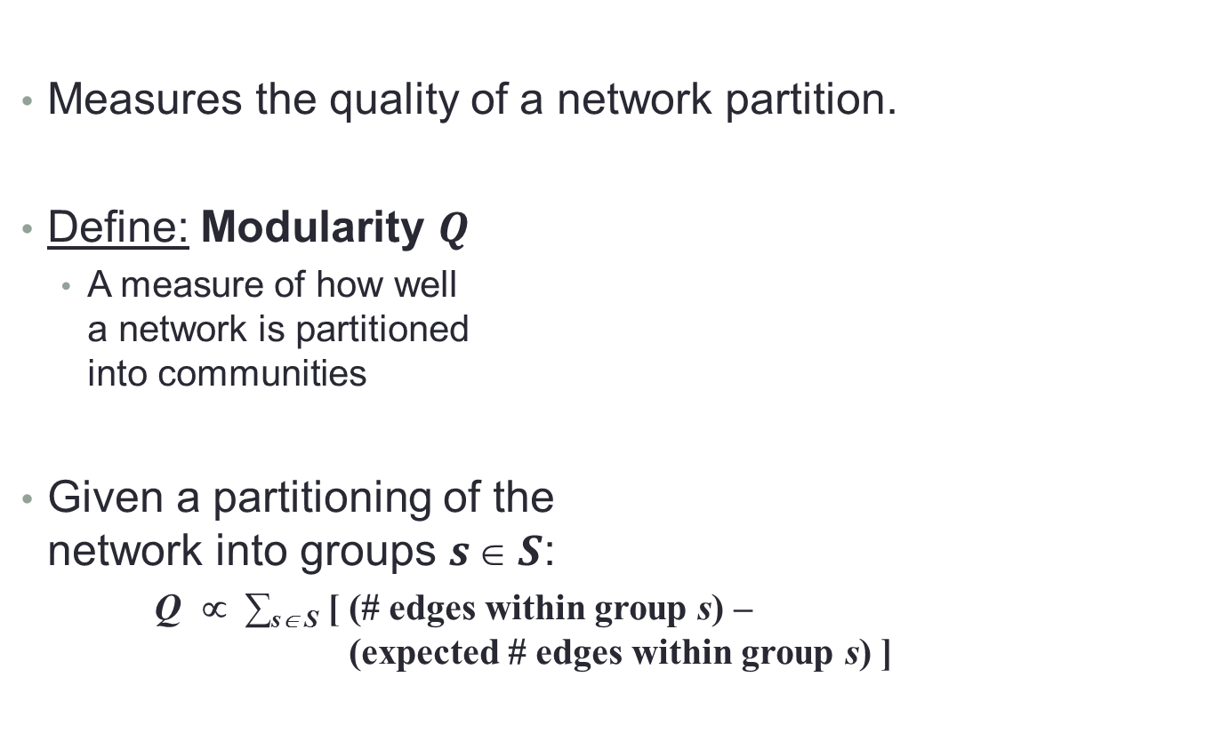
Modularity measure
Measures the quality of a network partition.
Define: Modularity $Q$
A measure of how well a network is partitioned into communities
Given a partitioning of the network into groups $s  S$:
Q ∝ ∑_{s∈ S} [ (# edges within group s) – (expected # edges within group s) ]

