Slide 1
Paper Presentation
achieve0410@gmail.com

Slide 2
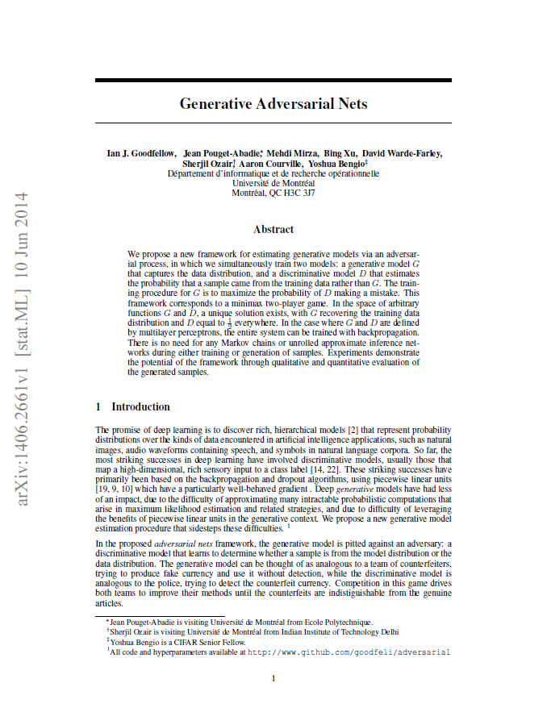
Generative Adversarial Nets – NIPS 2014

Slide 3
Context
Context
Introduction
Related work
Adversarial nets
Theoretical Results
Experiments
Advantages and disadvantages
Conclusions and future work

Slide 4
Ⅰ. Introduction
The promise of “Deep learning” is to discover rich, hierarchical models
Represent probability distributions (Natural images, Audio waveforms)
The most striking success in deep learning have involved discriminative models
Map a high-dimensional, rich sensory input to a class label
Based on the backpropagation and dropout algorithms, using piecewise linear units
Deep generative models have had less of an impact
Due to the difficulty of approximating many intractable probability computations

Slide 5
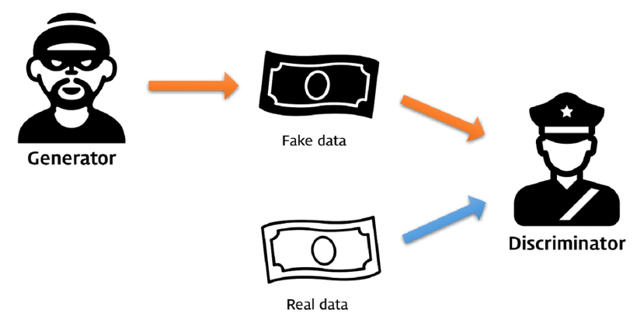
Ⅰ. Introduction
In the proposed adversarial nets framework
Pitted an adversary
Generative model & Discriminative model

Slide 6
Ⅱ. Related work
RBMs (Restricted Boltzmann Machines)
DBMs (Deep Boltzmann Machines)
MCMC (Markov chain Monte Carlo)
DBNs (Deep Belief Networks)
GSN (Generative Stochastic Network)
…

Slide 7
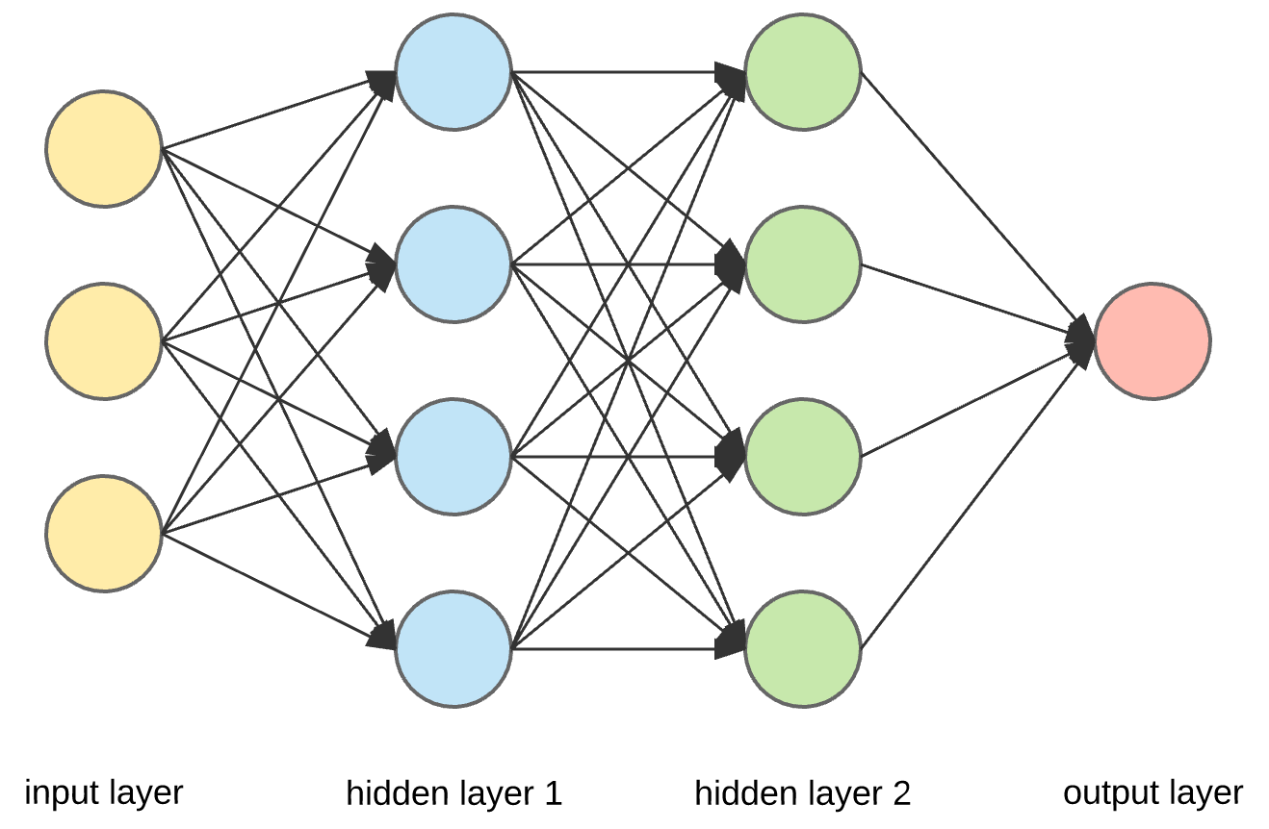
Ⅲ. Adversarial nets
Neural Network
1
23
3
5
2
2
5
5

Slide 8
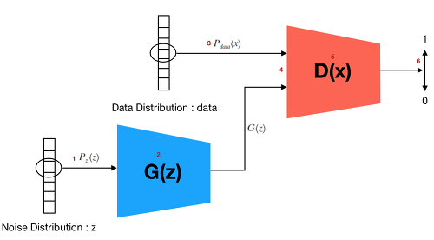





Ⅲ. Adversarial nets
GAN (Generative Adversarial Network)
data
x
$$p_{data}$$
$$D(x; θ_{d})$$
$$p_{g}$$
noise
z
$$p_{z}$$
$$G(z; θ_{g})$$

Slide 9
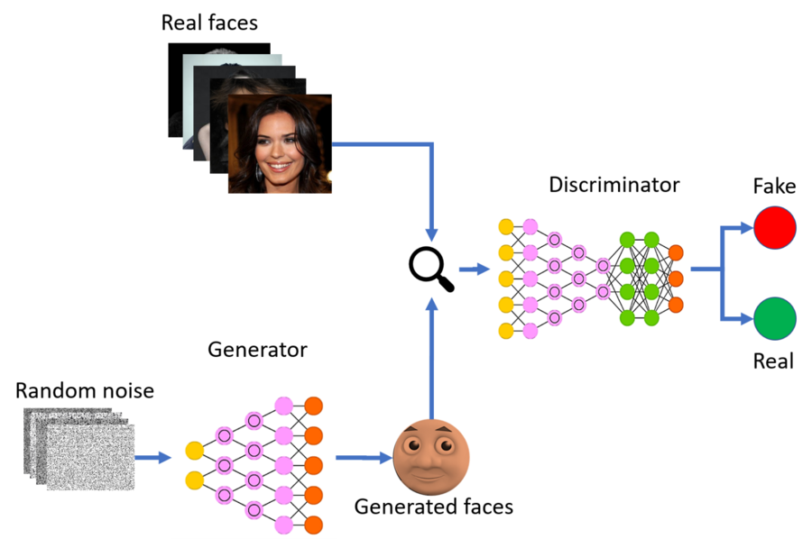







Ⅲ. Adversarial nets
GAN (Generative Adversarial Network)
$$p_{data}$$
data x
$$p_{g}$$
$$D(x; θ_{d})$$
$$p_{z}$$
latent variables z
$$G(z; θ_{g})$$

Slide 10


Ⅲ. Adversarial nets
D and G have a Value function $V(G,D)$
$$minmax V\left(D,G\right)= 𝔼_{x\sim p_{data}(x)}\left[D\left(x\right)\right]+ 𝔼_{z\sim p_{z}(z)}[1−D(G\left(z\right))]$$
Maximize
Discriminator
Minimize
Generator

Slide 11
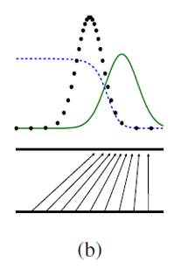
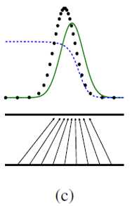
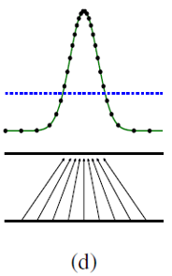
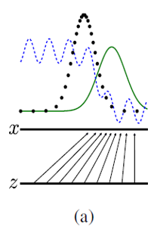
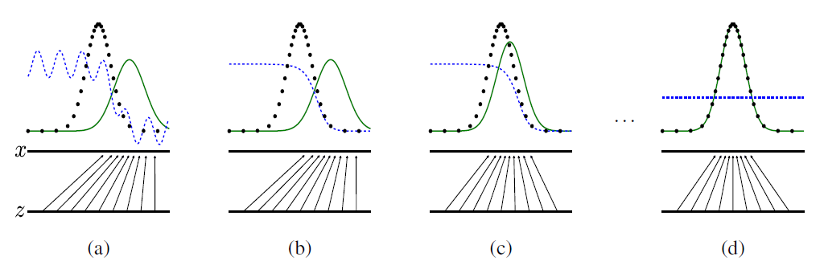
Ⅲ. Adversarial nets
Discriminative distribution (D, blue dashed line)
Data distribution (black dotted line)
Generative distribution (G, green solid line)

Slide 12
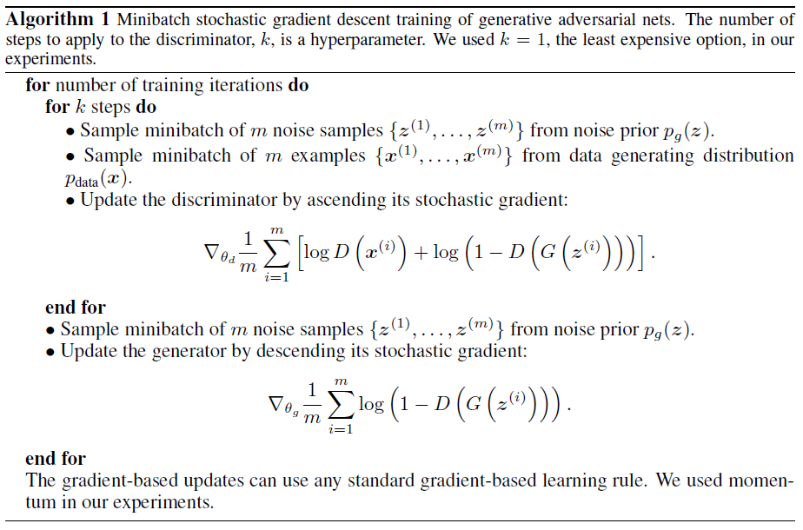
Ⅳ. Theoretical Results
Algorithm flow

Slide 13
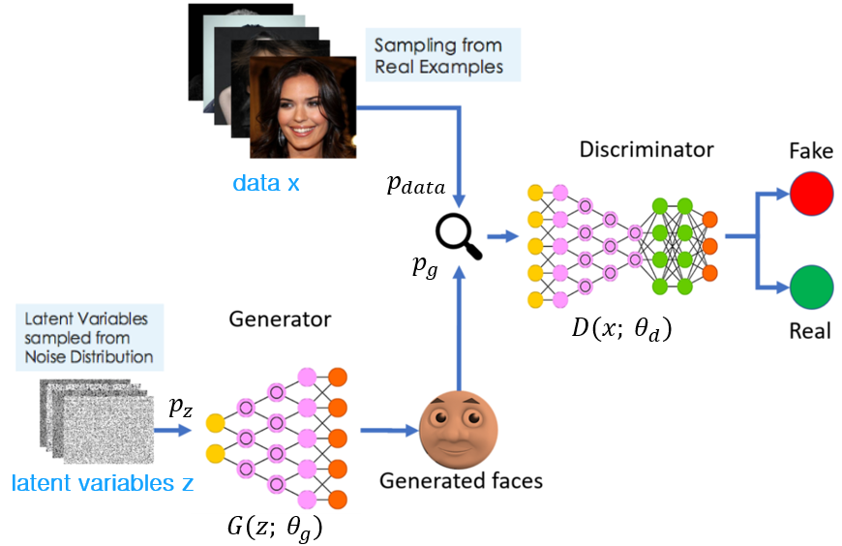

Ⅳ. Theoretical Results
Global Optimality of $p_{g}= p_{data}$

Slide 14
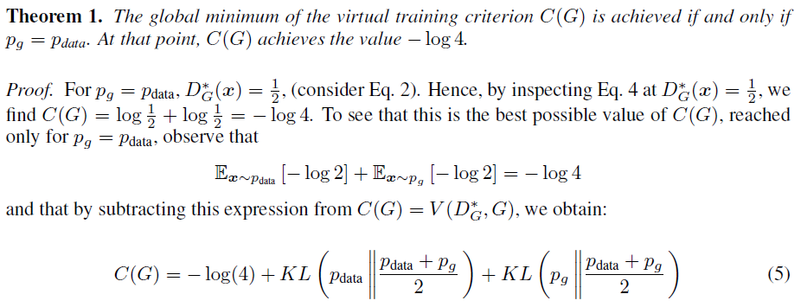
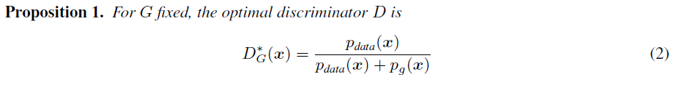
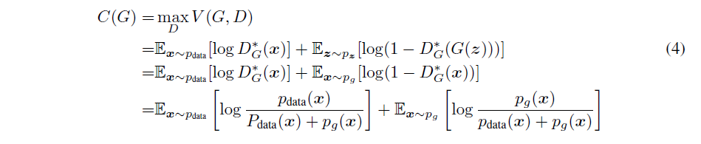
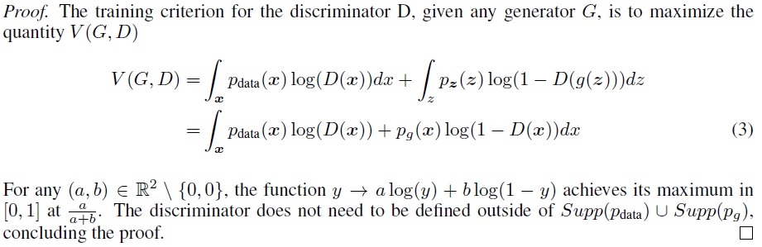
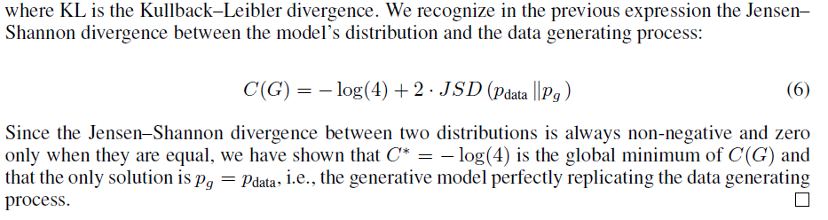
Ⅳ. Theoretical Results
Global Optimality of $p_{g}= p_{data}$

Slide 15
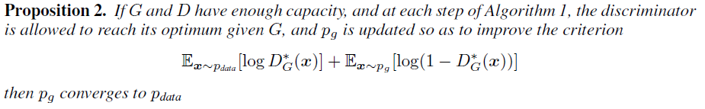
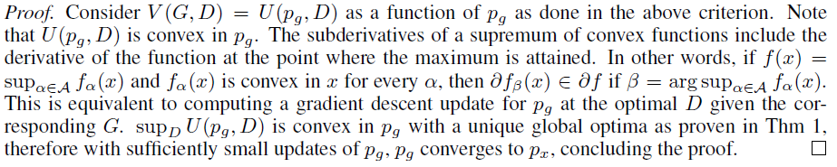
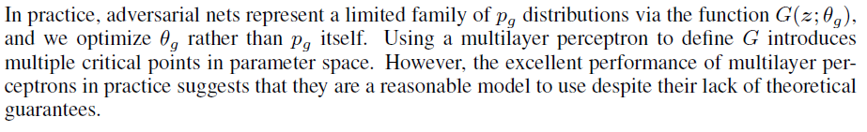
Ⅳ. Theoretical Results
Convergence of Algorithm 1

Slide 16
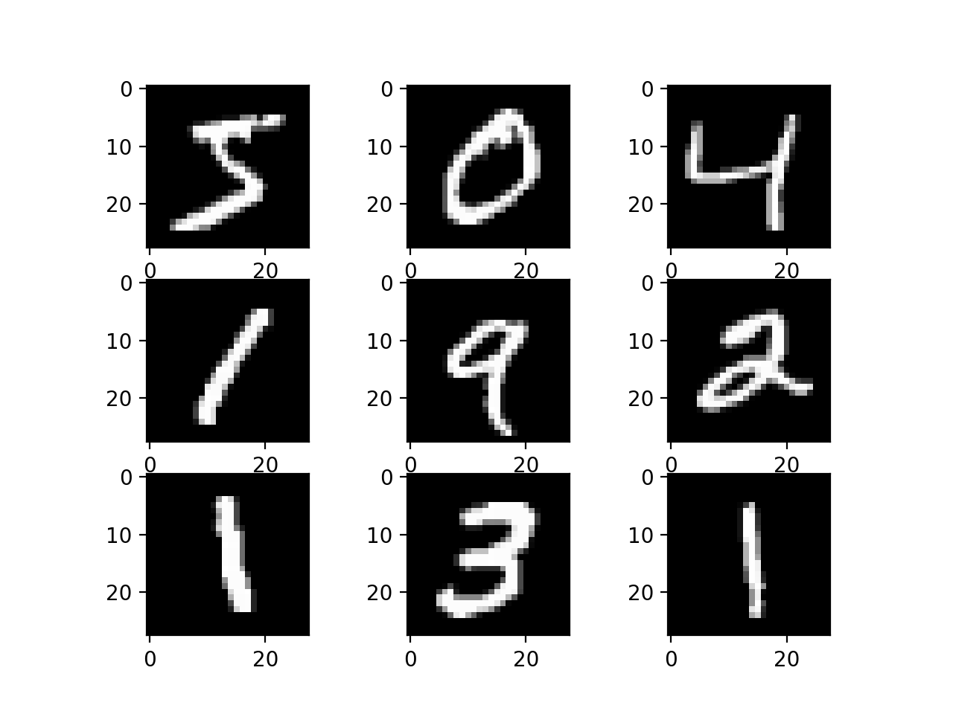
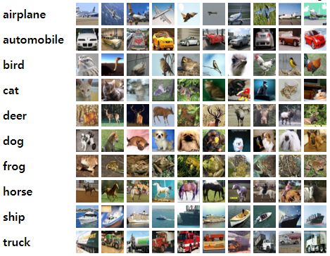
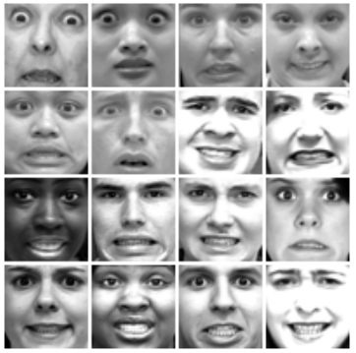
Ⅴ. Experiments
Train dataset
MNIST(Modified National Institute of Standards and Technology database)
TFD(Toronto Face Database)
CIFAR-10(Canadian Institute For Advanced Research)

Slide 17
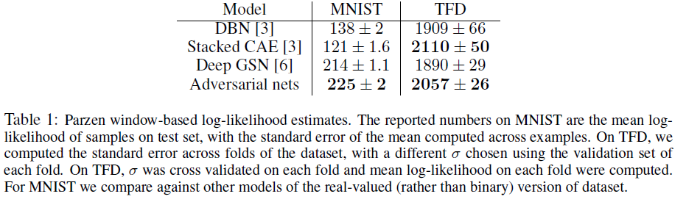
Ⅴ. Experiments
Result

Slide 18
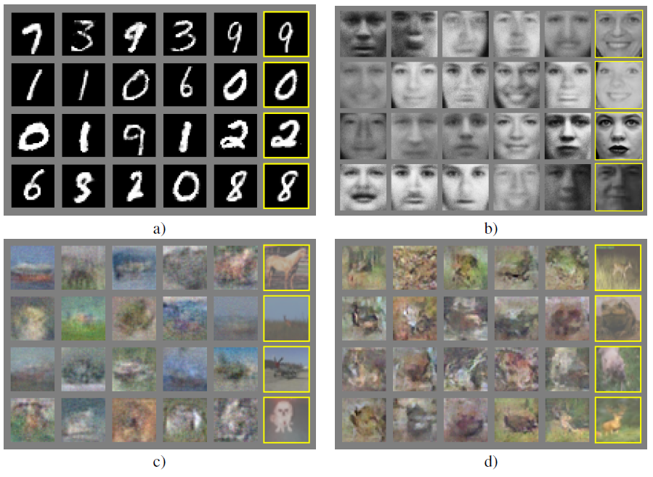
Ⅴ. Experiments
Result

Slide 19
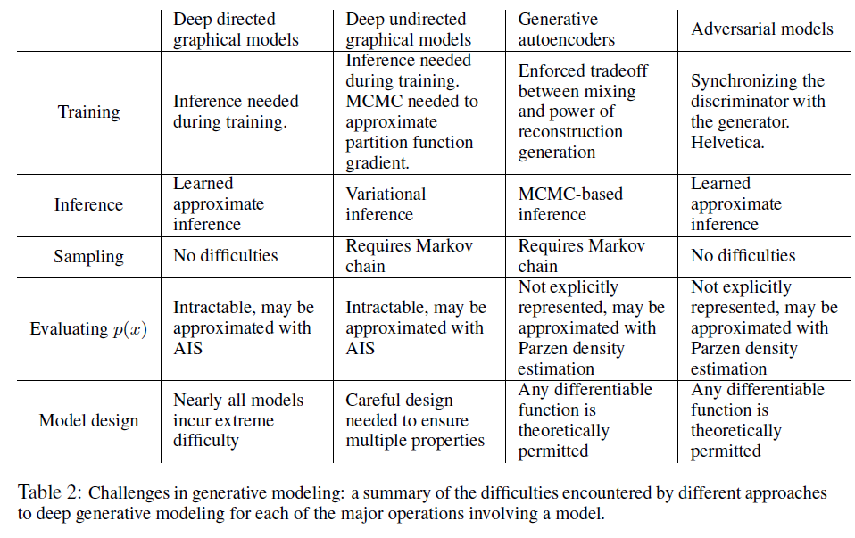
Ⅴ. Experiments
Result

Slide 20
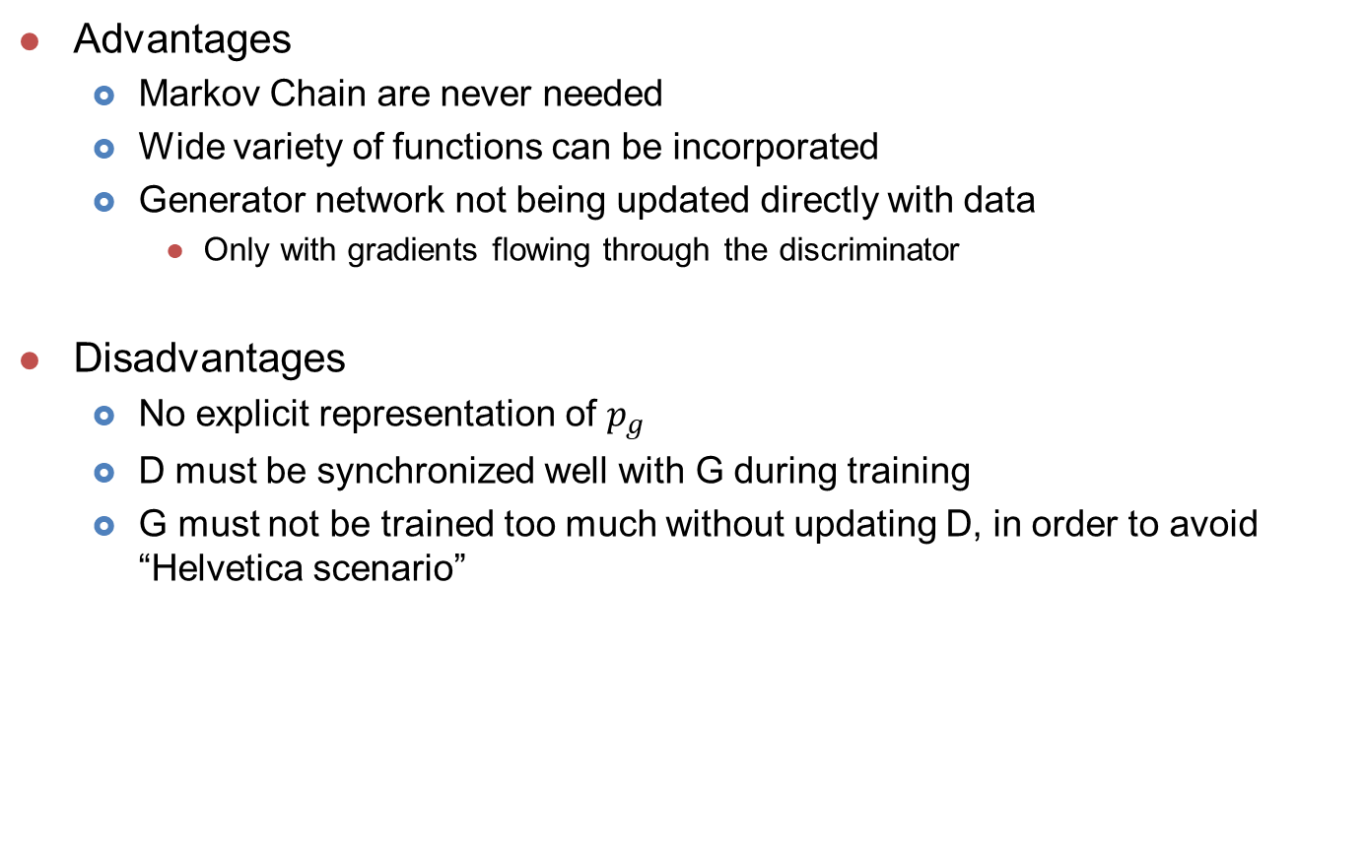
Ⅵ. Advantages and disadvantages
Advantages
Markov Chain are never needed
Wide variety of functions can be incorporated
Generator network not being updated directly with data
Only with gradients flowing through the discriminator
Disadvantages
No explicit representation of $p_{g}$
D must be synchronized well with G during training
G must not be trained too much without updating D, in order to avoid “Helvetica scenario”

Slide 21
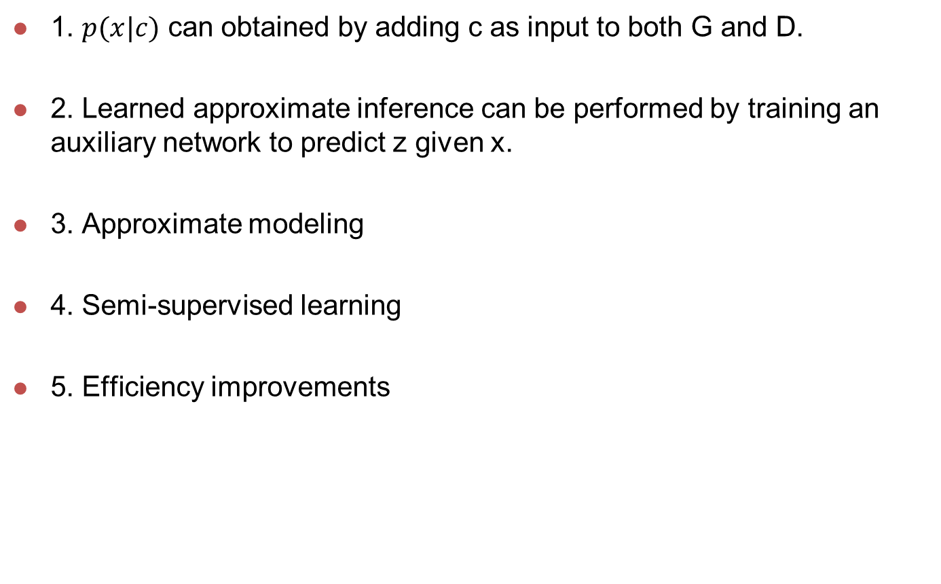
Ⅶ. Conclusions and future work
1. $p(x|c)$ can obtained by adding c as input to both G and D.
2. Learned approximate inference can be performed by training an auxiliary network to predict z given x.
3. Approximate modeling
4. Semi-supervised learning
5. Efficiency improvements

Slide 22
