Slide 1
Presentation
achieve0410@gmail.com

Slide 2
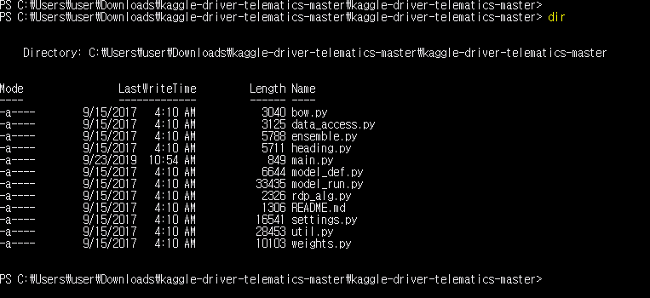
Analysis AXA 7nd winner’s code

Slide 3
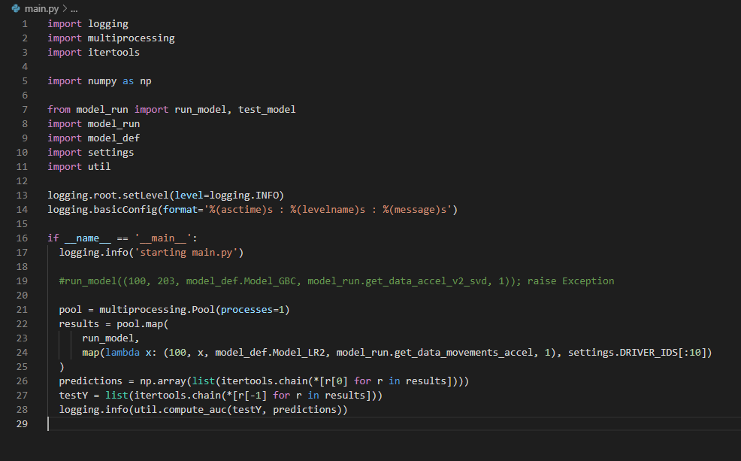
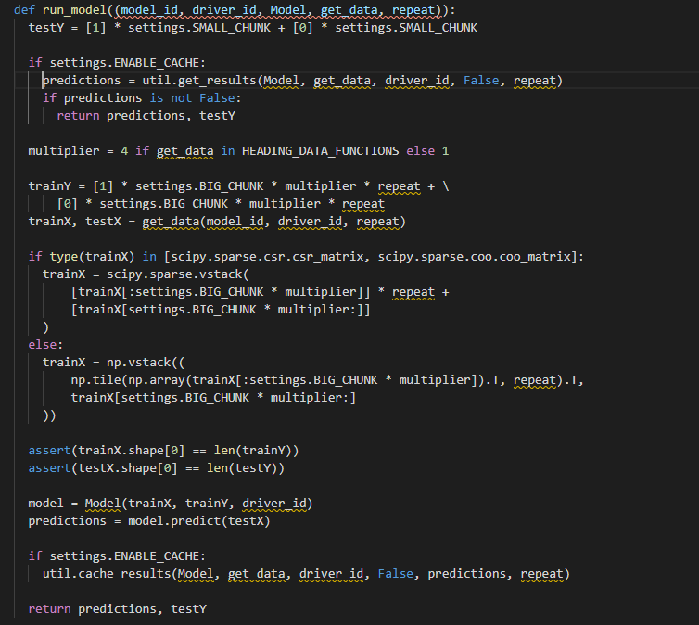
Analysis AXA 7nd winner’s code
call run_model()
main.py
model_run.py

Slide 4
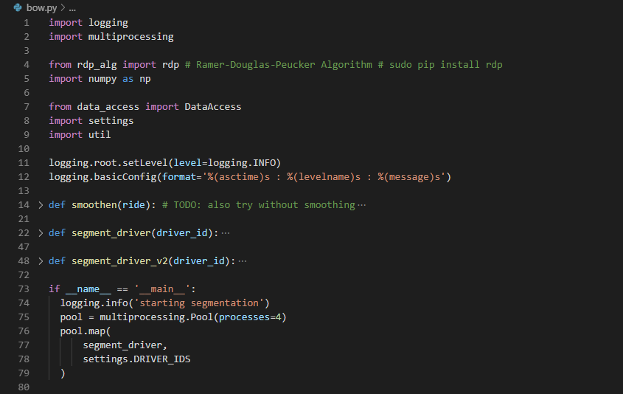
Analysis AXA 7nd winner’s code
bow_def.py
: segments the trips using the RDP algorithm

Slide 5
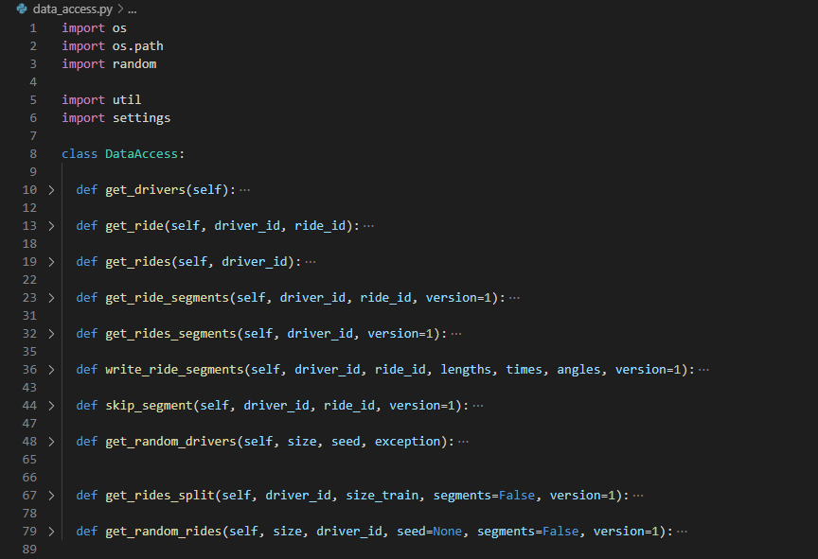
Analysis AXA 7nd winner’s code
data_access.py
: wrapper for reading trip data

Slide 6
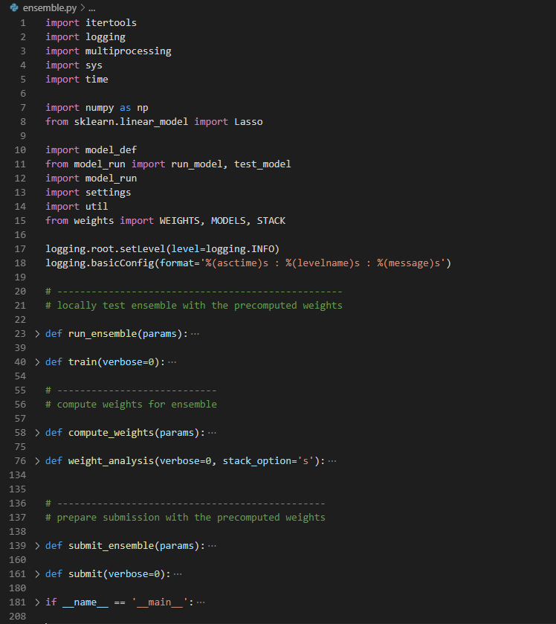
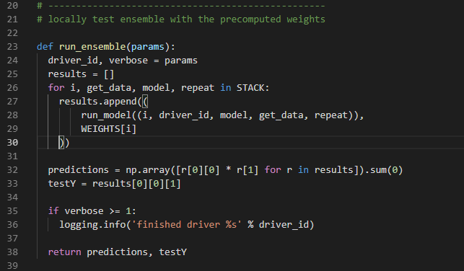
Analysis AXA 7nd winner’s code
ensemble.py
: code for training the ensemble,
performing local testing and
generating a submission

Slide 7
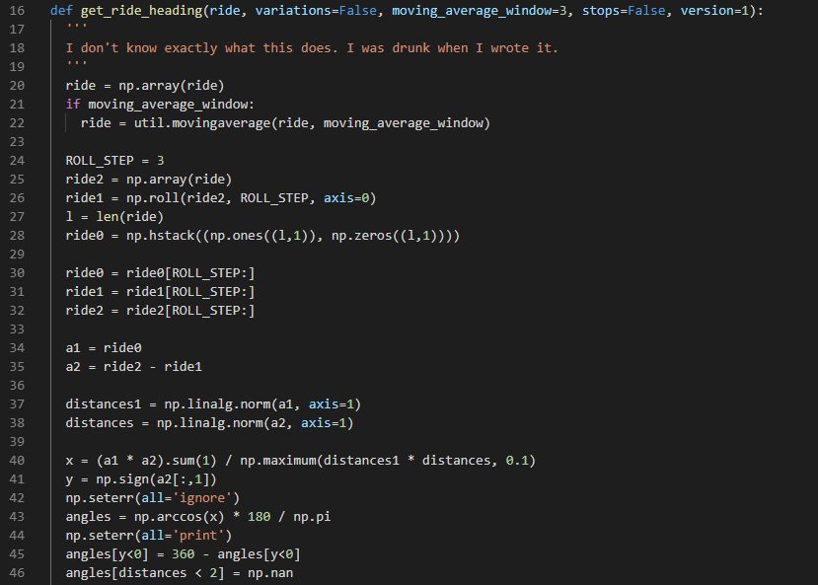
Analysis AXA 7nd winner’s code
heading.py
: segment a trip using the heading approach

Slide 8
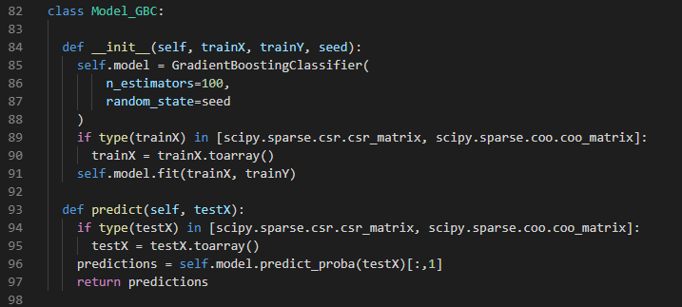
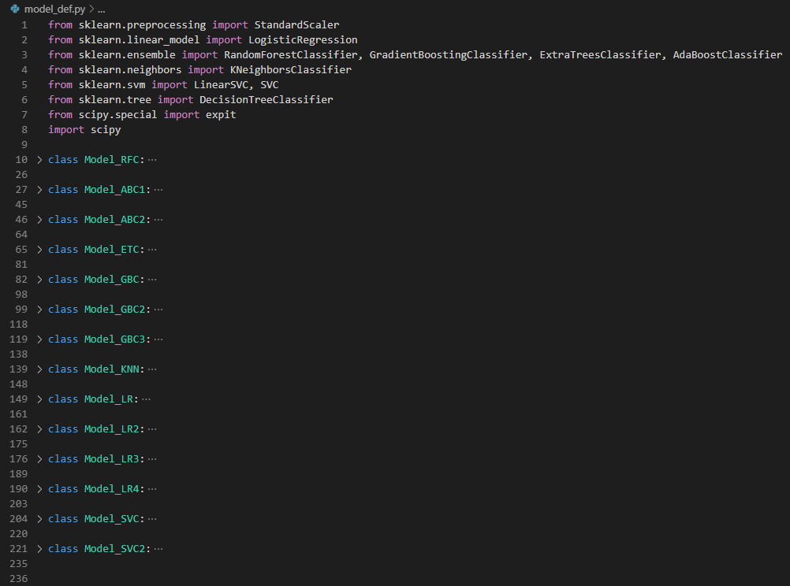
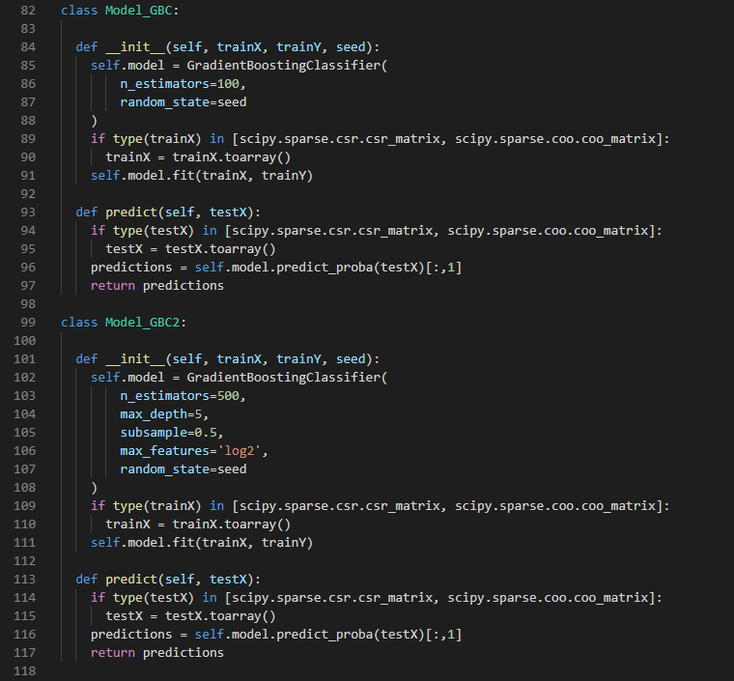
Analysis AXA 7nd winner’s code
model_def.py
: library with all the ML algorithms used

Slide 9
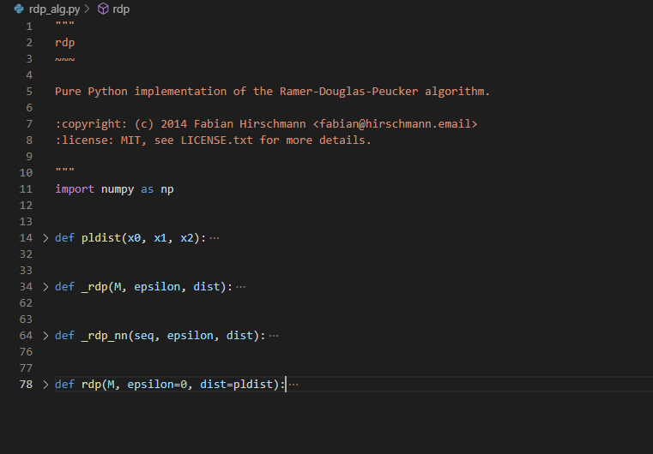
Analysis AXA 7nd winner’s code
rdp_alg.py
: the RDP algorithm

Slide 10
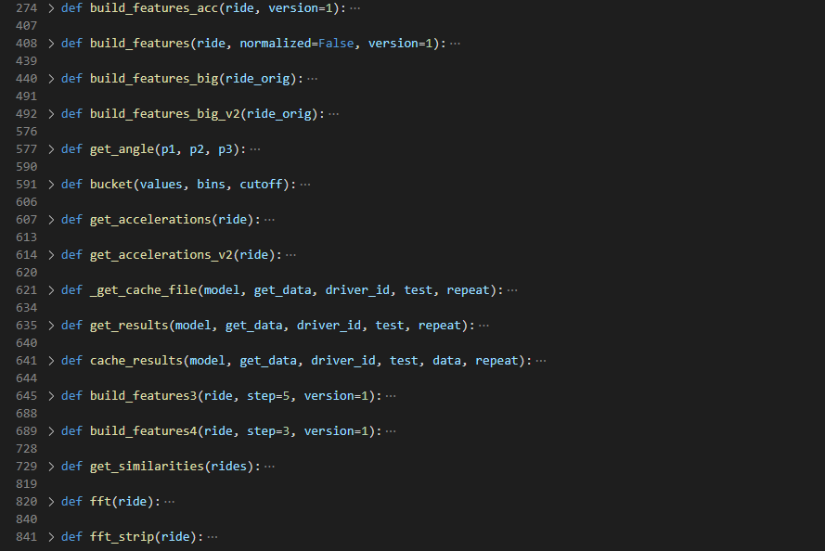
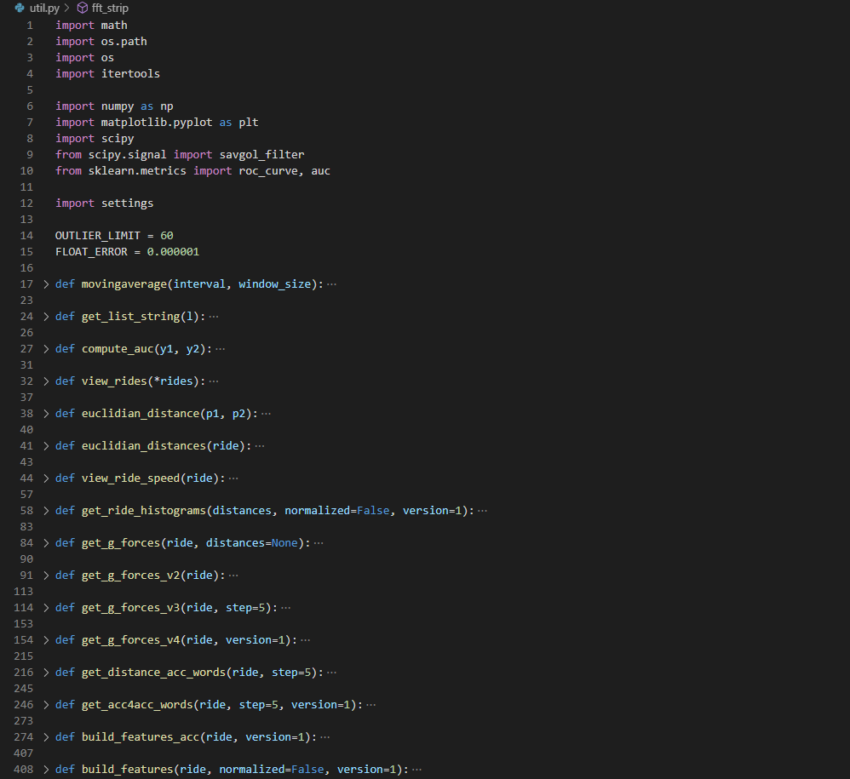
Analysis AXA 7nd winner’s code
util.py
: preprocessing data, feature extraction

Slide 11
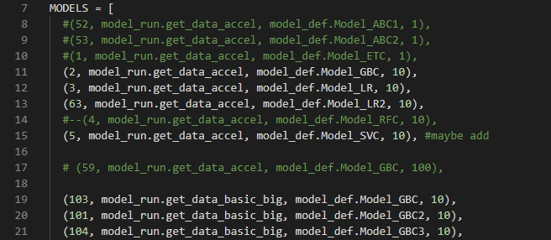
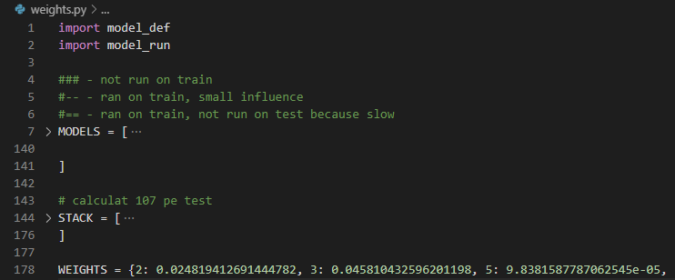
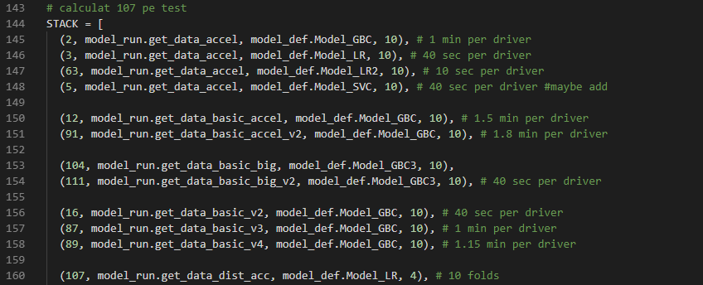
Analysis AXA 7nd winner’s code
weights.py
: contains all (or most of) the models tested (MODELS),
as well as the final ensemble (STACK) and the weights
needed for blending

