Slide 1

The perfect race
How Father Time (age) and Mother Nature (wind) affect sprint times of the world’s fastest athletes
By Anesu Masube and Aaron Childress

Slide 2
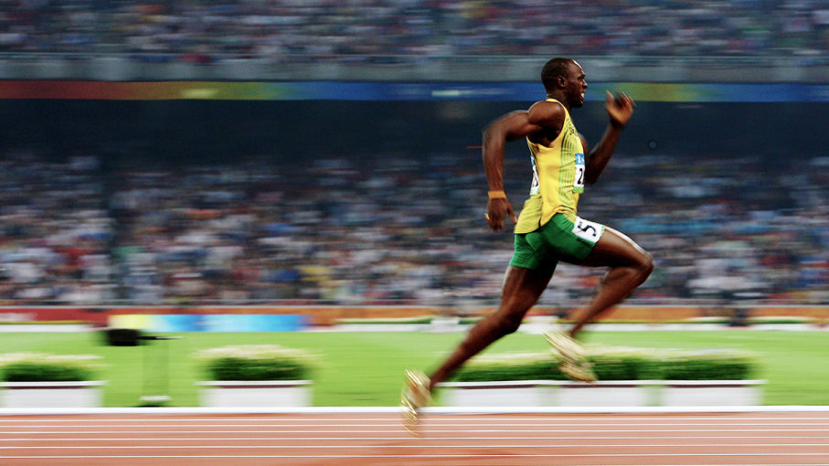
Optimizing for speed
Age: Analyze the impact of age on sprint times
Wind: Analyze the impact of headwind and tailwind on sprint times

Slide 3
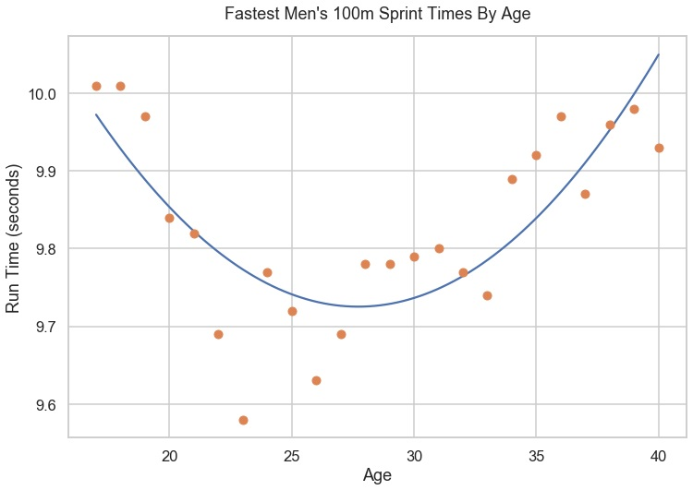
Is there an optimal sprint age?
Fastest Men’s 100m Sprint Times By Age
Plotting fastest times run by age yielded a parabolic pattern.
The minimum of the best-fit curve suggests an optimal age of 28.
Therefore, we tested whether mean run times of ages 27-29 are lower than other ages.

Slide 4
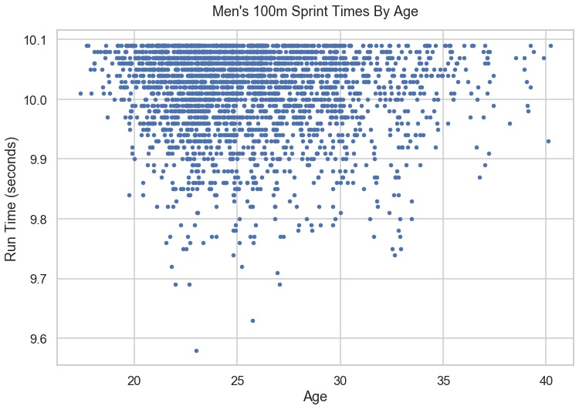
We can’t say with 95% confidence that age matters
Men’s 100m Sprint Times By Age
While sprinters 27-29 put up low times, they also put up high times.
Mean run time of 27-29 age group was lower than other ages, but there’s a 20% chance there’s no real difference.
Therefore, we cannot say that age matters.

Slide 5
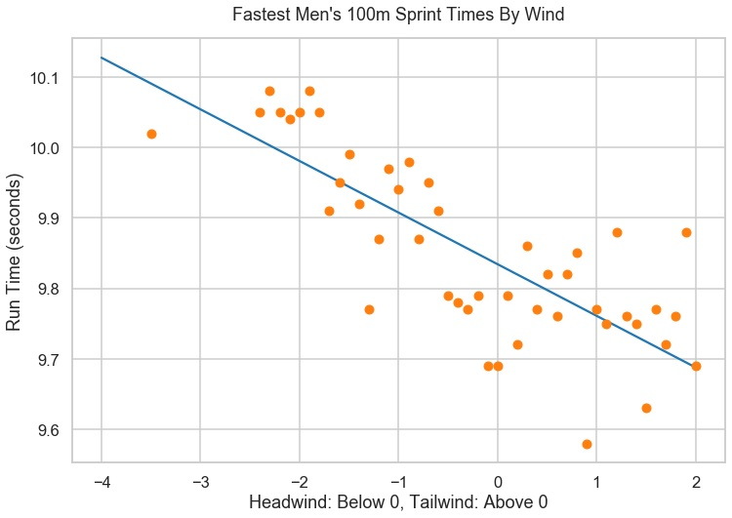
Does wind impact speed?
Fastest Men’s 100m Sprint Times By Wind
Plotting fastest run times by windspeed yielded a linear pattern.
The best-fit line suggests tailwind helps runners and headwind hurts runners.
Therefore, we tested whether mean run times of tailwind races are lower than headwind races.

Slide 6
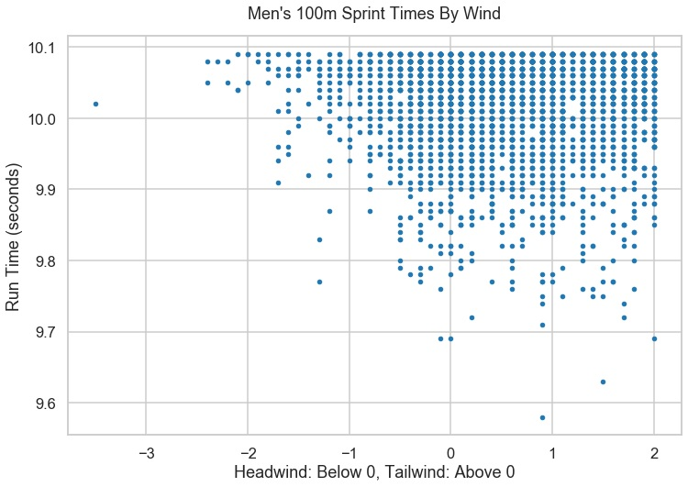
We can say with 95% confidence that wind matters
Men’s 100m Sprint Times By Wind
While higher times are recorded in all wind conditions, lower times are mainly recorded with tailwind.
Mean run time of tailwind group was lower than headwind group, and there’s only a 3% chance that means are really the same.
Therefore, we can say the means are different.

Slide 7
Results and implications
AGE
For the lowest times, there is a relationship between age and speed that indicates an optimal age for peak performance, but we could not confirm this for the entire sample.
Get more data
WIND
Every 1m/s change in wind speed correlates with 0.07s change in time.
Indoor meets are preferred venue; headwinds can prevent new records.

Slide 8
Next steps
AGE
Vary age test group range ( e.g. 25-30 vs control)
Look at frequencies of low times across age and time period categories (chi-squared test)
Analyze times by runner at different ages
WIND
Analyze times by runner under various wind conditions
OTHER
Weather on race day

