Slide 1
Rebartek Robotics Project

Slide 2
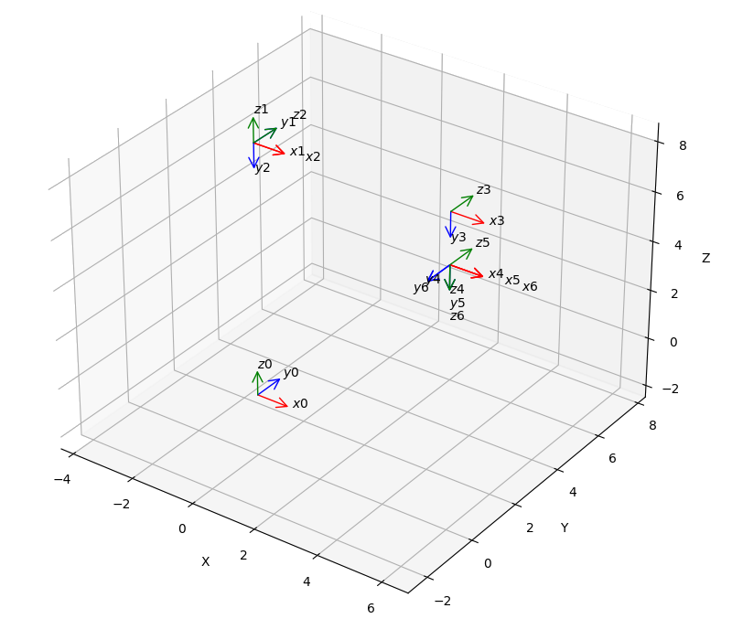
Puma 560 Achilleas Version
6DoF Robot
Denavit-Hartenberg
coordinate systems
for initial position

Slide 3
Forward Kinematics
Given the angle of each joint → Calculate the position and orientation of the end effector in respect of a initial fixed point (base of the robot)

Slide 4
Inverse Kinematics
Given the position and orientation of the end effector in respect of a initial fixed point (base of the robot) → Calculate the angle of each joint

Slide 5
Path Planning

Slide 6
Simulation

Slide 7
Thank you!

