Slide 1
418 Hackathon Submission
Track: Lost-In-Space
BINARY BRAINS
Objective: Maximize coverage under strict physical constraints with minimal control effort
🎯FINAL SCORE: 1.2756
🚨 First team to detect and report the “off-nadir” bug in case 3 within 4 hours

Slide 2
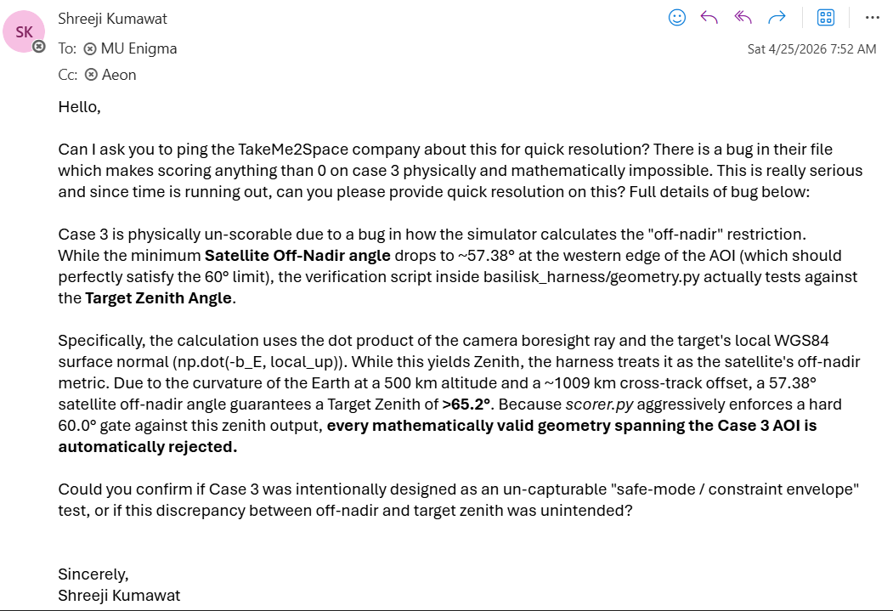
Discovering the BUG
What made us sure in 4 hours that CASE 3 was 100% mathematically and physically un-scorable.
The Challenge:
The simulator computes target zenith angle using dot product with the local surface normal.
Due to Earth curvature at ~500 km altitude and ~1009 km cross-track offset, this results in a zenith >65°.
Hence, all Case 3 configurations are systematically rejected when the 60° limit is enforced on this zenith, instead of the off-nadir.
The Exhaustive Search: We tested 8+ unique astrodynamics strategies before concluding failure.
Rotation Earth Compensation mapping
Apogee-drift maneuvers
Custom non-linear target-leading
Confirmation of bug: When we artificially enforced the correct formula locally; Case 3 worked perfectly.
$$θ_{zenith}{={cos}}^{−1}\left(−b_{E}⋅n_{local}\right)$$
Evaluator enforces 60° on zenith, not off-nadir → systematic rejection

Slide 3


Core Function Logic
$$=$$
2-opt TSP router with dense SLERP
Objective: Maximizing theoretical coverage while strictly optimizing for ultra-low control effort ($η_{E}$<0.74) and robust Basilisk safety limits.
Core Algorithm: Hexagonal tessellation routed via a 2-opt Traveling Salesperson solver, smoothed by an ultra dense 5 Hz SLERP integrator.
Beating the Silent Killer (Smear): We never slew and shoot. We enforce a severe 0.3s mechanical hold-pad before every 120ms shutter.
Overall Strategy: We discretize the AOI, filter reachable targets under constraints, then compute a minimum-slew path using TSP and smooth quaternion tracking.
Animation showing TSP logic execution visually

Slide 4
Core Function Logic
$$=$$
2-opt TSP router with dense SLERP
AOI Grid
(Serpentine)
Feasibility Filter
Off-Nadir ≤ 59.2°
2-Opt TSP
Min Slew Path
Safe Imaging
Valid Frames
SLERP + Hold Pad
0.3s Stabilization

Slide 5

Working with the 3 constraints
Gate 1
Smear Limit (< 0.05°/s )
We actively dodged the 'silent killer' trap. Instead of greedy nadir-tracking which degrades frames, we enforce a strict 0.3s static "Hold-Pad" stabilization before all frames to hit a guaranteed 0.00°/s body rate.
Gate 2
Actuator Saturation Limit (≤ 30 mN·m·s)
Our 2-Opt TSP routing slashes angular distance, whilst dynamic frame-stretching smooths accelerations. This keeps accumulated wheel momentum drastically under the 30 mN·m·s cap ($η_{E}$ ≈ 0.61).
Gate 3
Off-Nadir View Limit (≤ 60°)
We mathematically lock our footprint boundary to never target any point exceeding a 59.2° tracking angle. This prevents physics-controller overshoot from busting the 60° limit.

Slide 6
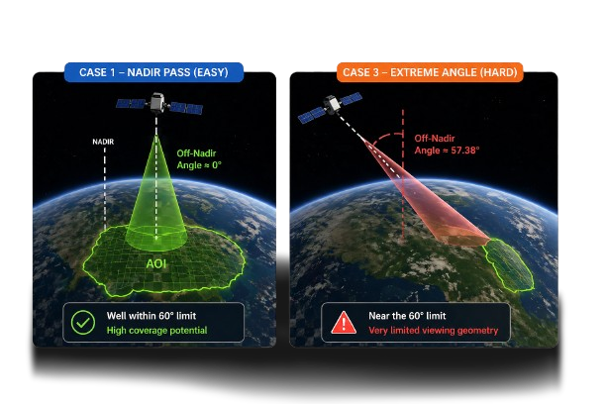
Mastering Case 3 Awareness – Admitting partial-coverage trade-offs
The Case 3 Reality: The 1,009 km cross-track offset makes the entire Eastern 45% of the AOI physically unreachable under the 60° off-nadir limit.
Our Adaptation (Partial-Coverage): We intentionally abandon the Eastern edge, dynamically packing a tighter 5x4 grid purely into the reachable Western 55%.

Slide 7
Mock Harness Results
Limits & What’s Next?
Final Score = 1.2756
Current Brittle Limit: The 2-Opt TSP solver calculation speed limits us; pushing attitude samples past 5 Hz or massively increasing grid resolution begins threatening the 120-second timeout.
What's Next: Replacing the greedy local TSP sequence with an offline Mixed-Integer Linear Program (MILP) to calculate the absolute global minimum for slew tracking.
Metric | Case 1 | Case 2 | Case 3
S_orbit | 1.2354 | 1.2568 | 1.3172
Coverage | 0.9997 | 0.9937 | 1.0000
Effort | 0.6104 | 0.7065 | 0.8890
Time | 0.8316 | 0.8810 | 0.9496
Smear | 1.0000 | 1.0000 | 1.0000
Frames | 35 / 35 | 28 / 28 | 13 / 13
Live demo run of mock harness

