Slide 1
STAT 521 Final Project
Team Omega

Slide 2
Choosing Our Model
Model | Feature | Coverage | Bias | RMSE
Linear Model A | 16 | ~94% | ~190 | ~1240
Linear Model B | 17 | 94% | 236 | 1204
BART | 38 | ~92% | ~120 | ~1400
Elastic Net | 17 | ~29% | ~180 | 1214
Random Forest | 15 | ~90% | ~270 | ~1450
m <- lm(formula = log(price) ~ dealer + year + school_pntg + diff_origin +
artistliving + winningbiddertype + Surface + engraved +
prevcoll + paired + finished + lrgfont + othgenre +
discauth + winningbiddertype:prevcoll +
Surface:mat_recode + famous_author:Surface, data = newTrain)

Slide 3
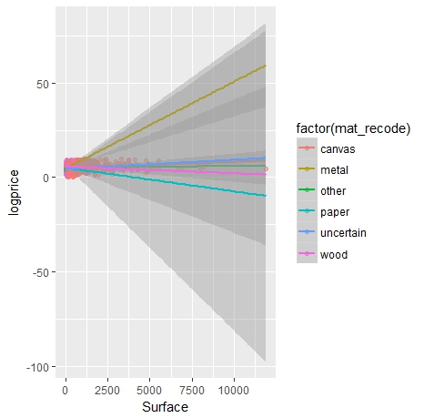
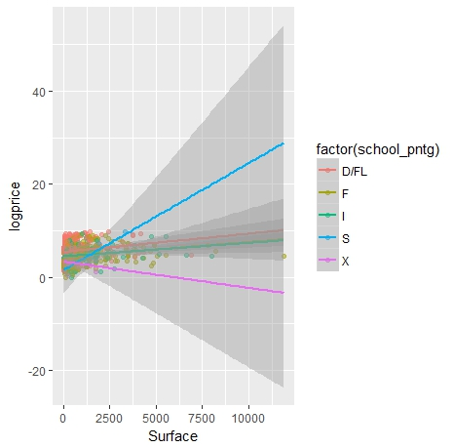
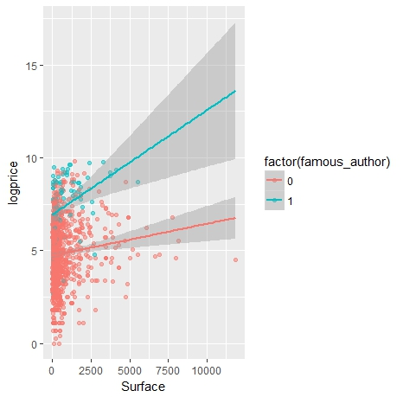
Feature Selection

Slide 4
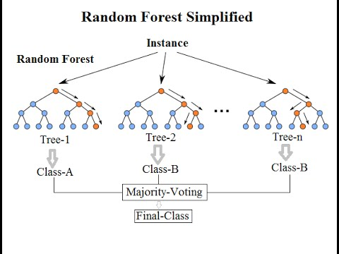
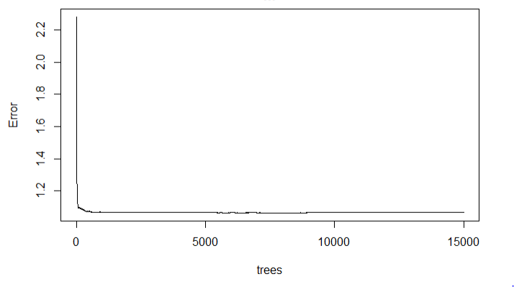

Random Forest & BART
Vanilla Random Forest
Number of trees, Number of features per level
Variables Included (dealer + year + school_pntg + mat_recode + famous_author +...)
Bayesian Additive Regression Tree
Full set of predicators (large bias and 1500+ rmse)
Trim down for better performanc (improved)

Slide 5
Elastic Net
Tuning alpha and lambda
Using Optimal alpha and lambda to train our dataset
Able to generate satisfying results in prediction
Unfortunately…
It is very hard to construct a prediction interval for Elastic Net
Bootstrap Estimate performs poorly

Slide 6
Conclusion
Our final model remains as linear model
Three most undervalued paintings (but predicted high value by our model)
(94469 vs. 8252), 1770, D/FL, Nicolas Berghem
figures, animaux dans un paysage, fabriques, dealer R
(53917 vs. 10100), 1777, D/FL, Nicolas Berghem
Paysage et femme sur un cheval, homme sur un mule, dealer R
(55048 vs 11500), 1776, D/FL, Nicolas Berghem, dealer R
Vue du chateau de Bentheim, figures, animaux

Slide 7
Thank you so much for your attention!

