Slide 1

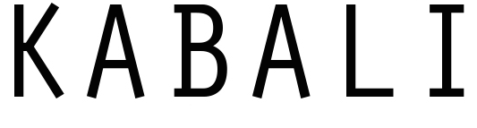

Hackathon – 2016
Lalitha | Alex | Vijay

Slide 2
Intent|
Given big data jobs have widely varying business needs
and operate in a shifting environment with respect to data, software and operations,
when I must assert their sanity regressively,
then I need a hassle-free, transparent mechanism to enforce sampling of the job runs in any environment
Solution|
Kabali is a library which
formalizes proportionate stratified sampling approach
enables fail-fast in production by first running the sample before entire population
easy declarative configuration for analysts
enforces sampling need contracts on developers, yet transparent, minimal and non- intrusive.
Audience| Big Data Analysts and Developers

Slide 3
Scope |
Kabali is not intended to train or validate the Business Model used in the job, as the Model is only one of the variables in a production job execution.
In case of big data jobs, the data, software and infrastructure are continuously shifting leading to variance in the job outputs over time, which Kabali will track and make a call.
Kabali initial approach of using weighted stratified sampling is a first attempt, we are pursuing experts for a stronger model.
Kabali serves as a medium for analysts, developers and operators to use sampling and ensure the job sanity in production via regression
Kabali is a library written in Scala and can be just added as a dependency.
It currently employs Apache Spark stack like DataSets and Spark SQL, but the testing principles can be ported later to any big data setup with appropriate tech plugged in.
Kabali brings sampling and regression testing as a first-class citizen to Big data environment, rather than being an after-thought.

Slide 4
Use-Cases
Characteristic | Job #1 | Job #2 | Job #3
Sampler(simple, complex, derived) | Mean Score | Mean Score | Average Property Value in the City
Samplable | Credit Purposed View | Credit Purposed View | Property Purposed View
Sample Ceiling Size | 1000 | 1000 | 1000
Strata (simple, complex, derived) | By Gender: M, F, A | By City: ATL, CHI, NYC | By Zipcode: 30004, 30050,30028….
Strata Weights | 0.25, 0.4, 0.35 250+400+350 | 0.01, 0.1, 0.05… 10+100+50.. <= 1000 | 0.25,0.2, 0.1…
Strata Sample Selection Method | Random without replacement | Random without replacement | Random without replacement
Threshold | 10% | 5% | 4%

Slide 5
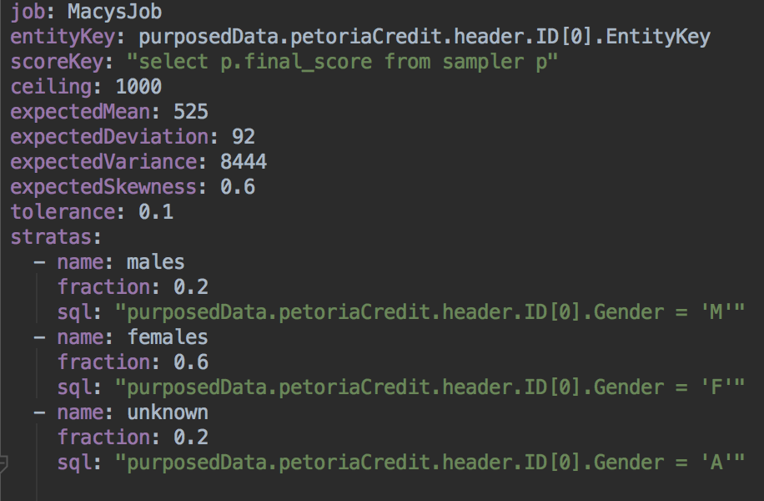
Use-Case | Market Analysis Job for Macy's promotional card
In order to promote a new credit card, Macy's would like to do an analysis based on gender-specific data to determine credit scores of men vs. women.
step1 | Analyst writes the following Kabali configuration

Slide 6
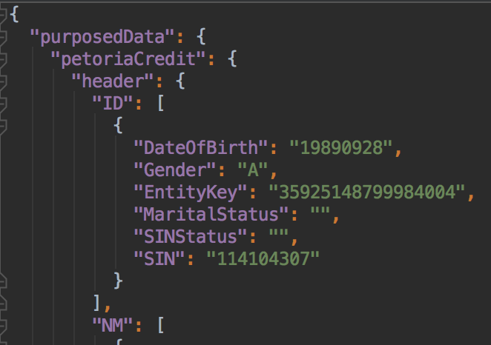
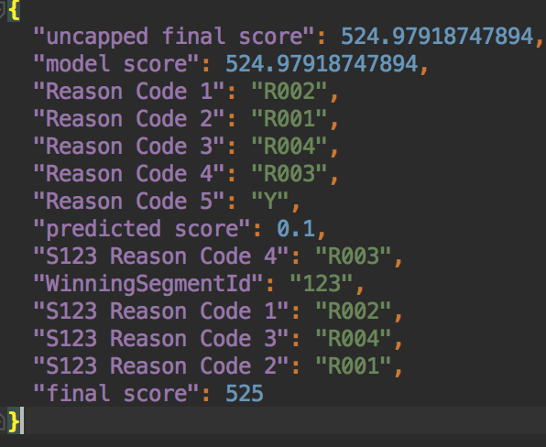
step1 | Analyst uses the following job-input as Samplable or job-output as Sampler
Samplable
Sampler

Slide 7
Step2 | Developer adds Kabali as dependency which enables job sampling
Any typical batch-fulfillment job
reads repository CDA records make entities from records make entities purposed as per business need make sure job is sane to run on entire population using Kabali
Kabali will
extract sample based on analyst configured stratified sampling run only the sample through the batch process validate the sample batch output through configured thresholds allow the job to proceed only if no significant deviation is found
“Talk is cheap, show me the code ..”

Slide 8
Scenario: Job blocked
*************************************JOB*********************************************** job:
|job_name=petoria_job|job_id=K001|client=Client_XYX|source=file:///data1/simulatedRepo/credit/credit.0040.repo.dat.gz|target=hdfs://depcent6601.cps.equifax.com:9000/|population=2762 *************************************LOG***********************************************
|name=males|fraction=0.3620564808110065|strata-fraction=0.18102824040550325
|name=females|fraction=0.3620564808110065|strata-fraction=0.10861694424330194
|name=unknown|fraction=0.3620564808110065|strata-fraction=0.07241129616220131
|kabali sample size = 435
|Job is exhibiting deviation from acceptable thresholds, hence cannot proceed! *************************************STAGES******************************************** stage:|name=records|status=Pass()|start_time=2016-06-20T02:34:57.268Z|end_time=2016-06-20T02:35:00.938Z|duration=3670 stage:|name=non-purposed|status=Pass()|start_time=2016-06-20T02:35:01.876Z|end_time=2016-06-20T02:35:07.805Z|duration=5929 stage:|name=purposed|status=Pass()|start_time=2016-06-20T02:35:07.805Z|end_time=2016-06-20T02:35:14.006Z|duration=6201 stage:|name=attribution|status=Pass()|start_time=2016-06-20T02:36:02.895Z|end_time=2016-06-20T02:36:02.901Z|duration=6 stage:|name=scores|status=Pass()|start_time=2016-06-20T02:36:02.901Z|end_time=2016-06-20T02:36:02.908Z|duration=7 *************************************STRATAS******************************************** strata:|name=males|query-size=1510|size=288 strata:|name=females|query-size=1129|size=139 strata:|name=unknown|query-size=110|size=8 *************************************FINAL_SAMPLE*************************************** sample:|size=435|mean=525.0|max=525.0|min=525.0|variation=0.0|skewness=NaN|deviation=0.0 *************************************END************************************************

Slide 9
Scenario: Job allowed
*************************************JOB************************************************ job:
|job_name=petoria_job|job_id=K002|client=Client_XYX|source=file:///data1/simulatedRepo/credit/credit.0040.repo.dat.gz|target=hdfs://depcent6601.cps.equifax.com:9000/|population=2762 *************************************LOG************************************************
|name=males|fraction=0.3620564808110065|strata-fraction=0.18102824040550325
|name=females|fraction=0.3620564808110065|strata-fraction=0.10861694424330194
|name=unknown|fraction=0.3620564808110065|strata-fraction=0.07241129616220131
|kabali sample size = 435
|Job is safe to proceed for entire population *************************************STAGES********************************************* stage:|name=records|status=Pass()|start_time=2016-06-20T02:52:07.167Z|end_time=2016-06-20T02:52:10.440Z|duration=3273 stage:|name=non-purposed|status=Pass()|start_time=2016-06-20T02:52:11.283Z|end_time=2016-06-20T02:52:17.147Z|duration=5864 stage:|name=purposed|status=Pass()|start_time=2016-06-20T02:52:17.147Z|end_time=2016-06-20T02:52:22.817Z|duration=5670 stage:|name=attribution|status=Pass()|start_time=2016-06-20T02:53:14.594Z|end_time=2016-06-20T02:53:14.599Z|duration=5 stage:|name=scores|status=Pass()|start_time=2016-06-20T02:53:14.600Z|end_time=2016-06-20T02:53:14.605Z|duration=5 stage:|name=attribution|status=Pass()|start_time=2016-06-20T02:53:25.075Z|end_time=2016-06-20T02:53:32.535Z|duration=7460 stage:|name=scores|status=Pass()|start_time=2016-06-20T02:53:32.535Z|end_time=2016-06-20T02:53:41.217Z|duration=8682 *************************************STRATAS******************************************** strata:|name=males|query-size=1510|size=288 strata:|name=females|query-size=1129|size=139 strata:|name=unknown|query-size=110|size=8 *************************************FINAL_SAMPLE*************************************** sample:|size=435|mean=525.0|max=525.0|min=525.0|variation=0.0|skewness=NaN|deviation=0.0 *************************************END************************************************

