Slide 1
Provision a Data Science Virtual Machine

Slide 2
How do you get R Server?
In the cloud:
Azure Data Science Virtual Machine
Windows & Linux
Azure SQL Server 2016
Azure HDInsights
On premises:
Microsoft R Client
SQL Server 2016 (Stand alone or with SQL Server)

Slide 3
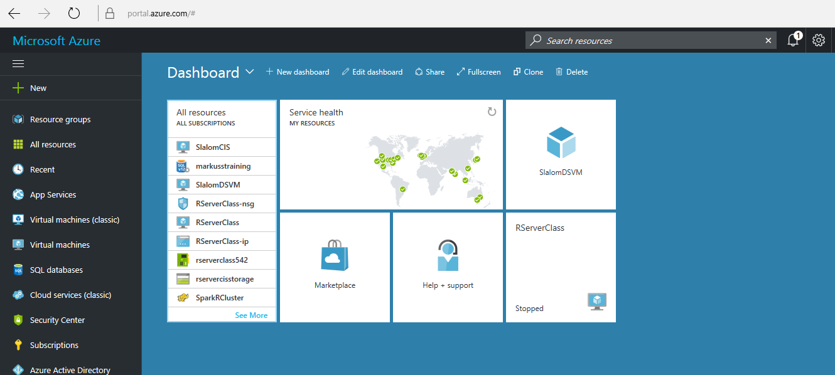
portal.azure.com
Notes:
Free subscription, $150/month credit for FTEs
Add ‘New’ and search for “Data Science”
Select data science VM (Windows or Linux)
What’s configured on the DSVM? R Server with ScaleR PEMA algorithms, Anaconda Python distribution, Jupyter, sample notebooks, Visual Studio Community edition, PowerBI
Pricing and size
Can configure web based R Studio Server.
https://azuremarketplace.microsoft.com/en-us/marketplace/apps/microsoft-ads.standard-data-science-vm

Slide 4
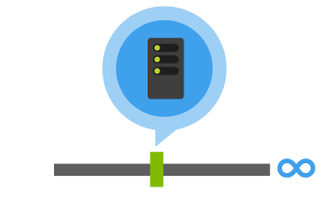
HDInsight
What it is:
Microsoft’s implementation of apache Hadoop (as a service) that uses Blobs for persistent storage
When to use it:
When you need to process large scale data (PB+)
When you want to use Hadoop or Spark as a service
When you want to compute data and retire the servers, but retain the results
When your team is familiar with the Hadoop Zoo
Notes:
Azure HDInsight: http://azure.microsoft.com/en-us/services/hdinsight/
SparkR

Slide 5
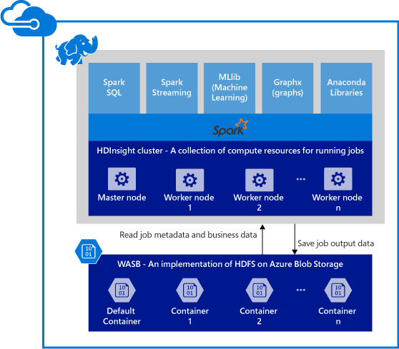
HDInsights = Hadoop and/or Spark clusters
Add R Server
Provisions Azure compute resources with Spark 1.6 installed and configured.
Data is stored in Azure Blob storage (WASB).

Slide 6
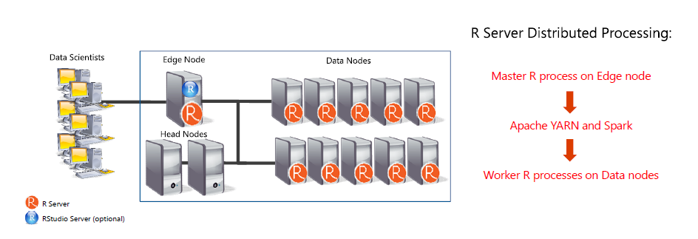
R Server HDInsights Architecture

Slide 7
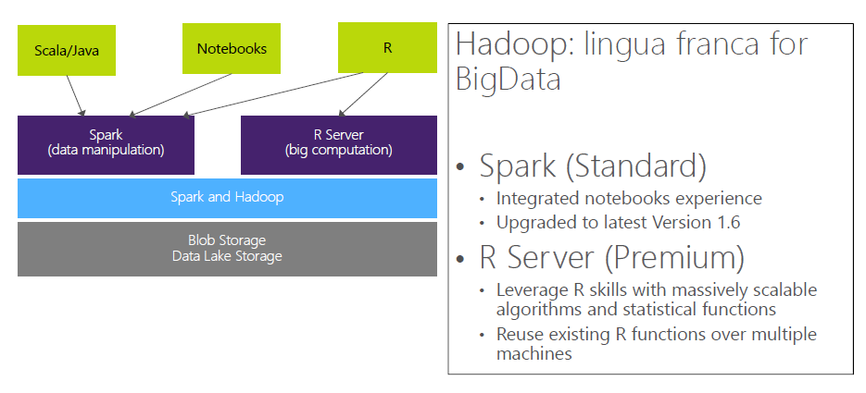
HDInsights w/R Server = managed Hadoop for advanced analytics
With HDInsights you can leverage SparkR and well as R Server.

Slide 8
R Server on Spark - substantially faster
Configuration:
HDI cluster size: 7 nodes
1 Edge Node: 8 cores, 28GB
4 Worker Nodes: 8 cores, 28GB
Dataset: Duplicated Airlines data (.csv)
Number of columns: 26
Source: Scalable Data Analytics Using R: Single Machines to Spark Clusters, Microsoft presentation KDD 2016

Slide 9
There are 3 main steps to getting started with R on HDInsights
Provision a HDInsight cluster
Create a compute context
Run R code
1
2
3
The following slides will give you some guidance, code examples and useful links to get more details.

Slide 10
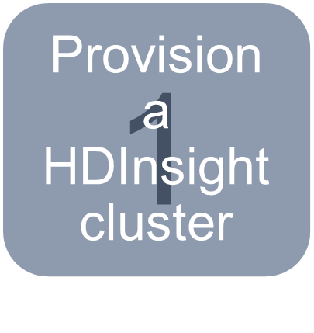
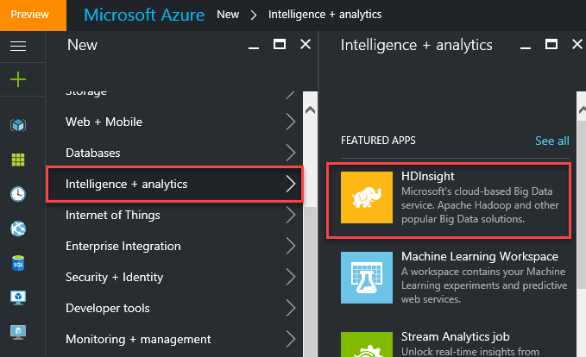
Provision an HDInsight cluster
Run R scripts against data stored on a Hadoop file system or within Spark.
Notes:
You choose a cluster type when provisioning, Hadoop, Spark, R Server on Spark
https://docs.microsoft.com/en-us/azure/hdinsight/hdinsight-hadoop-r-server-get-started

Slide 11
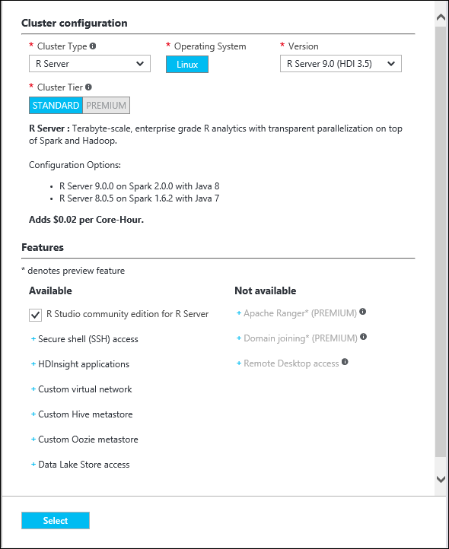
Different types of clusters – select R Server
RStudio Server enables you to provide a browser based interface to a version of R running on a remote Linux server. R Studio community edition for R Server: this browser-based IDE is installed by default on the edge/worker node. If you would prefer to not have it installed, then un-check the check box. If you choose to have it installed, then you’ll find the URL for accessing the RStudio Server login on a portal application blade for your cluster once it’s been created.

Slide 12
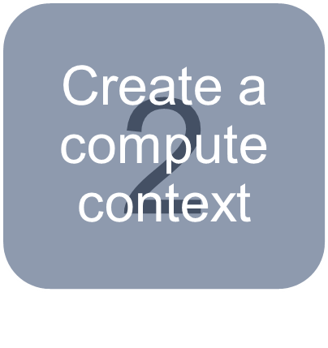
Create your compute context
Connect to your cluster using R Studio Server on port 8787, e.g. http://<ip address>:8787/
Hadoop MapReduce
a. Specify parameters:
myHadoopCluster <- RxHadoopMR(
hdfsShareDir = myHdfsShareDir
, shareDir = myShareDir
, sshUsername = mySshUsername
, sshHostname = mySshHostname
, sshSwitches = mySshSwitches)
b. Specify context:
rxSetComputeContext(myHadoopCluster)
Create a compute context for Hadoop MapReduce
Note: there are default values for shareDir and hdfsShareDir, if you’re running a node of the cluster using these defaults you don’t need to specify them. You also don’t need the host and user name if you’re already connected to a node on the cluster. See the link above for more detail on how to use R client to remotely connect to a Spark/Hadoop cluster.

Slide 13
Create your compute context
Spark
a. Specify parameters:
myHadoopCluster <- RxSpark(
hdfsShareDir = myHdfsShareDir
, shareDir = myShareDir
, sshUsername = mySshUsername
, sshHostname = mySshHostname
, sshSwitches = mySshSwitches)
b. Specify context:
rxSetComputeContext(myHadoopCluster)
Create a compute context for Spark

Slide 14
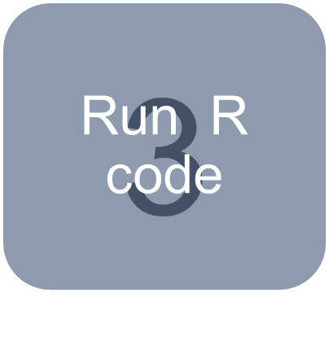
Run R code
Copy data into the cluster
bigDataDirRoot <- "/share" # define hdfs location of the example data
source <-system.file("SampleData/AirlineDemoSmall.csv", package="RevoScaleR") # create pointer to a sample data set
inputDir <- file.path(bigDataDirRoot,"AirlineDemoSmall") # create pointer to a directory location
rxHadoopMakeDir(inputDir) # make directory in hdfs
rxHadoopCopyFromLocal(source, inputDir) # copy sample data into the hdfs
(all that to copy a csv and store it!)
Define the data source, e.g. hdfs, for R Server
hdfsFS <- RxHdfsFileSystem()

Slide 15
Run R code
Read data into R Server
airDS <- RxTextData(file = inputDir
, missingValueString = "M"
, fileSystem = hdfsFS)
Summarize
adsSummary <- rxSummary(~ArrDelay+CRSDepTime+DayOfWeek
, data = airDS)
Some function names begin with rx and others with Rx. The Rx function name prefix is used to distinguish the class constructors such as data sources and compute contexts.

Slide 16
Appendix

Slide 17
Example using sparklyr package
>library(sparklyr)
>sc <- spark_connect(master = "yarn-client")
>download.file(http://alizaidi.blob.core.windows.net/training/taxi_large.csv
, "taxi_large.csv")
>wasb_taxi <- "/NYCTaxi/sample"
>rxHadoopListFiles("/")
>rxHadoopMakeDir(wasb_taxi)
>rxHadoopCopyFromLocal("taxi_large.csv", wasb_taxi)
>rxHadoopCommand("fs -cat /NYCTaxi/sample/taxi_large.csv | head")
>taxi <- spark_read_csv(sc, path = wasb_taxi, "taxisample", header = TRUE)
Tutorial on R Server, Spark and SparkR

Slide 18
R Server: portable across multiple platforms
Windows
Linux
HDInsight
Cloud
Hortonworks
Cloudera
MapR
Hadoop & Spark
R Server Technology
R Server portfolio
EDW
SQL Server 2016
Teradata Database
R+CRAN
Microsoft R Open
DeployR
DistributedR
RDBMS
SQL Server 2016 EE
SQL Server 2016 SE
ConnectR
Desktops & Servers
Windows
Linux
ScaleR

Slide 19
Useful links
Azure Data Science Virtual Machines
R Server on Hadoop
R Server Compute Context on Hadoop
Spark
MapReduce
Some function names begin with rx and others with Rx. The Rx function name prefix is used to distinguish the class constructors such as data sources and compute contexts.

Slide 20








Scale on big data - R Server + Azure
Data Streaming
Data Sources
Data Partition
Web Services
Consumption
Model Training
Feature Engineering
Predictions
HDInsight
Web Application
Azure Stream Analytics
Azure Blob Storage
Microsoft R Server
Azure Machine Learning
Power BI

