Slide 1

Project Title - Seasonal Agriculture Performance Analysis
[Achint Tiwari]
AICTE STU ID : ( STU6a58eac975beb1784212169)

Slide 2

PROBLEM STATEMENT
• Agricultural performance is influenced by seasonal variations in environmental conditions
• Farming practices, resource availability, and market conditions differ across seasons
• Raw agricultural data lacks clear insights into seasonal patterns and trends
• Need to identify meaningful patterns and relationships within seasonal data
• Goal: Analyze agricultural dataset to investigate seasonal differences in performance

Slide 3
Project Description
• Comprehensive analysis of seasonal agricultural performance across 3 seasons
• Dataset: Contains farm records from multiple states across Kharif, Rabi, and Zaid seasons
• Scope: Analyse 4,000+ farm records covering environmental, resource, and economic factors
• Methodology: Data Visualization & Pattern Recognition
• Tools: Python (pandas, matplotlib, seaborn) for data analysis and visualization
• Focus: Identify patterns, trends, and actionable insights for agricultural planning

Slide 4

WHO ARE THE END USERS?
🌾 Farmers: Plan seasonal crop selection and resource allocation
📊 Agricultural Planners: Design policies based on seasonal performance data
💼 Government Agencies: Support agricultural development programs
🏢 Agricultural Businesses: Optimize supply chain and procurement strategies
📈 Researchers: Study seasonal patterns and climate impacts on agriculture
🌍 Rural Development Organizations: Design targeted interventions

Slide 5

Technology Used
🐍 Python 3.x - Programming language
📊 Pandas - Data manipulation and analysis
📈 Matplotlib & Seaborn - Data visualization
🔢 NumPy - Numerical computing
📓 Jupyter Notebook - Interactive analysis environment
🔗 GitHub - Version control and project repository

Slide 6
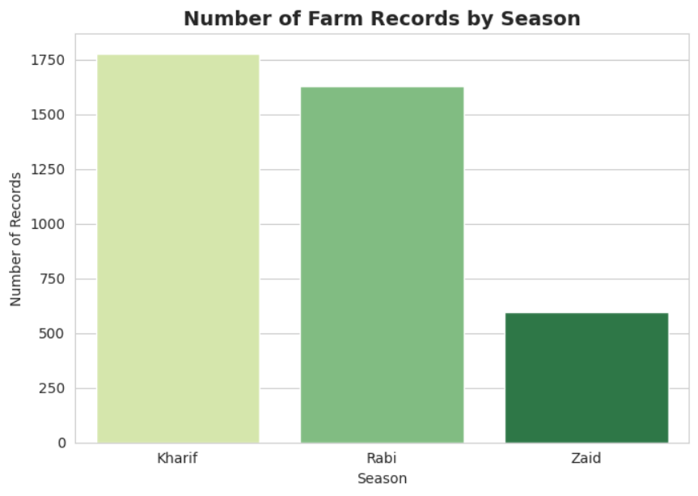
RESULTS; Farm Records Analysis

Slide 7
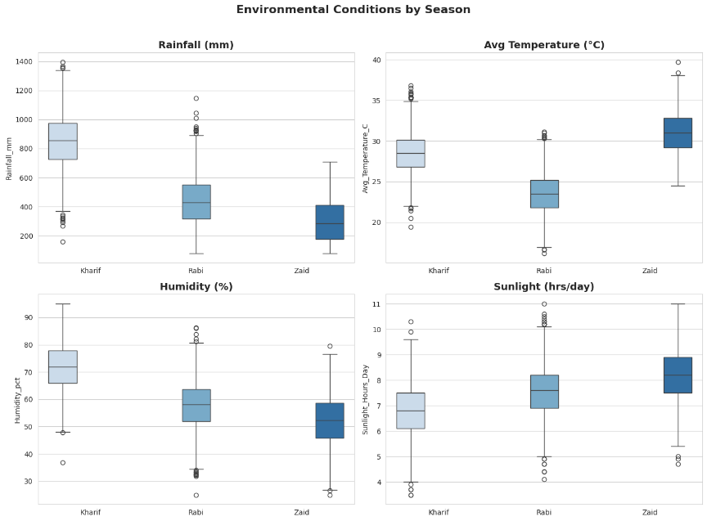
RESULTS: Environmental Conditions

Slide 8
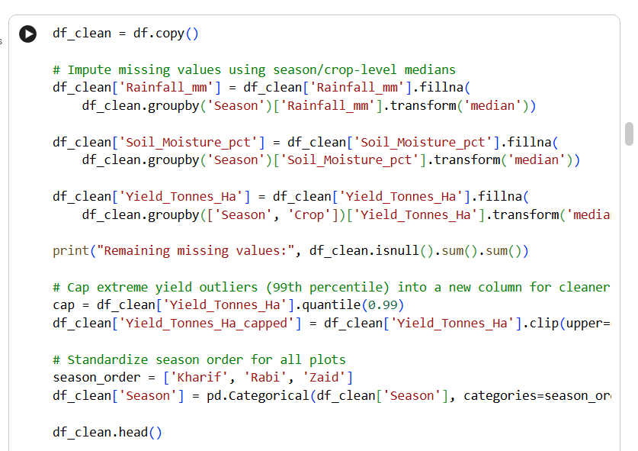
RESULTS
[Add screen shots of your code ]

Slide 9
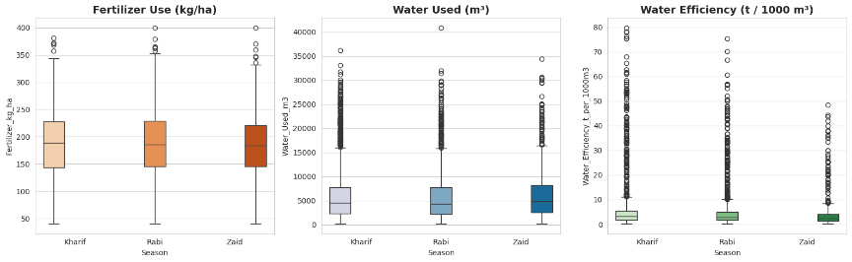
RESULTS: Resource Usage Analysis

Slide 10
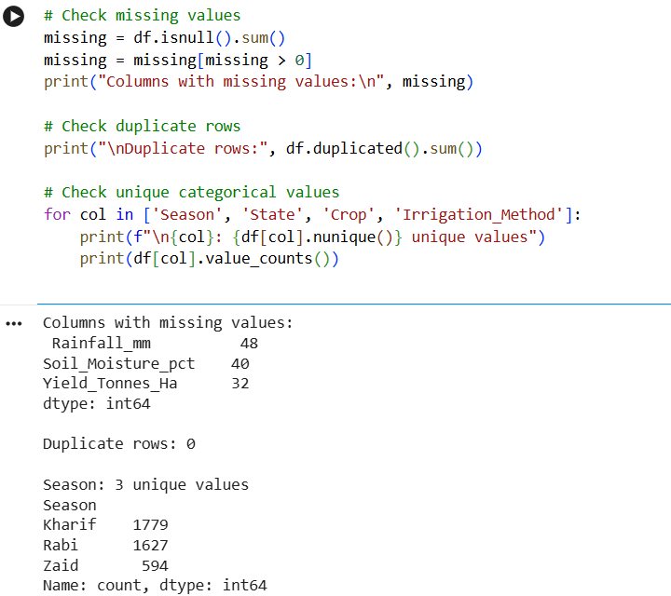
RESULTS

Slide 11
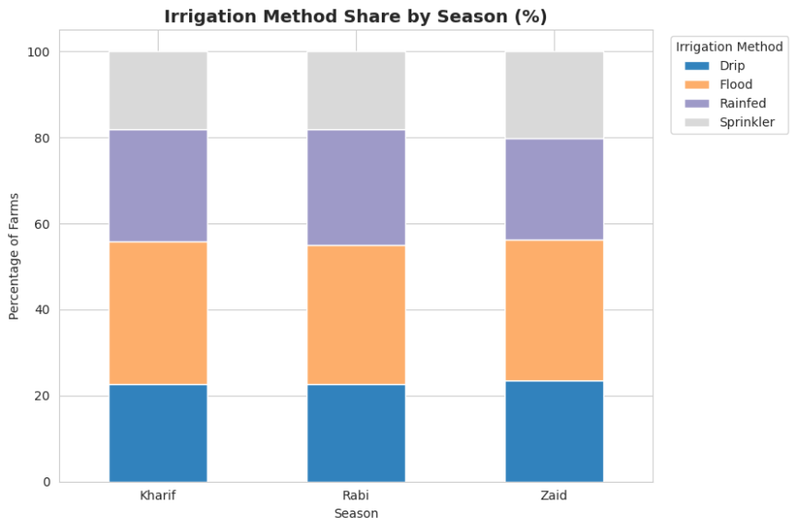
RESULTS: Irrigation Methods

Slide 12
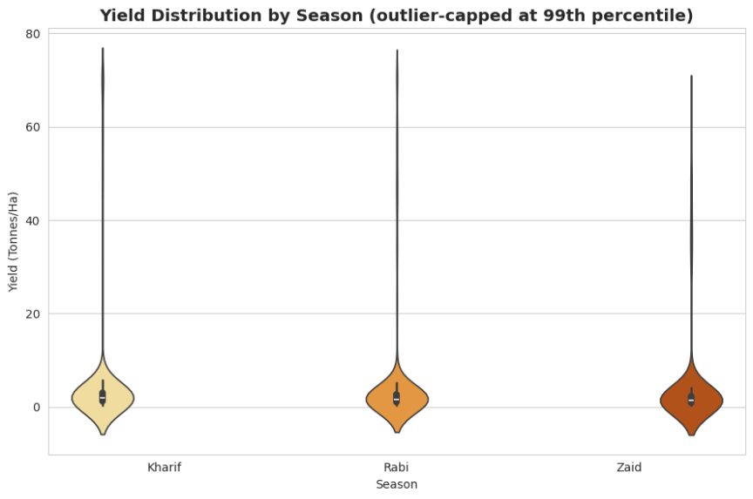
RESULTS: Yield Distribution

Slide 13
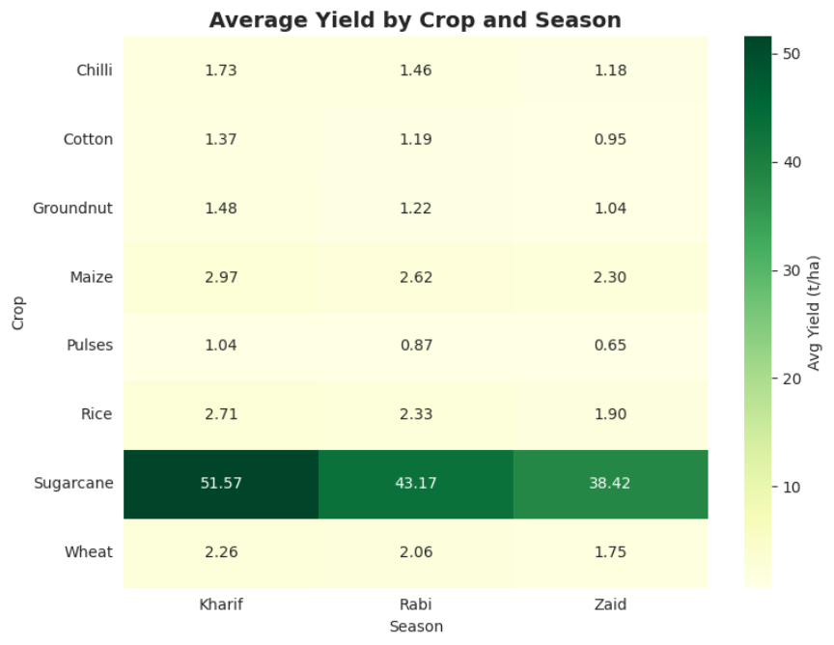
RESULTS: Crop-Wise Yield Analysis

Slide 14
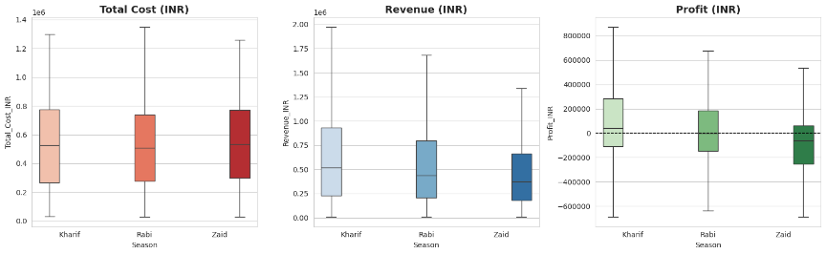
RESULTS: Economic Performance

Slide 15
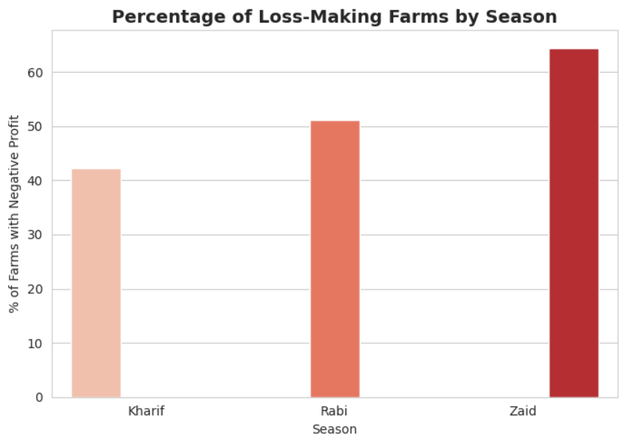
RESULTS: Loss-Making Farms

Slide 16
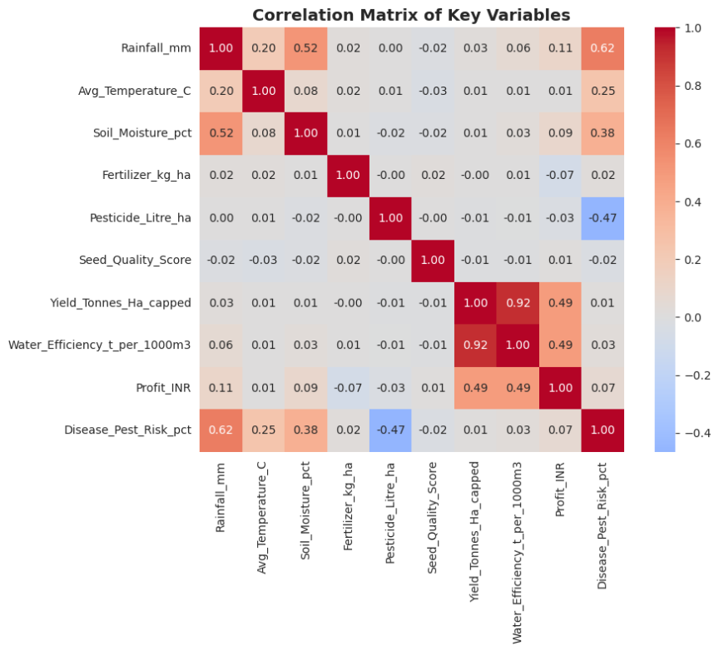
RESULTS: Correlation Analysis

Slide 17
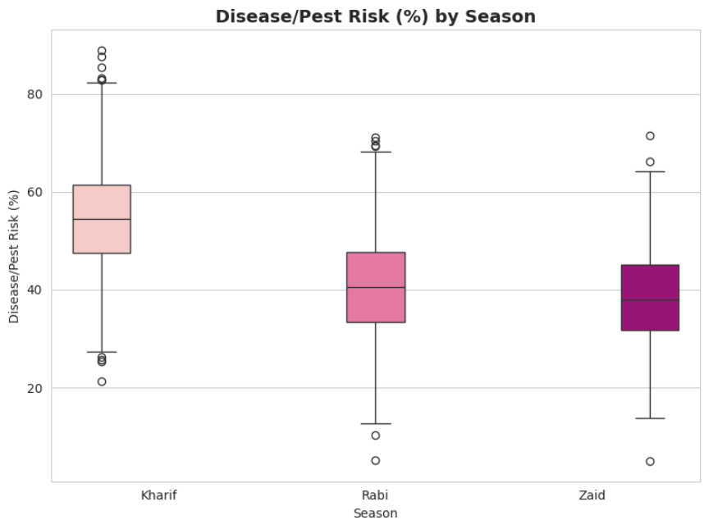
RESULTS: Disease & Pest Risk

Slide 18
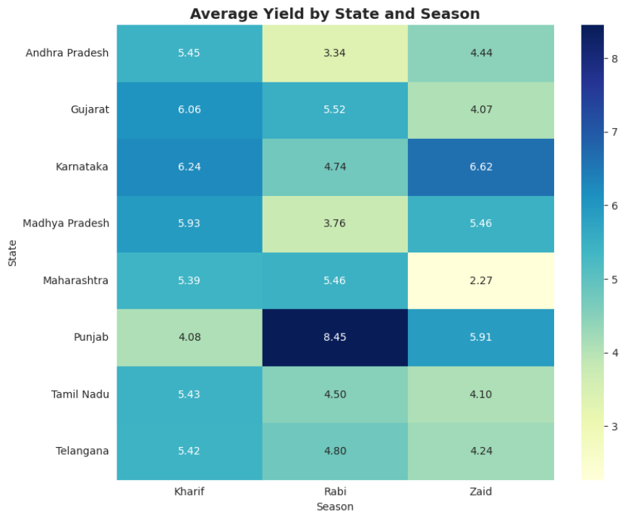
RESULTS: State-Wise Yield Heatmap

Slide 19
KEY FINDINGS
✓ Kharif season has highest farm records (1,750) with most favorable rainfall patterns
✓ Sugarcane shows highest yields across seasons (38-51 tonnes/ha)
✓ Kharif season has better profitability - only 43% farms loss-making vs 65% in Zaid
✓ Strong correlation (0.92) between yield and water efficiency - optimal irrigation critical
✓ Disease/pest risk highest in Kharif (median 55%) - seasonal risk management needed
✓ Punjab shows best yields in Rabi (8.45 t/ha) - regional climate advantage

Slide 20
FUTURE SCOPE
🔮 Predictive Modeling: Build ML models to forecast yield based on seasonal factors
🌡️ Climate Impact Analysis: Incorporate climate change data and its effect on agriculture
💡 Recommendation Engine: Develop system to suggest optimal crop selection per region/season
📱 Mobile Dashboard: Create real-time visualization tool for farmers and planners
🤖 AI-Powered Insights: Use advanced analytics for automated anomaly detection

Slide 21
GitHub Link
https://github.com/AswiniKumar55/-Seasonal-Agriculture-Performance-Analysis-.git
Google Colab File:
https://colab.research.google.com/drive/13_kPrFNLpCm5hlBcVbEfofSJp-dXqSNg#scrollTo=4e6188f1

Slide 22

VOIS Course completion certificate - Course name- Data Visualization
https://voisfortech.com/certificate-verification/VFLMS26_161501/301

Slide 23
Thank you
Achint Tiwari Seasonal Agriculture Performance Analysis
.
.

