Slide 1
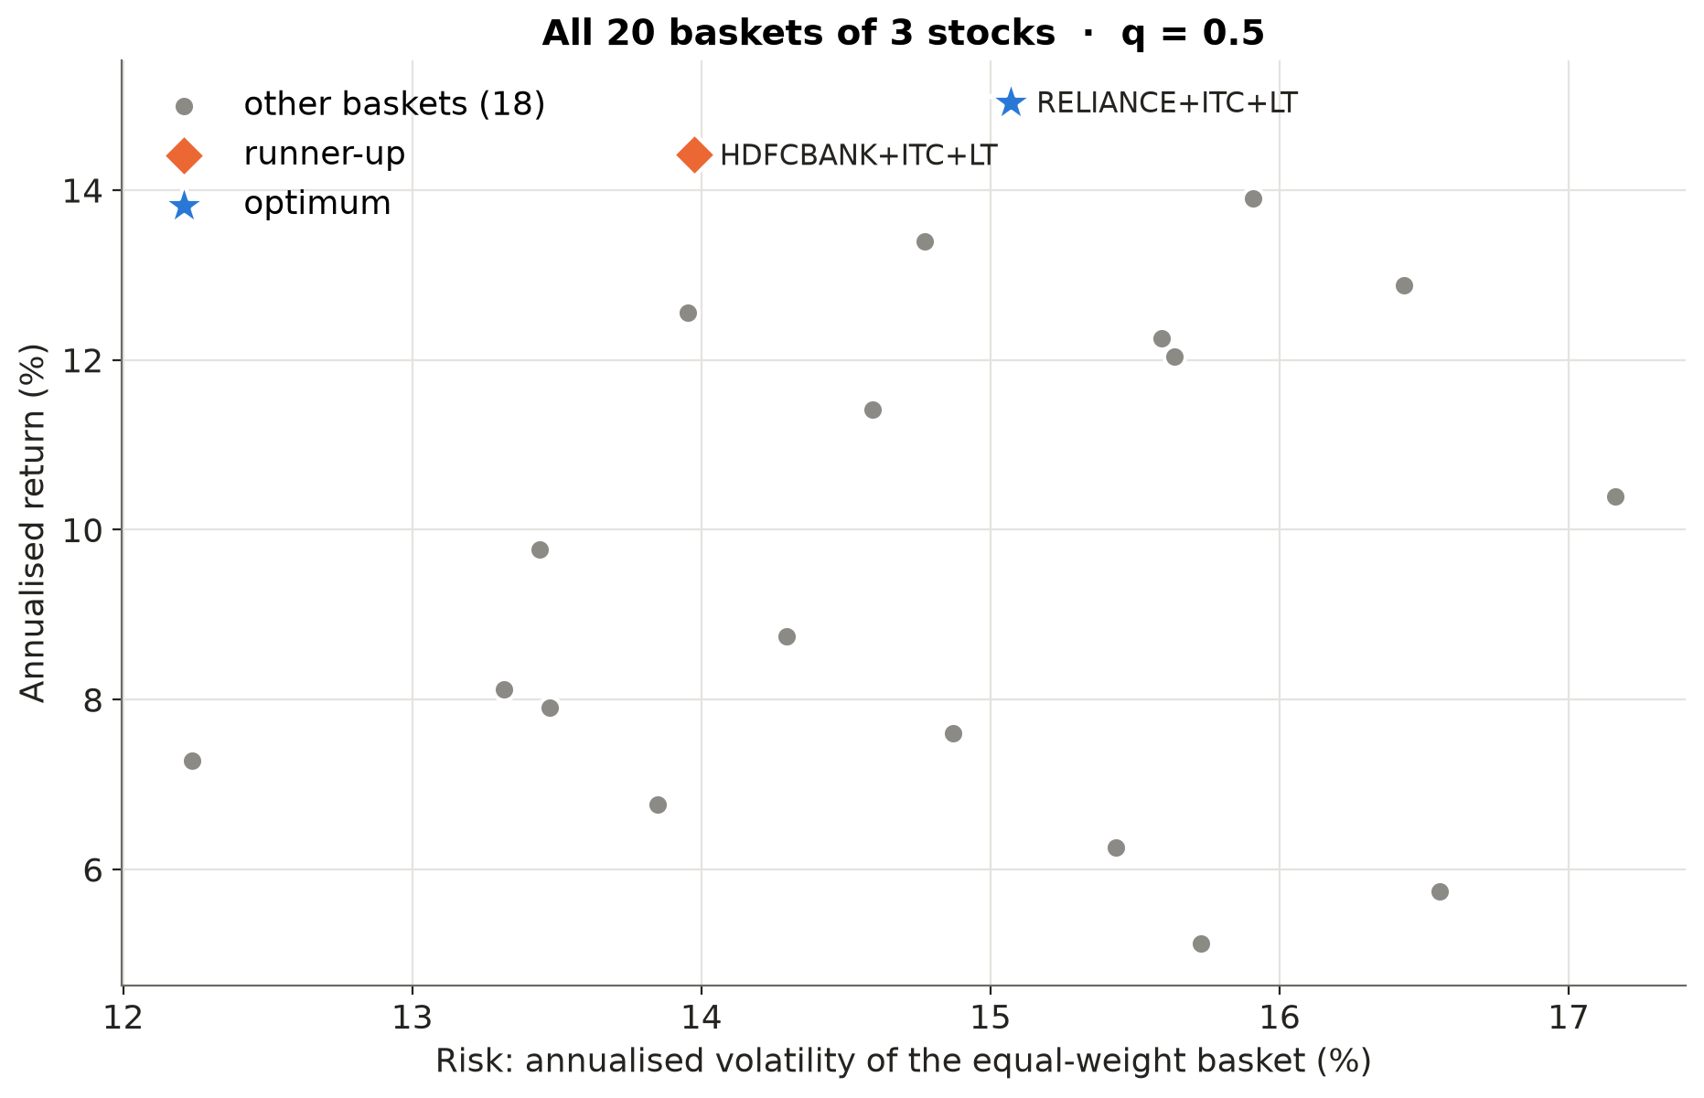
Picking the best 3 of 6 stocks, on a quantum computer
Robo-advisor model baskets · NSE large caps · return ↑ risk ↓
All C(6,3) = 20 baskets on the risk/return plane.
Basket count grows as C(n,k): ~185 000 for 10-of-20.
Goal: find the best basket for a client's risk aversion q.
Notes:
Robo-advisors in India sell model baskets: a few stocks, equal weights, for a given risk profile. Choosing which k stocks go in is a combinatorial problem. Here I pick 3 of 6 NSE large caps, which is 20 possible baskets; each dot on this chart is one of them. We want return up and risk down, and the client's risk aversion q sets the trade-off. The blue star is the best basket for q = 0.5, and the orange diamond is a very close runner-up. At 20 baskets a laptop checks them all instantly, but the count explodes as C(n,k), so it is a natural test bed for quantum optimisation.

Slide 2
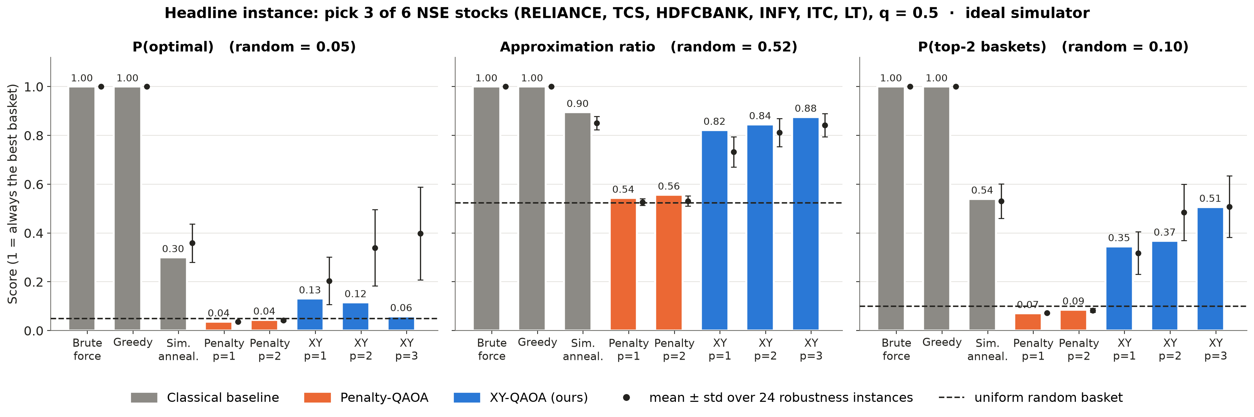
Put the constraint in the circuit, not in the cost
Penalty QAOA (X mixer)
XY-QAOA (Dicke state + XY mixer)
Searches all 64 bit strings, 44 invalid
→ finds the best basket at chance level
Only ever visits the 20 valid baskets
→ every shot is a real portfolio
100% valid baskets · P(optimal) 0.34 vs 0.05 random
comparable to simulated annealing · penalty-QAOA = random
Notes:
The textbook way to say 'exactly 3 stocks' is a penalty term in the cost. I tested it carefully: only 75% of its samples are valid baskets, and it finds the best one 4% of the time, the same as random guessing at 5%. So I moved the constraint into the circuit. A Dicke state starts in an equal mix of only the valid baskets, and an XY mixer swaps stocks in and out without changing the count. Every shot is a real portfolio. Over 24 test instances the best basket comes up 34% of the time, about the same as simulated annealing at 36%. Grey bars are classical baselines, blue is ours, orange is the penalty approach.

Slide 3
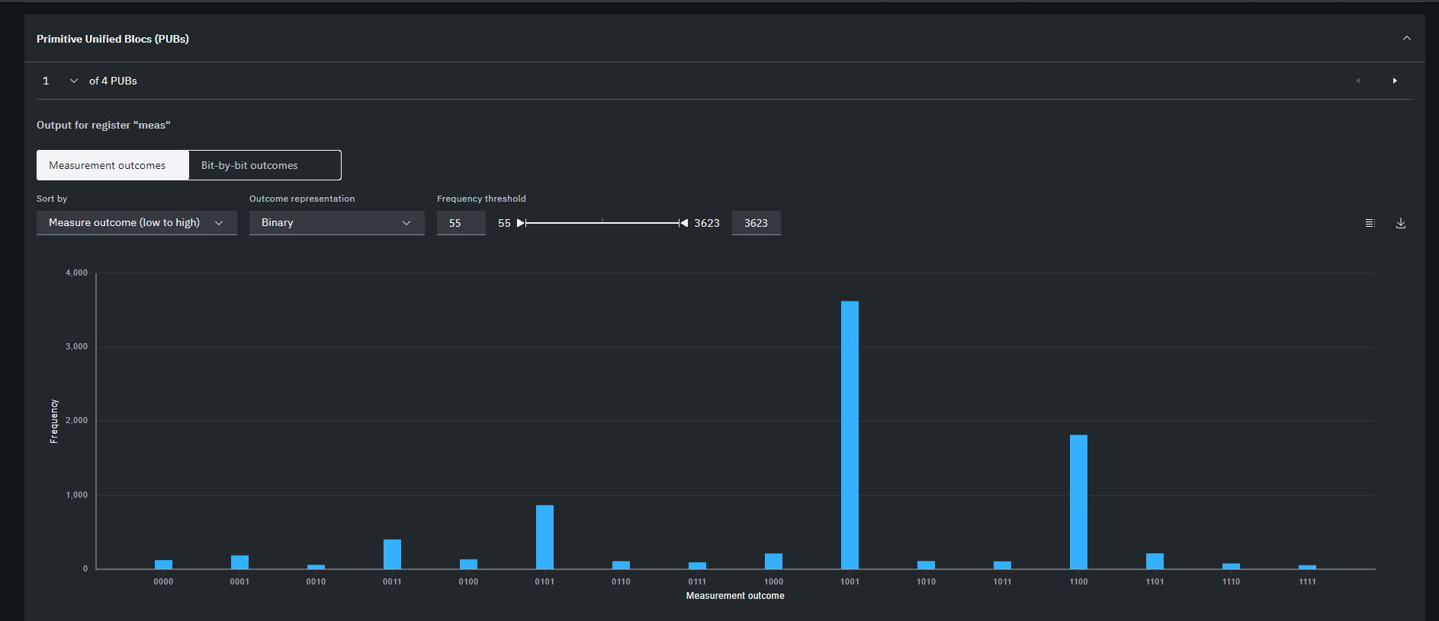
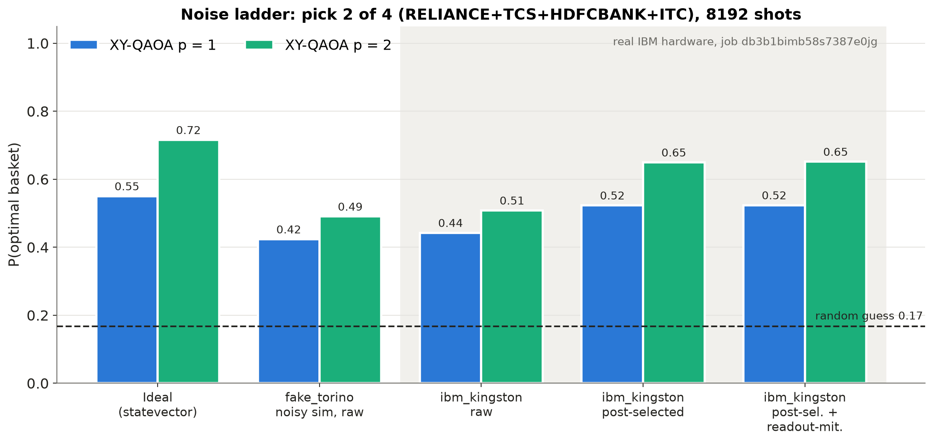
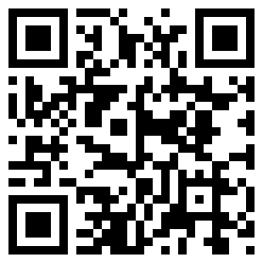
Real IBM quantum hardware: ibm_kingston
ibm_kingston: 0.51 raw → 0.65 post-selected (random 0.17); top answer = true optimum
Real ibm_kingston output — tallest bar 1001 = optimal basket (RELIANCE+ITC), second 1100 = runner-up
Limits: brute force is still faster at this size, so no quantum advantage is claimed; today's noise limits us to ~4–6 assets.
Repo
Notes:
Then I ran the same circuit on IBM's ibm_kingston, with 4 stocks and 2 picked. On the left is the raw output from the IBM dashboard: the tallest bar is the optimal basket and the second is the runner-up. Noise lets some invalid baskets through, about 22% of shots. The ideal circuit can never produce them, so I simply throw them away. That is free error detection. The optimal basket goes from 51% to 65%, against 17% for a random guess. Honest limits: at this size a laptop solves it instantly, so I claim no quantum advantage. The point is that building business constraints into the circuit is what makes quantum optimisation work at all. Code and live demo are behind the QR codes.

