Slide 1
GHCJS
And how to use it
Artem Chirkin
Notes:
Hi, my name is Artem
I am not a GHCJS developer
My experience in it is about several months.
During these months I've got some insight into its overall logic.
You know, GHCJS is a compiler from Haskell into JavaScript. This means the authors of GHCJS had to do some hackery stuff to make as least overhead as it possible while maintaining full functionality of original Haskell we all here love.
Today I will try to share with you the main ideas used in GHCJS that I managed to spot.
In the meantime I will show you pieces of code from my application. Since I am not a professional Haskell programmer, those are far from optimal, so you are welcome to suggest me changes.

Slide 2
GHCJS is a Haskell to JavaScript compiler
GHCJS is a Haskell to JavaScript compiler that uses the GHC API.
GHCJS supports many modern Haskell features, including:
  All type system extensions supported by GHC
  Lightweight preemptive threading with blackholes, MVar, STM, asynchronous exceptions
  Weak references, CAF deallocation, StableName, StablePtr
  Unboxed arrays, emulated pointers
  Integer support through JSBN, 32 and 64 bit signed and unsigned arithmetic (Word64, Int32 etc.)
  Cost-centres, stack traces
  Cabal support, GHCJS has its own package database
And some JavaScript-specific features:
  new JavaScriptFFI extension, with convenient import pattens, asynchronous FFI and a JSRef FFI type,
  synchronous and asynchronous threads.
Got this directly from README.md on
https://github.com/ghcjs/ghcjs
Notes:
First of all:
What is GHCJS?
…

Slide 3
Installation and HelloWorld
Available on GHCJS github repository
Compilation of the compiler and the base packages takes a while
$ cabal install ./ghcjs # standard way of installing stuff
$ ghcjs-boot # install ghcjs-base packages into cabal .ghcjs repository
For compilation use ghcjs
or cabal --ghcjs flag
or compiler: ghcjs in cabal.config of a sandbox
Notes:
In the earlier versions of GHCJS installation was a kind of complicated process.
Now it is really as simple as it could be:
You just install cabal packages and run executable ghcjs-boot
First command ghcjs-boot provides a set of base packages compiled into javascript.
So you could consider this as just another installation of ghc. You even can freely use cabal and cabal install to install literally any package from hackage!
[Go to hello world example in leksah]

Slide 4
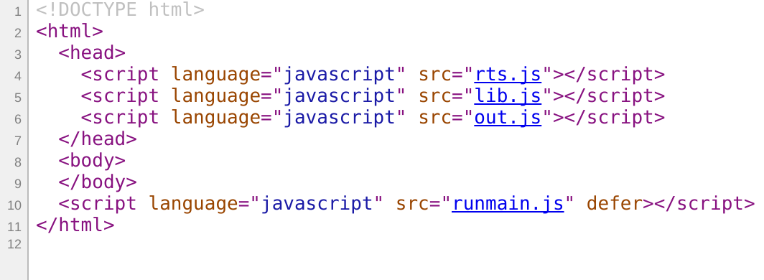
Compiled Hello World
HelloGHCJS.jsexe/index.html
On compilation ghcjs emits index.html test page and four js files:
runmain
+ lib (foreign (js) code – js-sources line in projec.cabal file)
+ out (our code)
+ rts

Slide 5
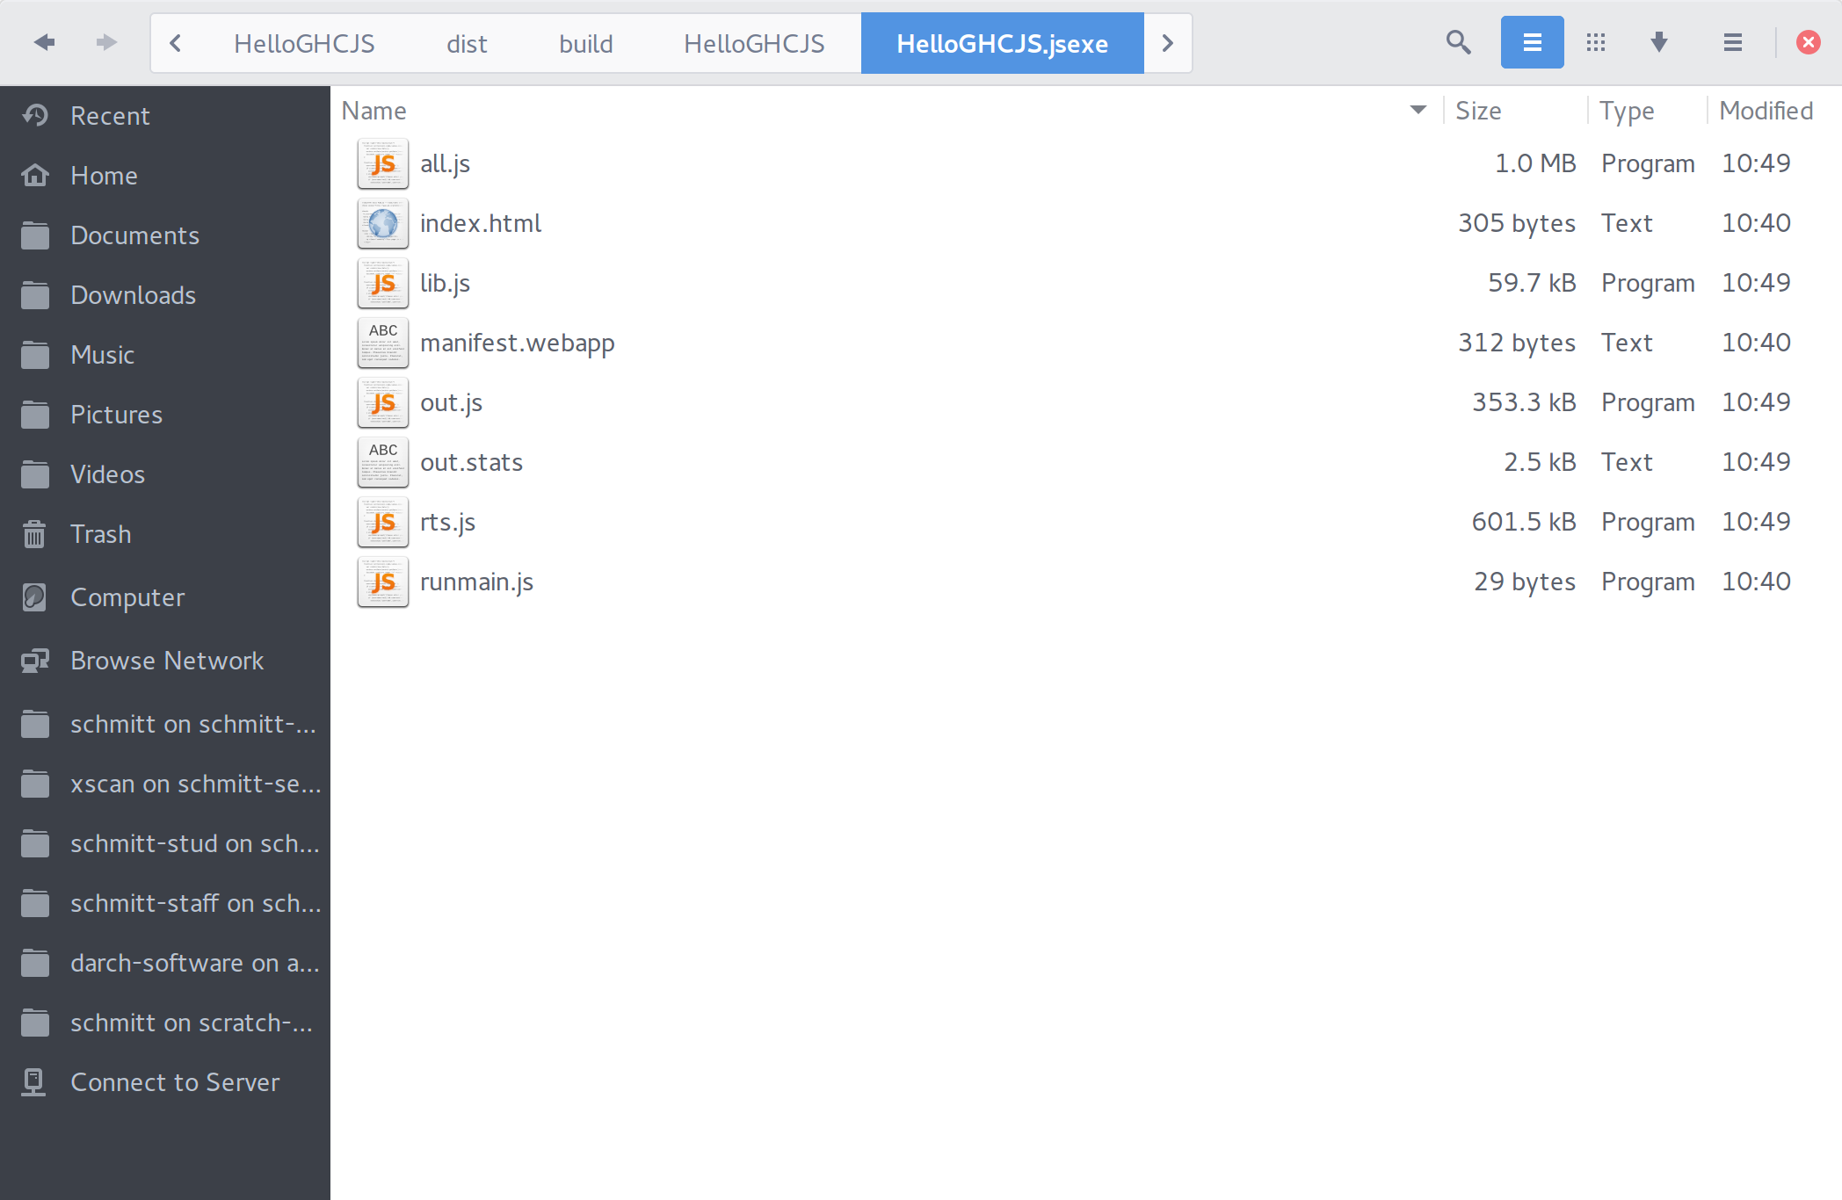
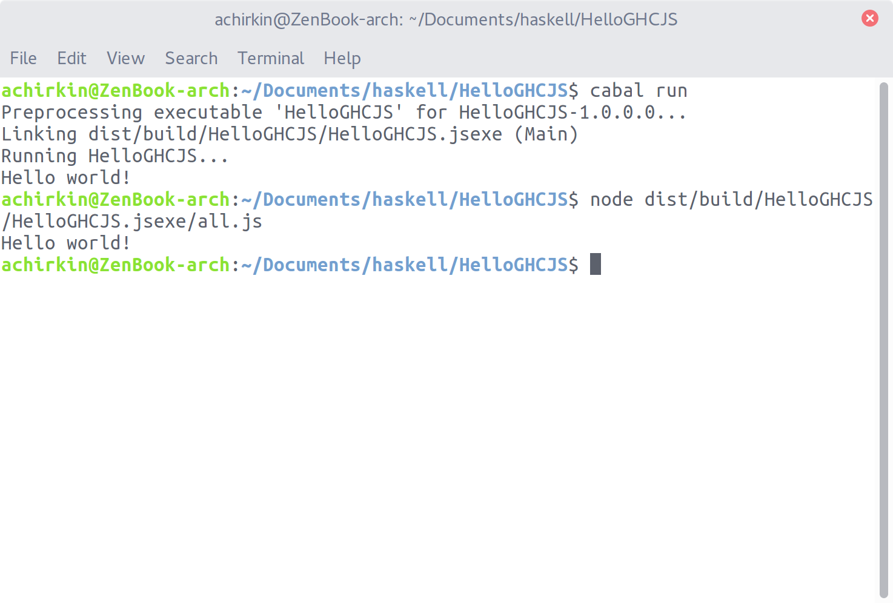
Compiled Hello World

Slide 6
Output sizes (out.stats)
HelloGHCJS – 2MB ghcjs-modeler – 6MB
code size summary per package:
base: 278061
ghc-prim: 3321
ghcjs_HwzX8eXAwveCUOoAWSdVDg:8376
integer-gmp: 1997
main: 839
code size per module:
base
Control.Exception.Base: 2754
...
System.Posix.Internals: 16161
ghc-prim
GHC.CString: 1876
GHC.IntWord64: 146
GHC.Tuple: 542
GHC.Types: 757
ghcjs_HwzX8eXAwveCUOoAWSdVDg
GHCJS.Prim: 7600
GHCJS.Prim.Internal: 776
integer-gmp
GHC.Integer.GMP.Prim: 172
GHC.Integer.Type: 1825
main
Main: 839
packed metadata: 60743
code size summary per package:
base: 820728
...
fgeom_0evYSJPzEL1G09aAlbVeCu:1144733
geojs_3CbpcJY6jNjI2tVx96NtiU:360433
ghc-prim: 28063
main: 1645078
...
vecto_EcjDyDlwiMg9atEfp9gJxH:2164
code size per module:
...
main
Controllers.ElementResizing: 1339
Controllers.GUIEvents: 1745
Controllers.GeoJSONFileImport: 9290
Controllers.LuciClient: 35407
Controllers.Pointer: 146774
GHCJS.Useful: 14126
Main: 32851
Program: 15973
...
Reactive: 75721
Services: 780
Services.Isovist: 161159
Services.RadianceService: 9902
SmallGL.Helpers: 24559
SmallGL.Shader: 41356
SmallGL.WritableVectors: 40912
...
packed metadata: 855934

Slide 7
Closure compiler is our friend
The command I use for ghcjs-modeler:
$ closure-compiler --language_in=ECMASCRIPT5 dist/build/ghcjs-modeler/ghcjs-modeler.jsexe/all.js web/misc.js web/luciConnect.js web/faultylabs.md5.js --compilation_level=ADVANCED_OPTIMIZATIONS > web/modeler.js
This combines libraries (~200KB) and ghcjs output (~6MB) into 2MB .js file.

Slide 8
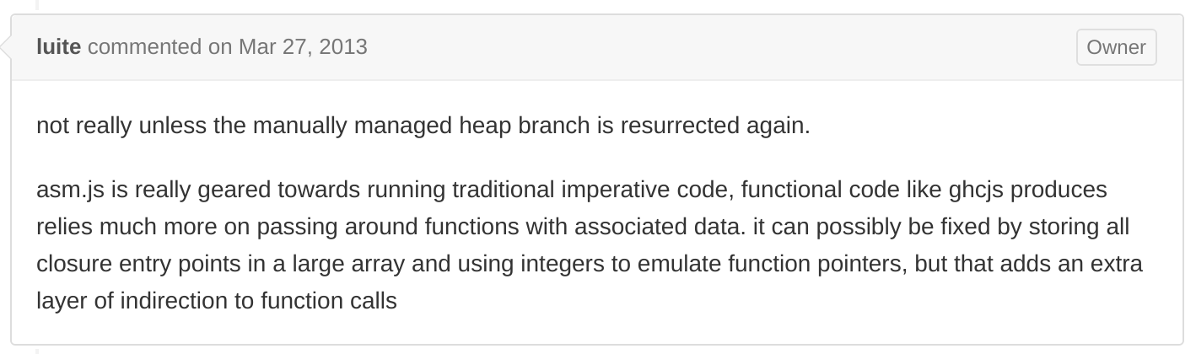
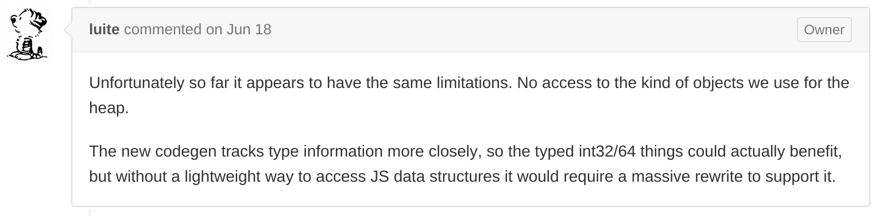
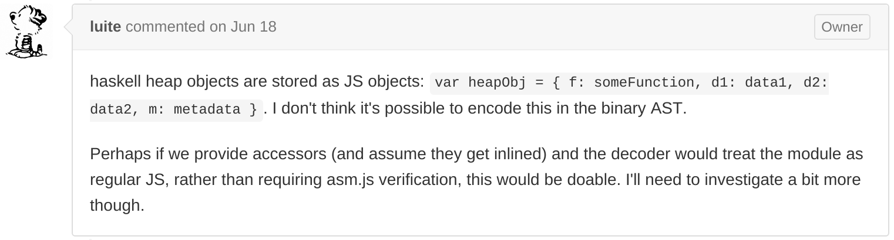
ASM.js and WebAssemblies are not here
GHCJS is not going to support ASM.js
And the same problem with WebAssembly
https://github.com/ghcjs/ghcjs/issues/53
https://github.com/ghcjs/ghcjs/issues/359

Slide 9
Threading and web workers
GHCJS implements its own lightweight threading system which runs in a single js thread.
In current version of ghcjs-base WebWorkers are not supported. I suppose, the main problem is that WebWorker threads are isolated, thus we need another copy of RTS running on WebWorker to make it run Haskell code.
There is a branch of ghcjs on github called improved-base. It has WebWorkers, but I have not tried it yet.

Slide 10
Foreign calls & GHCJS.Foreign
The principal type here is JSRef, which is a lifted type that contains a JavaScript reference. The JSRef type is parameterized with one phantom type, and GHCJS.Types defines several type synonyms for specific variants.
The code in this module makes no assumptions about 'JSRef a' types. Operations that can result in a JS exception that can kill a Haskell thread are marked unsafe (for example if the JSRef contains a null or undefined value). There are safe variants where the JS exception is propagated as a Haskell exception, so that it can be handled on the Haskell side.
For more specific types, like JSArray or JSBool, the code assumes that the contents of the JSRef actually is a JavaScript array or bool value. If it contains an unexpected value, the code can result in exceptions that kill the Haskell thread, even for functions not marked unsafe.
The code makes use of foreign import javascript, enabled with the JavaScriptFFI extension, available since GHC 7.8. There are three different safety levels:
  unsafe: The imported code is run directly. returning an incorrectly typed value leads to undefined behaviour. JavaScript exceptions in the foreign code kill the Haskell thread.
  safe: Returned values are replaced with a default value if they have the wrong type. JavaScript exceptions are caught and propagated as Haskell exceptions (JSException), so they can be handled with the standard Control.Exception machinery.
  interruptible: The import is asynchronous. The calling Haskell thread sleeps until the foreign code calls the `$c` JavaScript function with the result. The thread is in interruptible state while blocked, so it can receive asynchronous exceptions.
Unlike the FFI for native code, it's safe to call back into Haskell (`h$run`, `h$runSync`) from foreign code in any of the safety levels. Since JavaScript is single threaded, no Haskell threads can run while the foreign code is running.
Warning! “JSRef a” is changed to “JSVal”, with some consequences. See the last slide.
Taken from GHCJS.Foreign

Slide 11
Foreign calls & GHCJS.Foreign
Many examples are in GHCJS.Useful module of ghcjs-modeler
https://github.com/achirkin/ghcjs-modeler/blob/master/src/GHCJS/Useful.hs

Slide 12
Handle JS objects and JSON
JSON that comes from outside (via JavaScript) is always an external js object, so it has type “JSRef a” in Haskell.
But we would like to use our beloved aeson, right?
-- | These declarations are in GHCJS.Marshal
class FromJSRef a where
  fromJSRef :: JSRef a -> IO (Maybe a)
class ToJSRef a where
toJSRef :: a -> IO (JSRef a)
toJSRef_aeson :: ToJSON a => a -> IO (JSRef a)
-- | Easy to add JSON import on our own
fromJSRef_aeson :: FromJSON a => JSRef a -> IO (Maybe a)
fromJSRef_aeson = liftM (>>= f . fromJSON) . fromJSRef . castRef
where f (Error _) = Nothing
f (Success x) = Just x
Warning! This is an obsolete way for the new release of ghcjs. See the last slide.

Slide 13
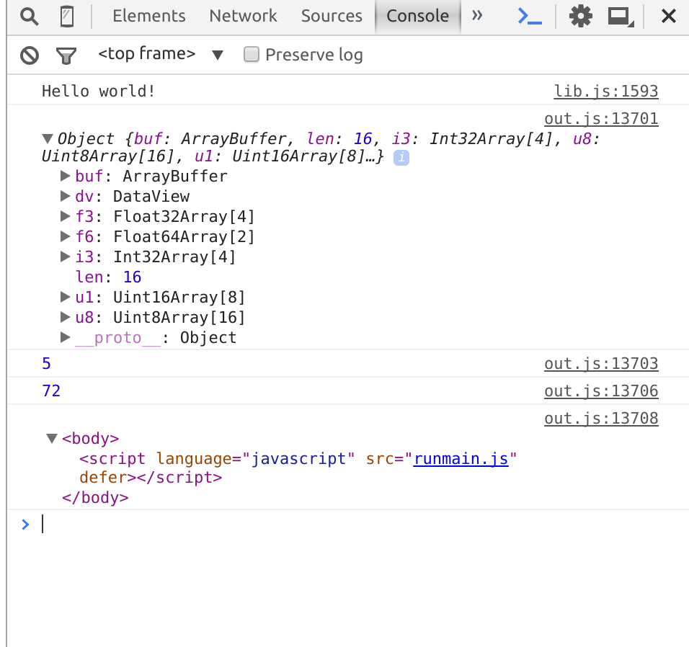
More on JSRef and ByteBuffers
Dirty hack:
By doing unsafeCoerce to GHC.Exts.Any we can get an insight how the objects in GHCJS Haskell are mapped onto JavaScript.
Note! It is not a conversion of types; it would be just the same as trying to print Ptr () in standard Haskell. The dirty trick is that we can always print anything in JS. So we do print ghcjs heap objects!
import GHC.Exts as Exts
-- | In JS we can print just anything
printAnything :: a -> IO ()
printAnything a = printAny (unsafeCoerce a :: Exts.Any)
foreign import javascript unsafe "console.log($1)"
printAny :: Exts.Any -> IO ()

Slide 14
WebGL (updated slide)
Look into ghcjs-webgl source code
Warning!
ghcjs-webgl now is adapted to a new ghcjs-base. New ghcjs does much better integration of js types.
https://github.com/achirkin/ghcjs-webgl/blob/master/src/GHCJS/WebGL/Types.hs
The new type for JS values: JSVal instead of JSRef a .
The new preferred way of wrapping JS types is as follows:
newtype WebGLRenderingContext = WebGLRenderingContext JSVal
instance IsJSVal WebGLRenderingContext
This allows to Data.coerce it to JSVal and back, or use the newtyped values directly in javascript imports!
foreign import javascript unsafe "$1.activeTexture($2)"
activeTexture :: WebGLRenderingContext -> GLenum -> IO ()

