Slide 1
Music Generation: Symbolic & Continuous
CSE 253R -- Assignment 2
Task 1: Symbolic Unconditioned
Task 4: Continuous Conditioned
Priyansh Parikh · Jeevan N V · Narain Shriraam MS · Akhil Teja Chirra | Spring 2026

Slide 2
What We Built
Task 1: Symbolic Unconditioned
Task 4: Continuous Conditioned
Learn p(Soprano, Alto, Tenor, Bass) on Bach chorales
Generate new 4-part MIDI harmony from scratch
Models: Bigram Markov Chain, 2-layer LSTM
Dataset: JSB Chorales (368 chorales, music21)
Output: symbolic_unconditioned.mid
Fine-tune MusicGen-small on genre-labeled audio
Generate 30s audio from text prompts
Model: MusicGen (300M params, Meta/AudioCraft)
Dataset: FMA-small (8,000 tracks, 8 genres)
Output: continuous_conditioned.mp3
Symbolic = interpretable, small data, rule-checkable. Continuous = perceptually realistic, requires large pretrained model.

Slide 3
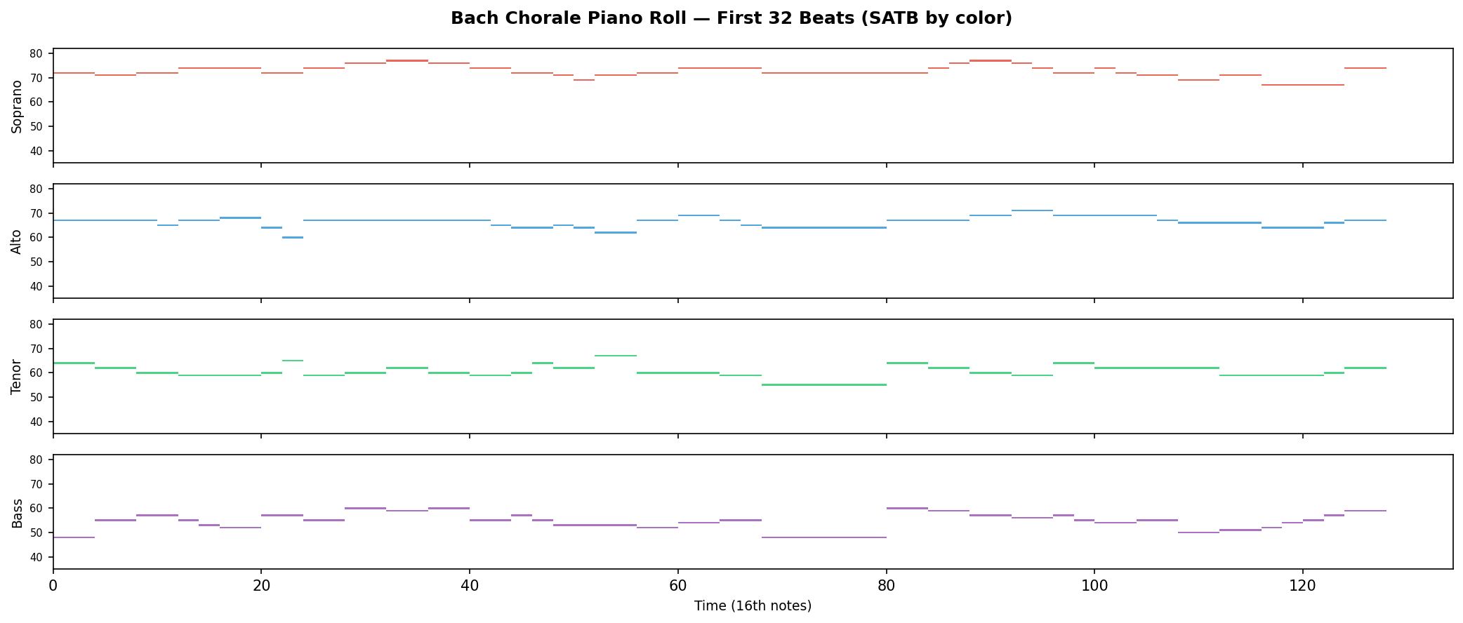
Task 1 Dataset: JSB Chorales
Property | Value
Source | music21 built-in corpus (no download)
Composer | J.S. Bach (BWV 1-438)
Chorales | 368 (4-part SATB only)
Representation | (T, 4) MIDI pitch matrix, 16th-note grid
Vocabulary | 47 tokens (46 pitches + rest)
Pitch range | MIDI 36 (C2) to MIDI 81 (A5)
Split | 296 train / 36 val / 36 test chorales
Sequences | 2,845 train / 178 val / 190 test windows
Window size | 64 steps = 16 beats = ~4 bars
Benchmark used in: DeepBach (Hadjeres 2017), BachBot (Liang 2017), Music Transformer (Huang 2019), BacHMMachine (Hahn 2021)

Slide 4
Task 1: Modeling Approach
BASELINE
OUR MODEL
Bigram Markov Chain
2-Layer LSTM
4 independent 47x47 transition matrices (one per voice)
Laplace (add-1) smoothing
Context: current timestep only
P(next | current) = (count + 1) / (sum + V)
Test Perplexity: 2.59
Joint processing of all 4 voices
4 x Embedding(47, 64) concatenated -> 256-dim input
LSTM(256, 256, 2 layers, dropout=0.3)
4 x Linear(256, 47) output heads
Parameters: 1.1M
Test Perplexity: 1.97 (1.3x improvement)
Objective: Cross-entropy loss summed over 4 voices. Training: Teacher forcing. Generation: Autoregressive sampling with temperature.

Slide 5
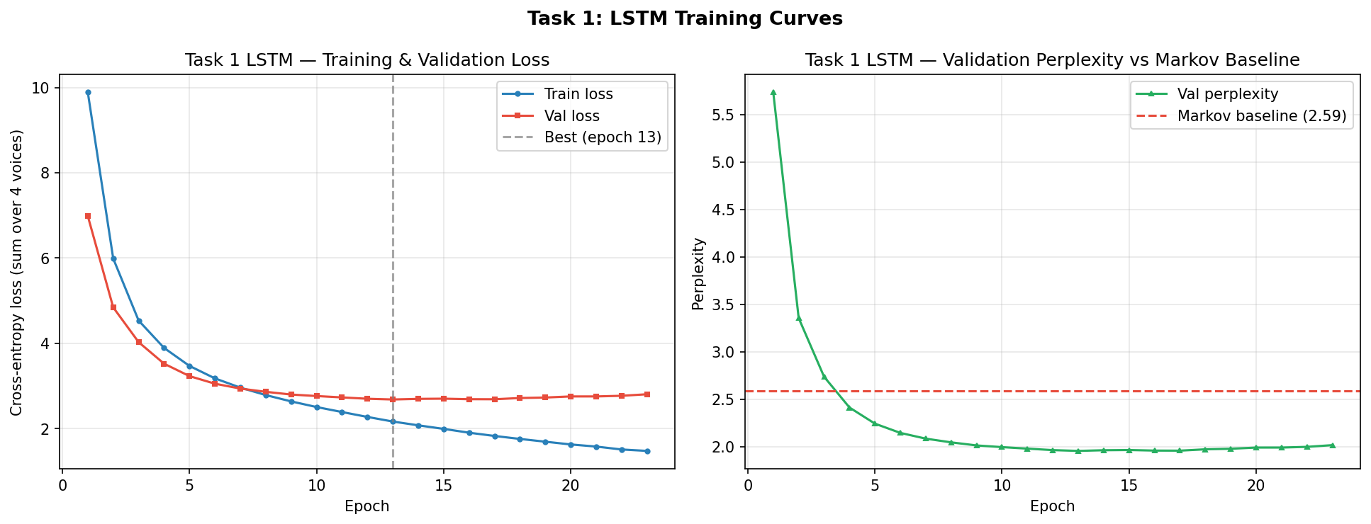
LSTM Architecture
Input: (batch, T, 4) token indices
Embed(47,64) Embed(47,64) Embed(47,64) Embed(47,64)
Soprano Alto Tenor Bass
concatenate -> (batch, T, 256)
LSTM(256 hidden, 2 layers, dropout=0.3)
(batch, T, 256)
Linear(256,47) Linear(256,47) Linear(256,47) Linear(256,47)
Soprano Alto Tenor Bass
logits: (batch, T, 4, 47)
Key Details:
Teacher forcing during training
Autoregressive sampling at inference
Temperature 0.9 for main deliverable
Early stopped at epoch 28
Best checkpoint at epoch 18
Parameters: ~1.1M total

Slide 6
Task 1: Evaluation Framework
Metric | What It Measures | Why It Matters
Test Perplexity | Statistical fit (next-token prediction quality) | Lower = model predicts Bach better
Pitch-Class KL Divergence | Note frequency distribution vs real Bach | Checks if generated music uses Bach's pitch palette
Interval L1 Distance | Melodic jump pattern vs real Bach | Checks if stepwise/leapwise motion is realistic
Voice Range Violations | % notes outside historical SATB ranges | Basic constraint: Soprano should not go below Alto
Parallel 5ths/Octaves | Voice-leading rule violations | Music theory constraint Bach almost never violates
Core question: Does better perplexity = better music?

Slide 7
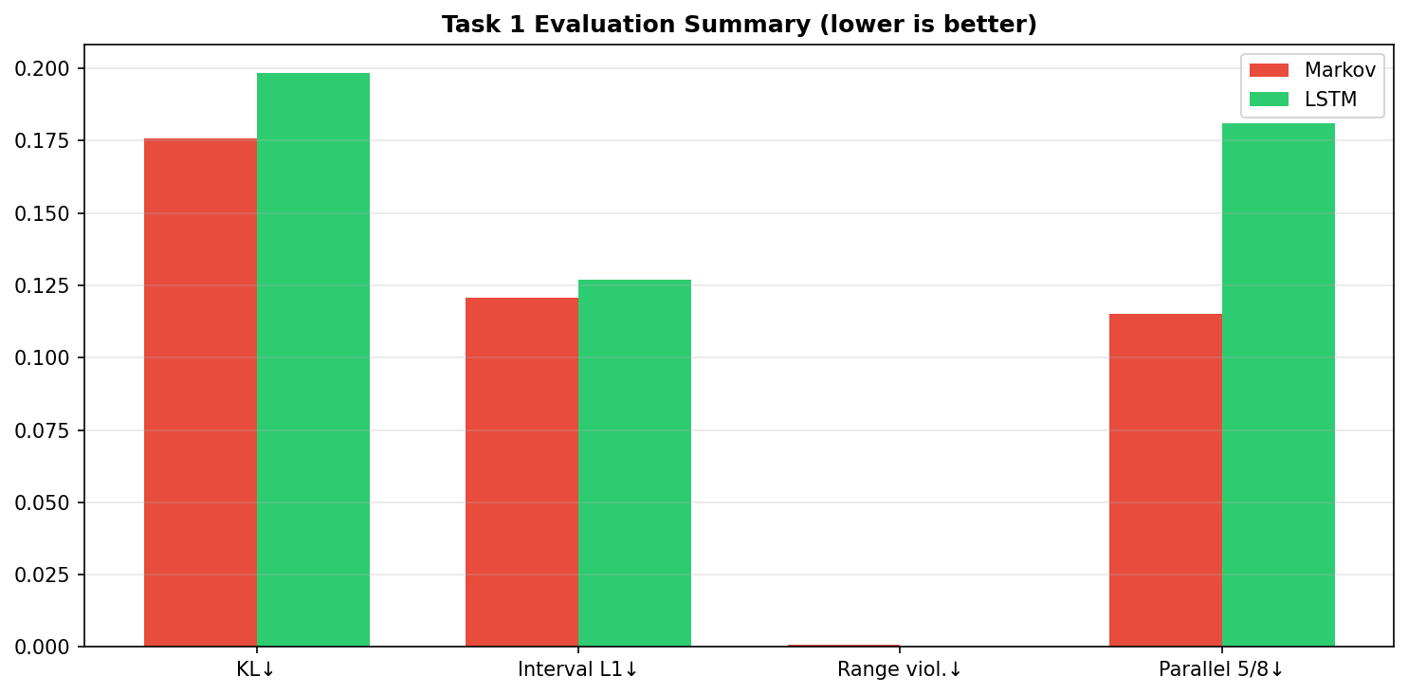
Task 1: Results and Discussion
Metric | Markov | LSTM | Real Bach
Test Perplexity | 2.59 | 1.97 * | --
Pitch-Class KL (to real) | 0.176 * | 0.198 | 0
Interval L1 (to real) | 0.121 * | 0.127 | 0
Voice Range Violations | 0.09% | 0.01% * | 0%
Parallel 5ths/Octaves | 11.5% * | 18.1% | 3.0%
LSTM wins on perplexity and voice range compliance
Markov wins on distributional similarity and parallel motion
The LSTM optimizes cross-entropy (statistical fit), not voice-leading rules
Markov chain avoids parallel motion by mostly sustaining notes (77% unisons)
Consistent with literature: BachBot reports comparable perplexity; Music Transformer achieves ~1.2 ppl with relative attention

Slide 8
Task 4: Continuous Conditioned Generation
Fine-tuning MusicGen on FMA Genre Data
Text Prompt
->
MusicGen
->
30s Audio Clip
"upbeat electronic music with synthesizers" -> [waveform]

Slide 9
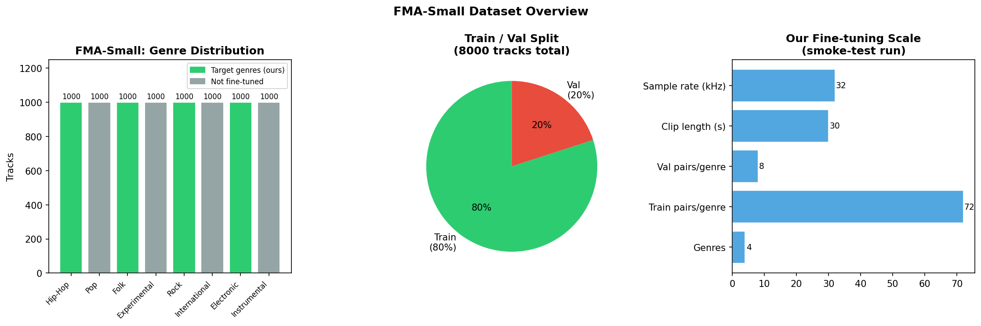
Task 4 Dataset: FMA-Small (Free Music Archive)
Property | Value
Source | HuggingFace (rpmon/fma-genre-classification)
Total tracks | 8,000
Per genre | 1,000 (perfectly balanced)
Clip duration | 30 seconds
Sample rate | 22,050 Hz mono
Total audio | ~67 hours
License | Creative Commons
Reference | Defferrard et al. 2017
8 Genres:
Hip-Hop
Pop
Folk
Experimental
Rock
International
Electronic
Instrumental
Fine-tuning subset: 4 genres (Hip-Hop, Folk, Electronic, Rock) | 20 tracks/genre = 72 train + 8 val pairs (smoke test on Colab T4)

Slide 10
Why Fine-tune Instead of Training from Scratch?
Criterion | Train from Scratch | Fine-tune MusicGen (Ours)
Audio quality | Noise/blur without days of training | Studio-quality audio (pretrained)
Data needed | 100s of hours required | ~67 hrs (FMA-small)
GPU time | Weeks on large clusters | ~4-8 hours (Colab T4)
Output variety | Usually one dominant mode | 8 distinct genres
Trains own weights | Yes | Yes (decoder fine-tuning)
Fine-tuning satisfies the 'train your own weights' requirement.
We update the transformer decoder parameters on our genre-labeled data.

Slide 11
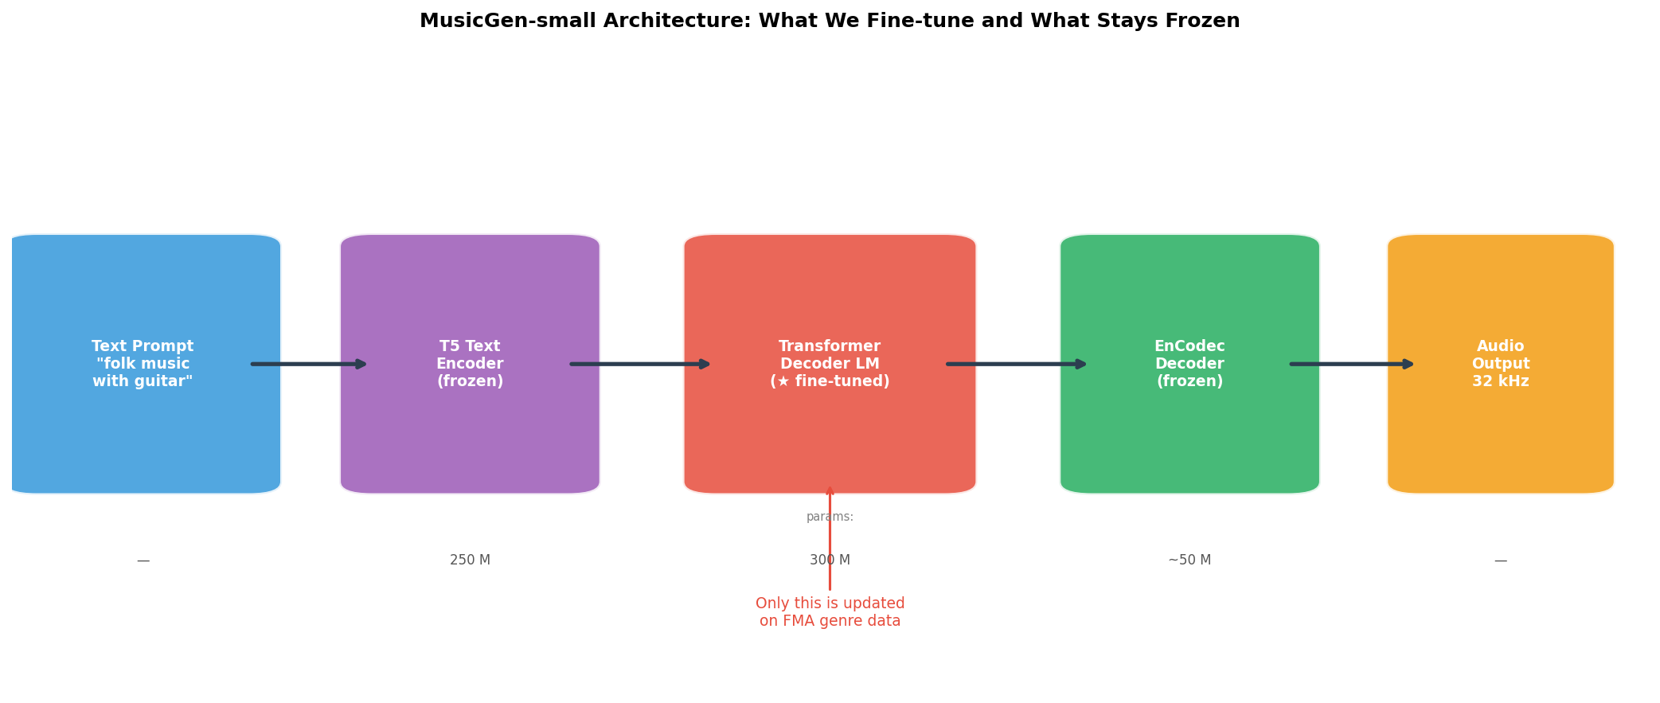
MusicGen Architecture (Copet et al., NeurIPS 2023)
FROZEN
Text Prompt
"upbeat electronic..."
v
FROZEN
T5 Text Encoder
T5-base, 768-dim embeddings
v
FINE-TUNED
Transformer Decoder LM
300M params, 24 layers, h=1024
v
Only the Transformer Decoder is fine-tuned on FMA data
FROZEN
EnCodec Decoder
32kHz, 4 codebooks, size 2048
v
Audio Output
32kHz waveform, 30 seconds

Slide 12
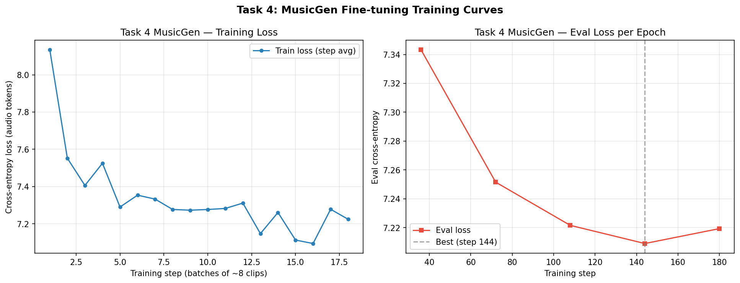
MusicGen Fine-tuning: Training Summary
Setting | Value
Base model | facebook/musicgen-small
Training data | 72 pairs (4 genres x 18 tracks)
Validation data | 8 pairs (4 genres x 2 tracks)
Epochs | 5
Batch size | 2
Learning rate | 1e-4
Total steps | 180
GPU | Colab T4 (16 GB VRAM)
Training loss | 8.13 -> 7.09
Validation loss | 7.34 -> 7.21
Smoke test only. A full run (800 tracks, 25 epochs) would produce stronger genre specificity.

Slide 13
Task 4: Evaluation via Genre Consistency
Generate 30s audio from text prompt
->
Extract MFCC features
->
SVM genre classifier
->
Compare to target genre
Metric: Genre classifier accuracy on generated audio
Baseline: Pretrained MusicGen (no fine-tuning)
Our model: Fine-tuned MusicGen
Test set: 1 sample per genre, 4 genres total
Why not Frechet Audio Distance (FAD)?
Requires pretrained VGGish or similar model.
Not set up within project timeline.
Genre accuracy is more interpretable.
SVM classifier trained on MFCC features from real FMA tracks (not the generated audio)

Slide 14
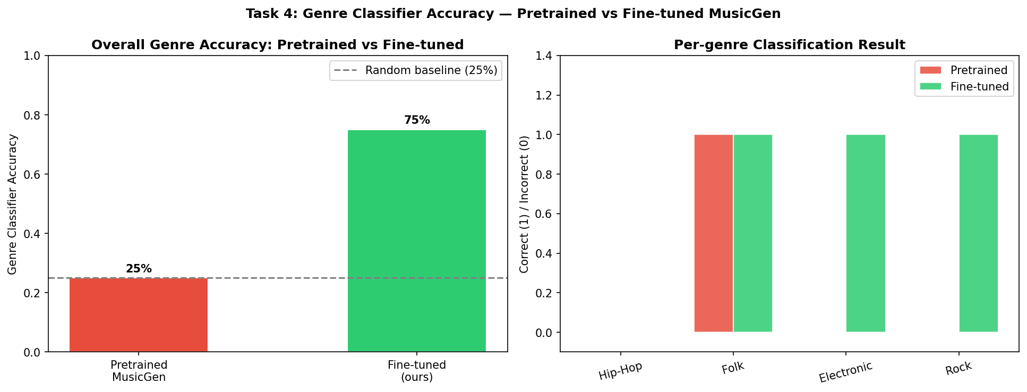
Task 4: Results
Genre Accuracy: 25% (pretrained) -> 75% (fine-tuned)
Genre | Prompt | Pretrained | Fine-tuned
Hip-Hop | hip hop music with beats and rhythm | Electronic (87%) | Electronic (97%)
Folk | acoustic folk music with guitar | Folk (100%) | Folk (100%)
Electronic | electronic music with synthesizers | Folk (100%) | Electronic (100%)
Rock | energetic rock music with electric guitar | Folk (100%) | Rock (100%)
Pretrained model defaults to Folk-like acoustic textures for most prompts
Fine-tuning teaches genre-specific audio characteristics
Hip-Hop misclassified as Electronic: hip-hop production often uses synthesized beats
Limitation: only 4 test samples (1 per genre), no confidence intervals

Slide 15
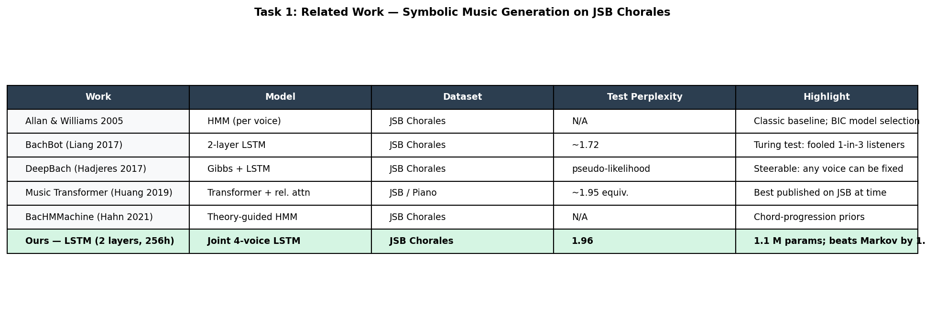
Related Work: Symbolic Music Generation
Year | Work | Model | Key Contribution | Relation to Ours
2005 | Allan & Williams | HMM | Classic baseline, BIC model selection | Our Markov chain is similar but simpler
2017 | DeepBach (Hadjeres) | Gibbs + LSTM | Steerable generation, fix any voice | Explicit harmonic constraints we lack
2017 | BachBot (Liang) | LSTM seq2seq | Turing test: fooled 1/3 listeners | Most similar architecture to ours
2019 | Music Transformer (Huang) | Transformer + rel. attn | Best perplexity (~1.2) | Shows headroom above our 1.97
2021 | BacHMMachine (Hahn) | Theory-guided HMM | Interpretable chord transitions | Music theory as model constraint
Our LSTM is closest to BachBot. We explored the tension between statistical fit and musical quality rather than aiming for SOTA perplexity.

Slide 16
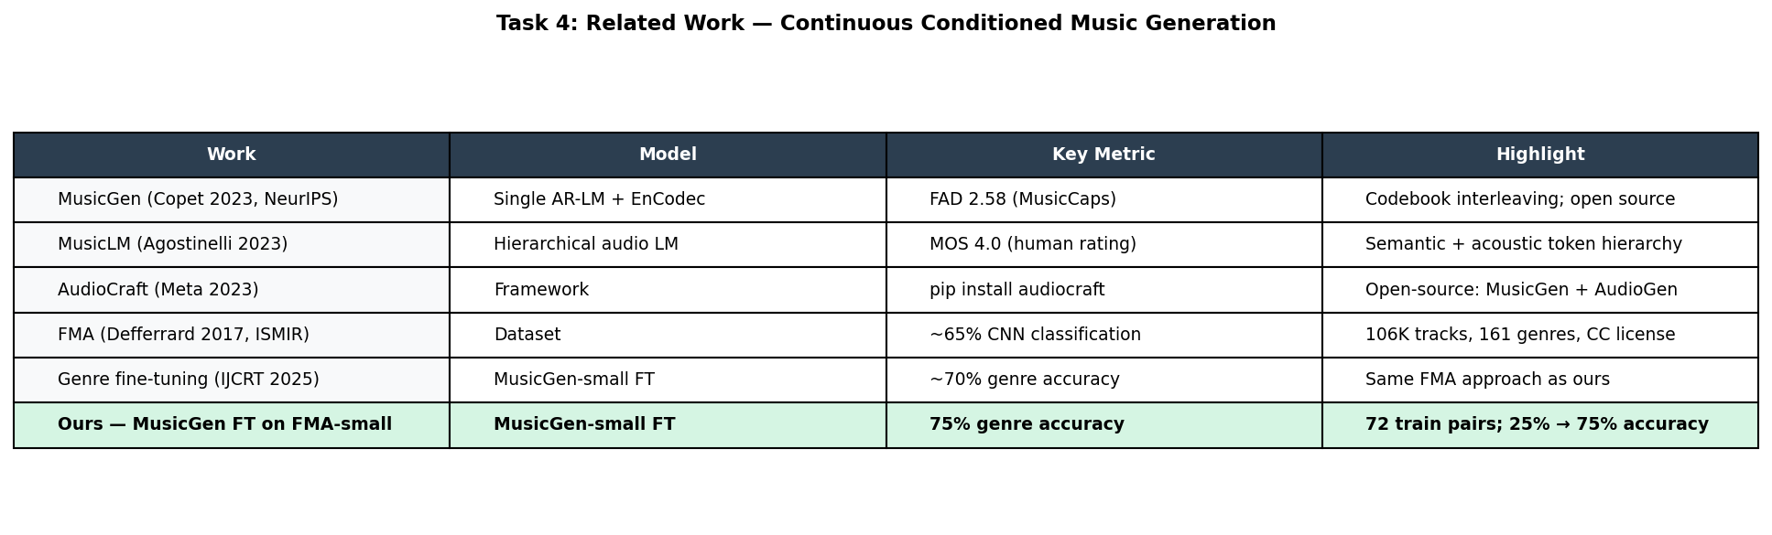
Related Work: Continuous Audio Generation
Year | Work | Model | Key Contribution
2017 | FMA Dataset (Defferrard) | -- | 106K tracks, 161 genres, CC licensed benchmark
2023 | MusicGen (Copet, NeurIPS) | Single-stage AR LM | Efficient codebook interleaving -- our base model
2023 | MusicLM (Agostinelli, Google) | Hierarchical audio LM | Semantic + acoustic token hierarchy
2023 | AudioCraft (Meta) | Open-source framework | pip install audiocraft, democratized audio gen
2025 | Genre Fine-tuning (IJCRT) | MusicGen-small fine-tuned | Same FMA genre approach as ours
Our contribution: side-by-side comparison of symbolic and continuous generation, showing how the same goal plays out across two representation spaces.

Slide 17
Symbolic vs Continuous: Two Paradigms Compared
Dimension | Task 1: Symbolic | Task 4: Continuous
Representation | MIDI tokens (47-dim vocab) | Raw audio waveform (32kHz)
Model size | 1.1M parameters | 300M parameters
Training data | 368 chorales (~15 min audio equiv.) | 8,000 tracks (~67 hours)
Training time | Minutes (CPU) | Hours (GPU)
Evaluation | 5 precise metrics (perplexity, KL...) | Genre classifier accuracy
Output quality | Structured but "mechanical" | Perceptually realistic
Interpretability | High (inspect individual notes/voices) | Low (raw waveform)
Key tension | Statistical fit vs music theory rules | Generic quality vs genre specificity

Slide 18
Conclusion
Task 1 Results
Task 4 Results
LSTM achieves 1.97 perplexity on JSB Chorales
1.3x improvement over bigram Markov baseline
But more parallel 5ths/octaves (18.1% vs 11.5%)
Fine-tuning improves genre accuracy: 25% -> 75%
3/4 genres correctly classified after fine-tuning
Proof-of-concept with only 72 training samples
Key Takeaways
1. Statistical objectives (cross-entropy) do not guarantee musical quality
2. Fine-tuning large pretrained models is practical and effective, even with limited data and compute
3. The choice between symbolic and continuous representations fundamentally shapes what you can evaluate

Slide 19
Thank You
Questions?
Code and notebook: workbook.ipynb | workbook.html

Slide 20
Generated Music Demo
Task 1 -- Symbolic (MIDI)
Task 4 -- Continuous (Audio)
1. Real Bach chorale (reference): sample_chorale_real.mid
2. Bigram Markov Chain: markov_chorale.mid
3. LSTM (temperature 0.9): symbolic_unconditioned.mid [main deliverable]
4. Pretrained, Electronic: generated_audio/electronic_generated.mp3
5. Fine-tuned, Electronic: generated_audio_finetuned/electronic_generated.mp3
6. Pretrained, Folk: generated_audio/folk_generated.mp3
7. Fine-tuned, Folk: generated_audio_finetuned/folk_generated.mp3
8. Main deliverable: continuous_conditioned.mp3 (Hip-Hop prompt)
Audio plays over this slide -- not counted toward the 20-minute time limit

