Slide 1

Debug strings
TX
USART2
LED commands
RX
MCU

Slide 2
Commands | Function
LEDOH | Turn ON LED Orange
LEDOL | Turn OFF LED Orange
LEDBH | Turn ON LED Blue
LEDBL | Turn OFF LED Blue
LEDRH | Turn ON LED Red
LEDRL | Turn OFF LED Red
LEDGH | Turn ON LED Green
LEDGL | Turn OFF LED Green
LEDAH | Turn ON ALL LEDs
LEDAL | Turn OFF ALL LEDs

Slide 3
Different USART Peripherals and Associated Pin Packs
U(S)ARTs | Pin Pack 1 |  | Pin pack 2 |  | Pin pack 3 |  | Bus
 | TX | RX | TX | RX | TX | RX
USART1 | PA9 | PA10 | PB6 | PB7 |  |  | APB2
USART2 | PA2 | PA3 | PD5 | PD6 |  |  | APB1
USART3 | PB10 | PB11 | PC10 | PC11 | PD8 | PD9 | APB1
UART4 | PA0 | PA1 | PC10 | PC11 |  |  | APB1
UART5 | PC12 | PD2 |  |  |  |  | APB1
USART6 | PC6 | PC7 | PG14 | PG9 |  |  | APB2

Slide 4
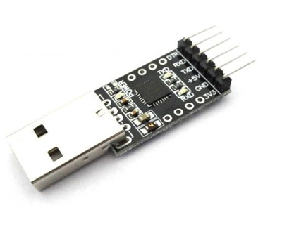
USB to TTL USB UART
serial port
converter
module

Slide 5
PC
TX
CP2102 USB to UART Convertor
PA2
RX
USB
USART2
TX
PA3
GND
RX
GND
MCU

