Slide 1
in action POP Vs OOP
Institut Teknologi Sumatera

Slide 2


Case
Story of two programmer
I’am captain america
I’am iron man

Slide 3
Case
One day, they both were given the same specification and were told to build an application
The specification are:
Can you are build GUI a Scquare, a Circle and a Triangle
when the user click a shape, the shape will rotate clockwise 360 degrees and play sound specific to the shape

Slide 4


Case
Iron man thought what procedures do we need ?
Is collection of procedures
ROTATE and PLAY SOUND

Slide 5
Case
Captain america, thought Object Oriented
Event click user: ROTATE and PLAY SOUND
the shapes

Slide 6
Procedural Oriented Programming (POP)
Object Oriented Programming (OOP)
Circle
rotate(){
// 360 degrees
}
play_sound(){
// find shape type
// play WAV shound
}
rotate(shape){
// 360 degrees
}
play_sound(shape){
// find shape type
// play WAV shound
}
main(){
// example
shape = Circle
rotate (shape);
play_sound(shape)
}
Scquare
rotate(){
// 360 degrees
}
play_sound(){
// find shape type
// play WAV shound
}
Triangle
rotate(){
// 360 degrees
}
play_sound(){
// find shape type
// play WAV shound
}

Slide 7
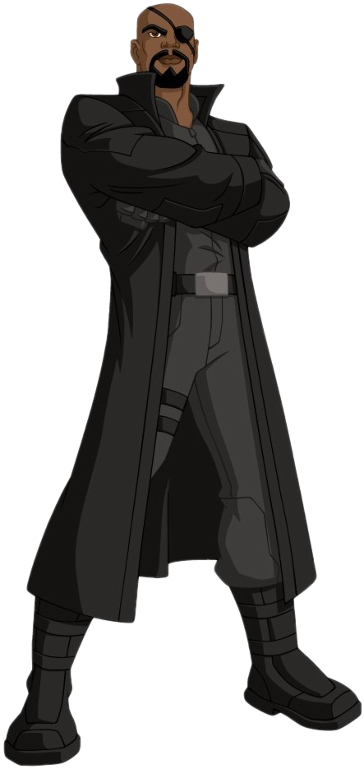
Case
iron man thought “i have nailed it ....”
But manager said
“i have changed the spacification”
The new specification is:
the new shape is “amoeba”
can rotate clockwise 360 degrees
play from Mp3 sound file

Slide 8
Procedural Oriented Programming (POP)
Object Oriented Programming (OOP)
rotate(shape){
// 360 degrees
}
play_sound(shape){
// find shape type
// play WAV shound
}
main(){
// example
shape = Circle
rotate (shape);
play_sound(shape)
}
still working
need changed
play_sound(shape){
// find shape type
// if shape is not amoeba
// play WAV shound
// else
// play Mp3 shound file
}

Slide 9
Procedural Oriented Programming (POP)
Object Oriented Programming (OOP)
Circle
rotate(){
// 360 degrees
}
play_sound(){
// find shape type
// play WAV shound
}
Scquare
rotate(){
// 360 degrees
}
play_sound(){
// find shape type
// play WAV shound
}
Amoeba
rotate(){
// 360 degrees
}
play_sound(){
// find shape type
// play Mp3 shound
}
Triangle
rotate(){
// 360 degrees
}
play_sound(){
// find shape type
// play WAV shound
}

Slide 10
Procedural Oriented Programming (POP)
Object Oriented Programming (OOP)
the changes previously tested code,
every time the specification changes.
lot of code is affected
just wrote new code without making any change
in previously tested code

Slide 11
Implementation
Rotate
Center point base on rectangle
coordinate (X,Y)

Slide 12
Procedural Oriented Programming (POP)
Object Oriented Programming (OOP)
Class Scquare
Public:
rotate(){
// 360 degrees
}
play_sound(){
// find shape type
// play WAV shound
}
rotate(shape, X, Y){
// if shape is not amoeba
// calculate center point
// rotate base center point
// else
// calculate use X, Y
// rotate
}
play_sound(shape){
// find shape type
// if shape is not amoeba
// play WAV shound
// else
// play Mp3 shound file
}
Class Amoeba
int X, Y;
Public:
rotate(){
// 360 degrees
// Using X, Y
}
play_sound(){
// find shape type
// play Mp3 shound
}
*same the other

Slide 13
Case
“No.. No.., captain america have any duplicate code! the rotate and play_sound procedure in all shapes.”

Slide 14
Class Amoeba
int X, Y;
Public:
rotate(){
// 360 degrees
// Using X, Y
}
play_sound(){
// find shape type
// play Mp3 shound amoeba
}
Object Oriented Programming (OOP)
Class Scquare
public:
rotate(){
// 360 degrees
}
play_sound(){
// find shape type
// play WAV shound
}
Class Circle
public:
rotate(){
// 360 degrees
}
play_sound(){
// find shape type
// play WAV shound
}
Class Triangle
public:
rotate(){
// 360 degrees
}
play_sound(){
// find shape type
// play WAV shound
}

Slide 15
Amoeba like a different rotate and play sound
Object Oriented Programming (OOP)
Base Class
Class Shape
rotate(){
// common feature
}
play_sound(){
// common feature
}
ClassAmoeba
Class Scquare
Class Triangle
Class Circle

Slide 16
Object Oriented Programming (OOP)
Base Class
ClassAmoeba
Class Shape
rotate(){
// common feature
}
play_sound(){
// common feature
}
Class Amoeba
rotate(){
// Amoeba specification
}
play_sound(){
// Amoeba specification
}
Amoeba specification
Is Overriding
Class Scquare
Class Triangle
Class Circle

Slide 17
Code implementation

Slide 18
End
Object Oriented Programming (OOP)
Reuse
Easy maintenance
Other

Slide 19
Task
One day, they both were given the same specification and were told to build an application
The specification are:
Can you are build GUI a Scquare, a Circle, a Triangle and a Amoeba
when the user click a shape, the shape will rotate clockwise 360 degrees, play sound specific to the shape and every a shape different action
scquare is get collor and set collor
circle is get radius and set radius
triangle is get hight and set hight
Amoeba is move
Wrote in java programming
define main method for implementation

Slide 20
Thanks

