Slide 1
Data Warehousing and
OLAP
Hector Garcia-Molina
Stanford University

Slide 2
Warehousing
Growing industry: $8 billion in 1998
Range from desktop to huge:
  Walmart: 900-CPU, 2,700 disk, 23TB
  Teradata system
Lots of buzzwords, hype
  slice & dice, rollup, MOLAP, pivot, ...

Slide 3
Outline
What is a data warehouse?
Why a warehouse?
Models & operations
Implementing a warehouse
Future directions

Slide 4
What is a Warehouse?
Collection of diverse data
  subject oriented
  aimed at executive, decision maker
  often a copy of operational data
  with value-added data (e.g., summaries, history)
  integrated
  time-varying
  non-volatile
more

Slide 5
What is a Warehouse?
Collection of tools
  gathering data
  cleansing, integrating, ...
  querying, reporting, analysis
  data mining
  monitoring, administering warehouse

Slide 6
Warehouse Architecture
Client
Client
Query & Analysis
Metadata
Warehouse
Integration
Source
Source
Source

Slide 7

Why a Warehouse?
Two Approaches:
  Query-Driven (Lazy)
  Warehouse (Eager)
?
Source
Source

Slide 8
Query-Driven Approach
Client
Client
Mediator
Wrapper
Wrapper
Wrapper
Source
Source
Source
Notes:
7

Slide 9
Advantages of Warehousing
High query performance
Queries not visible outside warehouse
Local processing at sources unaffected
Can operate when sources unavailable
Can query data not stored in a DBMS
Extra information at warehouse
  Modify, summarize (store aggregates)
  Add historical information

Slide 10
Advantages of Query-Driven
No need to copy data
  less storage
  no need to purchase data
More up-to-date data
Query needs can be unknown
Only query interface needed at sources
May be less draining on sources

Slide 11
OLTP vs. OLAP
OLTP: On Line Transaction Processing
  Describes processing at operational sites
OLAP: On Line Analytical Processing
  Describes processing at warehouse

Slide 12
OLTP vs. OLAP
OLTP
OLAP
Mostly updates
Many small transactions
Mb-Tb of data
Raw data
Clerical users
Up-to-date data
Consistency, recoverability critical
Mostly reads
Queries long, complex
Gb-Tb of data
Summarized, consolidated data
Decision-makers, analysts as users

Slide 13
Data Marts
Smaller warehouses
Spans part of organization
  e.g., marketing (customers, products, sales)
Do not require enterprise-wide consensus
  but long term integration problems?

Slide 14
Warehouse Models & Operators
Data Models
  relations
  stars & snowflakes
  cubes
Operators
  slice & dice
  roll-up, drill down
  pivoting
  other

Slide 15
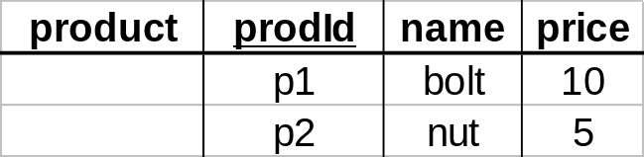
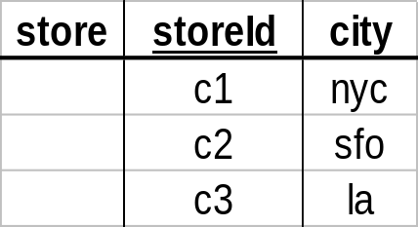
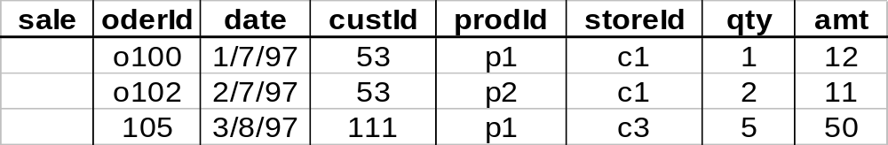
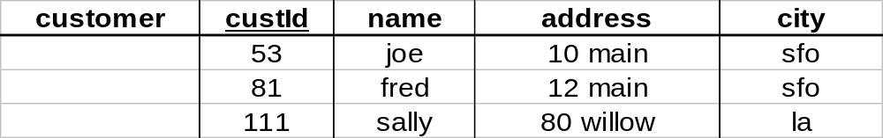
Star

Slide 16
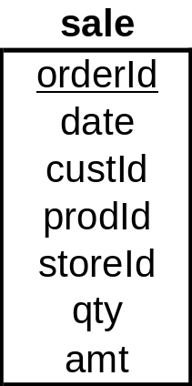
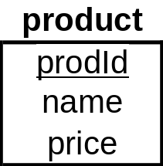
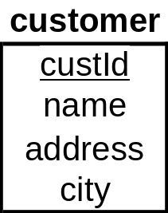
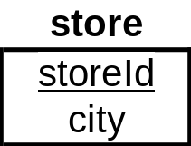
Star Schema

Slide 17
Terms
Fact table
Dimension tables
Measures

Slide 18
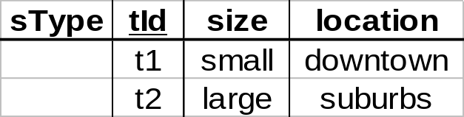
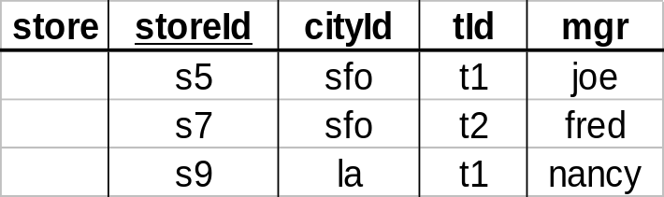
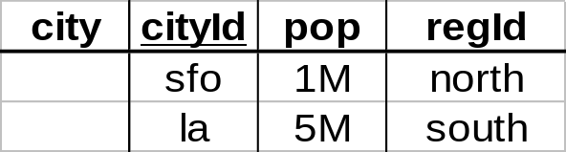
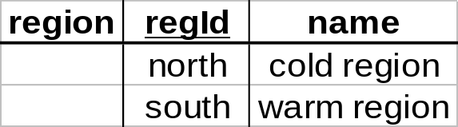
Dimension Hierarchies
sType
store
city
region
➔ snowflake schema
➔ constellations

Slide 19
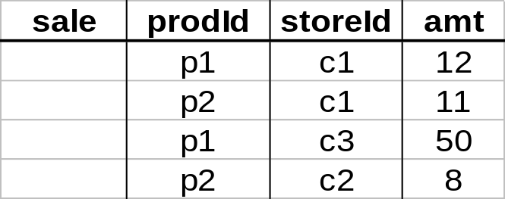
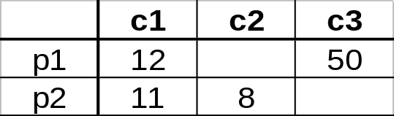
Cube
Fact table view:
Multi-dimensional cube:
dimensions = 2

Slide 20
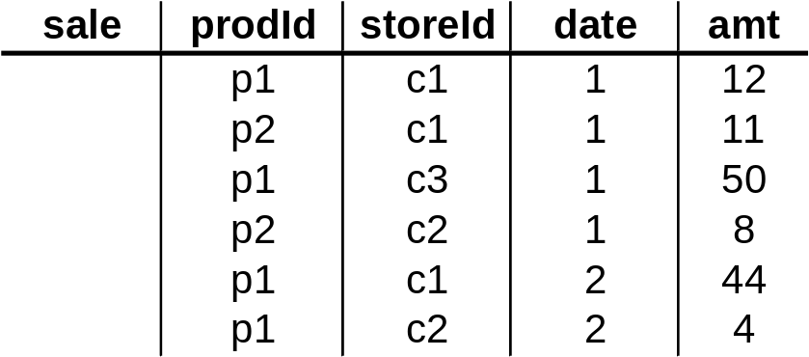
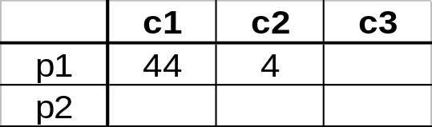
3-D Cube
Fact table view:
Multi-dimensional cube:
day 2
day 1
dimensions = 3

Slide 21
ROLAP vs. MOLAP
ROLAP:
Relational On-Line Analytical Processing
MOLAP:
Multi-Dimensional On-Line Analytical Processing

Slide 22
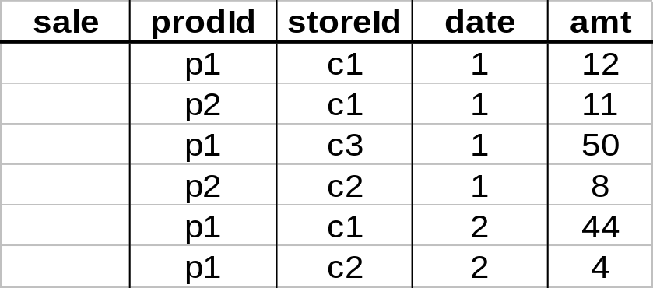
Aggregates
Add up amounts for day 1
In SQL: SELECT sum(amt) FROM SALE
WHERE date = 1
81

Slide 23
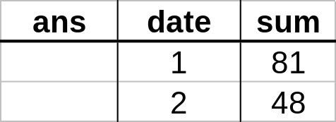
Aggregates
Add up amounts by day
In SQL: SELECT date, sum(amt) FROM SALE
GROUP BY date

Slide 24
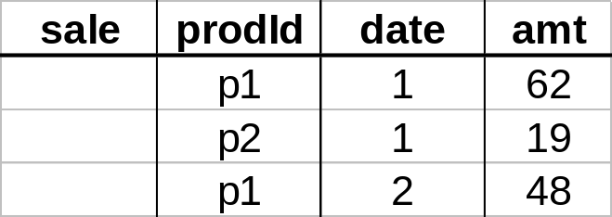
Another Example
Add up amounts by day, product
In SQL: SELECT date, sum(amt) FROM SALE
GROUP BY date, prodId
rollup
drill-down

Slide 25
Aggregates
Operators: sum, count, max, min, median, ave
“Having” clause
Using dimension hierarchy
  average by region (within store)
  maximum by month (within date)

Slide 26
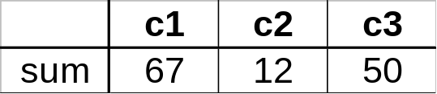
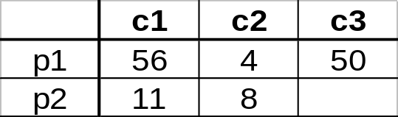
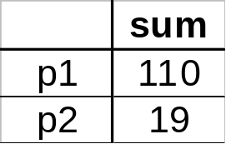
Cube Aggregation
Example: computing sums
day 2
. . .
day 1
129
rollup
drill-down

Slide 27
Cube Operators
day 2
. . .
day 1
sale(c1,*,*)
129
sale(c2,p2,*)
sale(*,*,*)

Slide 28
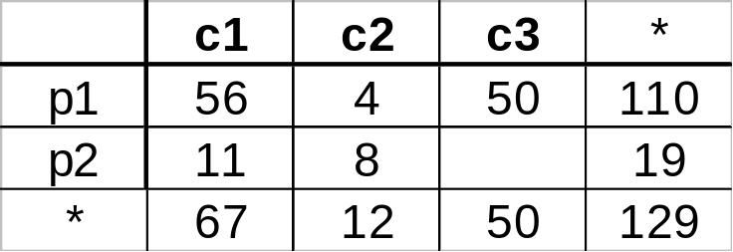
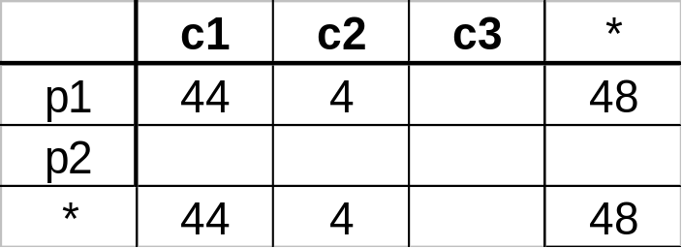
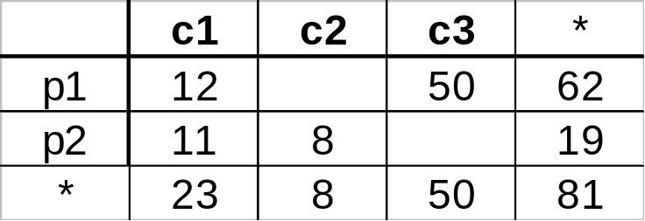
Extended Cube
*
day 2
sale(*,p2,*)
day 1

Slide 29
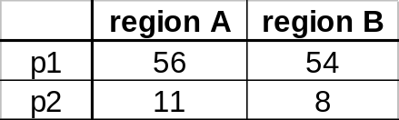
Aggregation Using Hierarchies
day 2
customer
day 1
region
country
(customer c1 in Region A;
customers c2, c3 in Region B)

Slide 30
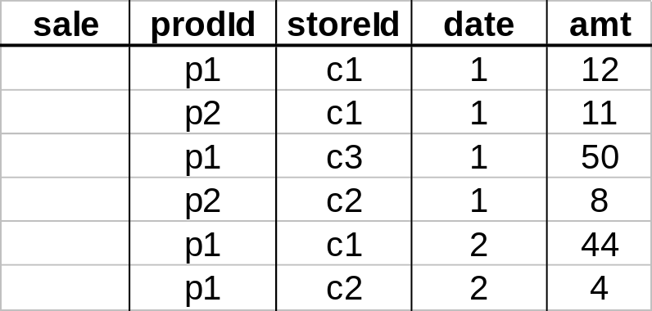
Pivoting
Fact table view:
Multi-dimensional cube:
day 2
day 1

Slide 31
Implementing a Warehouse
Monitoring: Sending data from sources
Integrating: Loading, cleansing,...
Processing: Query processing, indexing, ...
Managing: Metadata, Design, ...

Slide 32
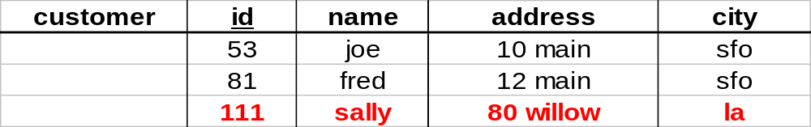
Monitoring
Source Types: relational, flat file, IMS, VSAM, IDMS, WWW, news-wire, …
Incremental vs. Refresh
new

Slide 33
Monitoring Techniques
Periodic snapshots
Database triggers
Log shipping
Data shipping (replication service)
Transaction shipping
Polling (queries to source)
Screen scraping
Application level monitoring
➔ Advantages & Disadvantages!!

Slide 34
Monitoring Issues
Frequency
  periodic: daily, weekly, …
  triggered: on “big” change, lots of changes, ...
Data transformation
  convert data to uniform format
  remove & add fields (e.g., add date to get history)
Standards (e.g., ODBC)
Gateways

Slide 35
Integration
Data Cleaning
Data Loading
Derived Data
Client
Client
Query & Analysis
Metadata
Warehouse
Integration
Source
Source
Source

Slide 36
Data Cleaning
Migration (e.g., yen ⇨ dollars)
Scrubbing: use domain-specific knowledge (e.g., social security numbers)
Fusion (e.g., mail list, customer merging)
Auditing: discover rules & relationships
(like data mining)
billing DB
customer1(Joe)
merged_customer(Joe)
service DB
customer2(Joe)

Slide 37
Loading Data
Incremental vs. refresh
Off-line vs. on-line
Frequency of loading
  At night, 1x a week/month, continuously
Parallel/Partitioned load

Slide 38
Derived Data
Derived Warehouse Data
  indexes
  aggregates
  materialized views (next slide)
When to update derived data?
Incremental vs. refresh

Slide 39
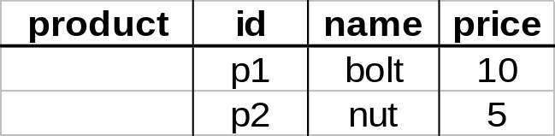
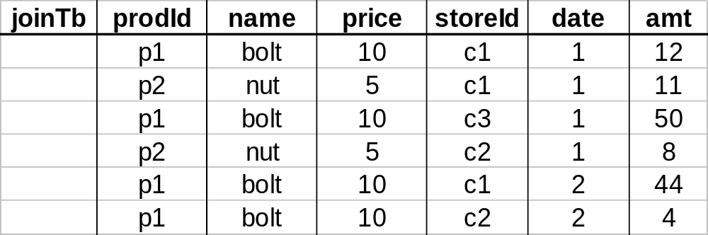
Materialized Views
Define new warehouse relations using SQL expressions
does not exist
at any source

Slide 40
Processing
ROLAP servers vs. MOLAP servers
Index Structures
What to Materialize?
Algorithms
Client
Client
Query & Analysis
Metadata
Warehouse
Integration
Source
Source
Source

Slide 41
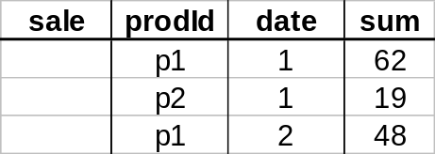
ROLAP Server
Relational OLAP Server
tools
ROLAP
server
Special indices, tuning;
Schema is “denormalized”
utilities
relational
DBMS

Slide 42
MOLAP Server
Multi-Dimensional OLAP Server
City
Sales
B
A
milk
soda
eggs
soap
M.D. tools
Product
1 2 3 4
Date
utilities
multi-dimensional
server
could also
sit on
relational
DBMS

Slide 43
Index Structures
Traditional Access Methods
  B-trees, hash tables, R-trees, grids, …
Popular in Warehouses
  inverted lists
  bit map indexes
  join indexes
  text indexes

Slide 44
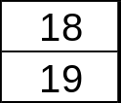
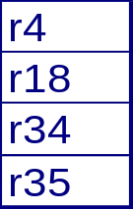
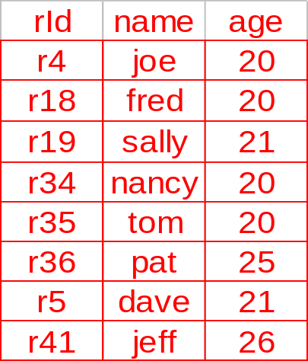
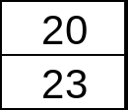
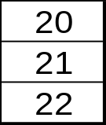
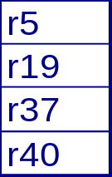
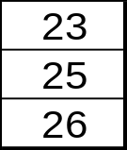
Inverted Lists
. . .
inverted
lists
data
records
age
index

Slide 45
Using Inverted Lists
Query:
  Get people with age = 20 and name = “fred”
List for age = 20: r4, r18, r34, r35
List for name = “fred”: r18, r52
Answer is intersection: r18

Slide 46

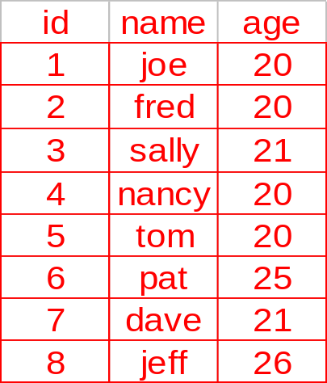

Bit Maps
. . .
age
index
bit
maps
data
records

Slide 47
Using Bit Maps
Query:
  Get people with age = 20 and name = “fred”
List for age = 20: 1101100000
List for name = “fred”: 0100000001
Answer is intersection: 010000000000
Good if domain cardinality small
Bit vectors can be compressed

Slide 48
Join
“Combine” SALE, PRODUCT relations
In SQL: SELECT * FROM SALE, PRODUCT

Slide 49
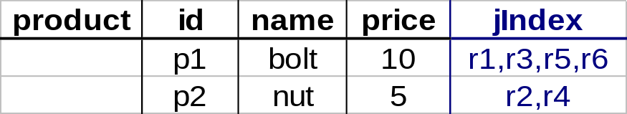
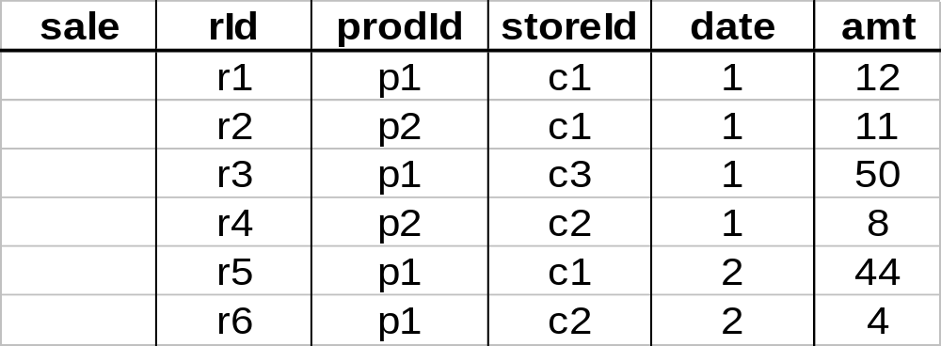
Join Indexes
join index

Slide 50

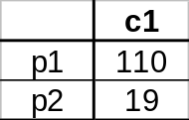
What to Materialize?
Store in warehouse results useful for common queries
Example:
total sales
day 2
. . .
day 1
129
materialize

Slide 51
Materialization Factors
Type/frequency of queries
Query response time
Storage cost
Update cost

Slide 52
Cube Aggregates Lattice
129
all
city
product
date
city, product
city, date
product, date
use greedy
algorithm to
decide what
to materialize
city, product, date
day 2
day 1

Slide 53
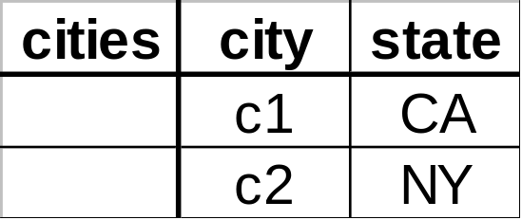
Dimension Hierarchies
all
state
city

Slide 54
Dimension Hierarchies
all
city
product
date
city, product
city, date
product, date
state
city, product, date
state, date
state, product
state, product, date
not all arcs shown...

Slide 55
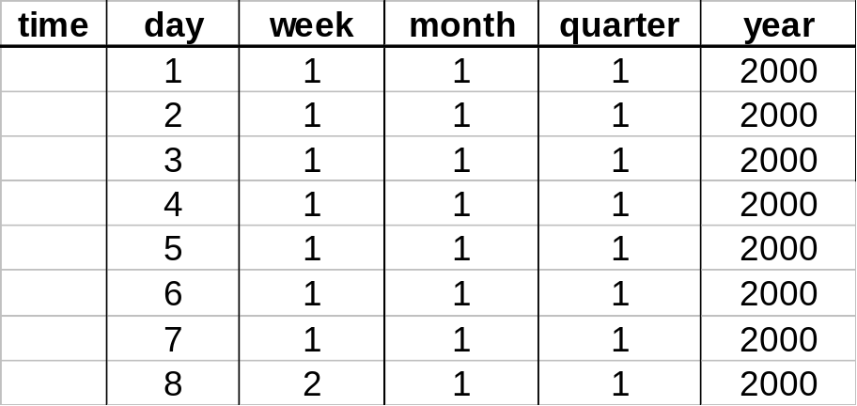
Interesting Hierarchy
all
years
weeks
quarters
months
conceptual
dimension table
days

Slide 56
Design
What data is needed?
Where does it come from?
How to clean data?
How to represent in warehouse (schema)?
What to summarize?
What to materialize?
What to index?

Slide 57
Tools
Development
  design & edit: schemas, views, scripts, rules, queries, reports
Planning & Analysis
  what-if scenarios (schema changes, refresh rates), capacity planning
Warehouse Management
  performance monitoring, usage patterns, exception reporting
System & Network Management
  measure traffic (sources, warehouse, clients)
Workflow Management
  “reliable scripts” for cleaning & analyzing data

Slide 58
Current State of Industry
Extraction and integration done off-line
  Usually in large, time-consuming, batches
Everything copied at warehouse
  Not selective about what is stored
  Query benefit vs storage & update cost
Query optimization aimed at OLTP
  High throughput instead of fast response
  Process whole query before displaying anything

