Slide 1
IaaS
Infrastructure as a Service
Achmad Syarif Abdullah <<175610099>>

Slide 2
Infrastructure as a service (IaaS) are online services that provide high-level APIs used to dereference various low-level details of underlying network infrastructure like physical computing resources, location, data partitioning, scaling, security, backup etc. A hypervisor, such as Xen, Oracle VirtualBox, Oracle VM, KVM, VMware ESX/ESXi, or Hyper-V, LXD, runs the virtual machines as guests. Pools of hypervisors within the cloud operational system can support large numbers of virtual machines and the ability to scale services up and down according to customers' varying requirements.
online services
provide high-level APIs
to dereference various low-level
IaaS

Slide 3
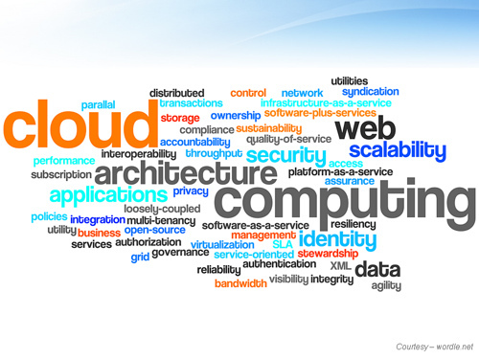
A collection of web pages and related content that is identified by a common domain name and published on at least one web server.
Is the on-demand availability of computer system resources, especially data storage and computing power, without direct active management by the user
Is a program or group of programs designed for end users.
Online Services
Everything can use by end user on internet

Slide 4
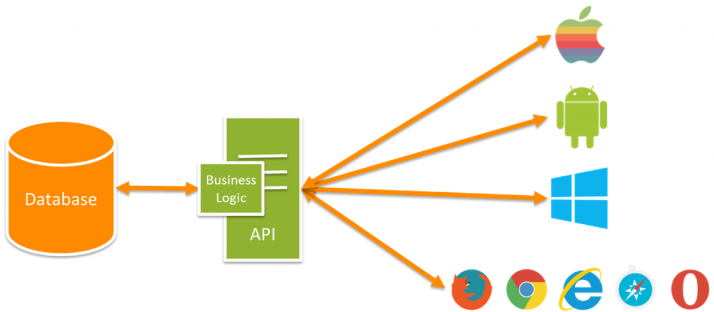
API
Application Programming Interface
Is an interface or communication protocol between different parts of a computer program intended to simplify the implementation and maintenance of software.
Bambang
(Developer)
Project A
Payment Gateway
Progress 1
For Windows Phone
Progress 2
For Android
Progress 3
For Apple
Tool / Library who make a easier way when development an specific function
Provide High-level APIs

Slide 5
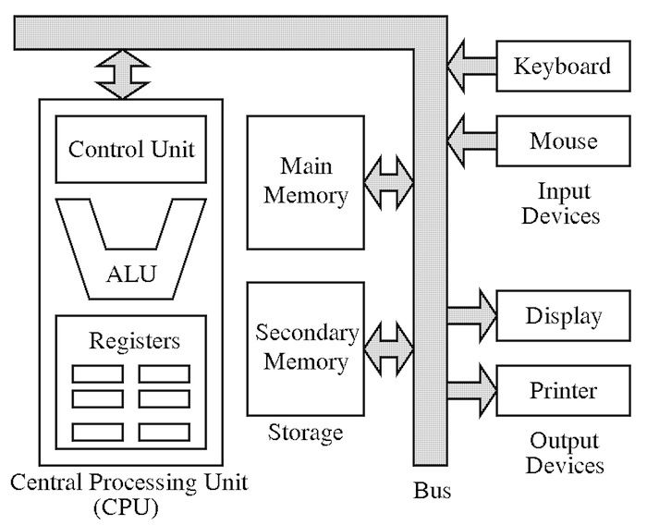
Low-level
Von-Neuman Architecture
RAM & ROM
Hard Drive
Processor
Basic Component From an server Architecture
To Dereference Various Low-level

Slide 6
Infrastructure as a Service
Cloud service who make a basic configuration of Server Architecture from the hardware, configuration, and application with an easier way to set and have high flexibility

Slide 7
Code Lab
01
Make Cloud Server
Make new EC2 on AWS Console
02
Setting the Enviroment
Use default setting with free payment
03
Launch Server
Waiting until server configuration done
04
Remote Server
Remote server from PC

Slide 8
Architecture Of IaaS

Slide 9
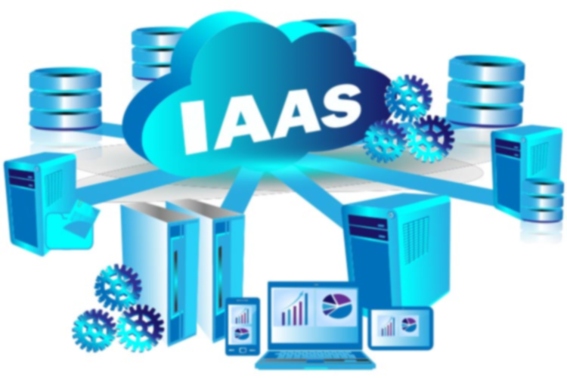

Infrastructure as a Service
Adventage
If we compare between using IaaS than buy PC Server by ourself we can get a cheapier cost when using IaaS. Because device of PC Server have ussualy have a high price.
We can custom specification of our server anytime and we can make a schedule who make server more flexible for high or low performance.
With IaaS we can free from anxiety if sometime our server meet the disaster, because with IaaS we can set backup in some data center.
Generally IaaS have a default setting for security, but we can make another setting inside our server from OS setting.
Cheaper
Flexibility Resource
Secure Device
Flexibility Security
.

Slide 10
Infrastructure as a Service
Weakness
Because need a lot of config this service much matching with an expert developer or system administrator with a lot experience.
If we want to migrate to another provider we need to setting from basic again, and it’s make us have a high dependency with one provider.
We need to config from device, OS, and server configuration if we use IaaS. It’s take a lot of time and not a simple task.
Need a Lot Config
Match with Expert
High Dependency
.

Slide 11

My Profile
Achmad Syarif Abdullah
Developer
Web and Game Developer

Slide 12
THANK YOU
For your attention

