Slide 1
VeriTest
Automated Testing Framework for Veriopt’s DSL
Achmad Afriza Wibawa (47287888)

Slide 2
Our Agenda
01 Purpose
02 Similar Work
03 Objectives
04 Methodology
05 Progress
06 Timeline
Why is this relevant at all?
What makes VeriTest different?
What would be the goals to VeriTest?
How it’s going to be implemented?
The good news!
My plan to make this work.
1/20

Slide 3
01
Purpose
Aren’t compilers always correct?

Slide 4
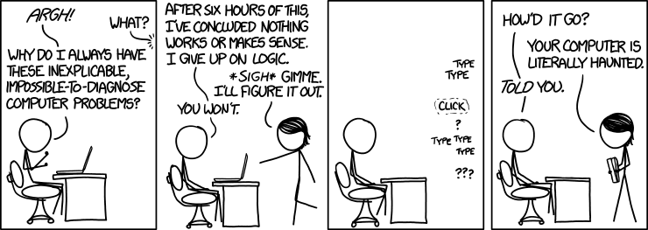
Compiler Verification
Inexplicable, https://xkcd.com/1316/
Compiler errors do sometimes happen [1, Sec. 1.2].
This is due to:
Pitfalls of the language the compiler is written in is just accepted by the community;
Didn’t consider edge cases on an optimization;
Human mistakes in implementation.
2/20

Slide 5
Ways to Verify a Compiler
Testing
Formal Verification
However, it is limited to the Humans defining the behavior of the compiler [2, 3].
A bit more tedious, but gets the job done [3].
Refers to the Compiler Research Thread!
3/20

Slide 6
Compiler Research Thread
1 Define
2 Find and Solve
3 Automate
Create an Intermediate Representation (IR)
of the compiler [1].
Find incorrect
optimization rules
through solver-based tools [1].
Build a compiler-compiler
for the optimization rules [1].
4/20

Slide 7
02
Similar Work
Or others that have successfully done this.

Slide 8
CompCert
Their Work
Their Solution
CompCert [3] formally verifies Clight: a subset of C language.
It utilizes an automated theorem prover Coq,
not only to verify but also generate compiler code.
Their work amounts to
42000 lines of Coq, equivalent
to 3 years of man-hours work.
1 With a deterministic program,
a compiler must be able to
translate to a program with the same behavior.
2 Provide the compiler with
the appropriate IR definitions.
3 Formally verify an optimization rule by either proving that:
The translation is correct;
The implementation is correct.
5/20

Slide 9
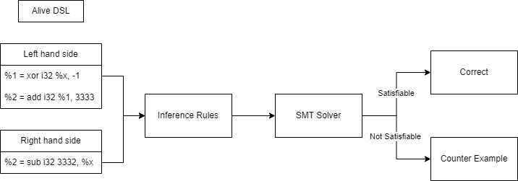
Alive
Their Work
Their Solution
Instead of formally verifying a whole programming language, Alive [4, 5] tackles an optimization phase that is done by LLVM.
It utilizes Satisfiability Modulo Theorem (SMT) solvers to:
Prove that a translation is correct;
Provide counterexamples.
Alive’s formal verification process [4, pp.1]
1 Translate LLVM code
into Inference Rules.
2 Pass the Inference Rules
into SMT solvers.
6/20

Slide 10
Veriopt
Their Work
Their Problem
Currently, Veriopt [7] formally verifies the side-effect-free optimization rules inside GraalVM.
GraalVM’s IR [6] is represented as a Domain Specific Language (DSL) inside Isabelle.
It utilizes Isabelle [8], an automated theorem prover similar to Coq, with SMT solver capabilities.
An optimization rule needs to be proven by the users [7].
Developers shouldn’t need to learn Isabelle to integrate Veriopt to their workflow [7, Sec. 7].
There are no tools in Veriopt’s infrastructure that helps provide fast feedback towards new optimization rules [7, Sec. 7].
7/20

Slide 11
03 Objectives
1
Is it possible to extend the current infrastructure of Veriopt to a tool that could provide feedback?
2
Would the feedback be useful to GraalVM developers?
3
How should VeriTest integrate into
GraalVM developer’s workflow?
4
How fast could VeriTest provide feedback
towards an optimization rule?
8/20

Slide 12
04
Methodology
How we’re going to do things.

Slide 13
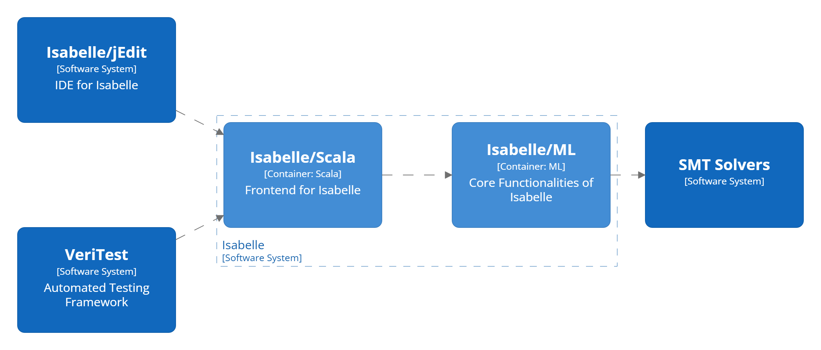
Isabelle
Nitpick
Isabelle translates a theory that needs to be proven into Inference Rules. These rules are passed on to SMT Solvers to check for their satisfiablity. [8, Sec. 5]
Sledgehammer
Instead of checking their satisfiability, Sledgehammer tries to solve the theory by cross-referencing it with relevant facts. [8, Sec. 3]
9/20

Slide 14
Methodology
Utilize Isabelle Client – Server interaction to process an optimization rule.
Isabelle Server
Extend Isabelle directly as a plugin via it’s façade: Isabelle/Scala.
Isabelle/Scala
Solution Space
Utilize Isabelle as a child process that is spawned whenever an optimization rule is processed.
Isabelle CLI
Create your own
automated theorem prover.
DSL Interpreter
10/20

Slide 15
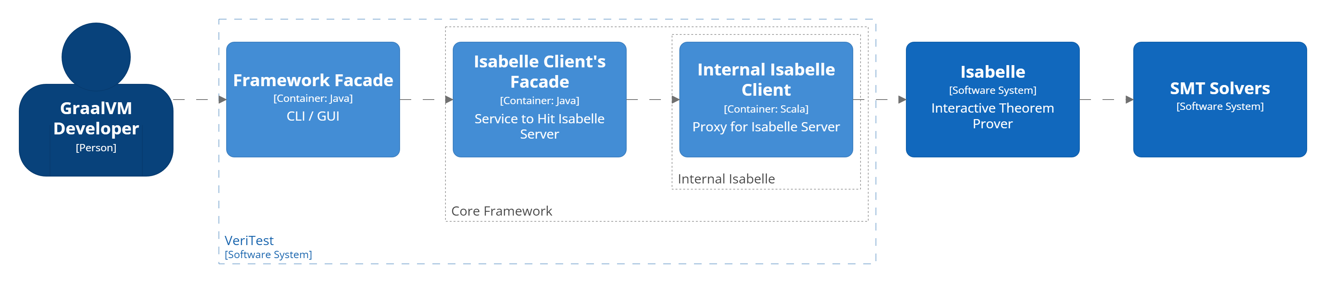
Isabelle Server
Isabelle Server [9, Ch. 4] acts as
the core system to process
an optimization rule.
Communications to Isabelle Server are done over TCP, with Isabelle Client acting as a proxy.
This allows VeriTest to offload time-consuming processes to external servers. As such, horizontal scaling is possible.
11/20

Slide 16
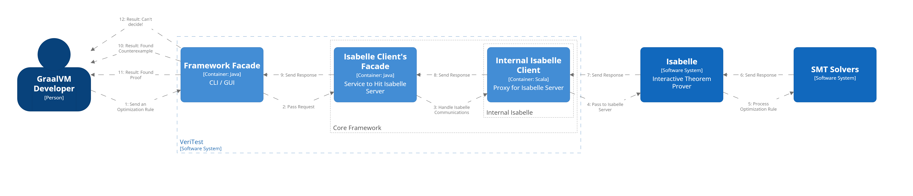
GraalVM Devs Workflow
12/20

Slide 17
05
Progress
The good news!

Slide 18
Isabelle Server is Feasible!

Slide 19
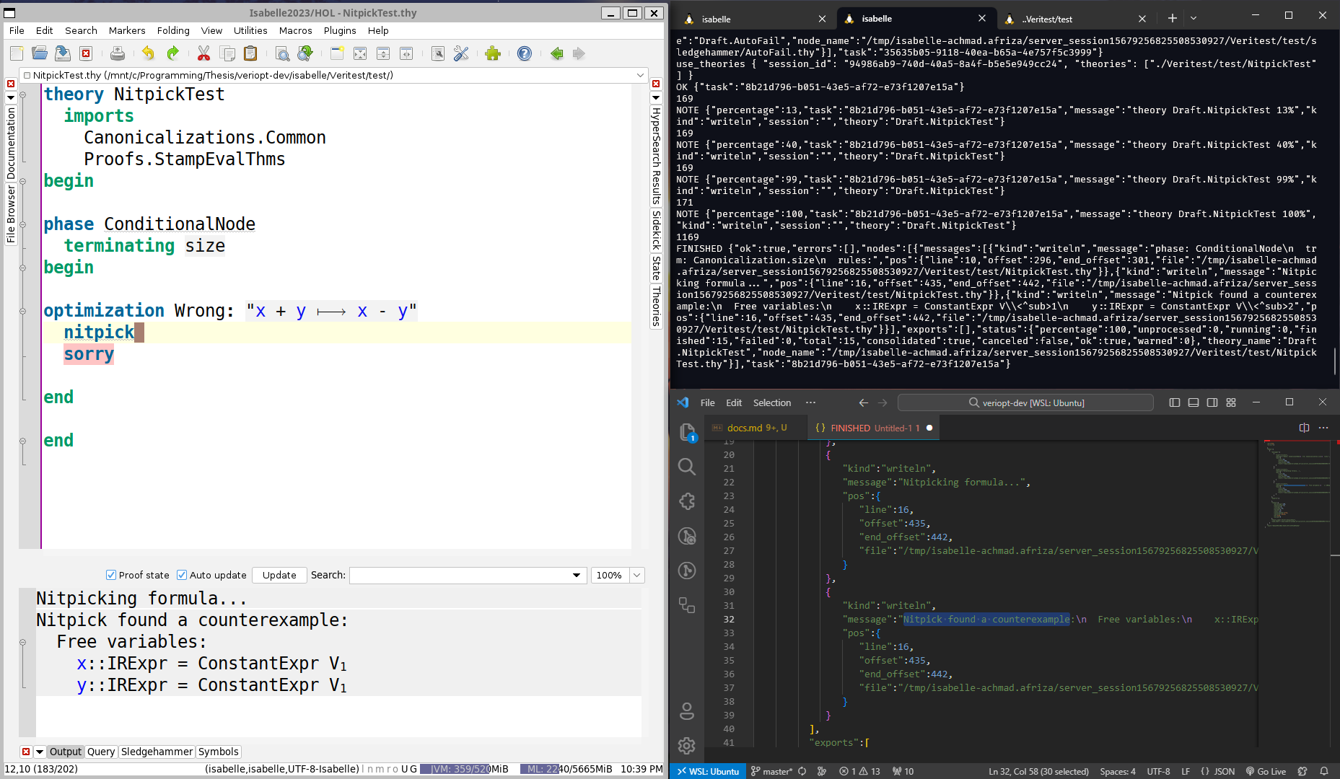
Counterexamples
13/20

Slide 20
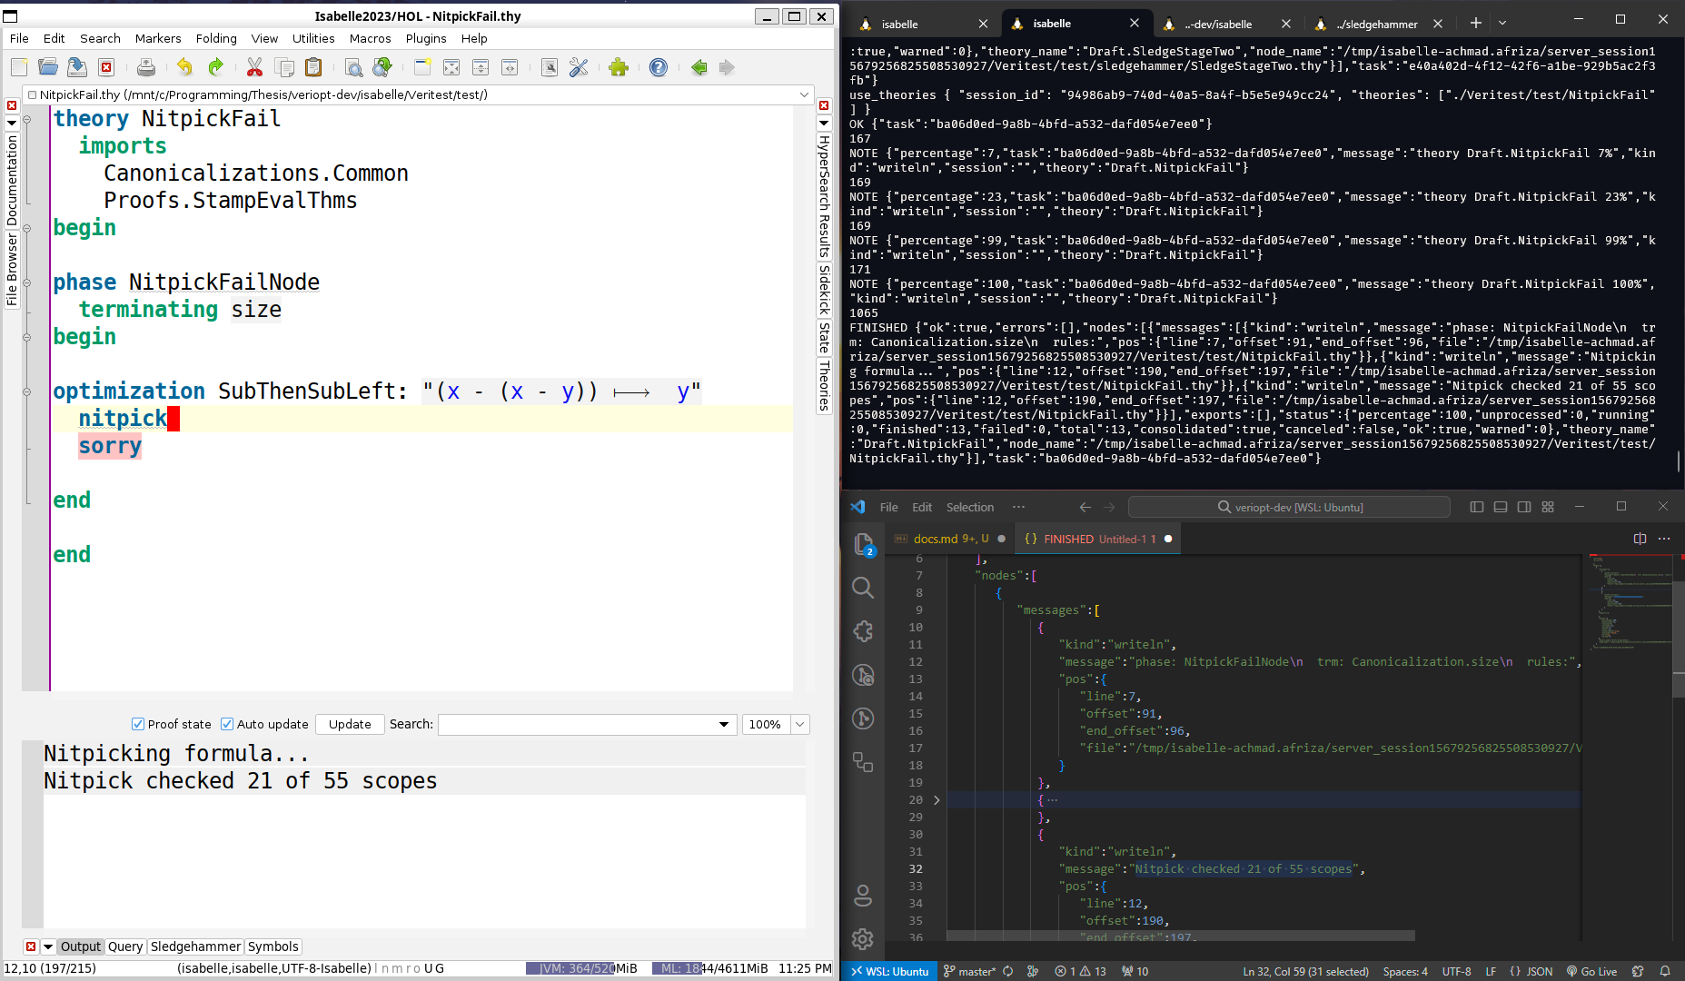
Counterexamples
14/20

Slide 21
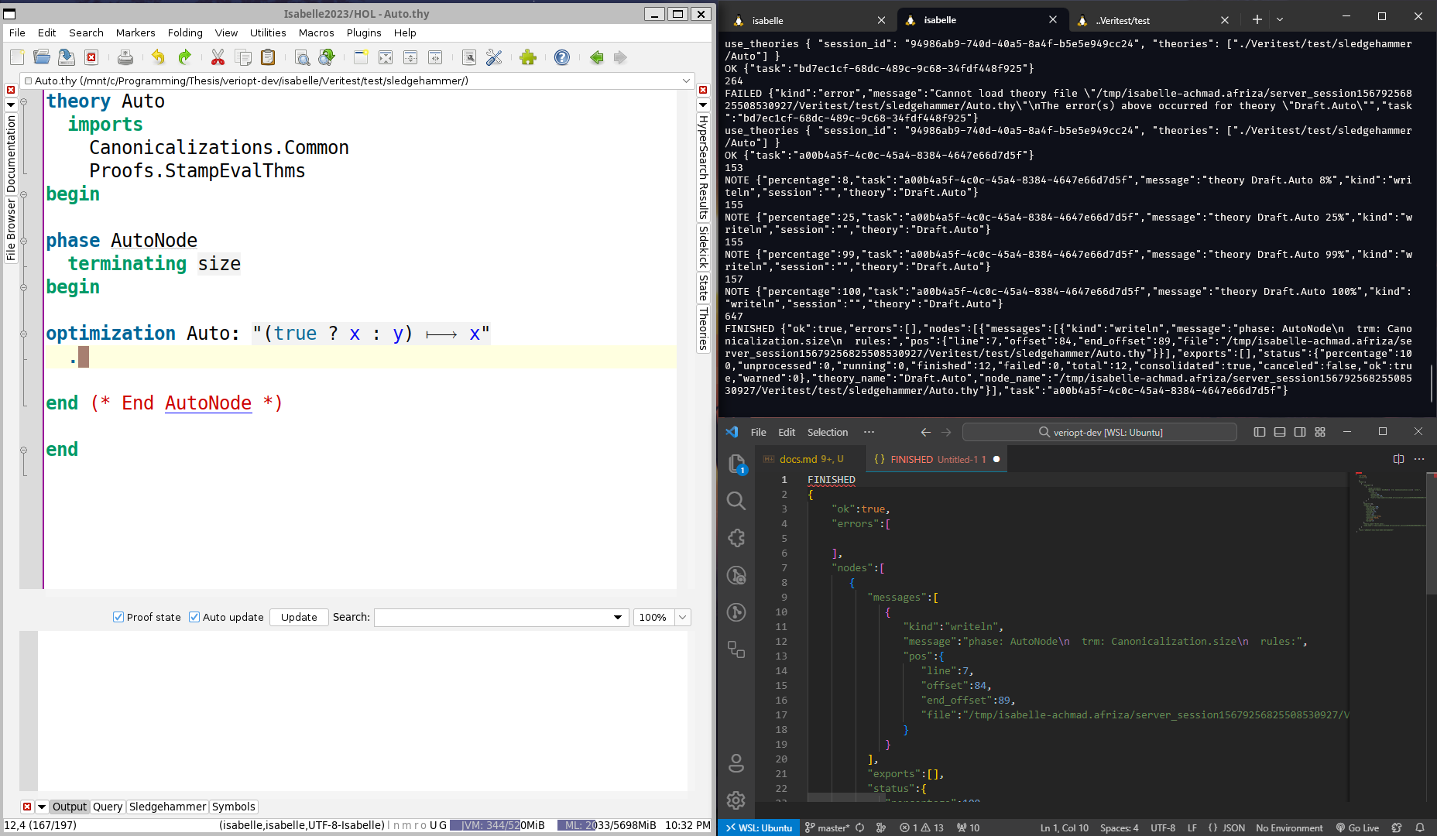
Simple Proofs
15/20

Slide 22
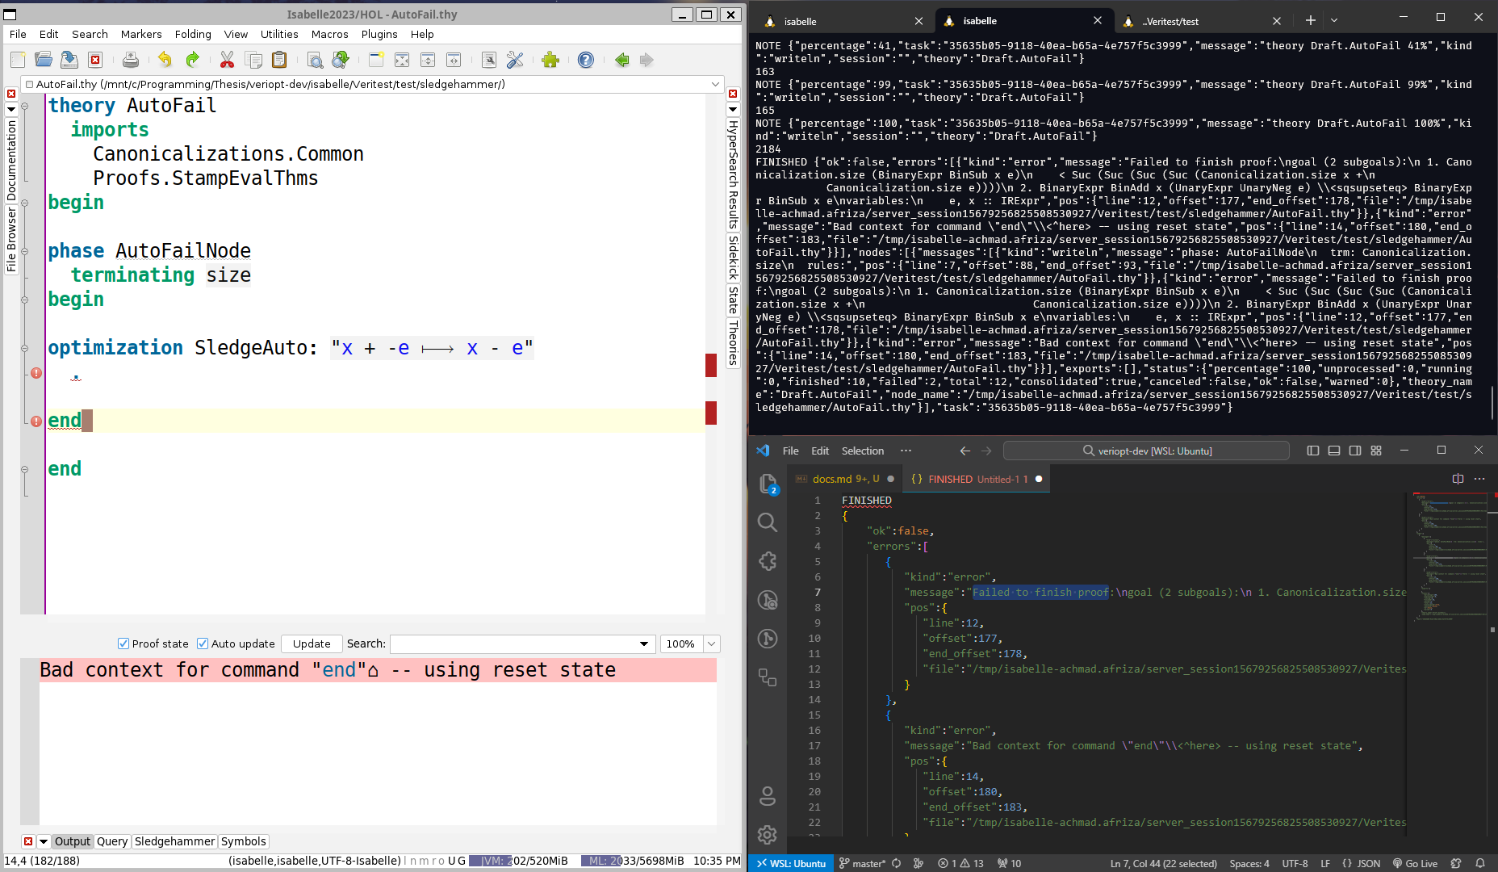
Simple Proofs
16/20

Slide 23
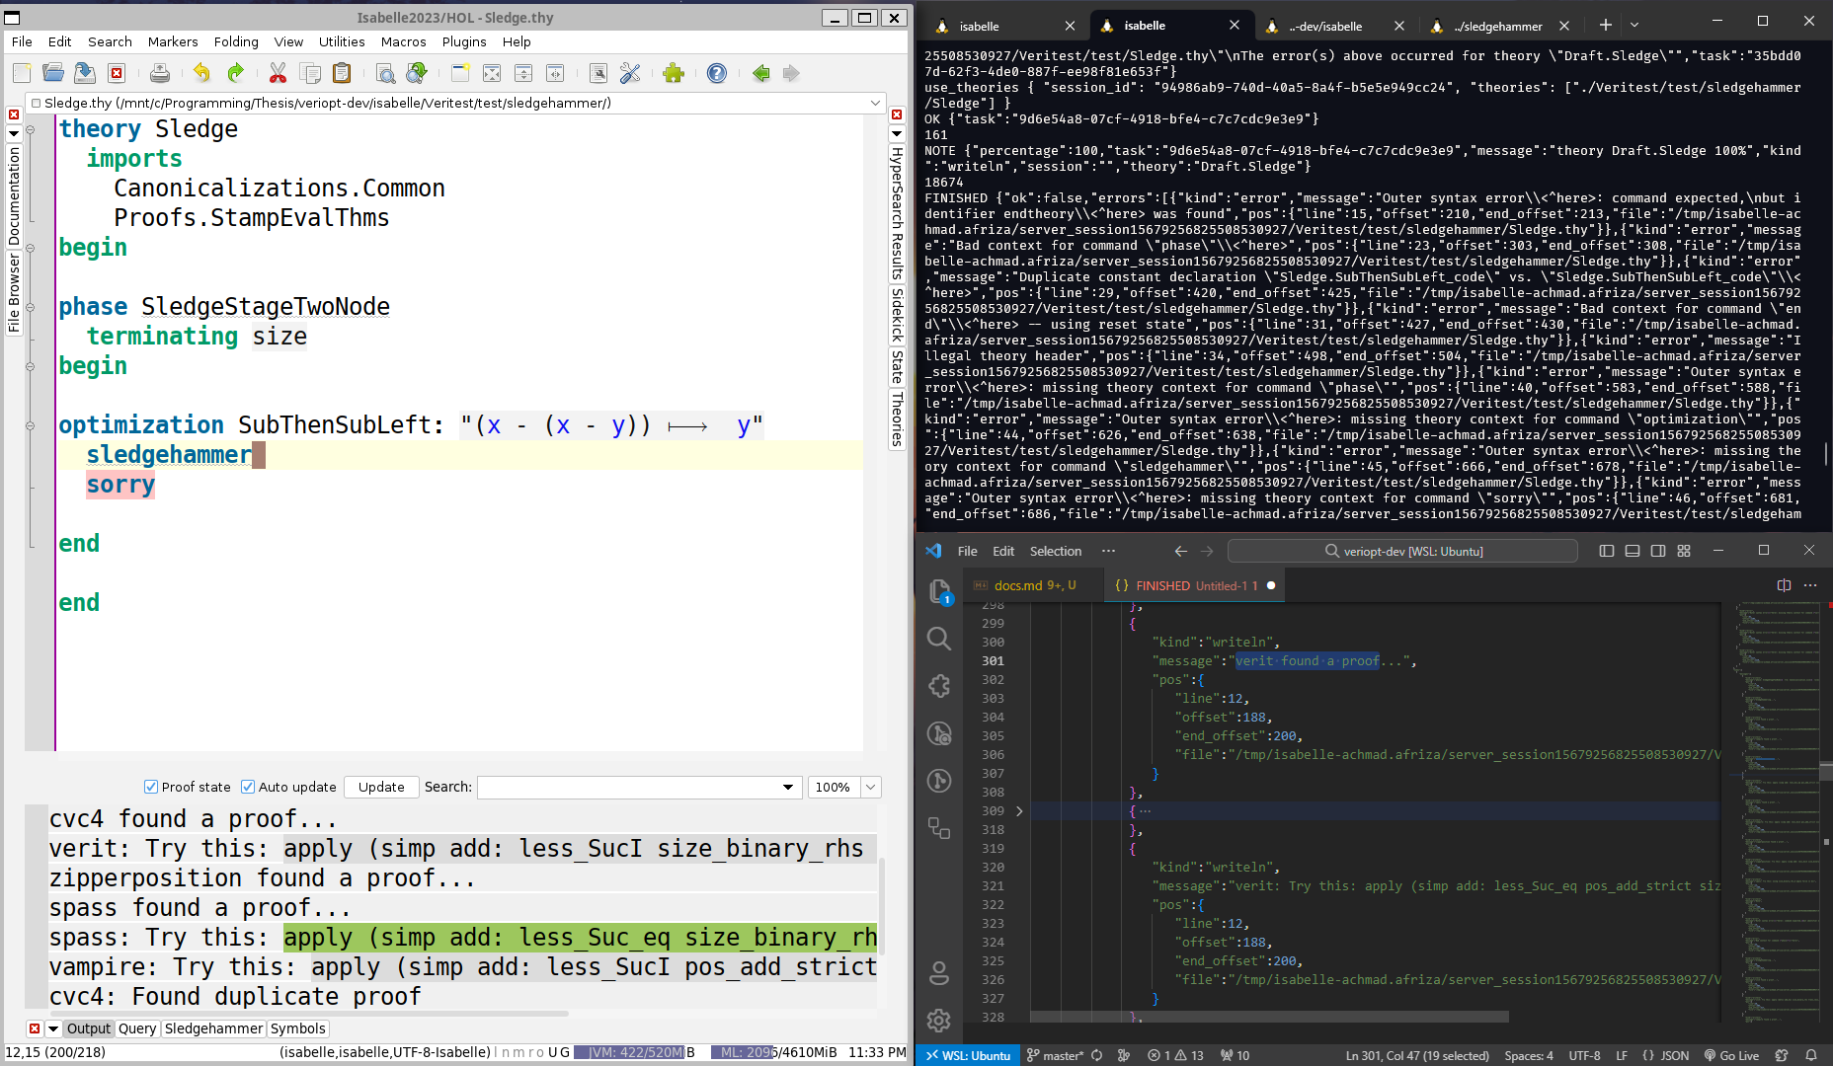
Some Non-Trivial Proofs
17/20

Slide 24
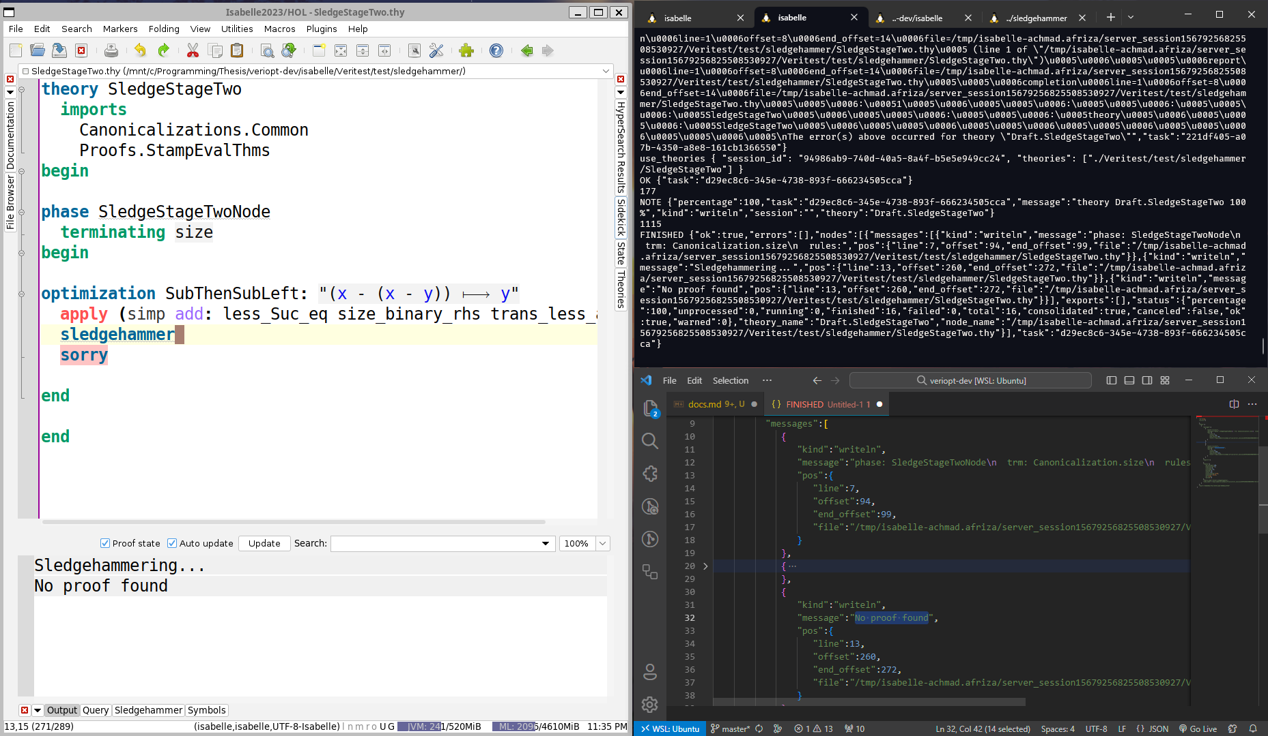
Some Non-Trivial Proofs
18/20

Slide 25
06
Timeline
Remaining work to be done.

Slide 26
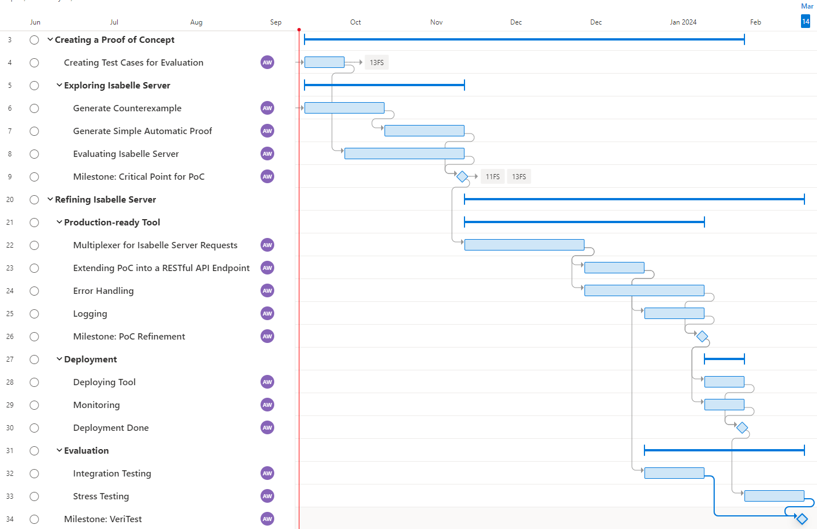
Our Timeline
19/20

Slide 27
References
[1] N. P. Lopes and J. Regehr, “Future directions for optimizing compilers,” arXiv preprint, Sep. 2018. arXiv: 1809.02161 [cs.PL].
[2] N. J. Wahl, “An overview of regression testing,” ACM SIGSOFT Software Engineering Notes, vol. 24, no. 1, pp. 69–73, Jan. 1999, issn: 0163-5948. doi: 10.1145/308769.308790.
[3] X. Leroy, “Formal verification of a realistic compiler,” Communications of the ACM, vol. 52, no. 7, pp. 107–115, Jul. 2009, issn: 0001-0782, 1557-7317. doi: 10 . 1145 /1538788.1538814.
[4] J. Lee, C.-K. Hur, and N. P. Lopes, “AliveInLean: A verified LLVM peephole optimization verifier,” in Computer Aided Verification, I. Dillig and S. Tasiran, Eds., Cham: Springer International Publishing, 2019, pp. 445–455, isbn: 978-3-030-25543-5. doi: 10.1007/978-3-030-25543-5_25.
[5] N. P. Lopes, J. Lee, C.-K. Hur, Z. Liu, and J. Regehr, “Alive2: Bounded translation validation for LLVM,” in Proceedings of the 42nd ACM SIGPLAN International Conference on Programming Language Design and Implementation, Virtual Canada: ACM, Jun. 2021, pp. 65–79, isbn: 978-1-4503-8391-2. doi: 10.1145/3453483.3454030.
[6] B. J. Webb, M. Utting, and I. J. Hayes, “A formal semantics of the GraalVM intermediate representation,” in Automated Technology for Verification and Analysis, Z. Hou and V. Ganesh, Eds., ser. Lecture Notes in Computer Science, vol. 12971, Cham: Springer International Publishing, Oct. 2021, pp. 111–126, isbn: 978-3-030-88885-5. doi: 10.1007/978-3-030-88885-5_8.
[7] B. J. Webb, I. J. Hayes, and M. Utting, “Verifying term graph optimizations using Isabelle/HOL,” in Proceedings of the 12th ACM SIGPLAN International Conference on Certified Programs and Proofs, ser. CPP 2023, Boston, MA, USA: Association for Computing Machinery, 2023, pp. 320–333, isbn: 9798400700262. doi: 10.1145/3573105.3575673.
[8] J. C. Blanchette, L. Bulwahn, and T. Nipkow, “Automatic Proof and Disproof in Isabelle/HOL,” en, in Frontiers of Combining Systems, C. Tinelli and V. SofronieStokkermans, Eds., vol. 6989, Series Title: Lecture Notes in Computer Science, Berlin, Heidelberg: Springer Berlin Heidelberg, 2011, pp. 12–27, isbn: 978-3-642-24363-9 978-3-642-24364-6. doi: 10.1007/978-3-642-24364-6_2.
[9] M. Wenzel, “The Isabelle System Manual,” en, [Online]. Available: https://isabelle.in.tum.de/dist/Isabelle2022/doc/system.pdf (visited on 09/13/2023).
20/20

Slide 28
Thanks
Slidesgo 2022
Do you have any questions?

Slide 29
07
Additional Resources
Other stuffs.

Slide 30
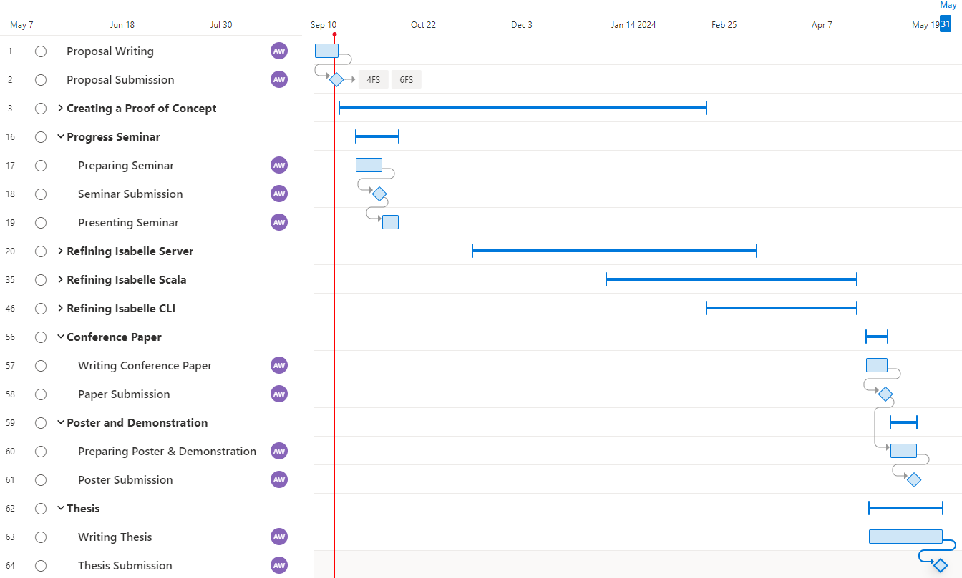
Overall Timeline

Slide 31
Isabelle/Scala
Isabelle/Scala can be extended directly as a library for Java / Scala application through Isabelle’s own compiler.
However, going through this solution means that offloading processing to external sites are not feasible.

Slide 32
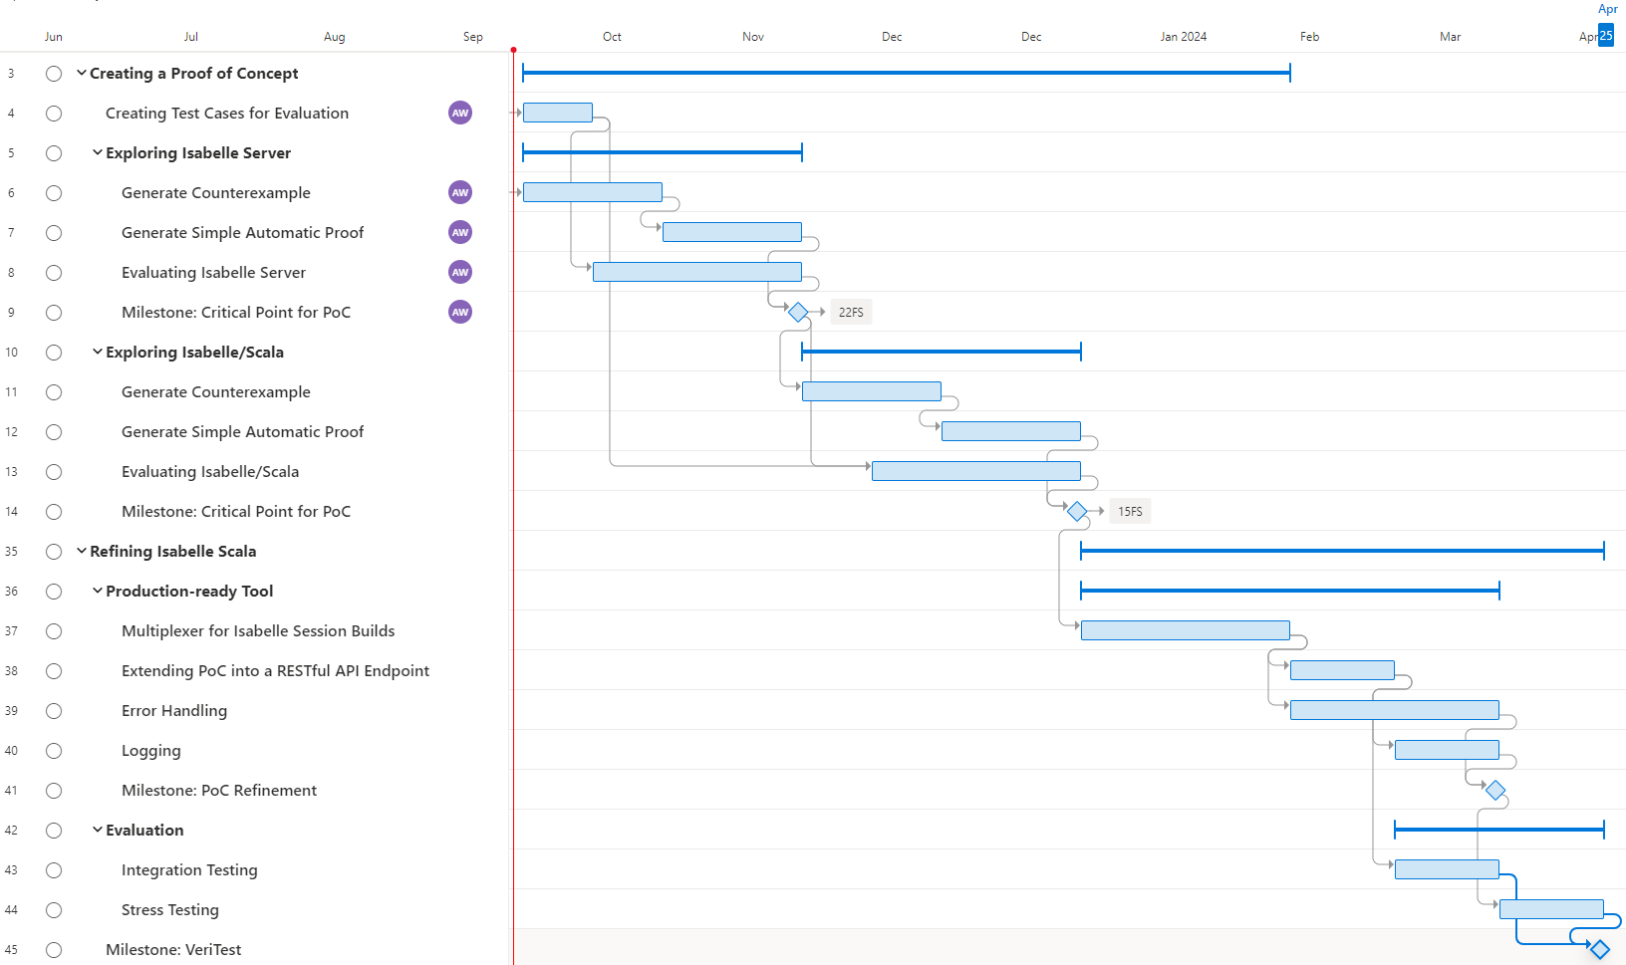
Isabelle/Scala Timeline

Slide 33
Isabelle CLI
Isabelle CLI builds upon the previous works done by Veriopt.
It is possible for Isabelle to process the theory files directly from the CLI, and conflicting / error in the theory file will result in a failed build.
However, this will mean that processing an optimization takes a long time, since each request would build the project from the ground-up.

Slide 34
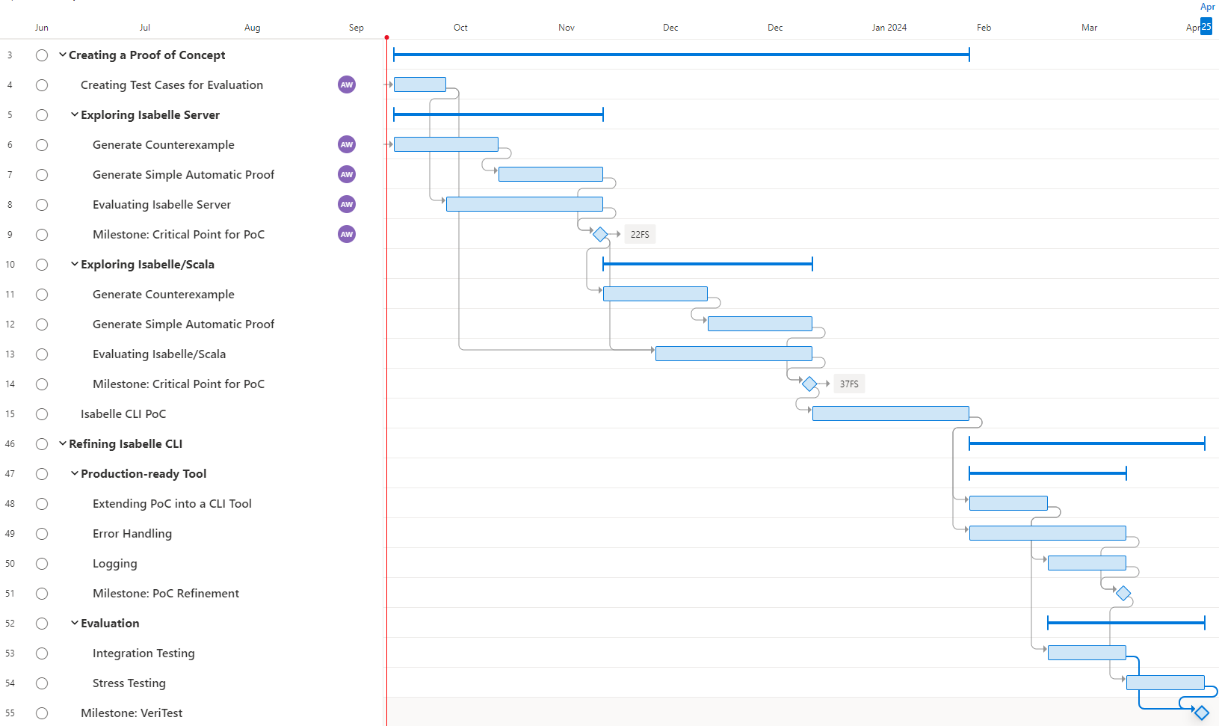
Isabelle CLI Timeline

