Slide 1
NetGuard AI
Predictive Network Failure & Anomaly Monitoring
Achmad Maulana
241730016
Universitas Islam Negeri Sultan Maulana Hasanuddin Banten
AI + Cyber Security
CICIDS2017
Flask Dashboard
Achmad Maulana | 241730016 | NetGuard AI | 1/12

Slide 2
Problem
NetGuard AI UAS Artificial Intelligence Defense Package
Gangguan jaringan sering diketahui setelah layanan turun.
Monitoring tradisional belum menerjemahkan data menjadi risiko.
Admin pemula butuh dashboard yang mudah dipahami.
Research Artifact
Reproducible
Low-Budget
Achmad Maulana | 241730016 | NetGuard AI | 2/12

Slide 3
Research Gap
NetGuard AI UAS Artificial Intelligence Defense Package
Banyak studi IDS berhenti di akurasi model.
Risiko faulty use CICIDS2017 masih perlu diantisipasi.
Deployment edukatif dan rekomendasi tindakan masih jarang dibahas.
Research Artifact
Reproducible
Low-Budget
Achmad Maulana | 241730016 | NetGuard AI | 3/12

Slide 4
Novelty
NetGuard AI UAS Artificial Intelligence Defense Package
Main novelty: ML anomaly detection + lightweight educational dashboard.
Secondary novelty: automated risk level + actionable recommendations.
Konteks: sekolah, kampus, lab, dan UMKM low-budget.
Research Artifact
Reproducible
Low-Budget
Achmad Maulana | 241730016 | NetGuard AI | 4/12

Slide 5
Research Method
NetGuard AI UAS Artificial Intelligence Defense Package
RM1: Dashboard-based ML anomaly detection.
RM2: Baseline Logistic Regression/Decision Tree vs Random Forest.
Dataset utama: CICIDS2017-style traffic flow CSV.
Research Artifact
Reproducible
Low-Budget
Achmad Maulana | 241730016 | NetGuard AI | 5/12

Slide 6
AI Pipeline
NetGuard AI UAS Artificial Intelligence Defense Package
Dataset
Preprocessing
Feature Handling
Training
Evaluation
Prediction
Dashboard
Narasi: pipeline ini menunjukkan bahwa proyek memiliki implementasi penuh, bukan hanya rangkuman jurnal.
Achmad Maulana | 241730016 | NetGuard AI | 6/12

Slide 7
Experiment Design
NetGuard AI UAS Artificial Intelligence Defense Package
Split 80:20, random_state 42.
Metrics: Accuracy, Precision, Recall, F1-score, Confusion Matrix.
Best model rule: F1-score, Recall, Accuracy.
Research Artifact
Reproducible
Low-Budget
Achmad Maulana | 241730016 | NetGuard AI | 7/12

Slide 8
Current Result
NetGuard AI UAS Artificial Intelligence Defense Package
Sample CSV only validates pipeline.
All models show 1.0000 because sample is tiny and simple.
Final research must use real CICIDS2017 subset.
Research Artifact
Reproducible
Low-Budget
Achmad Maulana | 241730016 | NetGuard AI | 8/12

Slide 9
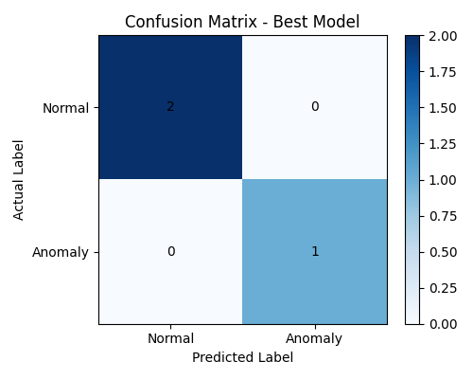
Dashboard Demo
NetGuard AI UAS Artificial Intelligence Defense Package
Cards: total, normal, anomaly, accuracy.
Charts: model comparison and confusion matrix.
Pages: upload, train, predict, report.
Research Artifact
Reproducible
Low-Budget
Achmad Maulana | 241730016 | NetGuard AI | 9/12

Slide 10
Deployment Plan
NetGuard AI UAS Artificial Intelligence Defense Package
Frontend future: Next.js + Tailwind + Framer Motion.
Backend current: Flask API; scalable future: NestJS/PostgreSQL.
Deploy: Vercel + Railway/Render + GitHub Actions.
Research Artifact
Reproducible
Low-Budget
Achmad Maulana | 241730016 | NetGuard AI | 10/12

Slide 11
Defense Message
NetGuard AI UAS Artificial Intelligence Defense Package
This is not only a literature review.
It includes working preprocessing, training, evaluation, prediction, dashboard, and artifacts.
Scientific strength depends on final real CICIDS2017 experiment.
Research Artifact
Reproducible
Low-Budget
Achmad Maulana | 241730016 | NetGuard AI | 11/12

Slide 12
Conclusion
NetGuard AI UAS Artificial Intelligence Defense Package
NetGuard AI is a low-budget AI cyber-security prototype.
It is suitable for UAS, final project, and thesis development.
Next: real dataset, tuning, cross-validation, feature importance.
Research Artifact
Reproducible
Low-Budget
Achmad Maulana | 241730016 | NetGuard AI | 12/12

