Slide 1
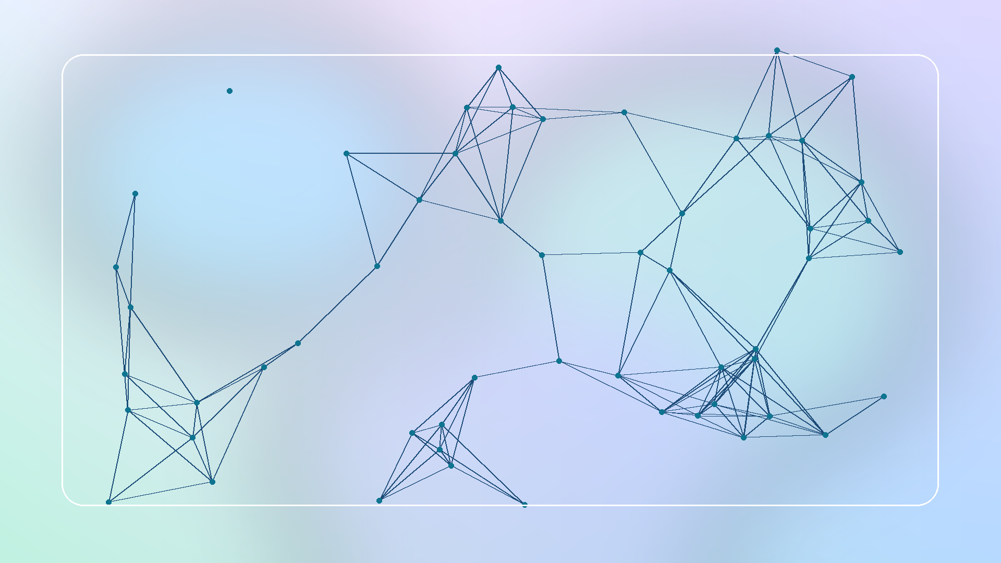
01
NetGuard AI
Predictive Network Failure and Anomaly Monitoring Achmad Maulana - 241730016
AI
Network Security
CICIDS2017
NetGuard AI - UAS Artificial Intelligence 2026

Slide 2
02
Masalah
Monitoring jaringan kampus/lab sering masih manual, sedangkan trafik abnormal dapat muncul cepat dan sulit dibaca dari log mentah.
Low Budget
Praktis
Reproducible
NetGuard AI - UAS Artificial Intelligence 2026

Slide 3
03
Research Gap
Banyak penelitian IDS kuat pada metrik, tetapi belum selalu menyediakan dashboard edukatif, risk score, rekomendasi tindakan, dan paket artefak yang mudah direplikasi mahasiswa.
Gap
Novelty
NetGuard AI - UAS Artificial Intelligence 2026

Slide 4
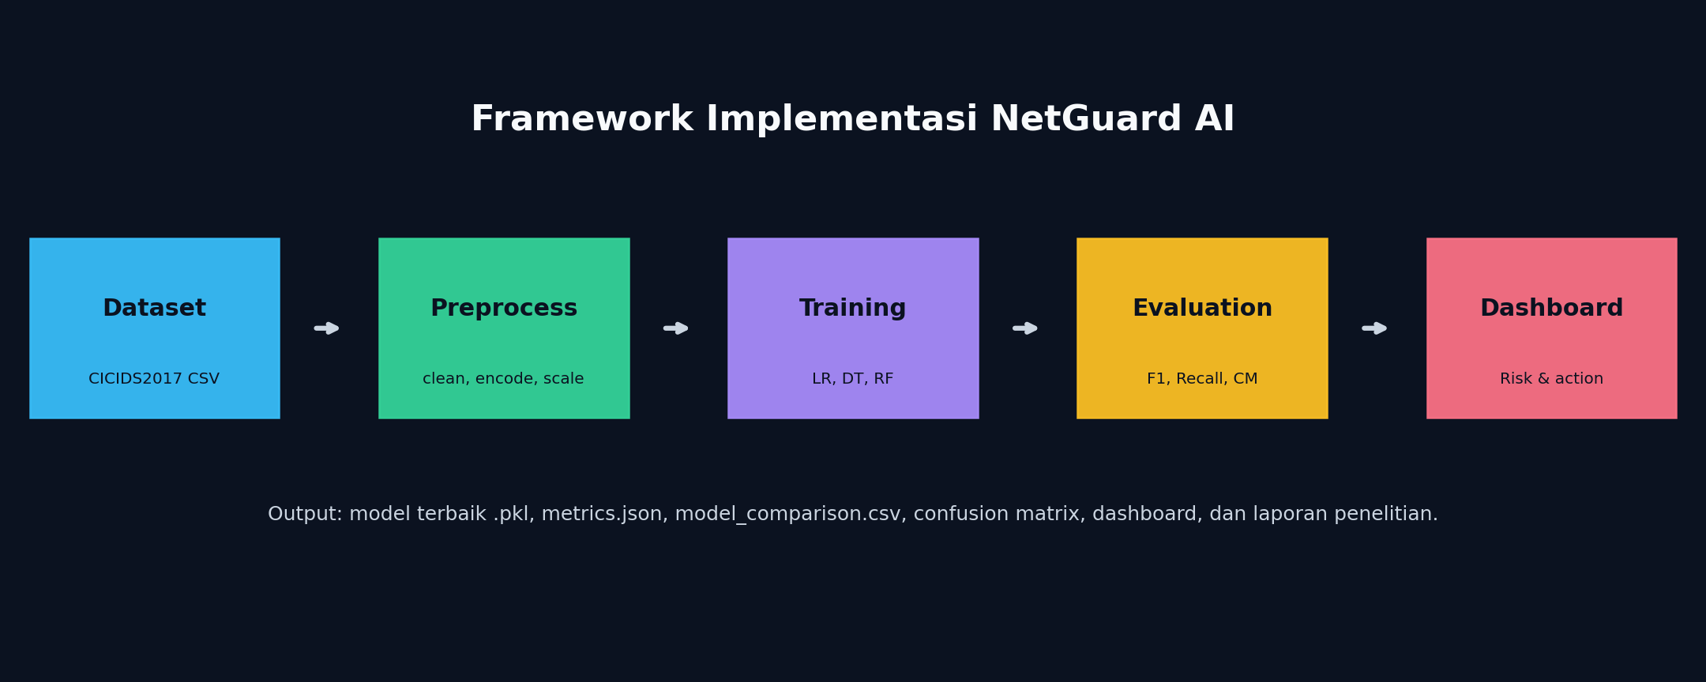
04
Novelty
Integrasi deteksi anomali machine learning dengan dashboard monitoring ringan, klasifikasi risiko otomatis, dan rekomendasi tindakan untuk administrator pemula.
Dashboard
Risk Action
NetGuard AI - UAS Artificial Intelligence 2026

Slide 5
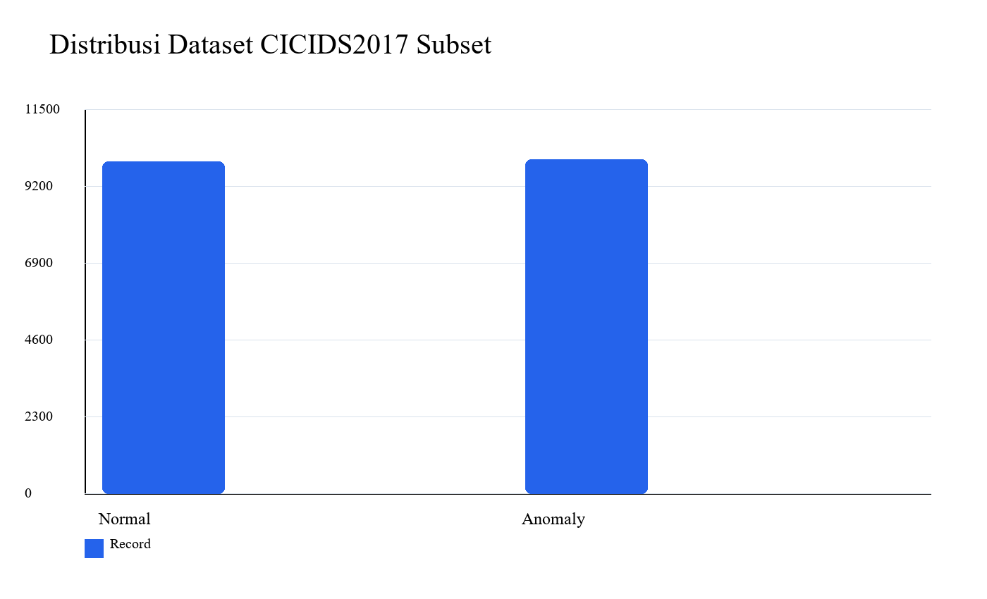
05
Dataset
CICIDS2017 Friday Afternoon DDoS subset representatif. Processed records: 19.935 Normal: 9.935 Anomaly: 10.000
Public Dataset
Binary Class
NetGuard AI - UAS Artificial Intelligence 2026

Slide 6
06
Preprocessing
Normalize columns -> label encoding -> numeric features -> handle infinity/missing values -> median imputation -> remove duplicates -> export processed CSV.
Pipeline
NetGuard AI - UAS Artificial Intelligence 2026

Slide 7
07
Model
Baseline: Logistic Regression Proposed practical model: Decision Tree / Random Forest comparison Selection: F1-score, Recall, Accuracy
LR
DT
RF
NetGuard AI - UAS Artificial Intelligence 2026

Slide 8
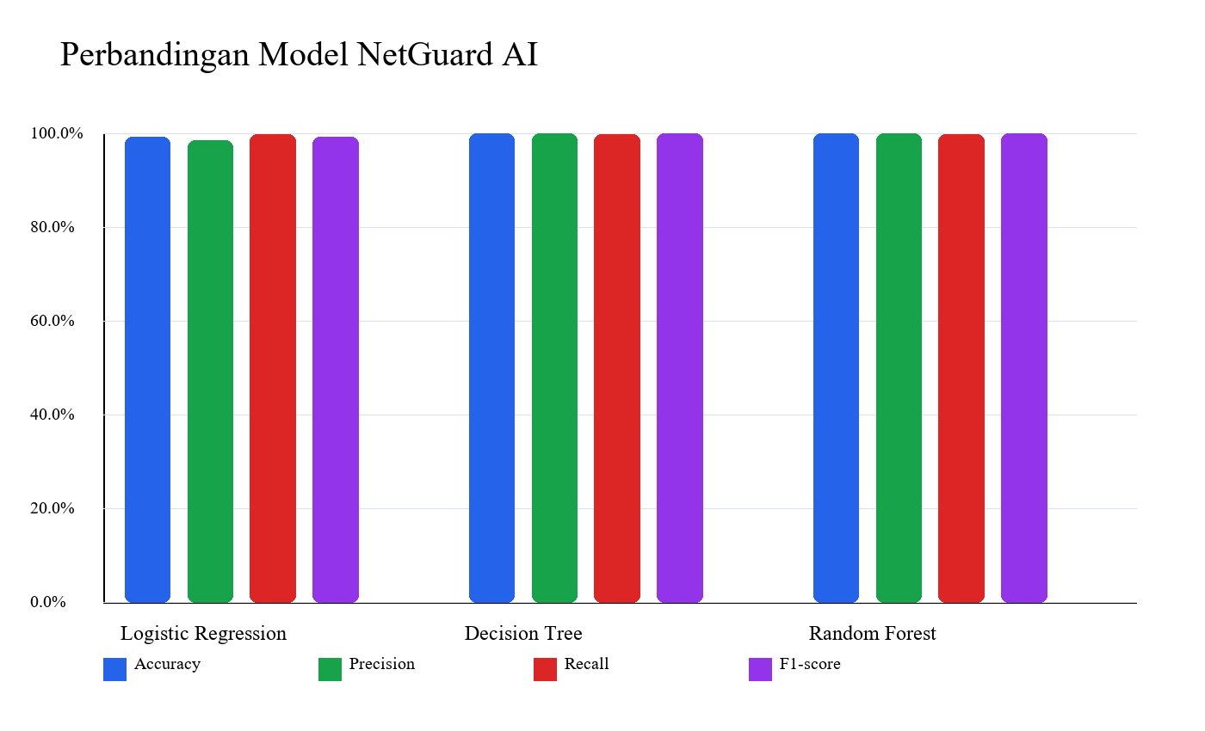
08
Hasil Utama
Best model: Decision Tree Accuracy: 0.9992 Precision: 0.9995 Recall: 0.9990 F1-score: 0.9992
Best Model
NetGuard AI - UAS Artificial Intelligence 2026

Slide 9
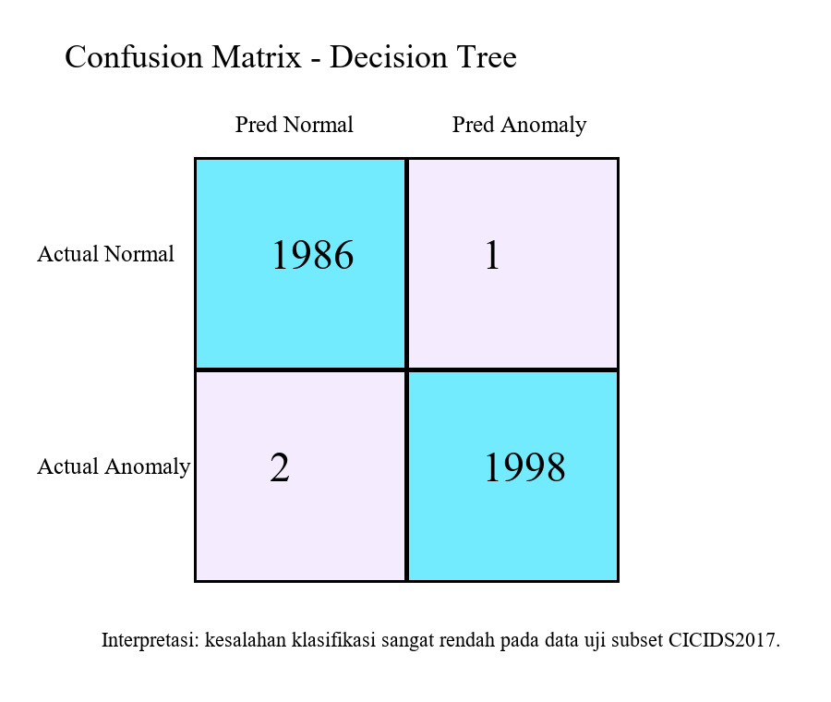
09
Confusion Matrix
Kesalahan klasifikasi sangat rendah pada data uji. Fokus evaluasi tetap pada false negative karena anomaly yang lolos deteksi berisiko terhadap layanan.
Evaluation
NetGuard AI - UAS Artificial Intelligence 2026

Slide 10
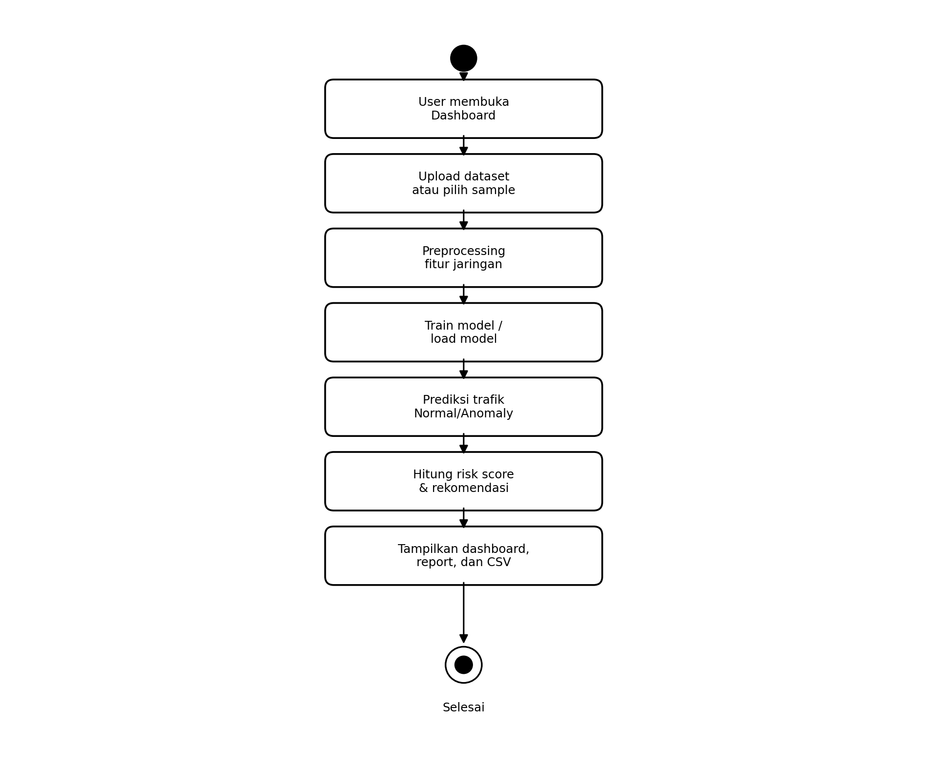
10
Dashboard
Dashboard menampilkan total record, normal traffic, anomaly traffic, model accuracy, risk score, risk level, recommended action, comparison chart, dan confusion matrix.
Flask
Chart.js
NetGuard AI - UAS Artificial Intelligence 2026

Slide 11
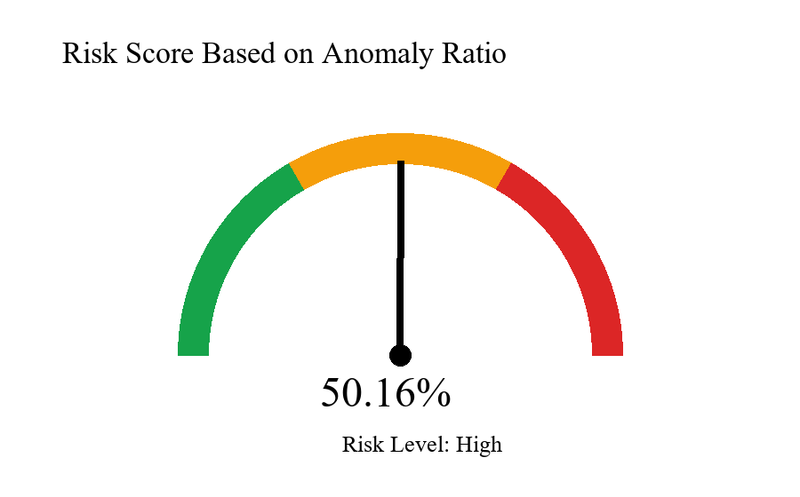
11
Risk Score
Low: anomaly ratio < 10% Medium: 10% sampai < 30% High: >= 30% Pada batch eksperimen, risk level masuk High.
Operational
NetGuard AI - UAS Artificial Intelligence 2026

Slide 12
12
Deployment
Mode sederhana: Flask lokal untuk demo dan VPS/Render/Railway untuk akses online. Domain dapat diarahkan melalui Cloudflare DNS ke server agar laptop tidak perlu menyala.
Domain
Server
NetGuard AI - UAS Artificial Intelligence 2026

Slide 13
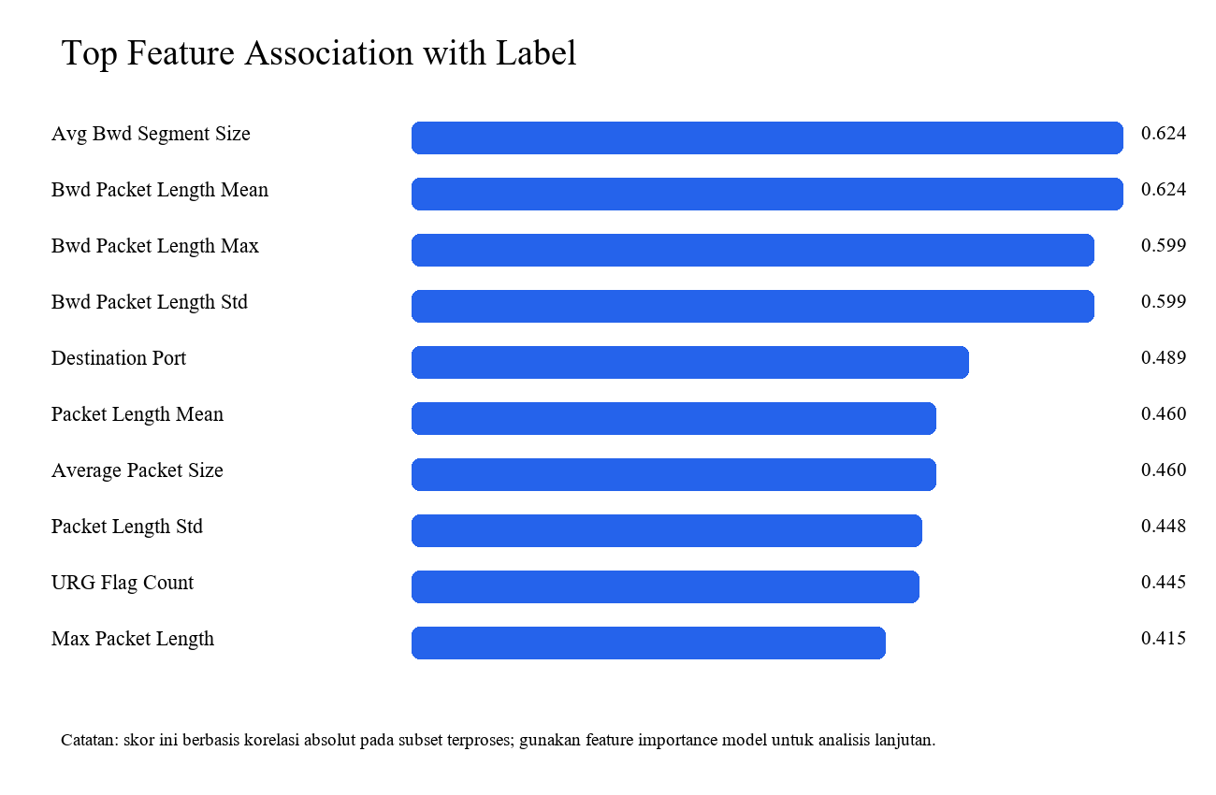
13
Keterbatasan
Masih memakai subset DDoS, belum cross-dataset, belum tuning sistematis, dan belum diuji pada trafik lokal kampus dengan izin etik.
Limitation
NetGuard AI - UAS Artificial Intelligence 2026

Slide 14
14
Penutup
NetGuard AI memenuhi siklus penelitian: literature mapping, gap, novelty, implementasi AI, eksperimen, dashboard, artefak, dan draft IEEE.
Ready for Defense
NetGuard AI - UAS Artificial Intelligence 2026

