Slide 1
SAS/BASE
DEPARTEMEN STATISTIKA PROGRAM STUDI STATISTIKA TERAPAN
INSTITUT PERTANIAN BOGOR
2018

Slide 2
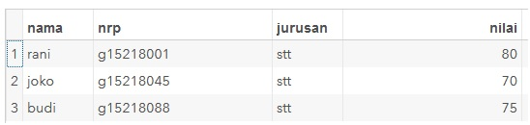
DATA: Membuat file gugus data SAS
libname mds '/folders/myfolders/MDS';
Data filestk;
input nama $ nrp $9. jurusan $ nilai;
cards;
rani g15218001 stt 80
joko g15218045 stt 70
budi g15218088 stt 75
run;

Slide 3
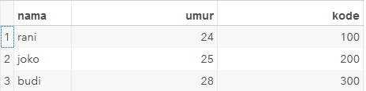
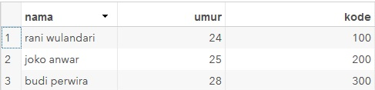
INPUT: Memasukkan data dengan In-Stream
Input List
Data inputlist;
input nama $ umur kode;
datalines;
rani 24 100
joko 25 200
budi 28 300
;
run;
Input column
Data inputcolumn;
input nama $ 1-15 umur 16-18 kode 19-21;
cards;
rani wulandari 24 100
joko anwar 25 200
budi perwira 28 300
;
run;

Slide 4
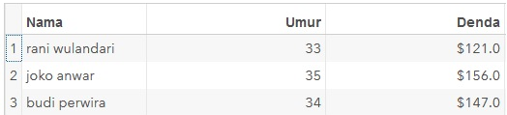
INPUT: Memasukkan data dengan In-Stream (Cont.)
Input Campuran
data inputcampuran;
input
@1 Nama $15.
@17 Umur 2.
@20 Denda dollar5.
;
format Denda dollar6.1
;
datalines;
rani wulandari 33 121
joko anwar 35 156
budi perwira 34 147
;
run;

Slide 5
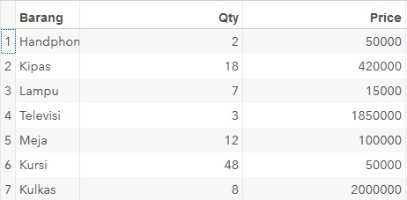
INFILE: Memasukkan data dari file NON-SAS
https://github.com/achmadsyaiful/R/blob/master/data_infile.txt
data Infile;
infile '/folders/myfolders/MDS/data_infile.txt' firstobs=1 obs=7;
input Barang $ Qty Price;
run;

Slide 6
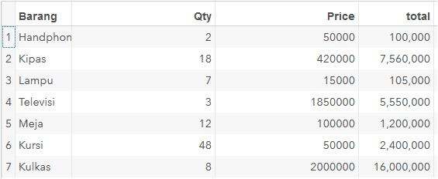
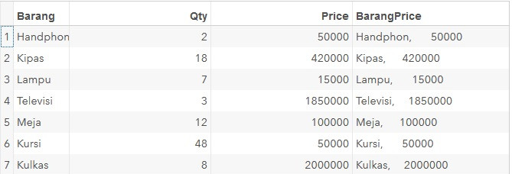
ASSIGNMENT: Peubah Baru diikuti (=) dilanjutkan Ekspresi.
Ekspresi Numerik
data EkspresiNum;
set infile;
Total=qty*price;
format total comma10.;
run;
Ekspresi String
data EkspresiString;
set infile;
BarangPrice= TRIM(Barang)||","||TRIM(price);
run;

Slide 7
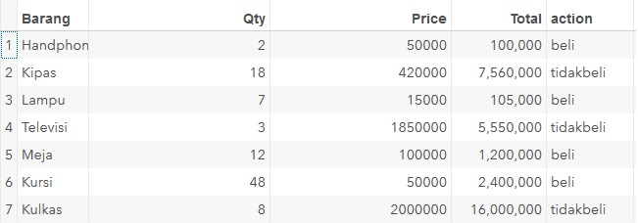
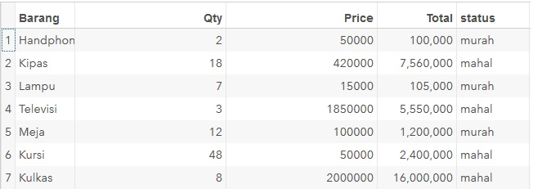
KONDISI : If – Then - Else
If-then
data ifthen;
set EkspresiNum;
length action $10.;
if price<=100000
then action='beli';
else action='tidakbeli';
run;
Beli jika
price <=100000
Do-Loop
data doloop;
set EkspresiNum;
length status $10.;
if Total<=2000000 then do
status='murah';
end;
else do
status='mahal';
end;
run;
Murah jika
Total<=2000000

Slide 8
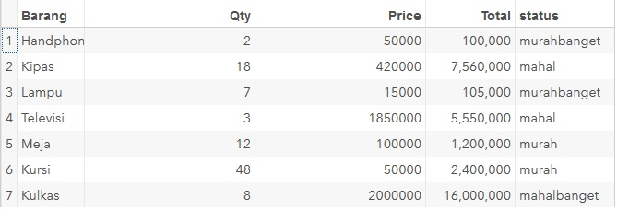
KONDISI : SYARAT BERSYARAT
Murahbaget jika total< 1000000
Murah jika total <5000000
Mahal jika total <10000000
Mahalbanget jika total >=10000000
data syaratbersyarat;
set EkspresiNum;
length status $10.;
if Total>=10000000 then status='mahalbanget';
else if Total>=5000000 then status='mahal';
else if Total>=1000000 then status='murah';
else status='murahbanget';
run;

Slide 9
Merge : Tanpa Penciri
DATA data1;
input nama $ kota $;
cards;
Ahmado Bogor
Bonita Jakarta
Hadian Bandung
;
run;
DATA data2;
INPUT tahun model $;
CARDS;
1986 corrola
1987 corrona
1988 mazda
1980 fiat
;
run;
data gabung1;
merge data1 data2;
run;

Slide 10
Merge : Tanpa Penciri (Cont.)
DATA data1;
input nama $ kota $;
cards;
Ahmado Bogor
Bonita Jakarta
Hadian Bandung
;
run;
DATA data2;
input nama $ tahun;
cards;
Bonita 1983
Hadian 1988
Rahma 1979
Kurnia 1980
;
run;
data gabung1;
merge data1 data2;
run;

Slide 11
Merge : Dengan Penciri
data kotasort;
set data1;
proc sort data=data1;
by nama;
run;
data tahunsort;
set data2;
proc sort data=data2;
by nama;
run;
data mergeby;
merge kotasort tahunsort;
by nama;
run;

Slide 12
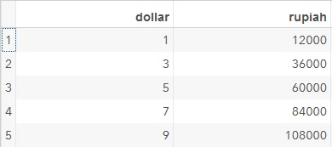
DO – LOOP: Pengerjaan proses serupa berulang-ulang dengan pengulangan tertentu.
Var1: Konstanta yang diulang
Var2: Nilai awal
Var3: Nilai akhir
Var4: Besar Penambahan
DO var1=var2 to var3 by var4;
.. END
data doloop1;
do dollar=1 to 10 by 2;
rupiah=dollar*12000;
output;
end;
run;

Slide 13
Thanks.

