Slide 1

SmartCard Lab: Final Presentation
Group 2
Martin Achtner
Ridon Arifi
Ines Ben Hmida
Maximilian Galanis
Simon Ulshöfer

Slide 2
Outline
Team B – Countermeasures
  Implemented Countermeasures
  Impact of Countermeasures
  Random Number Generation
Team A – DPA
  Improvements
  Countermeasures
  Benchmarks
Project Plan
SmartCard Lab | 03.07.2018 | Final Presentation Group 2

Slide 3
Team B – Countermeasures
Implemented Countermeasures
Impact of Countermeasures
Random Number Generation
SmartCard Lab | 03.07.2018 | Final Presentation Group 2

Slide 4
Implemented Countermeasures
Masking
Hiding
  Shuffling
  NOPs
SmartCard Lab | 03.07.2018 | Final Presentation Group 2

Slide 5
Masking
Precomputation:
Generate „input and output masks“ m, m’
Precompute masked inv. S-Box S’(x): S‘(x ⊕ m‘) = S(x) ⊕ m
Generate „transformed masks“ m1‘, m2‘, m3‘, m4‘ for inv. MixColumns
Precompute „input masks“ using inv. MC : (m1, m2, m3, m4) = inv. MC(m1’, m2’, m3’, m4’)
SmartCard Lab | 03.07.2018 | Final Presentation Group 2

Slide 6
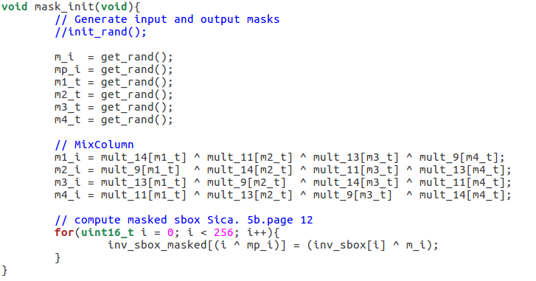
Masking
m_i → m
mp_i → m’
m1_t → m1’
...
SmartCard Lab | 03.07.2018 | Final Presentation Group 2

Slide 7
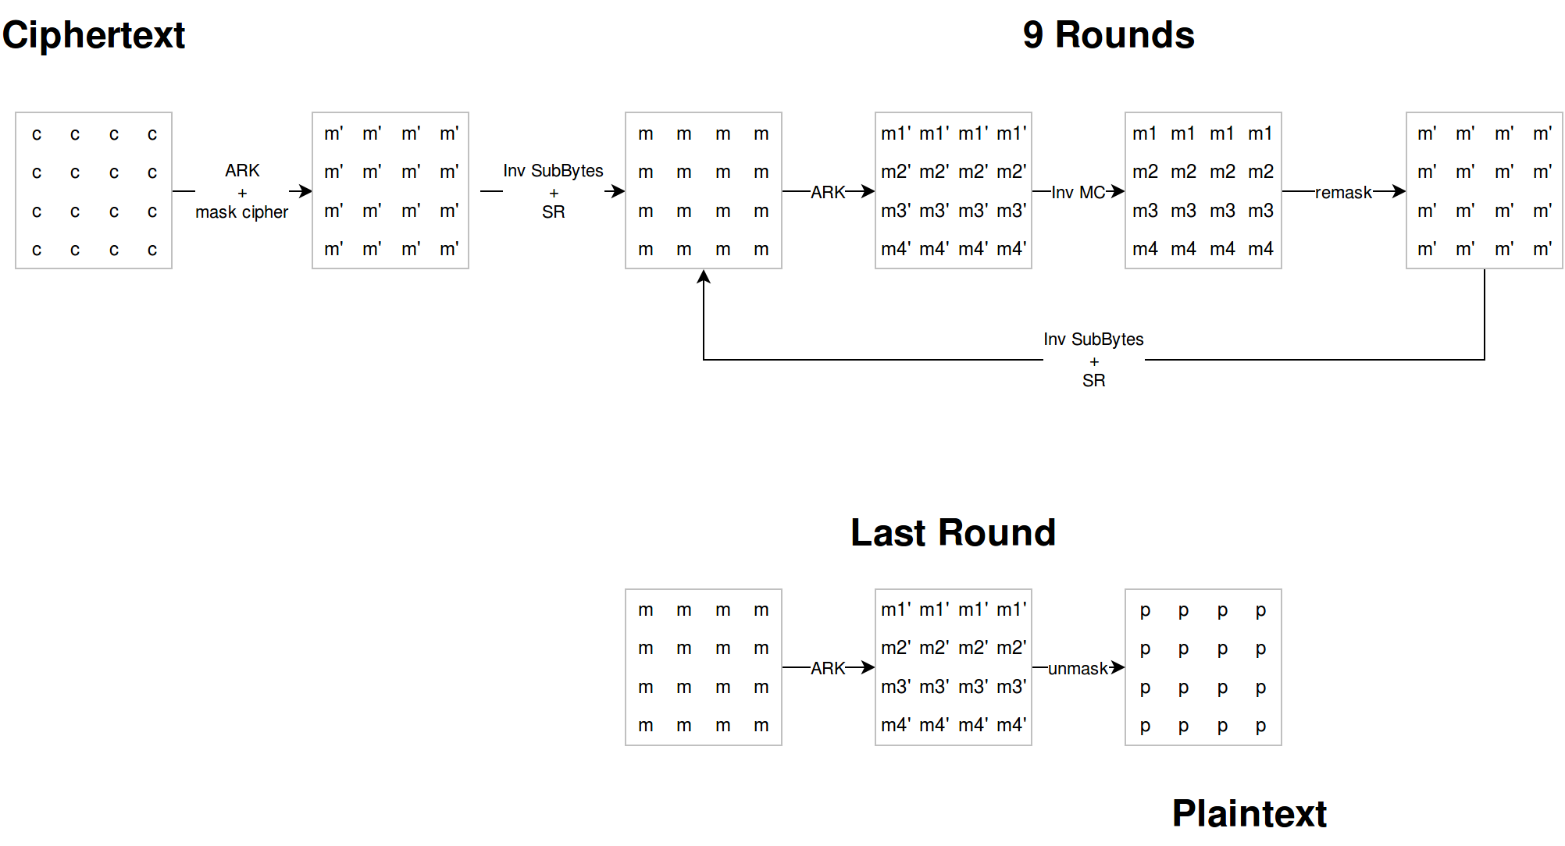
Masking
SmartCard Lab | 03.07.2018 | Final Presentation Group 2

Slide 8
Masking
SmartCard Lab | 03.07.2018 | Final Presentation Group 2

Slide 9
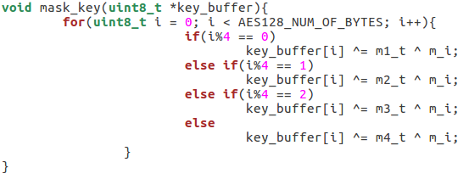
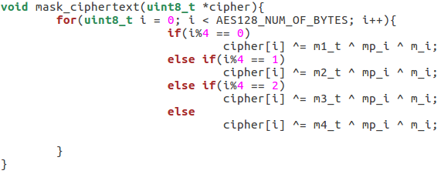
Masking
SmartCard Lab | 03.07.2018 | Final Presentation Group 2

Slide 10
Masking
SmartCard Lab | 03.07.2018 | Final Presentation Group 2

Slide 11
Masking
m_i → m
mp_i → m’
m1_t → m1’
...
SmartCard Lab | 03.07.2018 | Final Presentation Group 2

Slide 12
Masking
SmartCard Lab | 03.07.2018 | Final Presentation Group 2

Slide 13
Masking
(m1, …, m4) = MC(m1’, …, m4’)
SmartCard Lab | 03.07.2018 | Final Presentation Group 2

Slide 14
Masking
SmartCard Lab | 03.07.2018 | Final Presentation Group 2

Slide 15
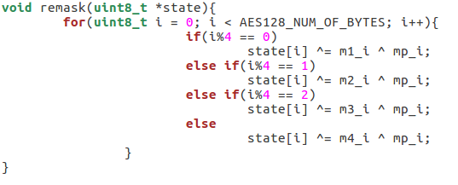
Masking
SmartCard Lab | 03.07.2018 | Final Presentation Group 2

Slide 16
Masking
SmartCard Lab | 03.07.2018 | Final Presentation Group 2

Slide 17
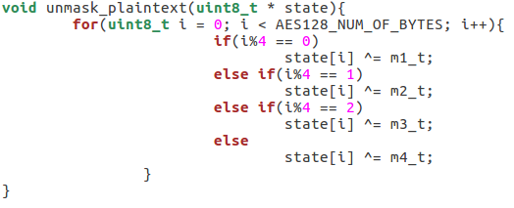
Masking
SmartCard Lab | 03.07.2018 | Final Presentation Group 2

Slide 18
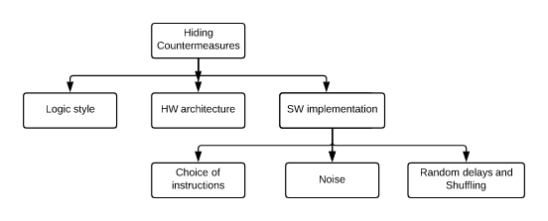
Implemented Countermeasures
Hiding power consumption
Principle: Altering the power consumption of the Smartcard

Slide 19
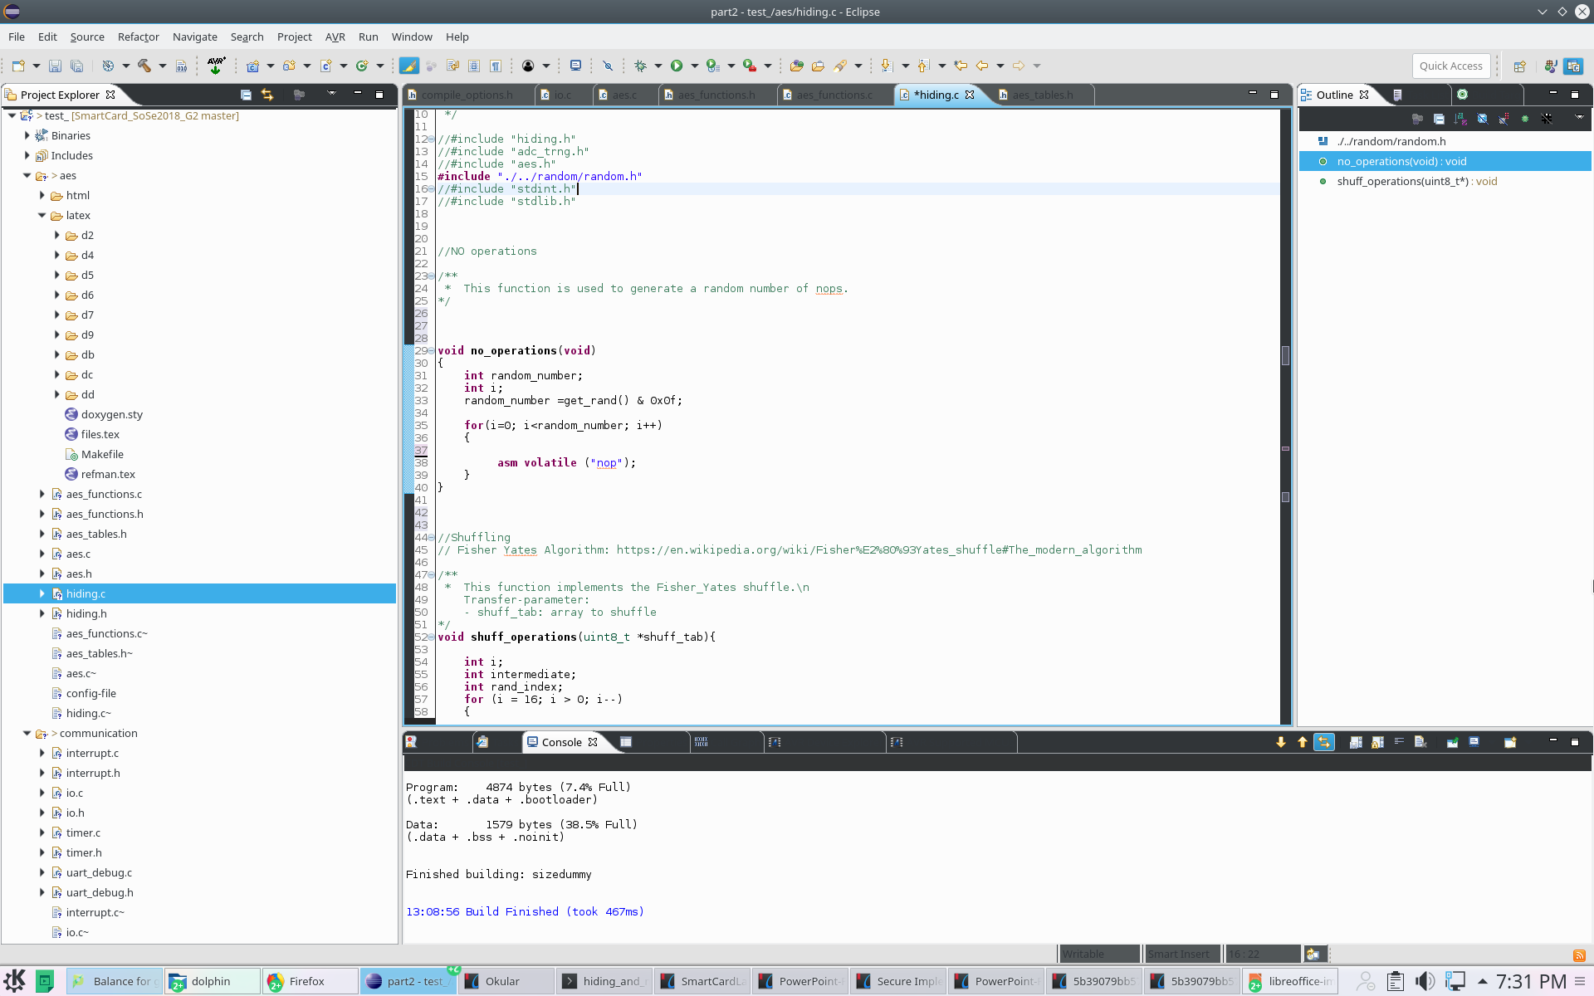
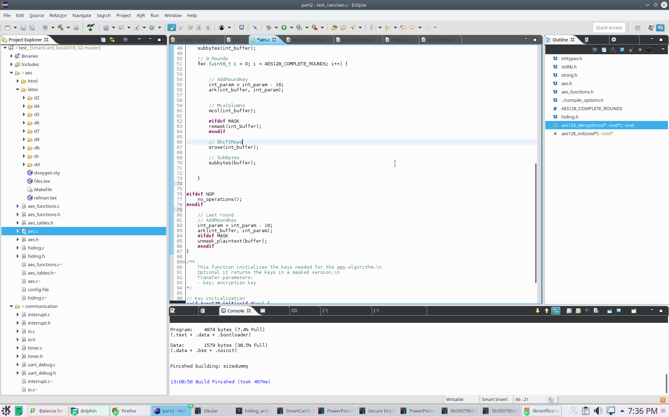
Implemented Countermeasures
NOPs
Principle: Inserting a random number of No operations → Random delays
Implementation: assembly no operations instruction implemented before last round of AES

Slide 20
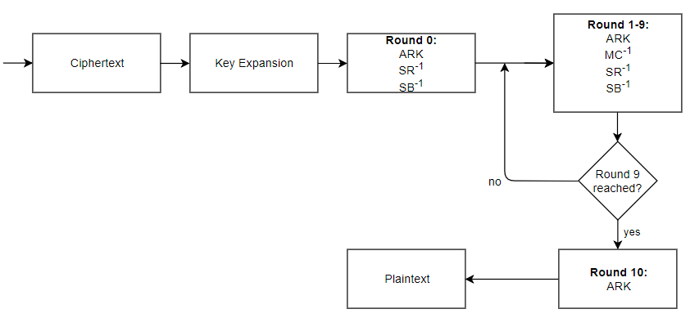
Implemented Countermeasures
NOPs
NOPs

Slide 21
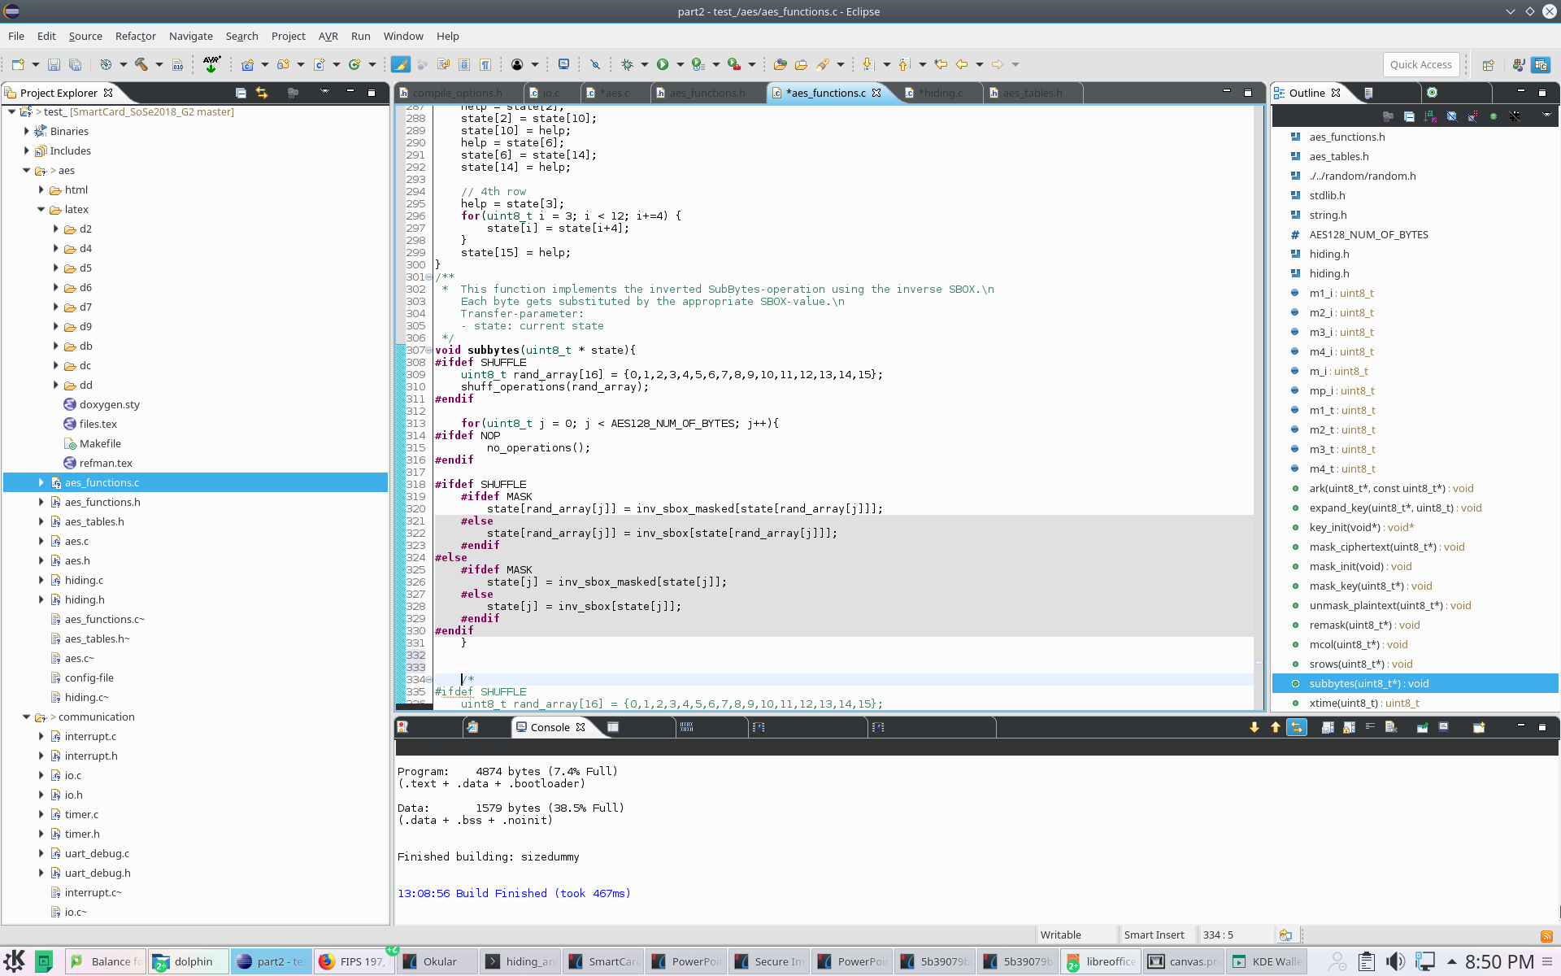
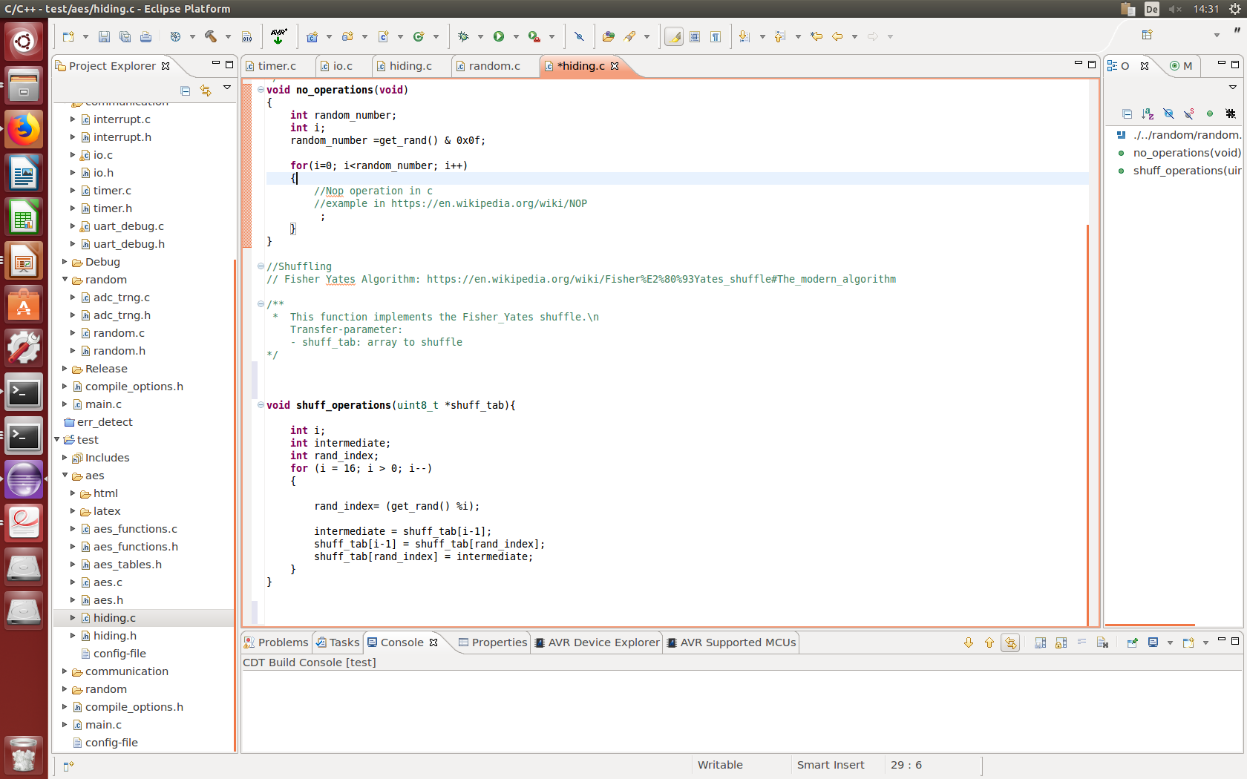
Implemented Countermeasures
Shuffling
Principle: Randomly change the sequence of operations performed in arbitrary order.
Implementation: Fisher-Yates Shuffle algorithm within subbytes table lookups.

Slide 22
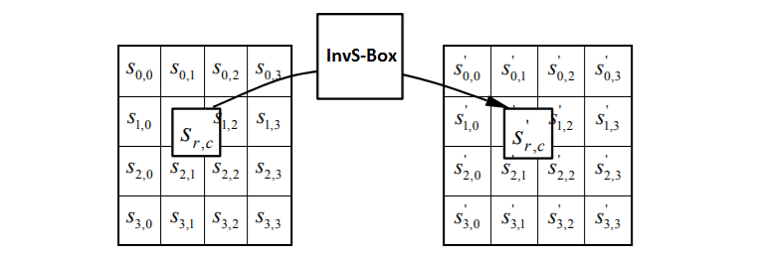
Implemented Countermeasures
Shuffling implemented in the subbytes function
Ordered Lookups from 0 to 15
Randomly Mixed Order Lookups
→ new level of randomization for every subbytes round

Slide 23
Implemented Countermeasures
About the effectiveness of Hiding Countermeasures
Advantages | Disadvantages
Generic Throughput unchanged with Shuffling Correlation linearly reduced → quadratic increase of the number of needed measurements for the attacker | If windowing by the attacker → linear increase of effort Alignment of power traces could remove the countermeasures

Slide 24
Impact of countermeasures

Slide 25
Impact of countermeasures

Slide 26
Random Number Generation
True RNG
  Implementation
  Statistical Tests
Pseudo RNG
  Implementation
  Statistical Tests

Slide 27
TRNG – Source
LSB of ADC is influenced by noise
Use multiple LSBs to generate a random byte
Use one or more of those random bytes as seed for PRNG

Slide 28
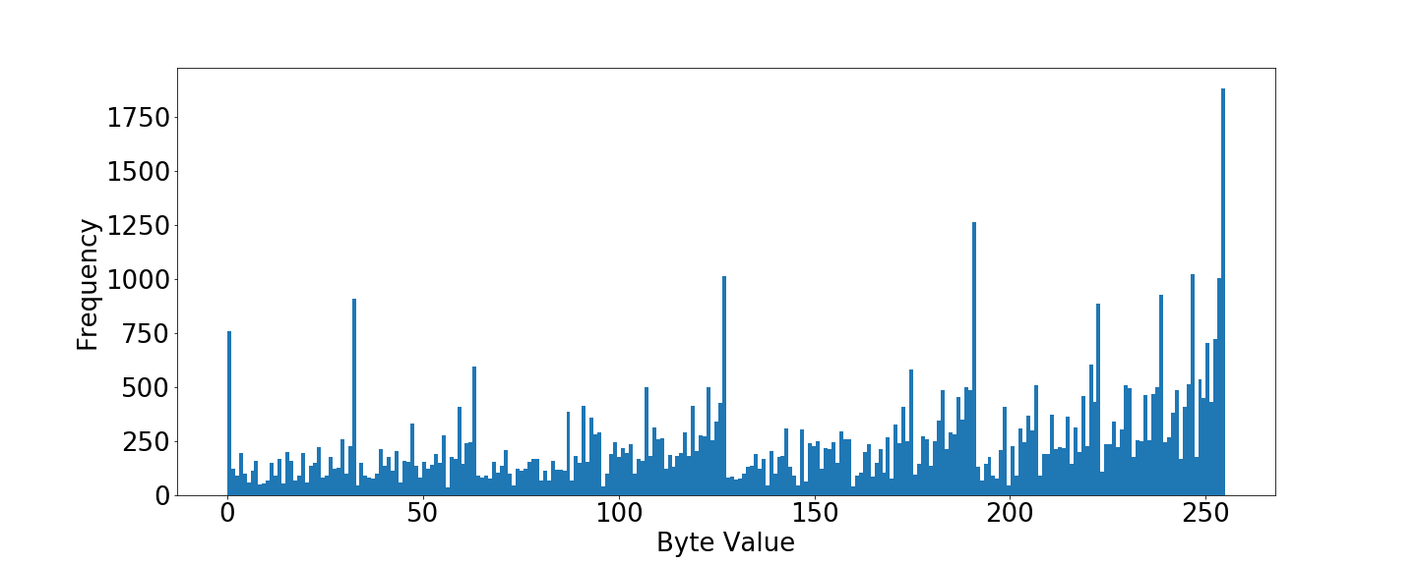
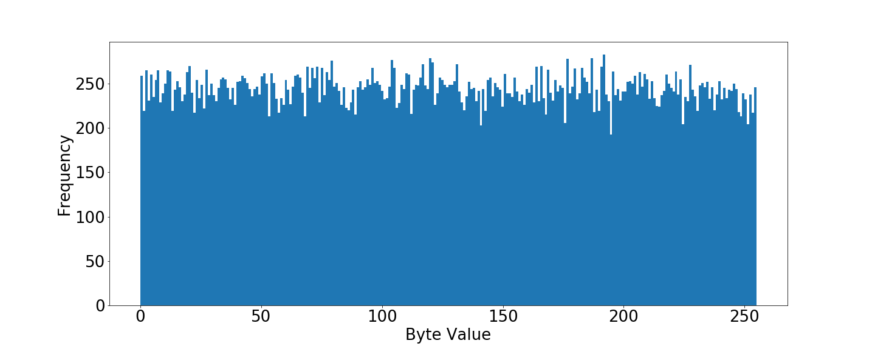
TRNG – Distribution
Using LSB directly
With Von-Neumann Correction

Slide 29
TRNG – Tests
Generated 500.000 Bits and send them to PC via UART
Applied NIST Test Suite with 1, 10 and 20 streams on the file
All tests passed
Entropy: 7.9969 bits per byte (Tested with program “ent”)

Slide 30
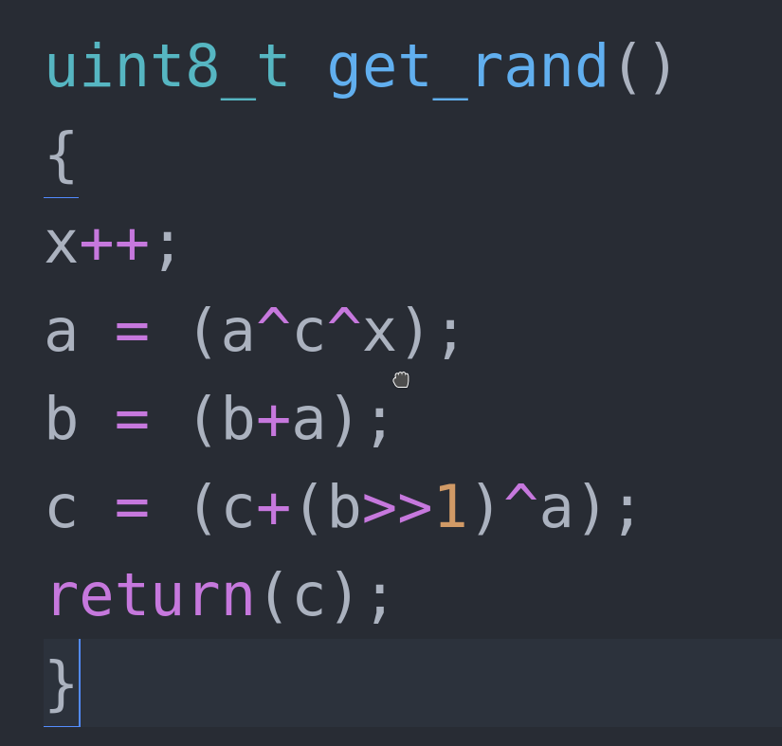
PRNG – Source Code
Three seeds required
Fast and easy algorithm
Used for Shuffling, NOPs and masks

Slide 31
PRNG – Statistics
Created 1 million bits
Tested with 1, 10 and 20 streams
All tests passed, results of similiar quality as reference RNG (Blum-Blum-Shub)
Entropy: 7.9985 bits per byte (Tested with program “ent”)

Slide 32
Team A – DPA
Improvements
Countermeasures
Benchmarks
SmartCard Lab | 03.07.2018 | Final Presentation Group 2

Slide 33
Speed Improvements
Massive speed improvements by getting rid of for loops
    Replace them by using vector operations
Trace compression

Slide 34
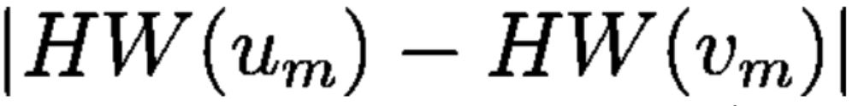

Higher-Order DPA
Problem: Power consumption does not depend on unmasked intermediate values anymore
Solution: Combine values in the power trace →
  Idea:
  New hypothesis:
Practical problems:
  quadratic effort in preprocessing
  Huge amount of traces and samples
SmartCard Lab | 03.07.2018 | Final Presentation Group 2

Slide 35
Memory Management
Problems:
  File alone barely fits into memory
  Even more memory needed during correlation
Solution:
  Load small amount of samples from the file into memory (~1000)
  Correlate on the segment → Save key hypothesis with highest correlation for every key byte
  Repeat 2. until all samples have been processed
  Extract key hypothesis for every byte with highest correlation from all segments
Performance:
  50000 samples in ~ 23 min on ULV CPU
  Memory usage of ~ 500 MB
SmartCard Lab | 03.07.2018 | Final Presentation Group 2

Slide 36
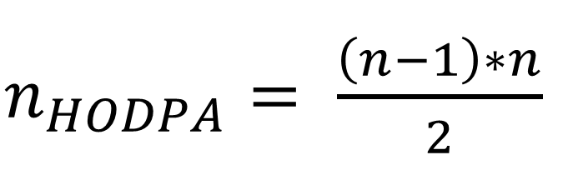

Preprocessing
First: calculation new number of samples
Check results by applying Second-Order DPA on unprotected smart card
-> decreases correlation, but still works

Slide 37
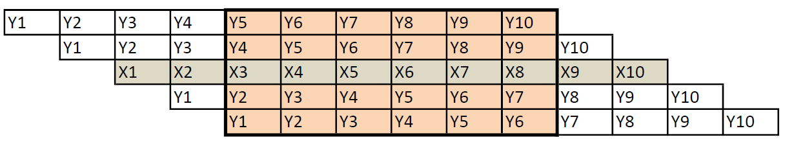
Trace alignment
X-Values = comparison trace (first trace)
Y-Values = trace
Choose the shift in percent (should be about 100 samples)
Find lowest absolute difference of all shifts
Less samples after trace alignment

Slide 38
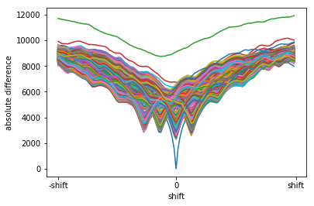
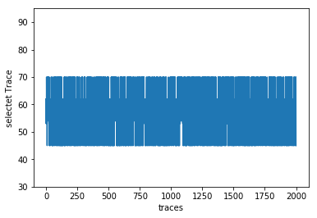
Trace alignment
Best correlation 3 nops
Selected trace 3 nops
Absolute difference for 3 nops
t(total) = 80,306s
Mostly discreet jumps

Slide 39
Benchmarks: no decryption
Best correlation (~ 0,5):
- Traces = 400 (given), Samples = 0 – 62500, compression = 25:1
→ 1000000 Samples
- T(total) = 0,609s, T(DPA) = 0,449s
Least traces:
- Traces = 157, Samples = 10000 – 55000, compression = 25:1
→ 282600 Samples
- T(total) = 0,278s, T(DPA) = 0,232s
Least time:
- Traces = 380, Samples = 32000– 53000, compression = 500:1
→ 15960 Samples
- T(total) = 0,077s, T(DPA) = 0,030s

Slide 40
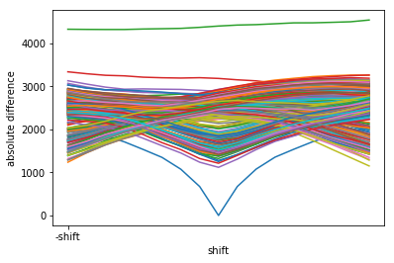
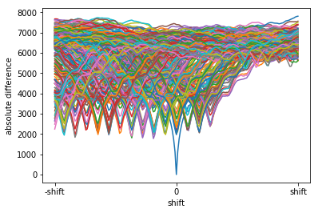
Benchmarks: Hiding
Least time for 3 nops
Least time for 15 nops
t(total) = 1,312s , t(DPA) = 0,176s
Traces = 280, alignment = 0,015%
Samples = 28000 – 55000
t(total) = 11,788s, t(DPA) = 0,269s
Traces =270, alignment = 0,09%
Samples = 0 - 50000

Slide 41
Benchmarks: Shuffling
We broke the first version of shuffling very easily
Second implementation needed more tinkering:
Traces = 10000, Samples 100000 – 118900, compression = 27:1
Trace alignment and running mean (100)
T(total) =51,426s, T(DPA)=1,846s

Slide 42
Benchmarks: Masking
Second-Order DPA works on unprotected implementation
- Traces = 180, Samples = 12000 – 50000, reduction = 100
- T(total) = 1,920s
Second-Order DPA on masking fails
- Traces = 10000, Samples = 0 – 62500, reduction = 25
- T(total) = ~6 min

Slide 43
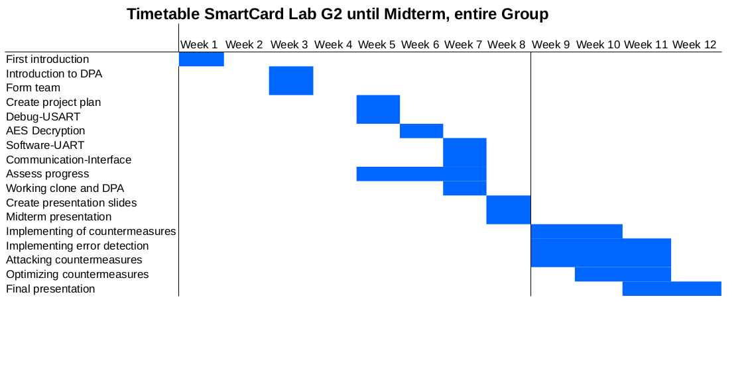
Project Plan

Slide 44
Thank you for your attention!

