Slide 1

SmartCard Lab: Final Presentation
Group 2
Martin Achtner
Ridon Arifi
Ines Ben Hmida
Maximilian Galanis
Simon Ulshöfer

Slide 2
Outline
Team B – Countermeasures
  Implemented Countermeasures
  Impact of Countermeasures
  Random Number Generation
Team A – DPA
  Improvements
  countermeasures
  benchmarks
Project Plan
SmartCard Lab | 03.07.2018 | Final Presentation Group 2

Slide 3
Team B – Countermeasures
Implemented Countermeasures
Impact of Countermeasures
Random Number Generation
SmartCard Lab | 03.07.2018 | Final Presentation Group 2

Slide 4
Implemented Countermeasures
Masking
Hiding
  Shuffling
  NOPs
SmartCard Lab | 03.07.2018 | Final Presentation Group 2

Slide 5
Masking
Precomputation:
Generate „input and output masks“ m, m’ → (m_i, mp_i)
Precompute masked inv. S-Box S’(x): S‘(x ⊕ m‘) = S(x) ⊕ m
Generate „transformed masks“ m1‘, m2‘, m3‘, m4‘ for inv. MixColumns
Precompute „input masks“ using inv. MC : (m1, m2, m3, m4) = inv. MC(m1’, m2’, m3’, m4’)
SmartCard Lab | 03.07.2018 | Final Presentation Group 2

Slide 6
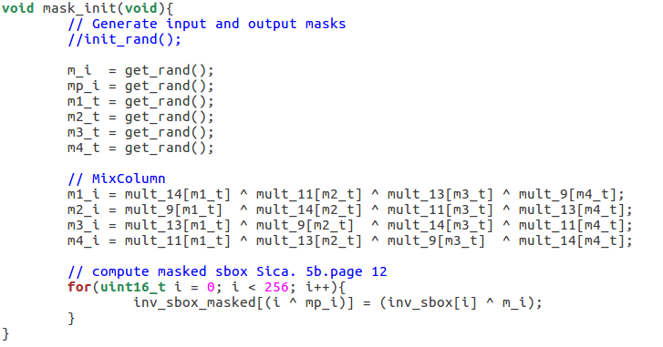
Masking
m_i → m
mp_i → m’
m1_t → m1’
...
SmartCard Lab | 03.07.2018 | Final Presentation Group 2

Slide 7
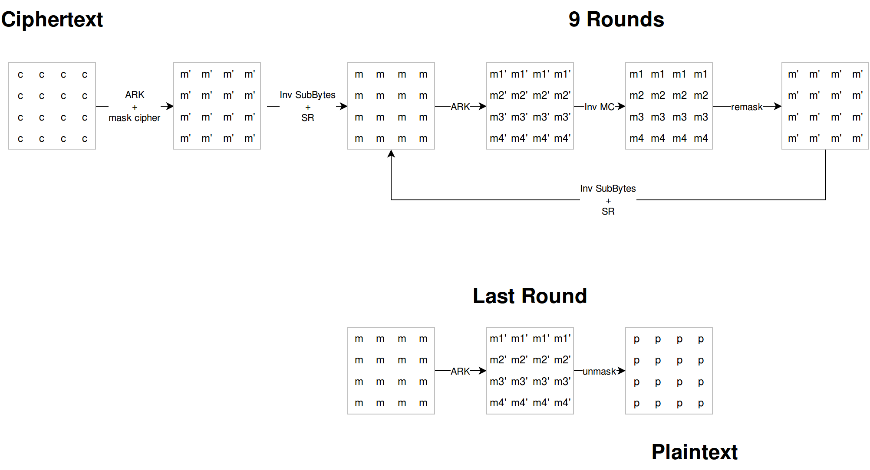
Masking
SmartCard Lab | 03.07.2018 | Final Presentation Group 2

Slide 8
Masking
SmartCard Lab | 03.07.2018 | Final Presentation Group 2

Slide 9
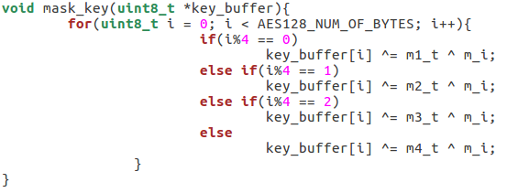
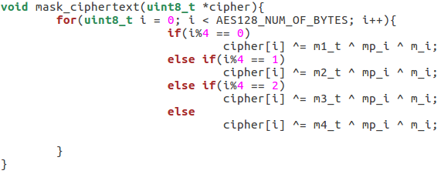
Masking
SmartCard Lab | 03.07.2018 | Final Presentation Group 2

Slide 10
Masking
SmartCard Lab | 03.07.2018 | Final Presentation Group 2

Slide 11
Masking
m_i → m
mp_i → m’
m1_t → m1’
...
SmartCard Lab | 03.07.2018 | Final Presentation Group 2

Slide 12
Masking
SmartCard Lab | 03.07.2018 | Final Presentation Group 2

Slide 13
Masking
(m1, …, m4) = MC(m1’, …, m4’)
SmartCard Lab | 03.07.2018 | Final Presentation Group 2

Slide 14
Masking
SmartCard Lab | 03.07.2018 | Final Presentation Group 2

Slide 15
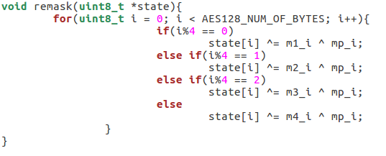
Masking
SmartCard Lab | 03.07.2018 | Final Presentation Group 2

Slide 16
Masking
SmartCard Lab | 03.07.2018 | Final Presentation Group 2

Slide 17
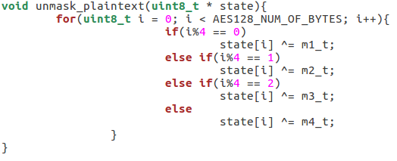
Masking
SmartCard Lab | 03.07.2018 | Final Presentation Group 2

Slide 18
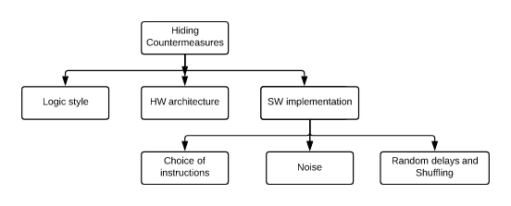
Implemented Countermeasures
Hiding power consumption
Principle: Altering the power consumption of the Smartcard

Slide 19
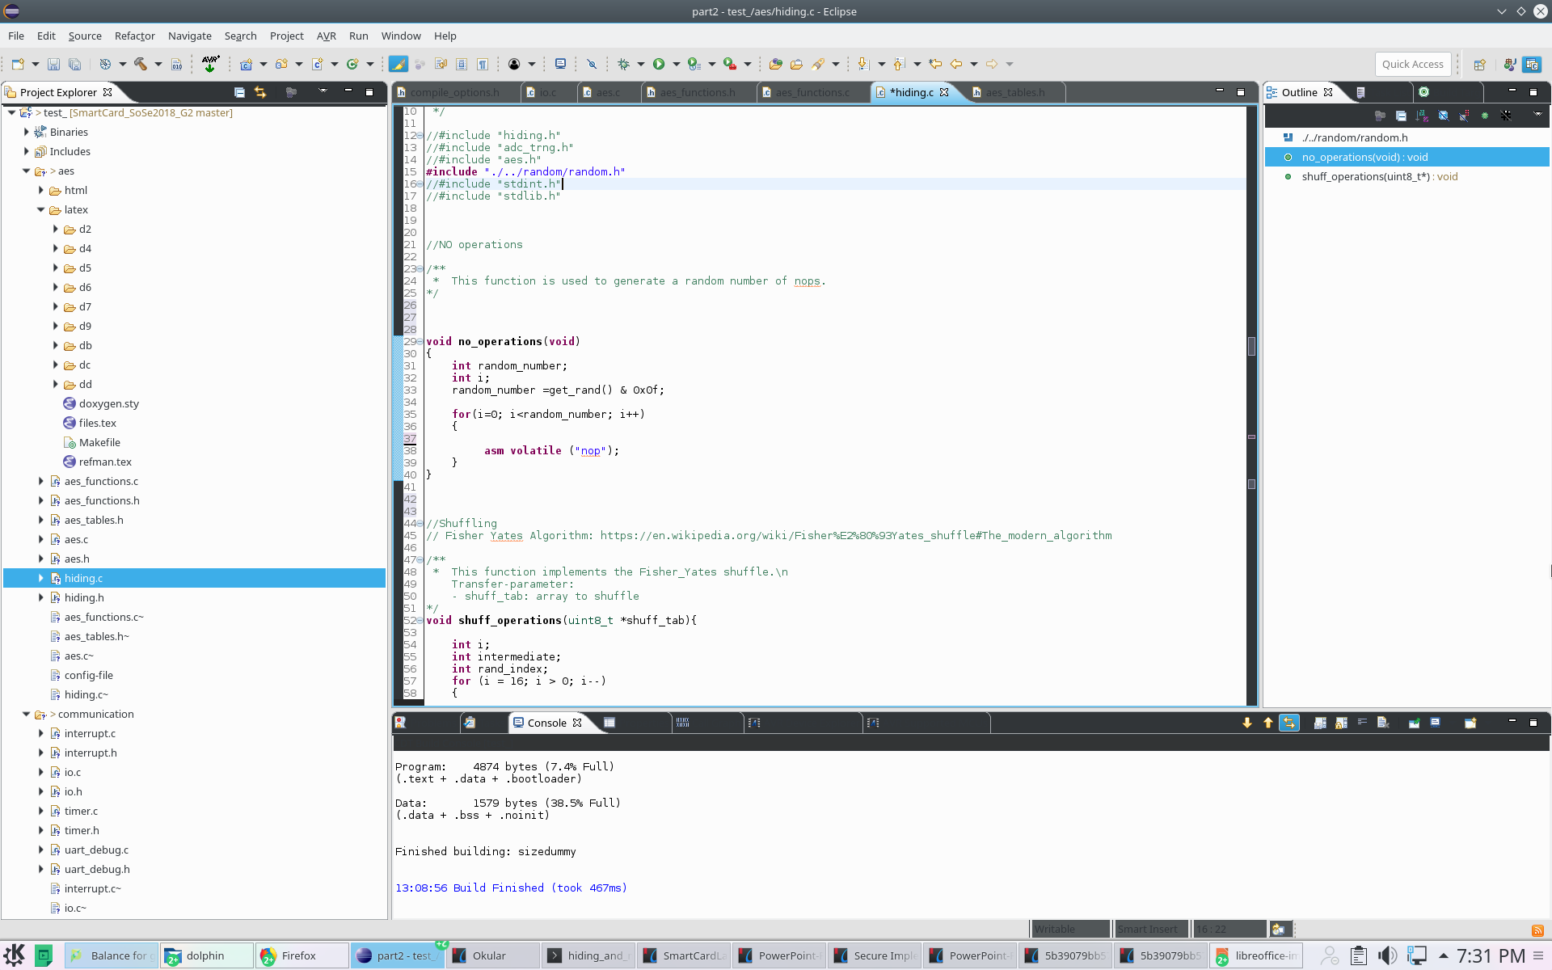
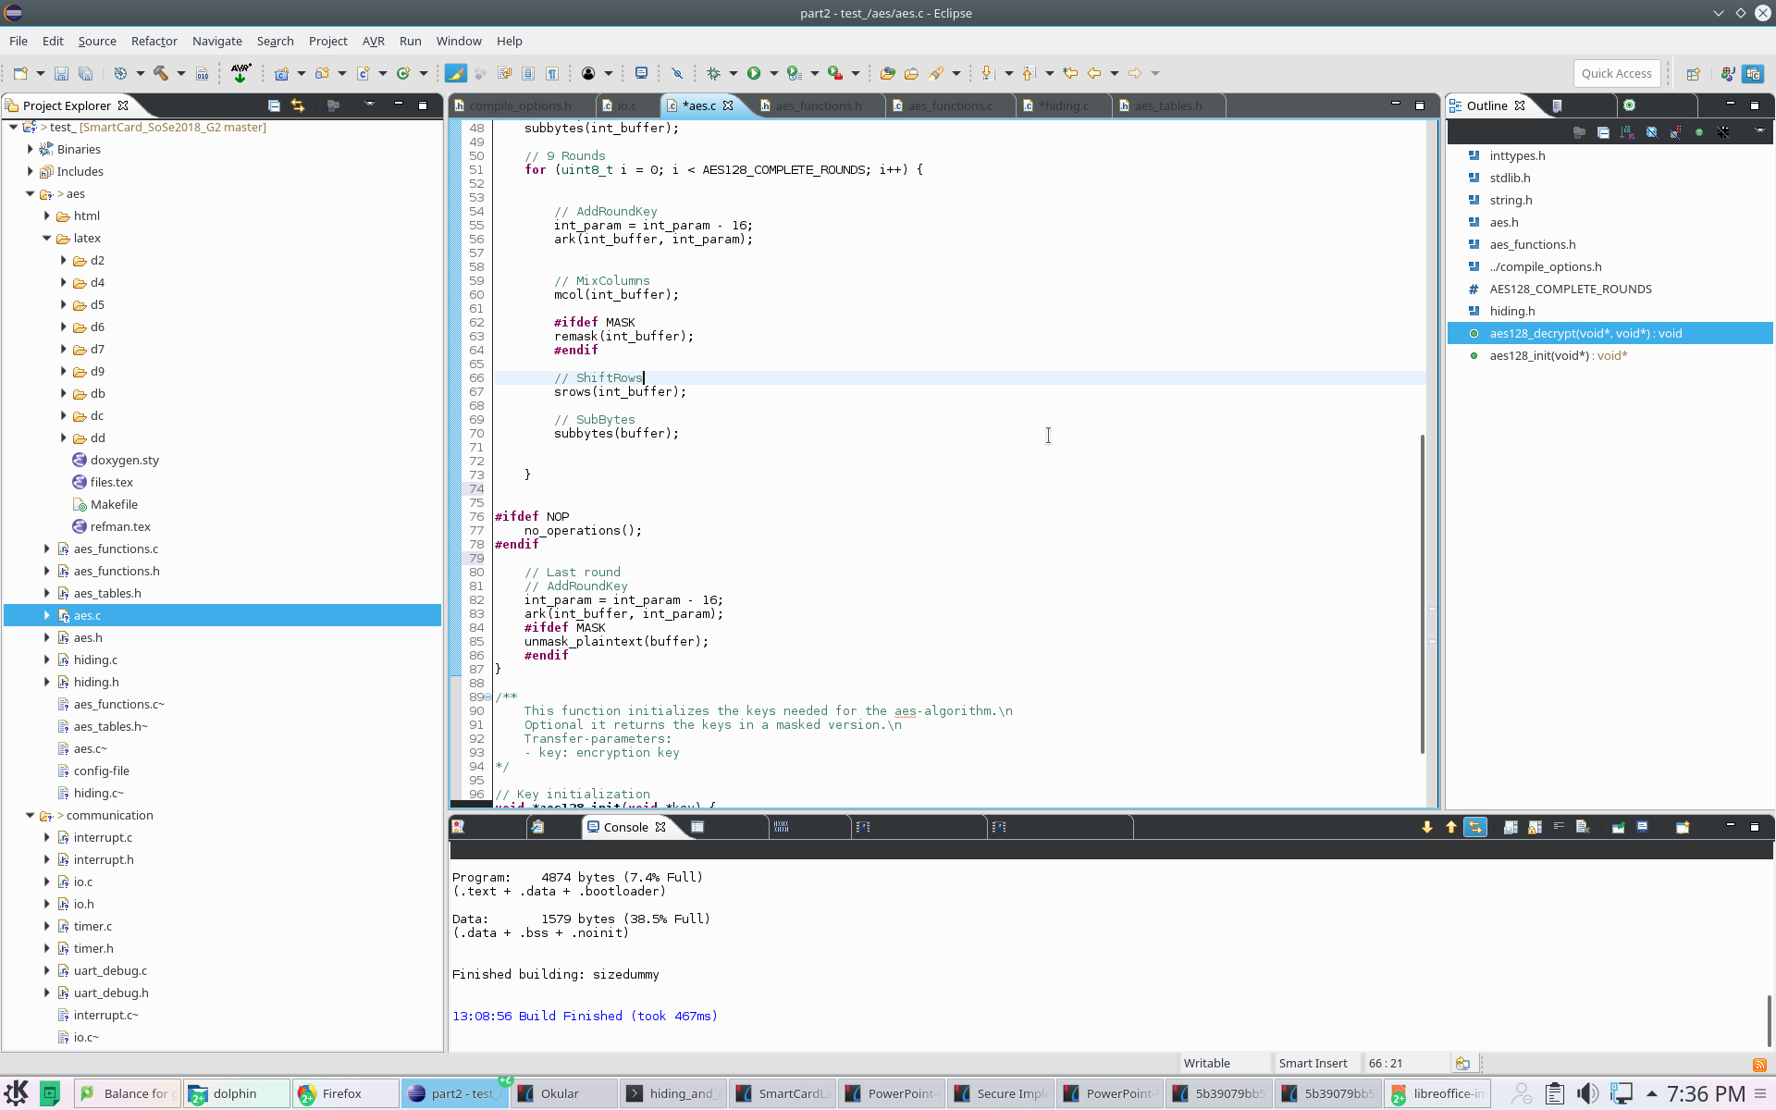
Implemented Countermeasures
NOPs
Principle: Inserting a random number of No operations => Random delays
Implementation: assembly no operations instruction implemented before last round of DES

Slide 20
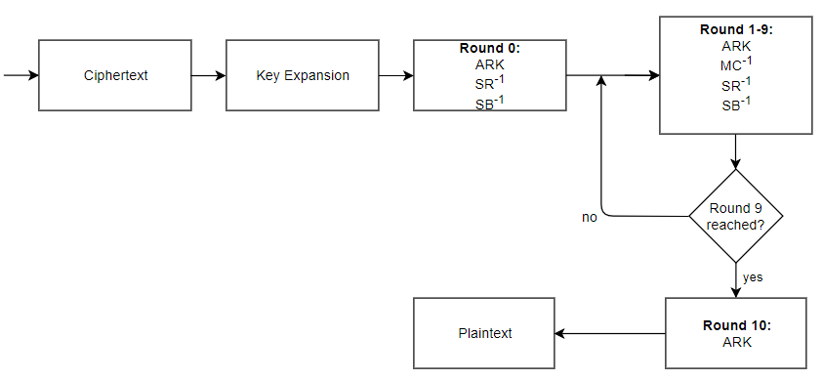
Implemented Countermeasures
NOPs
NOPs

Slide 21
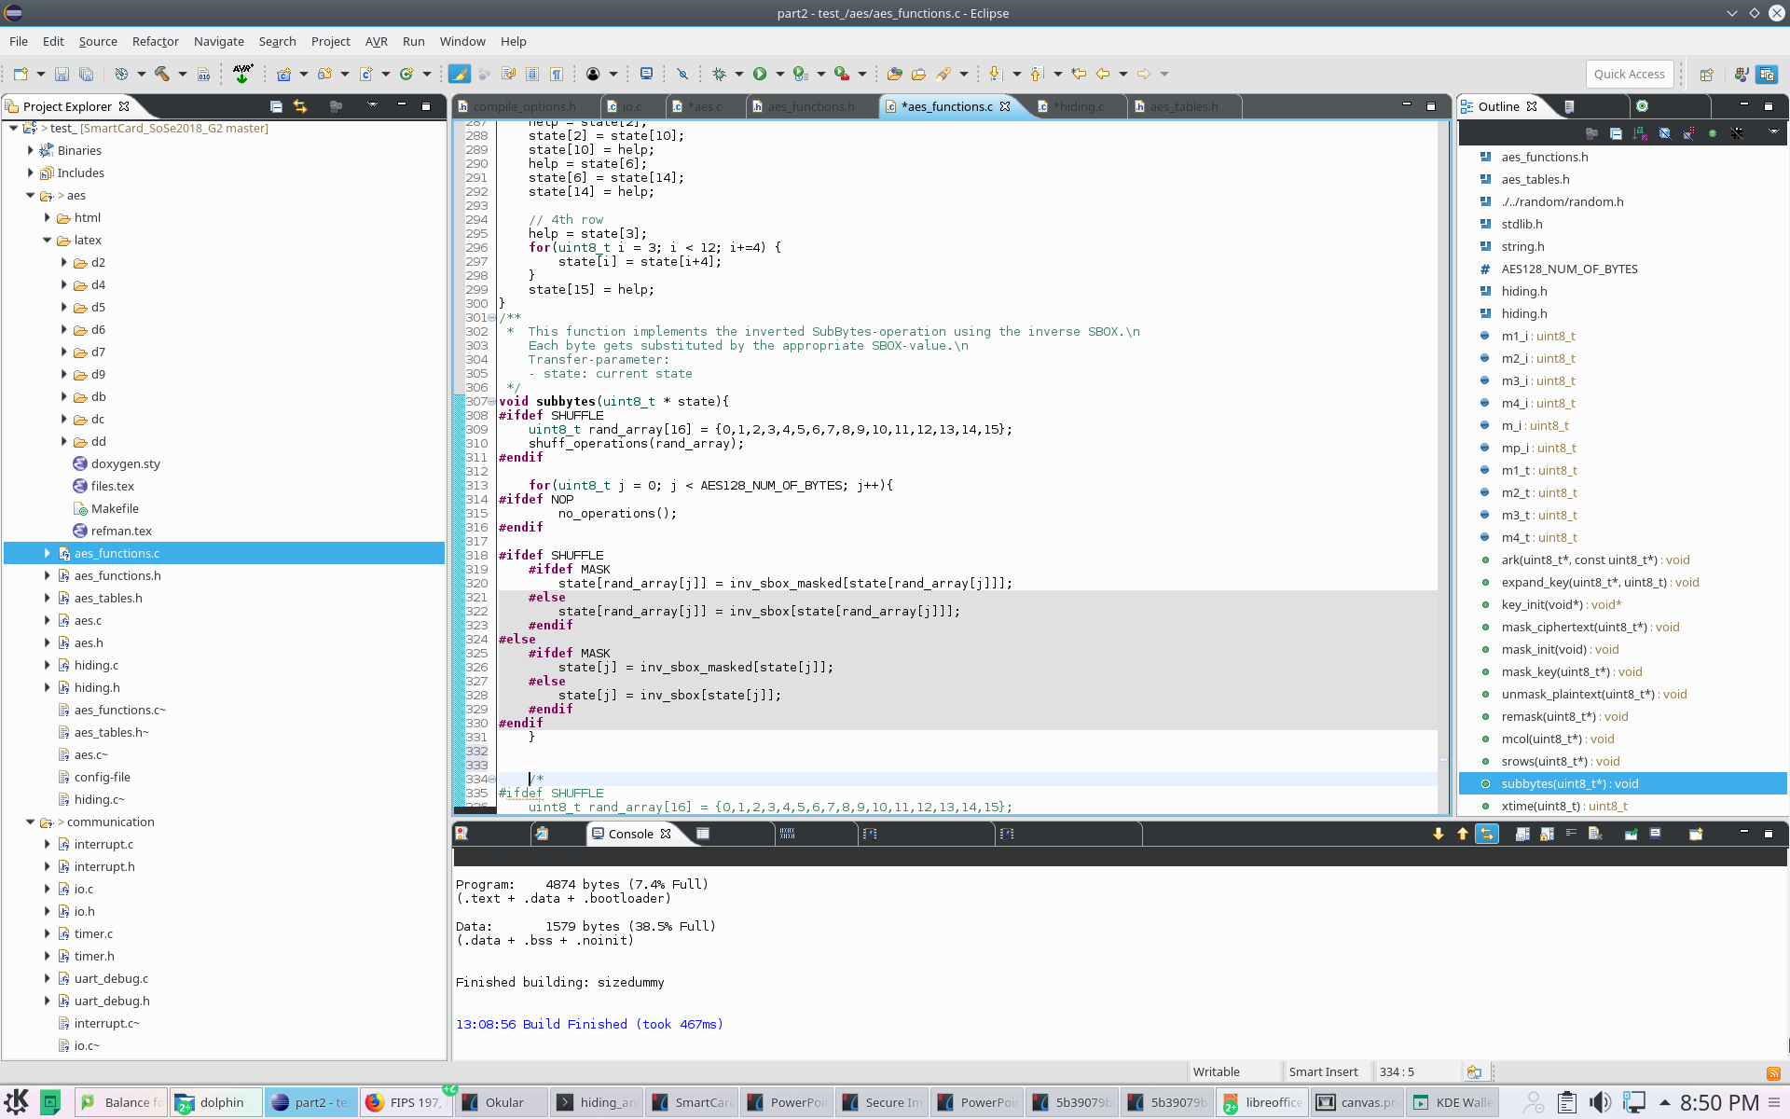
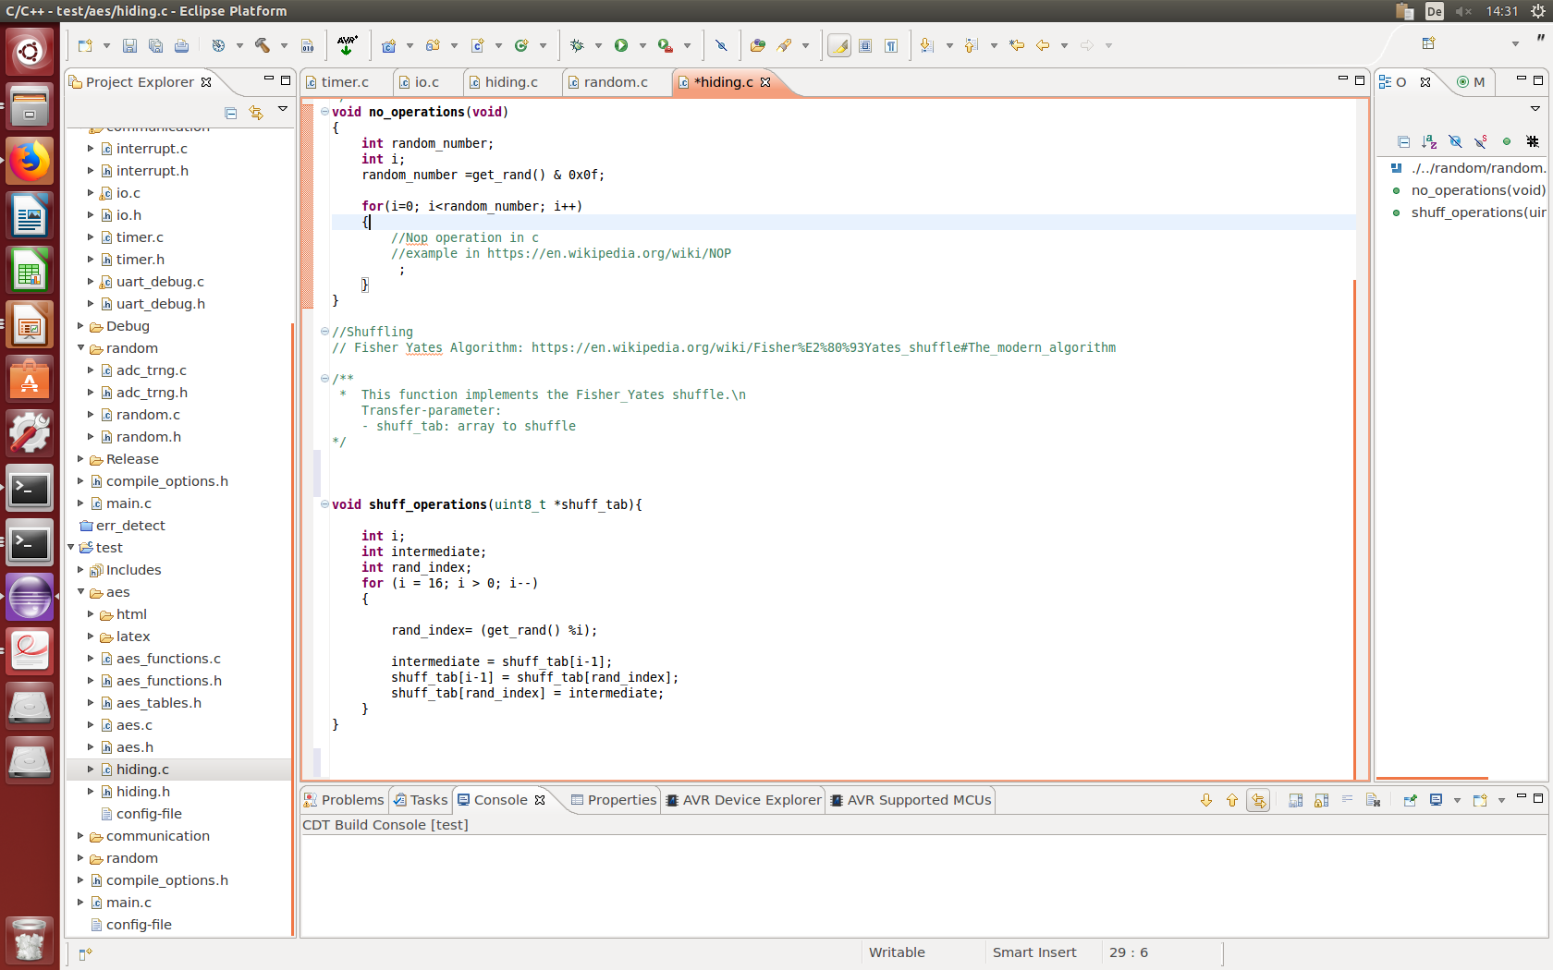
Implemented Countermeasures
Shuffling
Principle: Randomly change the sequence of operations performed in arbitrary order.
Implementation: Fisher-Yates Shuffle algorithm within subbytes table lookups.

Slide 22
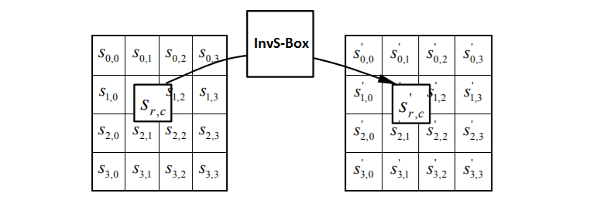
Implemented Countermeasures
Shuffling implemented in the subbytes function
Ordered Lookups from 0 to 16
Randomly Mixed Order Lookups
=> new level of randomization for every subbytes round

Slide 23
Implemented Countermeasures
About the effectiveness of Hiding Countermeasures
Advantages | Disadvantages
Generic Throughput unchanged with Shuffling Correlation linearly reduced => quadratic increase of the number of needed measurements for the attacker | If windowing by the attacker => linear increase of effort Alignement of power traces could remove the countermeasures

Slide 24
Impact of countermeasures

Slide 25
Random Number Generation
True RNG
  Implementation
  Statistical Tests
Pseudo RNG
  Implementation
  Statistical Tests

Slide 26
TRNG – Source
LSB of ADC is influenced by noise
Use multiple LSBs to generate a random byte
Use one or more of those random bytes as seed for PRNG

Slide 27
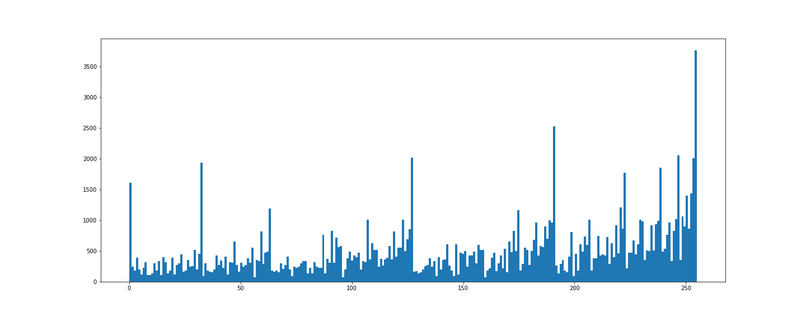
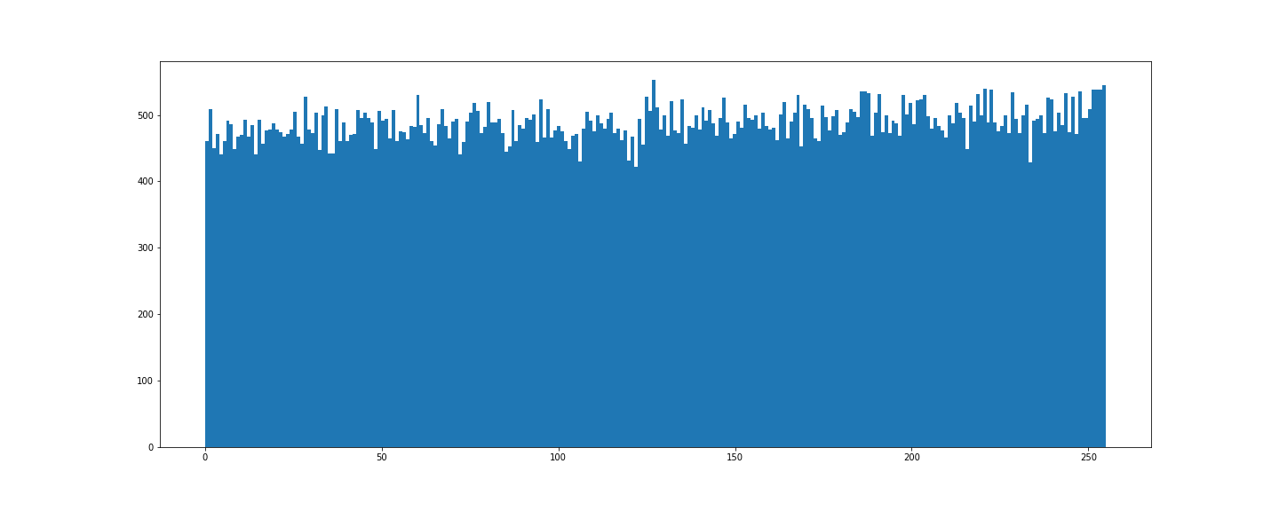
TRNG – Distribution
Using LSB directly
With Von-Neumann Correction

Slide 28
TRNG – Tests
Generated 125.000 Bytes and send them to PC via UART
Applied NIST Test Suite with 1, 10 and 20 streams on the file

Slide 29
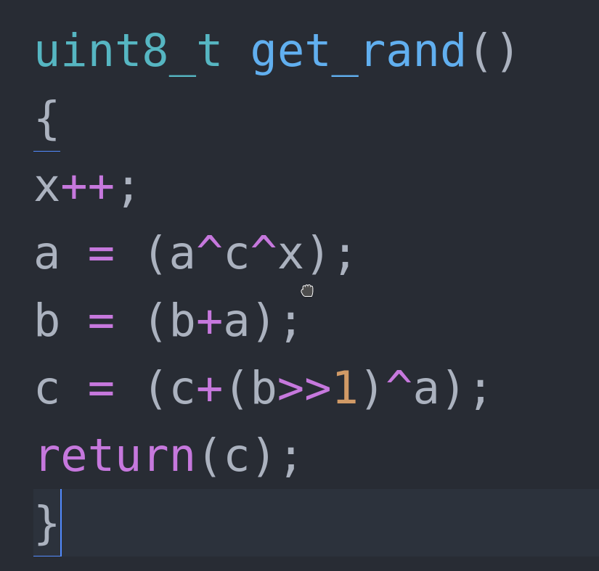
PRNG – Source Code
Three seeds required

Slide 30
PRNG – Statistics
Created 1 million bits
Tested with 1, 10 and 20 streams
All tests passed, results of similiar quality as reference RNG

