Slide 1

SmartCard Lab: Final Presentation
Group 2
Martin Achtner
Ridon Arifi
Ines Ben Hmida
Maximilian Galanis
Simon Ulshöfer

Slide 2
Outline
Team B – Countermeasures
  Implemented Countermeasures
  Impact of Countermeasures
  Random Number Generation
Team A – DPA
Project Plan

Slide 3
Team B – Countermeasures
Implemented Countermeasures
Impact of Countermeasures
Random Number Generation

Slide 4
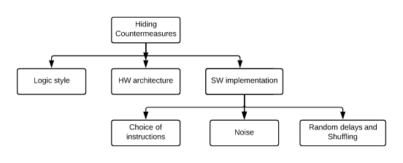
Implemented Countermeasures
Hiding power consumption
Principle: Altering the power consumption of the Smartcard

Slide 5
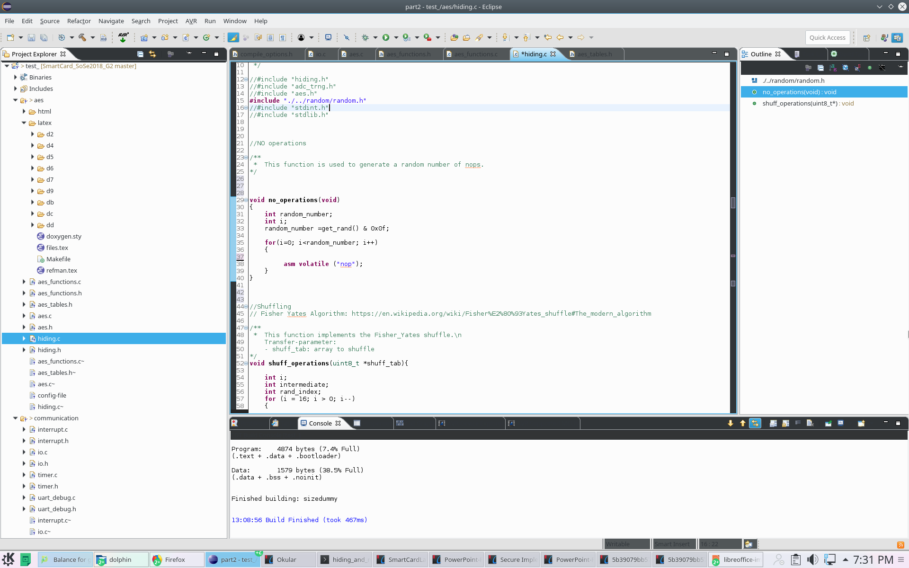
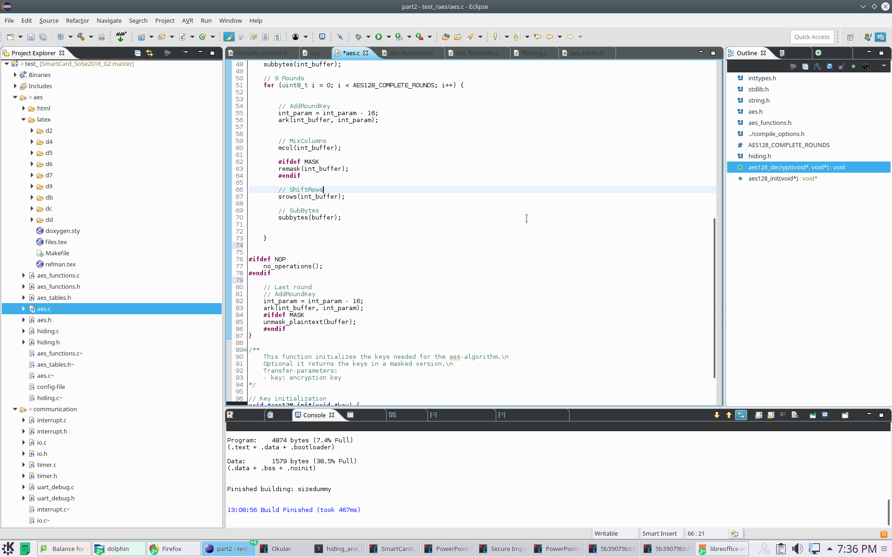
Implemented Countermeasures
NOPs
Principle: Inserting a random number of No operations => Random delays
Implementation: assembly no operations instruction implemented before last round of DES

Slide 6
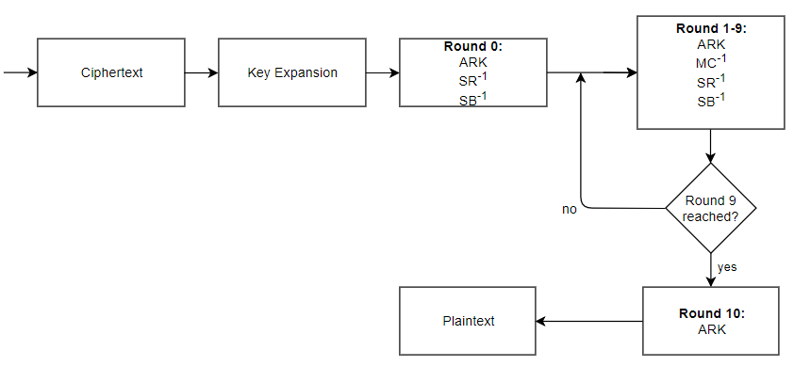
Implemented Countermeasures
NOPs
NOPs

Slide 7
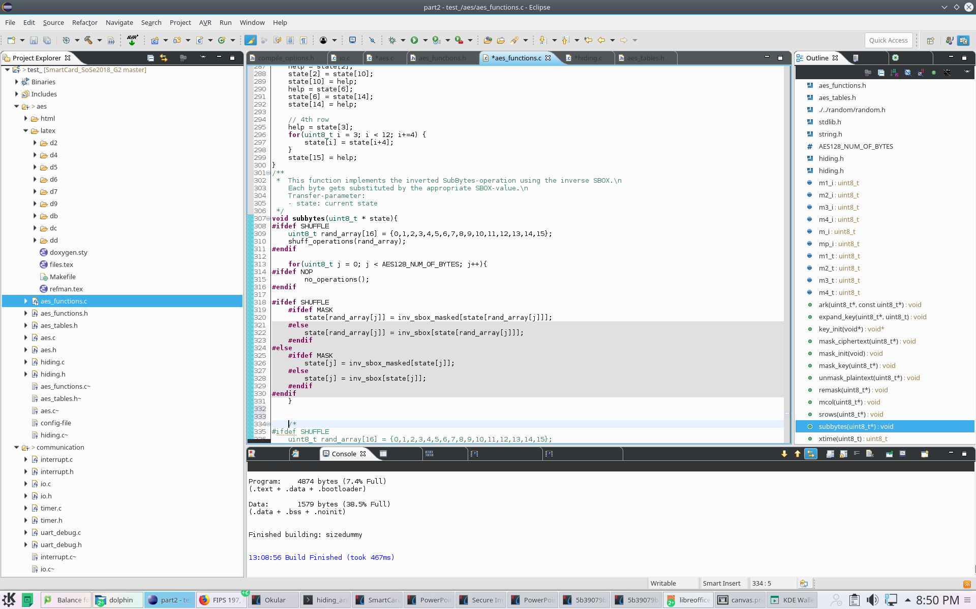
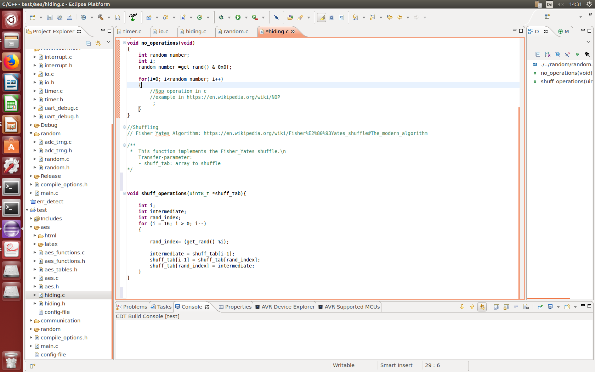
Implemented Countermeasures
Shuffling
Principle: Randomly change the sequence of operations performed in arbitrary order.
Implementation: Fisher-Yates Shuffle algorithm within subbytes table lookups.

Slide 8
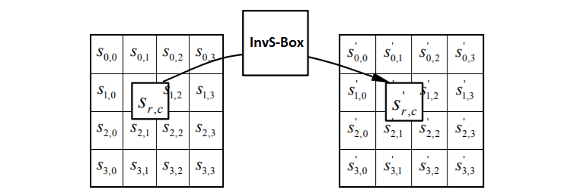
Implemented Countermeasures
Shuffling implemented in the subbytes function
Ordered Lookups from 0 to 16
Randomly Mixed Order Lookups
=> new level of randomization for every subbytes round

Slide 9
Implemented Countermeasures
About the effectiveness of Hiding Countermeasures
Advantages | Disadvantages
Generic Throughput unchanged with Shuffling Correlation linearly reduced => quadratic increase of the number of needed measurements for the attacker | If windowing by the attacker => linear increase of effort Alignement of power traces could remove the countermeasures

Slide 10
Impact of countermeasures

