Slide 1

SmartCard Lab: Final Presentation
Group 2
Martin Achtner
Ridon Arifi
Ines Ben Hmida
Maximilian Galanis
Simon Ulshöfer

Slide 2
Outline
Team B – Countermeasures
  Implemented Countermeasures
  Impact of Countermeasures
  Random Number Generation
Team A – DPA
Project Plan

Slide 3
Team B – Countermeasures
Implemented Countermeasures
Impact of Countermeasures
Random Number Generation

Slide 4
Implemented Countermeasures
Masking
Hiding
  Shuffling
  NOPs

Slide 5
Impact of Countermeasures
Code Size
Run Time

Slide 6
Random Number Generation
True RNG
  Implementation
  Statistical Tests
Pseudo RNG
  Implementation
  Statistical Tests

Slide 7
TRNG – Source
LSB of ADC is influenced by noise
Use multiple LSBs to generate a random byte
Use one or more of those random bytes as seed for PRNG

Slide 8
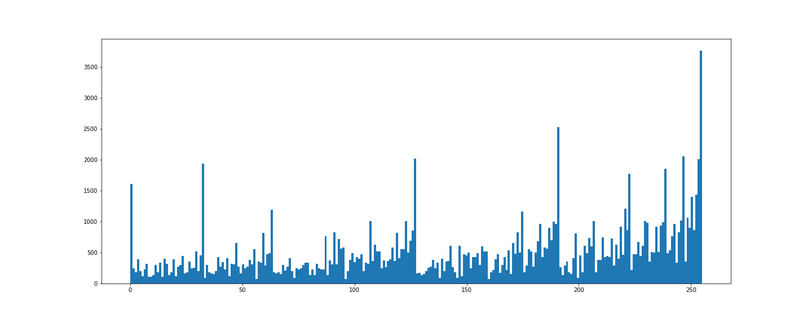
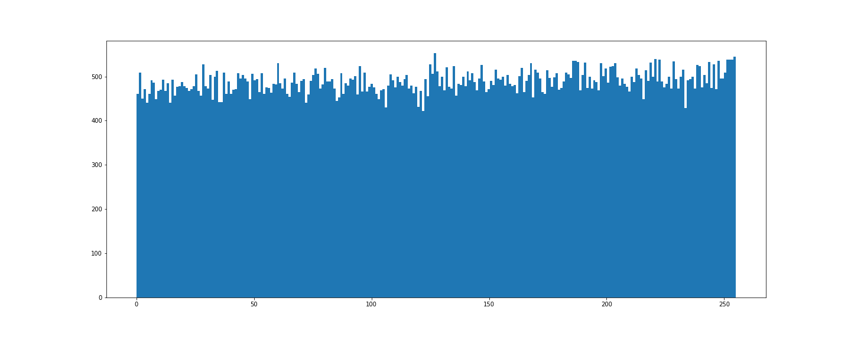
TRNG – Distribution
Using LSB directly
With Von-Neumann Correction

Slide 9
TRNG – Tests
Generated 125.000 Bytes and send them to PC via UART
Applied NIST Test Suite with 1, 10 and 20 streams on the file

Slide 10
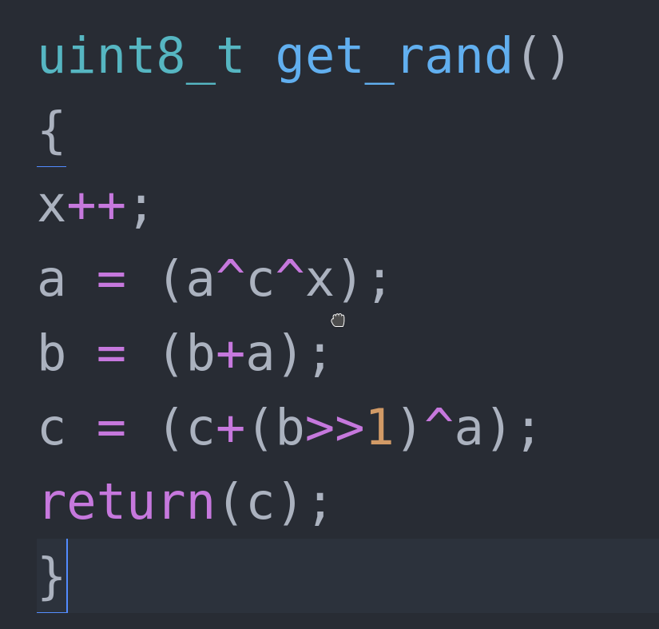
PRNG – Source Code
Three seeds required

Slide 11
PRNG – Statistics
Created 1 million bits
Tested with 1, 10 and 20 streams
All tests passed, results of similiar quality as reference RNG

Slide 12
Evaluation
Size of entire OS:
4378 Bytes
Size AES Implementation:
3306 Bytes
Timing AES Implementation:
  Reference Card: 8.45 ms
  Clone Card: 9.75 ms
  → 15% slower than Reference Card

Slide 13
Team A – DPA
Attack Structure
Setup
Evaluation
Optimization

Slide 14
Extracting the Key using DPA
Attack last round of AES decryption → plaintext-only attack
Attack on first round of AES decryption → ciphertext-only attack
→ Attack last round of decryption with plaintexts
→ Last round key of decryption == secret key

Slide 15
DPA on AES Encryption
Round 0:
  ARK (Add Round Key)
Round 1-9:
  SB (Sub Bytes)
  SR (Shift Rows)
  MC (Mix Columns)
  ARK
Round 10:
  SB
  SR
  (no MC)
  ARK
Source: SICA lecture notes – Chapter 2

Slide 16
Attack Structure
perform_dpa
Initialize variables
For-loop for every key-byte
Reverse addRoundKey & InvSubBytes operations
for every hypothesis and trace
Calculate hamming weight for every intermediate
value
Direct implementation of the given formula for the
Peason Correlation Coefficient
Find row of biggest element in correlation matrix
calc_intermediate
hamming_weights
correlation
selection

Slide 17
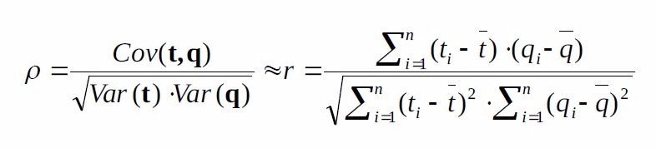
Pearson Correlation Coefficient
Several possible implementations
We tried: Pearsonr (scipy)

Slide 18
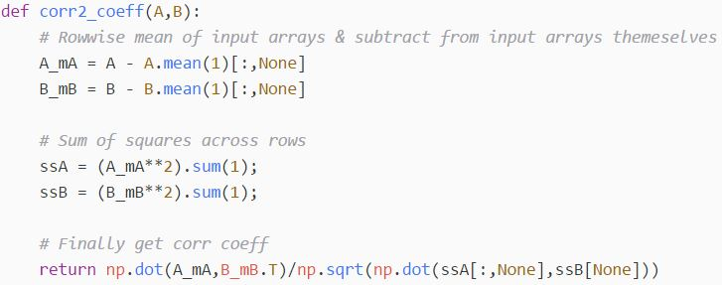
Pearson Correlation Coefficient
Several possible implementations
We tried: Direct Implementation
Source: https://stackoverflow.com/questions/30143417/computing-the-correlation-coefficient-between-two-multi-dimensional-arrays/30143754#30143754

Slide 19
Setup
Measurements:
  Sample Rate: 125 MHz
  Number of samples: 62500
  Number of traces: 400
  → Default values
Shunt resistor C was used

Slide 20
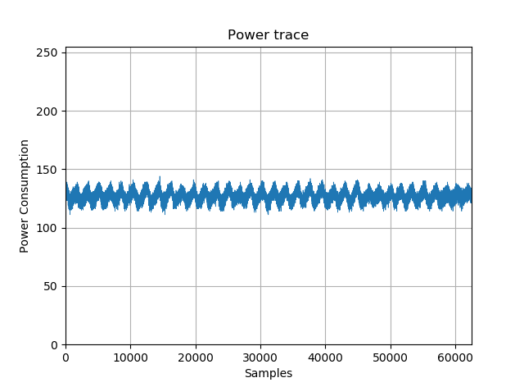
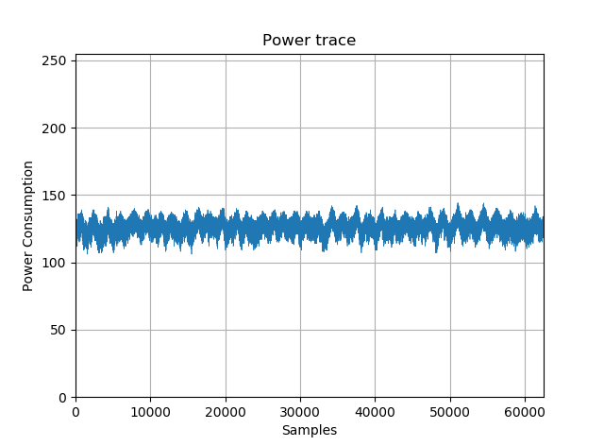
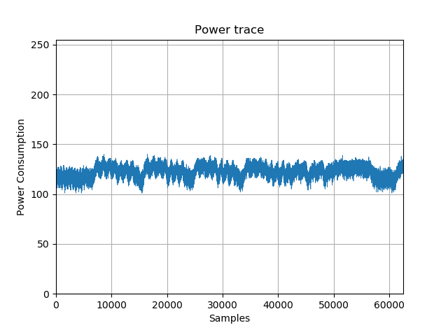
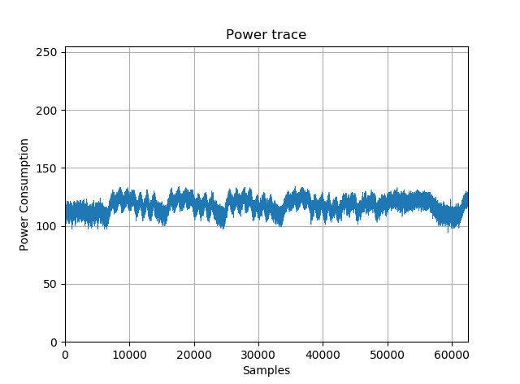
Visualization of the Traces
Jumper A
Jumper B
Jumper C
Jumper D

Slide 21
Evaluation
Encrypt plaintext using extracted key
Compare result with given ciphertext

Slide 22
Optimization
Massive improvement with direct implementation of the Pearson Correlation
So far no other optimizations seemed necessary
  Attack time: ~ 20 seconds

Slide 23
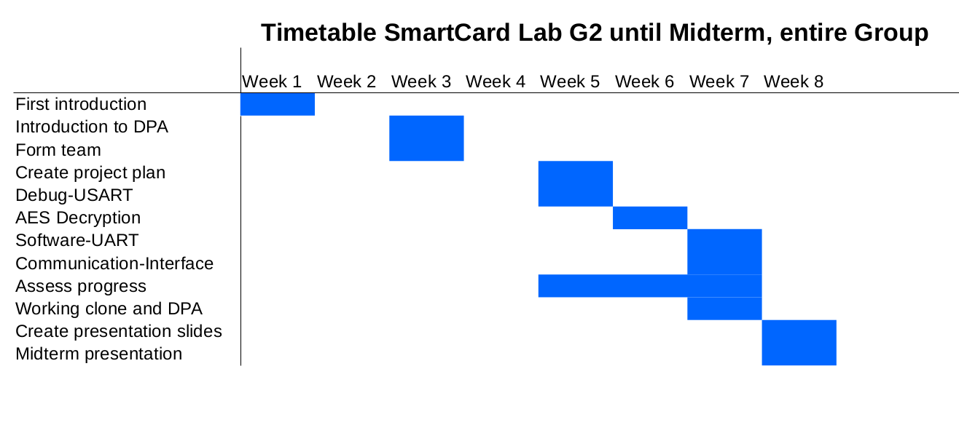
Timetable

Slide 24
Outlook
Meeting within the next week to discuss the next steps
  Team A challenges
    Power trace preprocessing:
      Implementing trace compression
    Handling very large files
    Setup optmization
  Team B
    Implement countermeasures
      Masking
      Shuffling
      Hiding

