Slide 1

SmartCard Lab: Final Presentation
Group 2
Martin Achtner
Ridon Arifi
Ines Ben Hmida
Maximilian Galanis
Simon Ulshöfer

Slide 2
Outline
Team B – Countermeasures
  - Implemented Countermeasures
  - Impact of Countermeasures
  - Random Number Generation
Team A – DPA
- Improvements
- Countermeasures
- Benchmarks
Project Plan
SmartCard Lab | 03.07.2018 | Final Presentation Group 2

Slide 3
Team B – Countermeasures
Implemented Countermeasures
Impact of Countermeasures
Random Number Generation
SmartCard Lab | 03.07.2018 | Final Presentation Group 2

Slide 4
Implemented Countermeasures
Masking
Hiding
  - Shuffling
  - NOPs
SmartCard Lab | 03.07.2018 | Final Presentation Group 2

Slide 5
Masking
Precomputation:
Generate „input and output masks“ m, m’ → (m_i, mp_i)
Precompute masked inv. S-Box S’(x): S‘(x ⊕ m‘) = S(x) ⊕ m
Generate „transformed masks“ m1‘, m2‘, m3‘, m4‘ for inv. MixColumns
Precompute „input masks“ using inv. MC : (m1, m2, m3, m4) = inv. MC(m1’, m2’, m3’, m4’)
SmartCard Lab | 03.07.2018 | Final Presentation Group 2

Slide 6
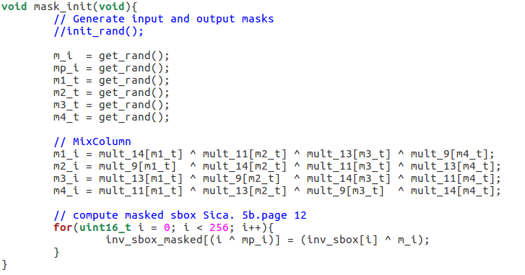
Masking
m_i → m
mp_i → m’
m1_t → m1’
...
SmartCard Lab | 03.07.2018 | Final Presentation Group 2

Slide 7
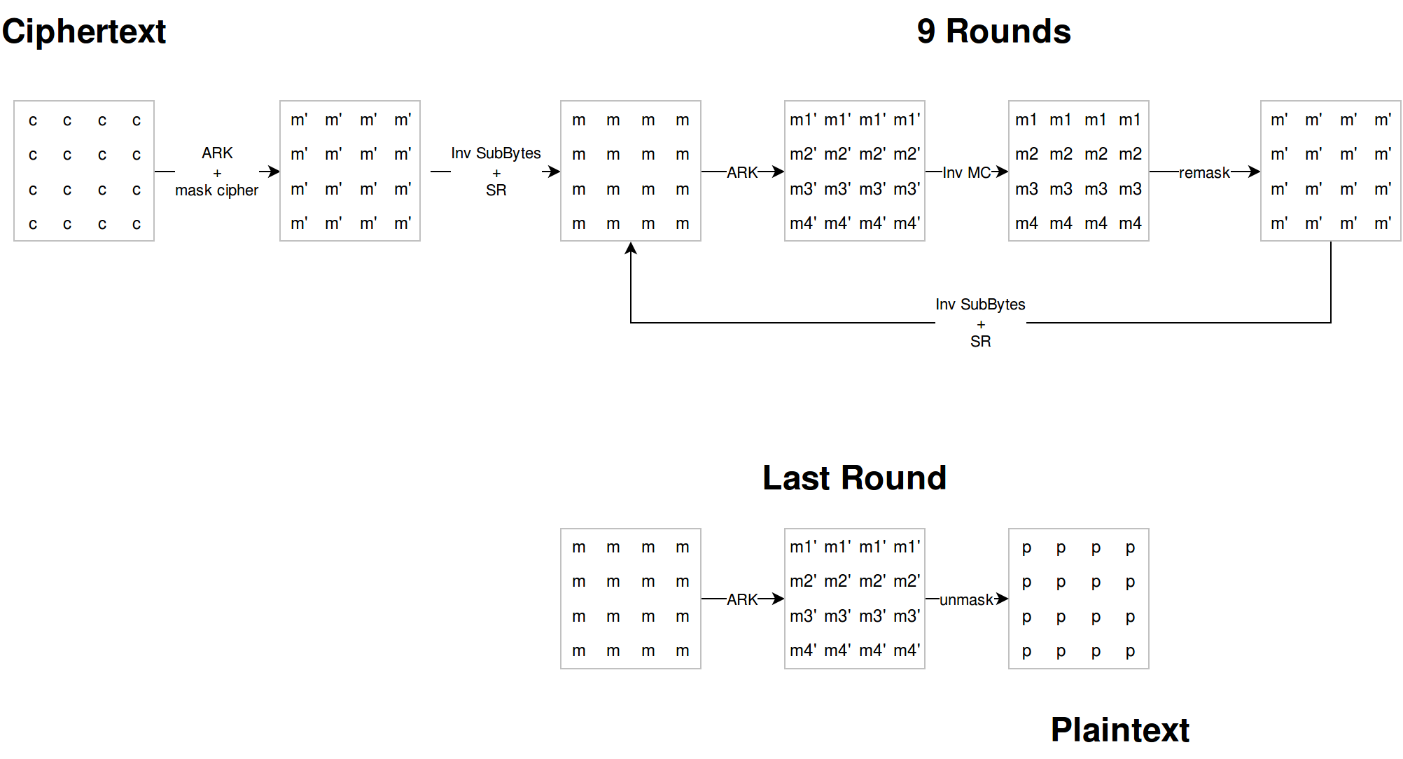
Masking
SmartCard Lab | 03.07.2018 | Final Presentation Group 2

Slide 8
Masking
SmartCard Lab | 03.07.2018 | Final Presentation Group 2

Slide 9
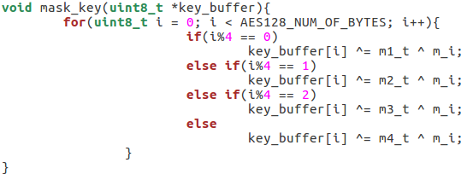
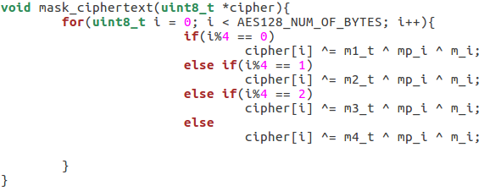
Masking
SmartCard Lab | 03.07.2018 | Final Presentation Group 2

Slide 10
Masking
SmartCard Lab | 03.07.2018 | Final Presentation Group 2

Slide 11
Masking
m_i → m
mp_i → m’
m1_t → m1’
...
SmartCard Lab | 03.07.2018 | Final Presentation Group 2

Slide 12
Masking
SmartCard Lab | 03.07.2018 | Final Presentation Group 2

Slide 13
Masking
(m1, …, m4) = MC(m1’, …, m4’)
SmartCard Lab | 03.07.2018 | Final Presentation Group 2

Slide 14
Masking
SmartCard Lab | 03.07.2018 | Final Presentation Group 2

Slide 15
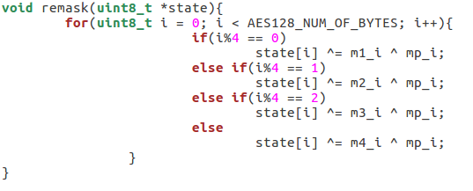
Masking
SmartCard Lab | 03.07.2018 | Final Presentation Group 2

Slide 16
Masking
SmartCard Lab | 03.07.2018 | Final Presentation Group 2

Slide 17
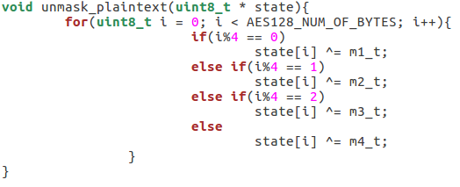
Masking
SmartCard Lab | 03.07.2018 | Final Presentation Group 2

