Slide 1

SmartCard Lab: Final Presentation
Group 2
Martin Achtner
Ridon Arifi
Ines Ben Hmida
Maximilian Galanis
Simon Ulshöfer

Slide 2
Outline
Team B – Countermeasures
  Implemented Countermeasures
  Impact of Countermeasures
  Random Number Generation
Team A – DPA
Improvements
countermeasures
benchmarks
Project Plan
SmartCard Lab | 03.07.2018 | Final Presentation Group 2

Slide 3
Team B – Countermeasures
Implemented Countermeasures
Impact of Countermeasures
Random Number Generation
SmartCard Lab | 03.07.2018 | Final Presentation Group 2

Slide 4
Implemented Countermeasures
Masking
Hiding
  Shuffling
  NOPs
SmartCard Lab | 03.07.2018 | Final Presentation Group 2

Slide 5
Impact of Countermeasures
Code Size
Run Time
SmartCard Lab | 03.07.2018 | Final Presentation Group 2

Slide 7
Random Number Generation
True RNG
  Implementation
  Statistical Tests
Pseudo RNG
  Implementation
  Statistical Tests
SmartCard Lab | 03.07.2018 | Final Presentation Group 2

Slide 8
Evaluation
Size of entire OS:
4378 Bytes
Size AES Implementation:
3306 Bytes
Timing AES Implementation:
  Reference Card: 8.45 ms
  Clone Card: 9.75 ms
  → 15% slower than Reference Card
SmartCard Lab | 03.07.2018 | Final Presentation Group 2

Slide 9
Team A – DPA
Attack Structure
Setup
Evaluation
Optimization
SmartCard Lab | 03.07.2018 | Final Presentation Group 2

Slide 10
Extracting the Key using DPA
Attack last round of AES decryption → plaintext-only attack
Attack on first round of AES decryption → ciphertext-only attack
→ Attack last round of decryption with plaintexts
→ Last round key of decryption == secret key
SmartCard Lab | 03.07.2018 | Final Presentation Group 2

Slide 11
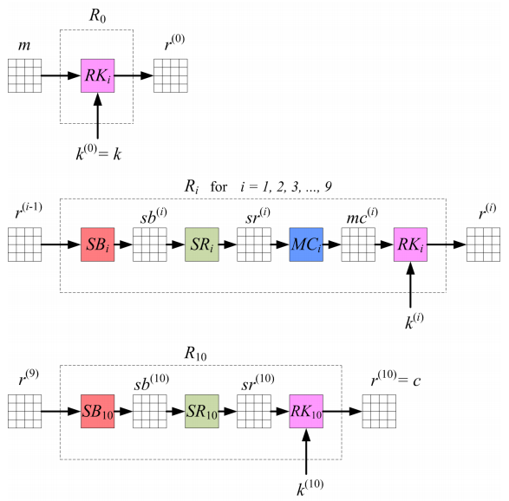
DPA on AES Encryption
Round 0:
  ARK (Add Round Key)
Round 1-9:
  SB (Sub Bytes)
  SR (Shift Rows)
  MC (Mix Columns)
  ARK
Round 10:
  SB
  SR
  (no MC)
  ARK
Source: SICA lecture notes – Chapter 2
SmartCard Lab | 03.07.2018 | Final Presentation Group 2

Slide 13
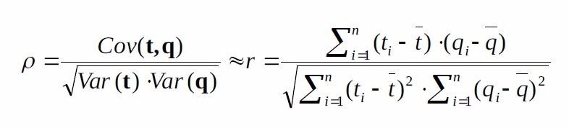
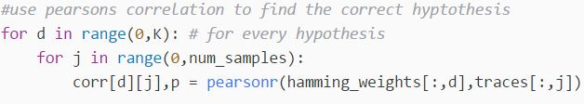
Pearson Correlation Coefficient
Several possible implementations
We tried: Pearsonr (scipy)
SmartCard Lab | 03.07.2018 | Final Presentation Group 2

Slide 14
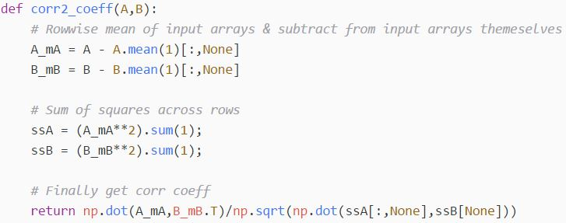
Pearson Correlation Coefficient
Several possible implementations
We tried: Direct Implementation
Source: https://stackoverflow.com/questions/30143417/computing-the-correlation-coefficient-between-two-multi-dimensional-arrays/30143754#30143754
SmartCard Lab | 03.07.2018 | Final Presentation Group 2

Slide 15
Setup
Measurements:
  Sample Rate: 125 MHz
  Number of samples: 62500
  Number of traces: 400
  → Default values
Shunt resistor C was used
SmartCard Lab | 03.07.2018 | Final Presentation Group 2

Slide 17
Evaluation
Encrypt plaintext using extracted key
Compare result with given ciphertext
SmartCard Lab | 03.07.2018 | Final Presentation Group 2

Slide 18
Optimization
Massive improvement with direct implementation of the Pearson Correlation
So far no other optimizations seemed necessary
  Attack time: ~ 20 seconds
SmartCard Lab | 03.07.2018 | Final Presentation Group 2

Slide 19
Team A
General Improvements
- Compression
- Speed imporovements
Circumvent countermeasures
- Trace alignment
- HO-DPA
- Memory Management
- Preprocessing
Benchmarks

Slide 20
Compression (Max )
Max , Average

Slide 21
Speed Improvements
Massive speed improvements by getting rid of for loops
    - replace them by using vector operations
time in s

Slide 22
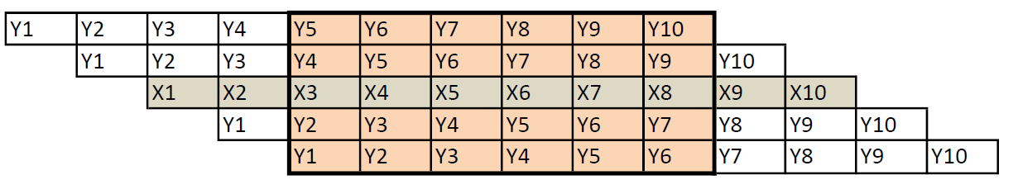
Trace alignment
X-Values = comparison trace (first tarce)
Y-Values = trace
Choose the shift in percent (should be about 100 samples)
Find lowest absolute difference of all shifts
After trace alignment less samples

Slide 23
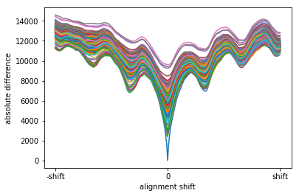
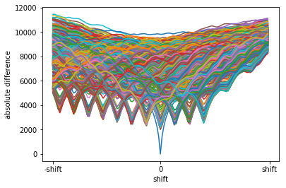
Trace alignment
Trace alignment with no protection
Trace alignment with
nops
Trace alignment at unprotected traces -> worse correlation
Trace alignment at protected traces -> much better correlation

Slide 24
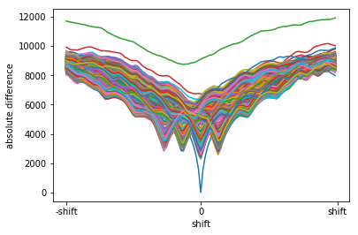
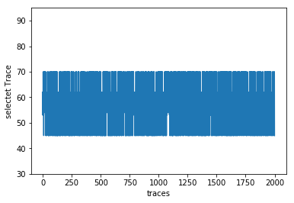
Trace alignment
Best correlation 3 nops
Selected trace 3 nops
Absolute difference for 3 nops
t(total) = 80,306s
Mostly discreet jumps

Slide 25
High Order DPA (Max)

Slide 26
Memory Management (Max)

Slide 27


Preprocessing
First: calculation new number of samples
Check results by applying second order DPA on unprotected smart card
    -> worth correlation but success

Slide 28
Benchmarks: no decryption
Best correlation (~ 0,5):
    - Traces = 400 (given), Samples = 0 – 62500, reduction = 25
      → 1000000 Samples
    - T(total) = 0,609s, T(DPA) = 0,449s
Least traces:
    - Traces = 157, Samples = 10000 – 55000, reduction = 25
      → 282600 Samples
    - T(total) = 0,278s, T(DPA) = 0,232s
Least time:
    - Traces = 380, Samples = 32000– 53000, reduction = 500
      → 15960 Samples
    - T(total) = 0,077s, T(DPA) = 0,030s

Slide 29
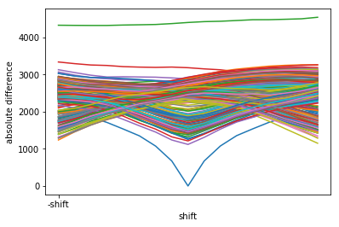
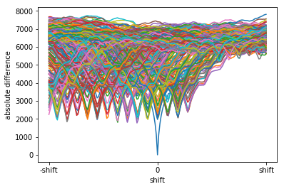
Benchmarks: Hiding
Least time for 3 nops
Least time for 15 nops
t(total) = 1,312s , t(DPA) = 0,176s
Traces = 280, alignment = 0,015%
Samples = 28000 – 55000
t(total) = 11,788s, t(DPA) = 0,269s
Traces =270, alignment = 0,09%
Samples = 0 - 50000

Slide 30
Benchmarks: Shuffling
We broke the first version of shuffling
- After team B improve there algorithm we are not able to break it
- traces = 10000, Samples = 0 – 125000, reduction = 25

Slide 31
Benchmarks: Masking
Second order DPA works on not decrypted measurement
- Traces = 180, Samples = 12000– 50000, reduction = 100
    - T(total) = 1,920s
We can not manage do to attack traces with masking
    - Traces = 10000, Samples = 0 – 62500, reduction = 25
    - T(total) = ~ 6 min

Slide 32
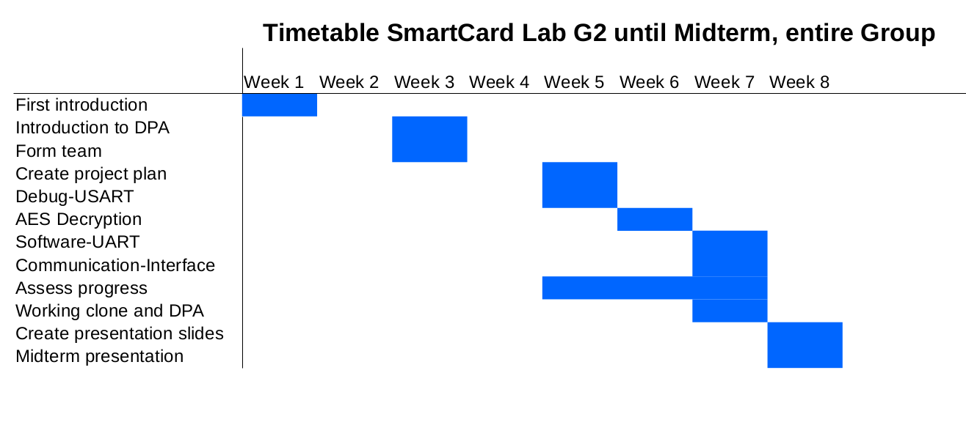
Timetable
SmartCard Lab | 03.07.2018 | Final Presentation Group 2

Slide 33
Outlook
Meeting within the next week to discuss the next steps
  Team A challenges
    Power trace preprocessing:
      Implementing trace compression
    Handling very large files
    Setup optmization
  Team B
    Implement countermeasures
      Masking
      Shuffling
      Hiding
SmartCard Lab | 03.07.2018 | Final Presentation Group 2

