Slide 1
RAG Playground
https://community.fullstackretrieval.com/document-loaders/text-splitting

Slide 2
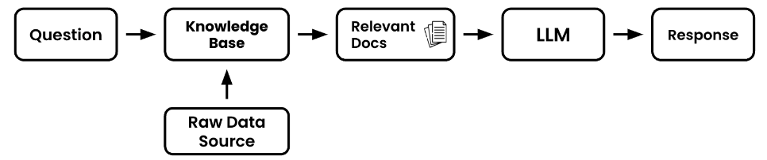
Retrieval Overview
Retrieval Components
Question – This will be the piece of text that you’d like the language model to help reason about or answer
Raw Data Source – This will be the entire collection of raw text
Knowledge Base – This is where the raw data will be prepped and ready to be processed by our retrieval application
Relevant Docs – These are the subset of the documents in your full knowledge base that your retrieval application deems helpful to answer your question

Slide 3
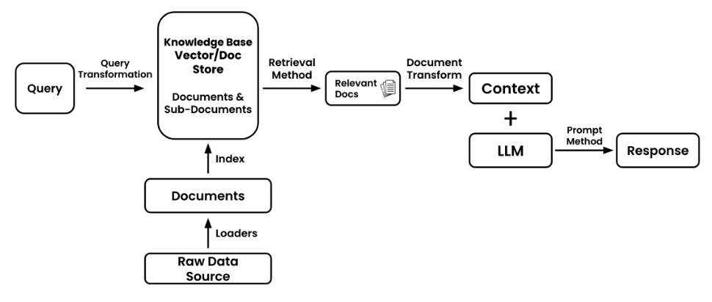
Retrieval Overview
Though this architecture may work for introductory applications, there are number of situations that could make things more complicated
사용자가 잘못된 질문을 한다면 ?
처리할 이미지가 있다면?
PDF 에 구문 분석과 분석이 필요한 테이블이 있다면?
원시 문서(raw document)에 유사성 점수를 매기는 것이 작동하지 않는다면?

Slide 4
Retrieval Overview
Query – The initial piece of data that will guide the retrieval process (e.g. user question, chat history, image, audio, prompt, table, or other various data)
Query Transformation – The process of modifying or reformatting the original query to make it more suitable for retrieval
Raw Data Source – Original collection of information. Unprocessed unstructured from which you’ll extract. (e.g. website, images, picture, other application)
Document Loaders – Tools or functions that extract data from a raw source
Documents – Individual units of data or information that have been extracted and are ready for indexing. (e.g. individual pieces of texts, single customer records)
Index – Data structure that organizes information from your documents that makes retrieval faster, more efficient or better performance
Knowledge Base – A structured repository that contains indexed documents from which the retrieval process extracts documents from. This is often the combination of a vector store and document store
Retrieval Method – The technique or algorithm used to search for and extract the most relevant documents from the knowledge base in response to a query
Relevant Docs – The subset of documents that the retrieval method determines to be most useful in addressing the query
Document Transform – The process of further refining or reformatting the relevant documents to make them more suitable for the language model. This could include summarization, compression (removing information) or other transformations
Context – The combined content derived from the transformed documents that provide the necessary background or information for the language model to generate its response
Large Language Model (LLM) – The machine learning model that will generate a response based on the context and prompt it’s given
Prompting Method – The technique or method used to present the context to the language model. This also includes chaining different prompts together
Response – The final answer or output generated by the language model based on the context and prompting method

Slide 5
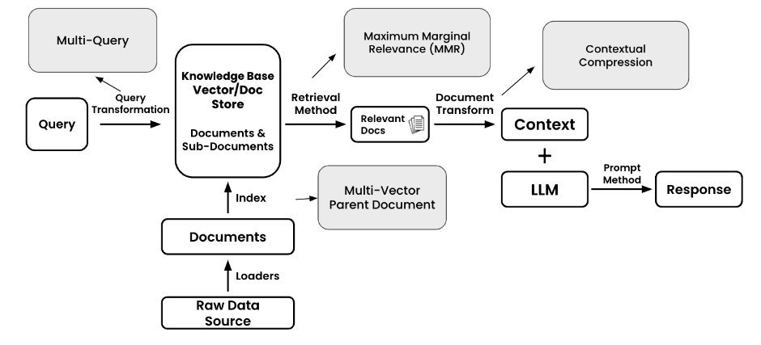
Retrieval Inventory
Full Stack Retrieval - Inventory

Slide 6
Retrieval Inventory
Below is a list of various retrieval techniques and resources grouped by which part of the stack they influence
Query Transformation – Augment, structure, or enhance your input query
Multi-Query – Generate additional questions/queries based on your original query to return more holistic documents
Index – Adjust your data structures and associations
Multi-Vector – In addition to you’re the normal embeddings of your documents it is sometimes helpful to have multiple alternative embeddings per document. These can include embeddings of summary, hypothetical questions, or any other custom text
Parent Document Retriever – A version of multi-vector where large chunks are further split up into smaller(child) chunks
Retrieval Methods – The method in which you pull documents out of your knowledge base
Top-K Similarity Search – Select the top K similar documents that match your query from your vector store.
Maximum Marginal Relevance (MMR) – Return similar but diverse documents. Great for when you’d like to remove redundancy in your context
Document Transform – Transform your documents before using them as context with your LLM
Contextual Compression – Extract contextually relevant information from your retrieved docs. Generally used to try and to increase signal:noise ratio

Slide 7
Query Transformation
Multi-Query
Why is this helpful?
Generally builders will use Multi-Query for two main reasons: Enhance a suboptimal query & Expand a results set
Enhance a suboptimal query
Users don't always give the best queries - They are just trying to user your product, not construct the perfect query.
To help with this, we turn to the multi-query method to help us fill in any gaps to a users query.
Expand a results set
With multiple queries, you'll likely get more results back from your database. The aim of multi-query is to have an expanded results sets which might be able to answer questions better than docs from a single query.
These results will be deduplicated (in case the same document comes back multiple times) and then used as context in your final prompt.

Slide 8
Indexing - Multi-Vector
Overview
Multi-Vector is an advanced method of the Indexing stage of retrieval
Often times your raw, chunked, documents may not be the optimal text to get your embeddings from. It could be the case that an alternative text derived from your original documents would be better. This could include summaries, hypothetical questions, extractions, or child documents.
The goal of multi-vector retrieval is to have additional embeddings in your retrieval process which might more closely match your anticipated queries.
Why is this helpful?​
This is helpful when having a more processed or derived form of your original documents would better suit your search process. Think of this like a pre-processing step on your documents that aims to be more attuned to your search needs.

Slide 9
Indexing - Parent Document Retriever
Overview
The Parent Document retriever is a type of Multi-Vector, an advanced indexing and retrieval technique.
The Parent document retriever is a form of Multi-Vector retrieval, a class of retrieval methods by which the builder embeds alternative representations of their original documents. These alternative embeddings will be then used in the similarity process to compare with the query the user or application gives.
In the case of the parent document retriever, the original large chunks will be further split into 'child' chunks.
Instead of returning the child chunks as context, the Parent Document Retriever will return the parents documents (red boxes below) of those child docs (blue boxes below).

Slide 10
Document Loaders - Text Splitting (chunking)
Levels Of Text Splitting
Level 1: Character Splitting - Simple static character chunks of data
Level 2: Recursive Character Text Splitting - Recursive chunking based on a list of separators
Level 3: Document Specific Splitting - Various chunking methods for different document types (PDF, Python, Markdown)
Level 4: Semantic Splitting - Embedding walk based chunking
Level 5: Agentic Splitting - Experimental method of splitting text with an agent-like system. Good for if you believe that token cost will trend to $0.00
*Bonus Level:* Alternative Representation Chunking + Indexing - Derivative representations of your raw text that will aid in retrieval and indexing
Notebook resources
Video Overview
ChunkViz.com – Visual representation of chunk splitting methods
RAGAS – Retrieval evaluation framework
Eval Frameworks
LangChain Evals
Llama Index Evals
RAGAS Evals

Slide 11
Retrieval Methods - Maximum Marginal Relevance (MMR)
Overview
MMR is a search type which specificies your Retrieval Method
The Maximal Marginal Relevance (MMR) criterion strives to reduce redundancy while maintaining query relevance in re-ranking retrieved documents - Source
When it comes to retrieving documents, the majority of methods will do a similarity metric like cosine similarity, euclidean distance, or dot product. All of these will return documents that are most similar to your query/question.
However, what if you want similar documents which are also diverse from each other? That is where Maximum Marginal Relevance (MMR) steps in.
** 목표는 반환할 문서를 결정할 때 검색된 문서가 서로 얼마나 유사한지 고려하는 것.
Why is this helpful?
여러 측면을 포함하는 복잡한 쿼리: 쿼리에 여러 구성 요소나 측면이 있는 경우 MMR은 하나에만 초점을 맞추는 것이 아니라 쿼리의 모든 측면을 포괄하는 문서 세트를 검색하는 데 도움이 된다.
중복 정보 방지: 단순 유사성 검색으로 반환된 상위 문서가 서로 매우 유사한 경우 MMR은 중복 정보를 방지하는 데 도움이 된다.
콘텐츠 요약: 대규모 문서 세트에서 요약을 작성할 때 MMR은 관련성이 있고 반복적이지 않은 핵심 정보를 식별하는 데 도움이 될 수 있으며, 이는 요약 질문에 더 잘 대답하는 데 도움이 된다.
쿼리 명확성: 쿼리 용어가 모호하거나 여러 의미를 갖는 경우 MMR은 용어의 다양한 의미 또는 컨텍스트를 나타내는 문서를 검색할 수 있다.
Notes:
기존 유사도 검색(코사인 유사도 등): 쿼리와 문서 간의 유사도를 계산하여 가장 유사한 문서들을 반환합니다. 결과물이 유사할 수록 높은 점수를 받습니다.
MMR: 쿼리와 문서 간의 유사도 뿐만 아니라 이미 선택된 문서들과의 중복을 최소화하여 다양한 정보를 포함하는 문서들을 선택합니다.

Slide 12
Retrieval Methods - Top-K Similarity Search
Overview
Top-K Similarity search type which specifies how you should retrieve documents from your knowledge base. This is type of a retrieval method
Top-K Similarity search is the process of pulling "K" number of documents from your knowledge base. Its aim is to get you the most similar documents to a query according to your similarity metric.
There are two concepts which are important
Similarity Metric - This is the equation or metric you'll use to compare the embedding of your query to the embeddings of your corpus of documents. The most common similarity metrics are cosine, dotproduct, and euclidean. The smaller the metric, the more similar two embeddings are expected to be.
Number of documents to retrieve - This specifies the number of documents to retrieve. It may seem like more is better, but remember, it's important to keep the signal to noise ratio of your retrieval process high. The more documents you retrieve the more likely it is you'll overwhelm your model.

Slide 13
Document Transform - Contextual Compression
Overview
Contextual Compression is method of the to transform your retrieved documents
Contextual Compression refers to the process of extracting information from your retrieved docs that you think will be relevant to your final answer. It's all about increasing the signal-to-noise ratio.
Contextual compression works by iterating over your retrieved documents, then passing them through a LLM which will extract information according to context you specify in a prompt.
You're compressing your final docs based on context you give it, "contextual compression" get it? The key component here is the "compressor" which will do our extraction/compressing for us.
Say you wanted to know everything about bananas, but you retrieved document talks about apples, oranges, and bananas. The compressor will pull out everything about bananas and then pass it on to your final prompt for a response.

Slide 14
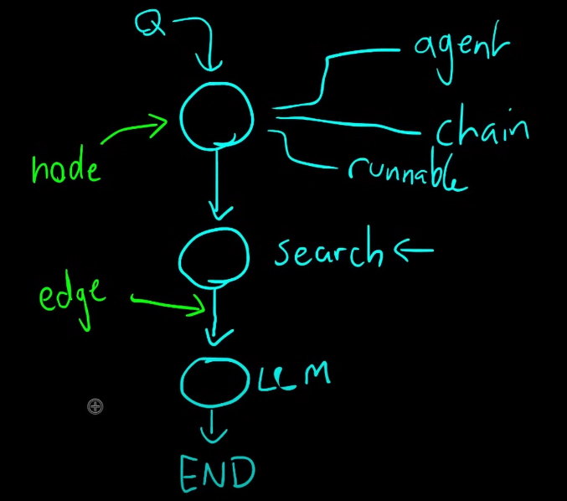
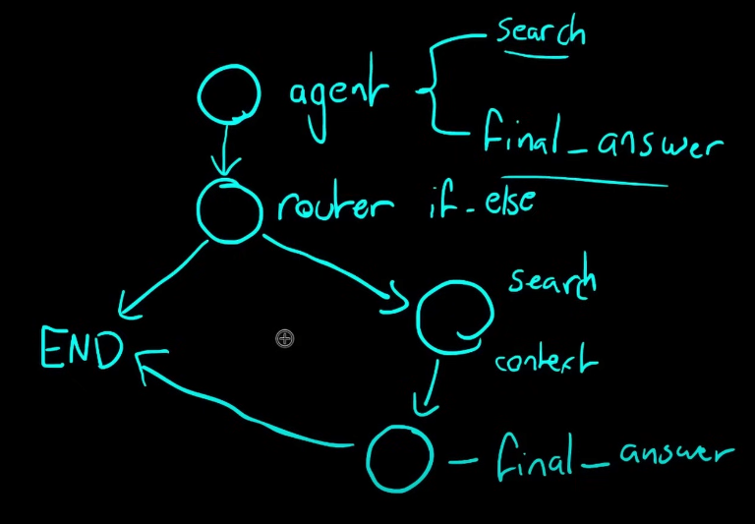
LangGraph – It’s best with Agent
What is LangGraph?
LangGraph enables us to create stateful, multi-actor applications utilizing LLMs as easily as possible. It extends the capabilities of LangChain, introducing the ability to create and manage cyclical graphs, which are pivotal for developing sophisticated agent runtimes. The core concepts of LangGraph include: graph structure, state management, and coordination.
Graph structure
Imagine your application as a directed graph. In LangGraph, each node represents an LLM agent, and the edges are the communication channels between these agents. This structure allows for clear and manageable workflows, where each agent performs specific tasks and passes information to other agents as needed.
State management
One of LangGraph's standout features is its automatic state management. This feature enables us to track and persist information across multiple interactions. As agents perform their tasks, the state is dynamically updated, ensuring the system maintains context and responds appropriately to new inputs.
Coordination
LangGraph ensures agents execute in the correct order and that necessary information is exchanged seamlessly. This coordination is vital for complex applications where multiple agents need to work together to achieve a common goal. By managing the flow of data and the sequence of operations, LangGraph allows developers to focus on the high-level logic of their applications rather than the intricacies of agent coordination

Slide 15
LangGraph – It’s best with Agent
Why LangGraph?
LangGraph offers several significant advantages for developers working with complex LLM applications. Here are some of the real-world benefits LangGraph offers.
Simplified development
LangGraph abstracts away the complexities associated with state management and agent coordination. This means developers can define their workflows and logic without worrying about the underlying mechanisms that ensure data consistency and proper execution order. This simplification accelerates the development process and reduces the likelihood of errors. It’s a game-changer!
Flexibility
With LangGraph, developers have the flexibility to define their own agent logic and communication protocols. This allows for highly customized applications tailored to specific use cases. Whether you need a chatbot that can handle various types of user requests or a multi-agent system that performs complex tasks, LangGraph provides the tools to build exactly what you need. It’s all about giving you the power to create.
Scalability
LangGraph is built to support the execution of large-scale multi-agent applications. Its robust architecture can handle a high volume of interactions and complex workflows, enabling the development of scalable systems that can grow with your needs. This makes it suitable for enterprise-level applications and scenarios where performance and reliability are critical.
Fault tolerance
Reliability is a core consideration in the design of LangGraph. The library includes mechanisms for gracefully handling errors, ensuring that your application can continue to operate even when individual agents encounter issues. This fault tolerance is essential for maintaining the stability and robustness of complex multi-agent systems. Peace of mind is just a feature away.

Slide 16
LangGraph – Real World Applications
Chatbots
By leveraging multiple LLM agents, these chatbots can process natural language queries, provide accurate responses, and seamlessly switch between different conversation topics. The ability to manage state and coordinate interactions ensures that the chatbot maintains context and delivers a coherent user experience.
Autonomous agents
For applications requiring autonomous decision-making, LangGraph enables the creation of agents that can perform tasks independently based on user inputs and predefined logic.
These agents can execute complex workflows, interact with other systems, and adapt to new information dynamically. LangGraph's structured framework ensures that each agent operates efficiently and effectively, making it suitable for tasks like automated customer support, data processing, and system monitoring.
Multi-Agent systems
LangGraph excels in building applications where multiple agents collaborate to achieve a common goal. For example, different agents can manage inventory, process orders, and coordinate deliveries in a supply chain management system. LangGraph's coordination capabilities ensure that each agent communicates effectively, sharing information and making decisions in a synchronized manner. This leads to more efficient operations and better overall system performance.
Workflow automation tools
With LangGraph, automating business processes and workflows becomes straightforward. Intelligent agents can be designed to handle tasks such as document processing, approval workflows, and data analysis. By defining clear workflows and leveraging LangGraph's state management, these tools can execute complex sequences of actions without human intervention, reducing errors and increasing productivity.
Recommendation systems
Personalized recommendation systems can greatly benefit from LangGraph's capabilities. By employing multiple agents to analyze user behavior, preferences, and contextual data, these systems can deliver tailored suggestions for products, content, or services. LangGraph's flexibility allows for integrating various data sources and algorithms, enhancing the accuracy and relevance of recommendations.
Personalized learning environments
In educational platforms, LangGraph can be used to create adaptive learning environments that cater to individual learning styles and needs. Multiple agents can assess a student's progress, provide customized exercises, and offer real-time feedback. The stateful nature of LangGraph ensures that the system retains information about each learner's performance and preferences, enabling a more personalized and effective educational experience.

Slide 17
Agents
Agents
The core idea of agents is to use a language model to choose a sequence of actions to take. In chains, a sequence of actions is hardcoded (in code). In agents, a language model is used as a reasoning engine to determine which actions to take and in which order.
For example, you may have an agent integrated with Google Search, Wikipedia and OpenAI LLM. With given agent tools, they can search for results in Google, then use retrieved context in Wikipedia tool to find detailed information and expand the context.
Bear in mind that you have to put clearly defined instructions to make sure that the agent will invoke tools in a proper order
작성중

Slide 18
Reference

